Slide 2
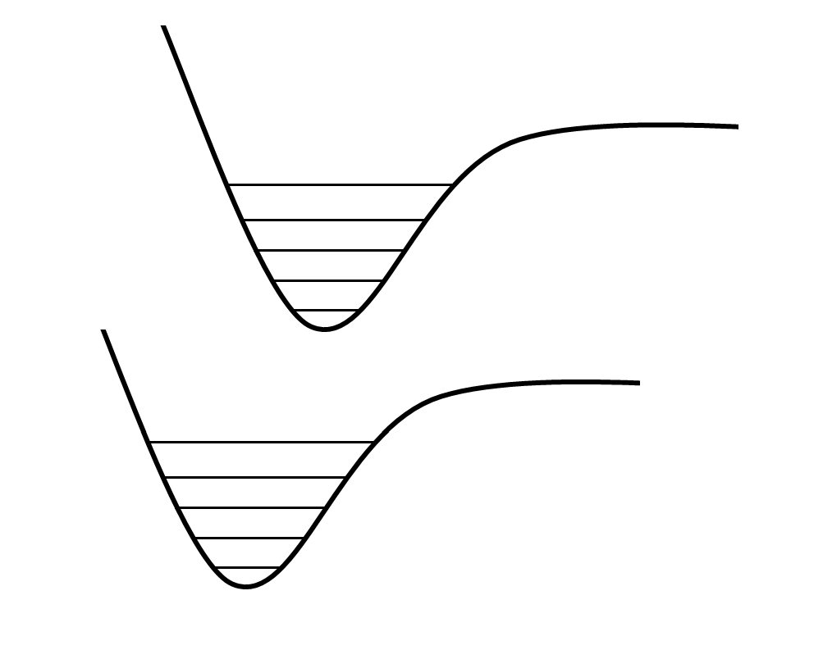
A
Energy
B
Inter-atomic Distance

