Slide 2
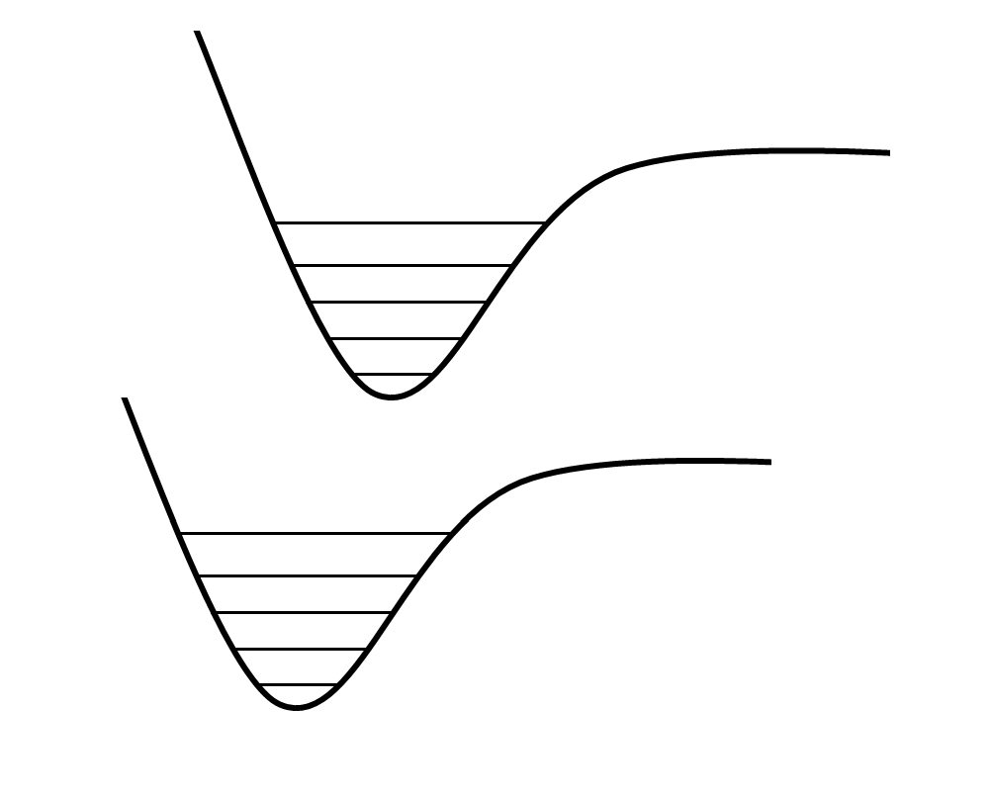
Excited State
4
3
A
2
1
Energy
ν' = 0
Ground State
4
3
B
2
1
ν = 0
Inter-atomic Distance

