Slide 1
Things thought about and decided on choosing certain plots, etc. also just production processes

Slide 2
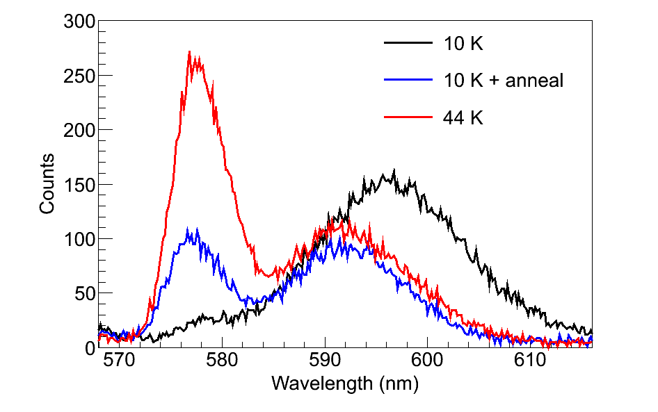
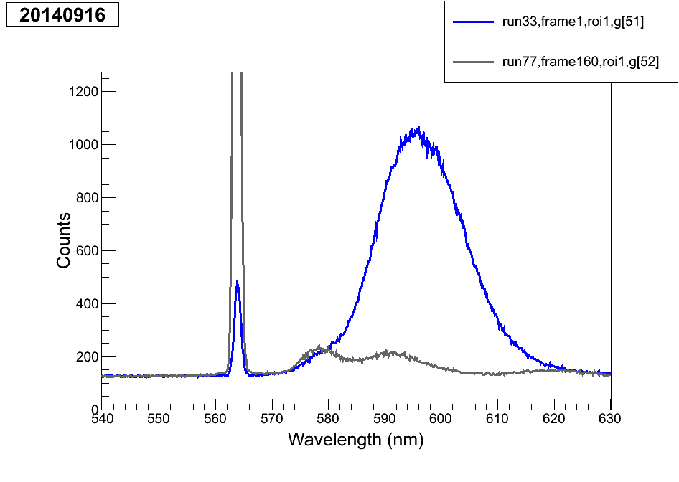
In considering a more comprehensive (including 619 etc.) version of this plot, I looked at the 2014-09-16 data, but nothing is quite as good. The 40K deposit for run 77 etc. is not similar to the other ones, because this day had long WL deposits. Here is a comparison of same-excitation for 11 K and 40 K, but again I don’t think they’re similar enough, and you should just use a separate day’s tests for seeing the 619 magnitude vs. deposit temp.

Slide 3
On deciding what to call the leak rate for leak44 (for 619 leak rate dependence):
2014-07-29, the data used for leak rates in BaSpec, give:
Leak50 120 nm/s
Leak48 55 nm/s
Leak46 30 nm/s
Leak44 8 nm/s but these are not exactly right due to neglect of SXe n
Those are at 11 K. For quoting at ~50 K, multiply by (31/37) based on recent test. Then, to get the real leak rate, multiply above numbers by (37/55) since leak 48 was measured to be 37 nm/s at 11 K in recent stuff (rather than 55 nm/s).
But since the thing in the thesis is describing the leak rate 44 at 11 K, just do:
(8 nm/s) х (37/55) ≈ 5 nm/s.

Slide 4
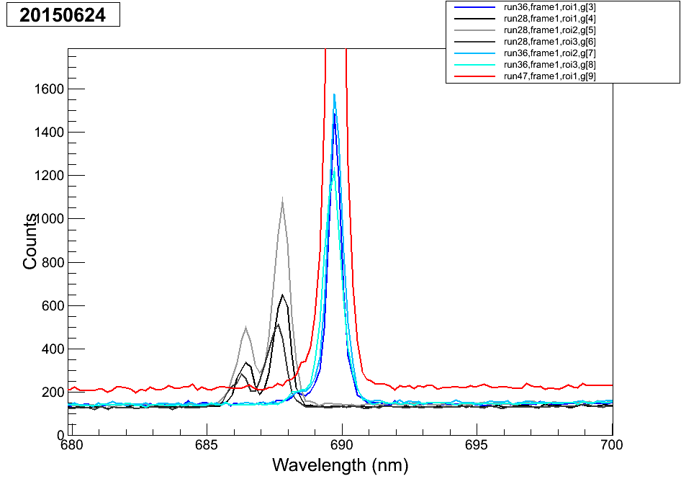
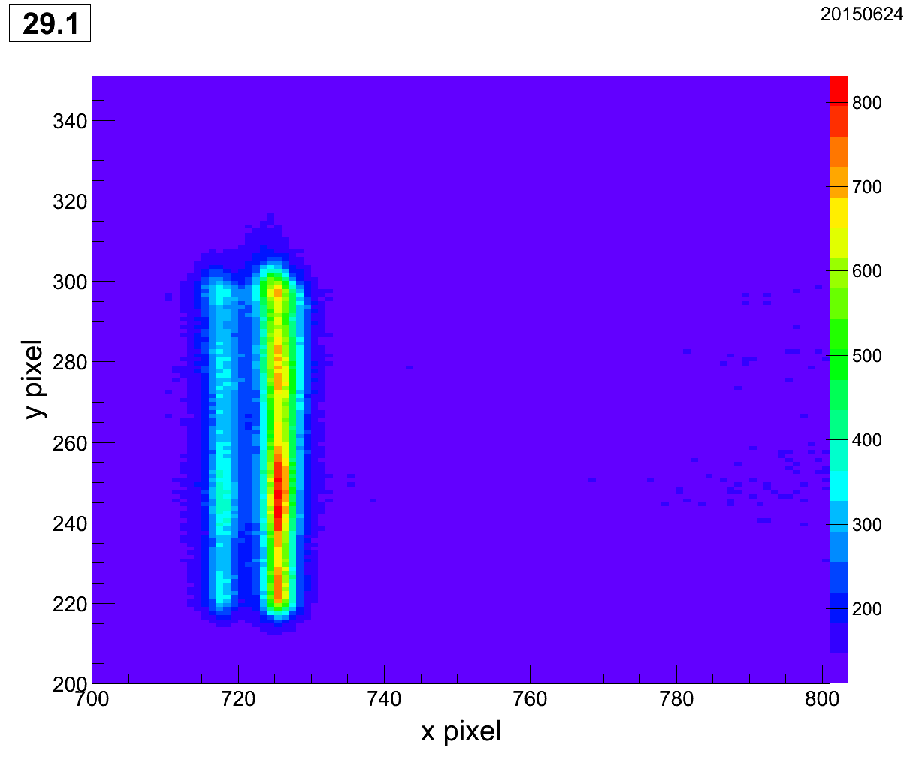
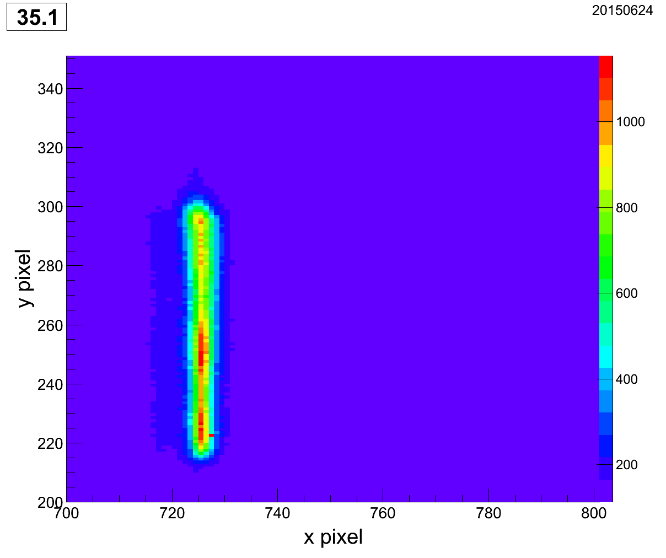
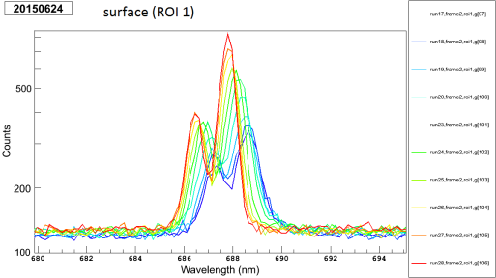
On 693 peak(s)
This was misleading because the grating
was at different places (and uncalibrated):
What really seems to happen is that the lower-wavelength one goes away between ~100 K and ~15 K (T measurements aren’t really good for this, but that’s close):
~100 K
~15 K
The old paper was at 77 K, so… idk
Cooling from room temp does this

Slide 5
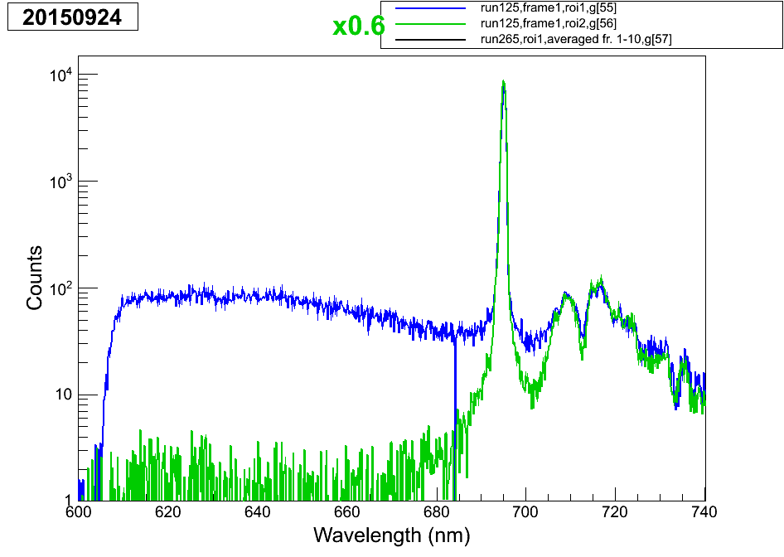
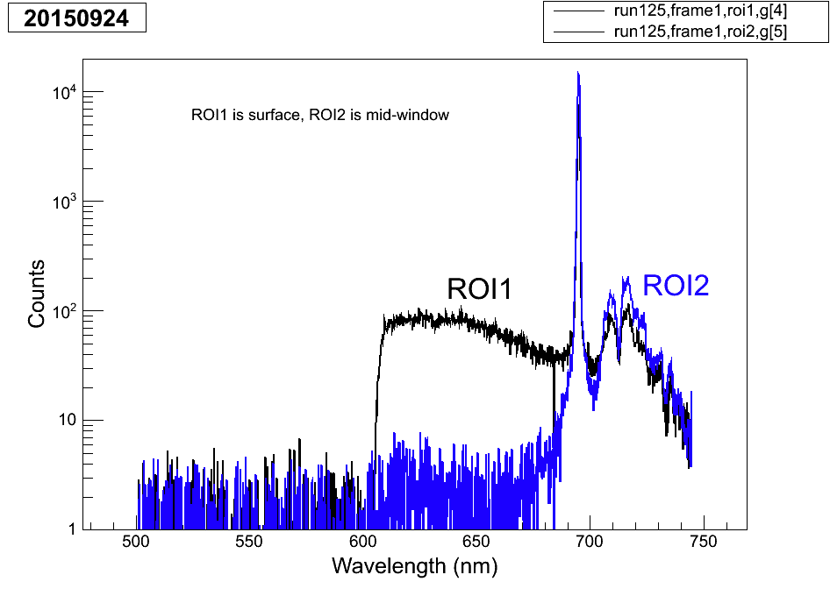
Achieving the surface BG spectrum:
unscaled
The reason to multiply the sapphire part by 0.6 is that it should not be larger than the black spectrum (which is surfBG + sapp). The surface part has less sapp in it because it is tapering off there, so it needs scaling, and this is sort of the best guess, albeit not necessarily correct – however, the sapp contribution in the region we care about is small anyway.

Slide 6
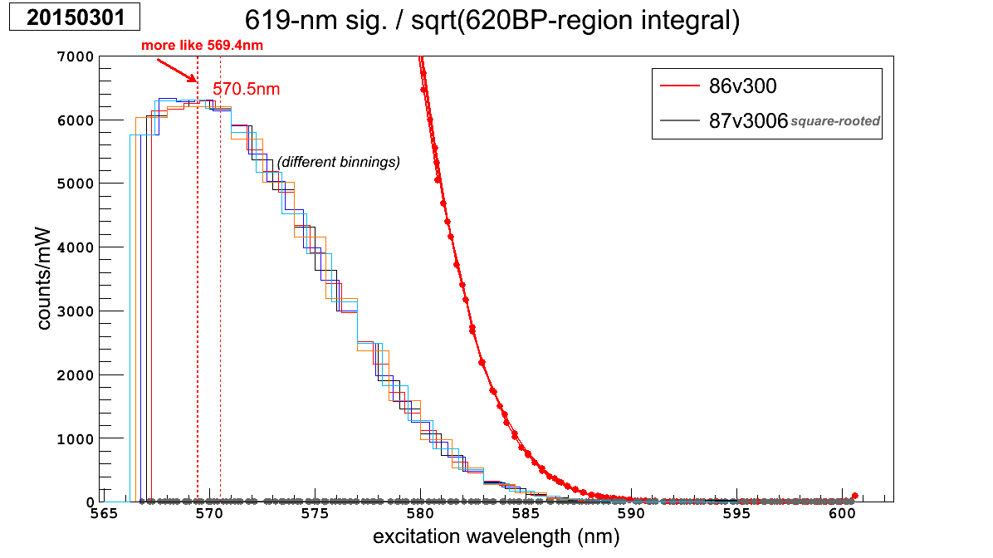
I cannot find the code for re-binning plots, so I for-went this one:

Slide 7
Determining the “typical variance” of laser position in image:
5 × average(abs(x/y pos minus that of previous run))
8-7 x .741 μm
9-16 x .484 μm y .62 μm
ignored 8-7 y due to cam warming

Slide 8
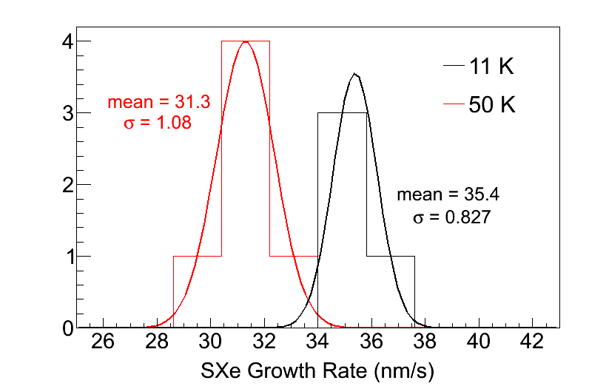
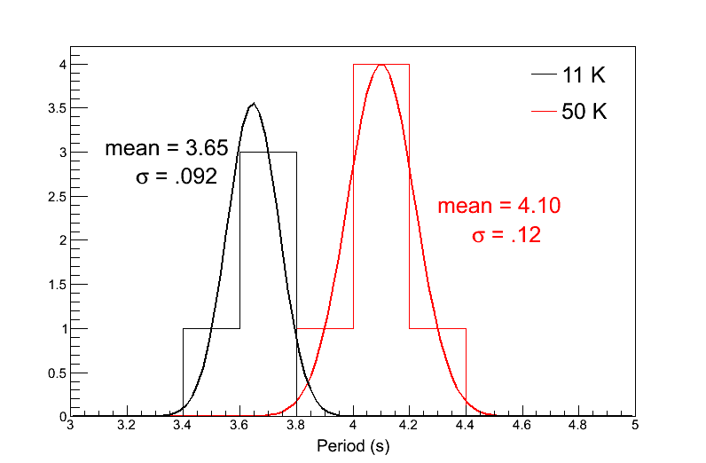
Determining stat. and syst. errors on these
Stat error = 1.08/sqrt(6) = 0.44
Stat error = 0.827/sqrt(4) = 0.41
Systematic errors come from the horrible equation in fringe_interference.xlsx, and come from just inputting the central values for T:
0.31 and 0.35
And for the full error I just did quadrature sum

Slide 9
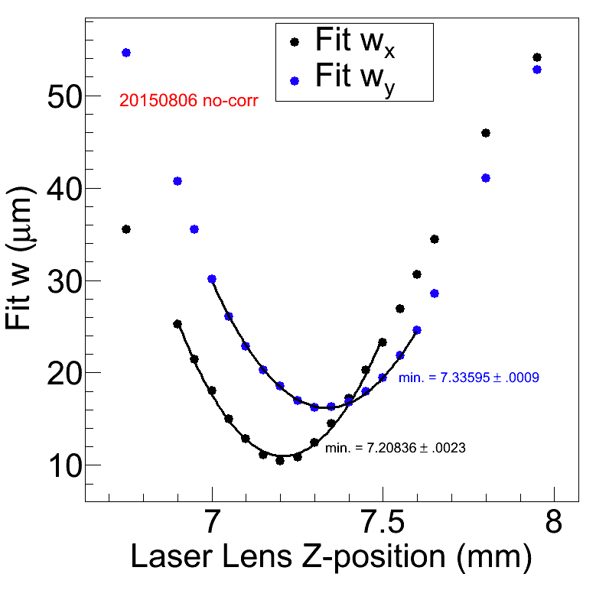
Value/uncertainty on difference between x and y focus w/ no astig. corr.
127.59 ± 2.5 μm
From quadrature adding of the two uncertainties

Slide 10
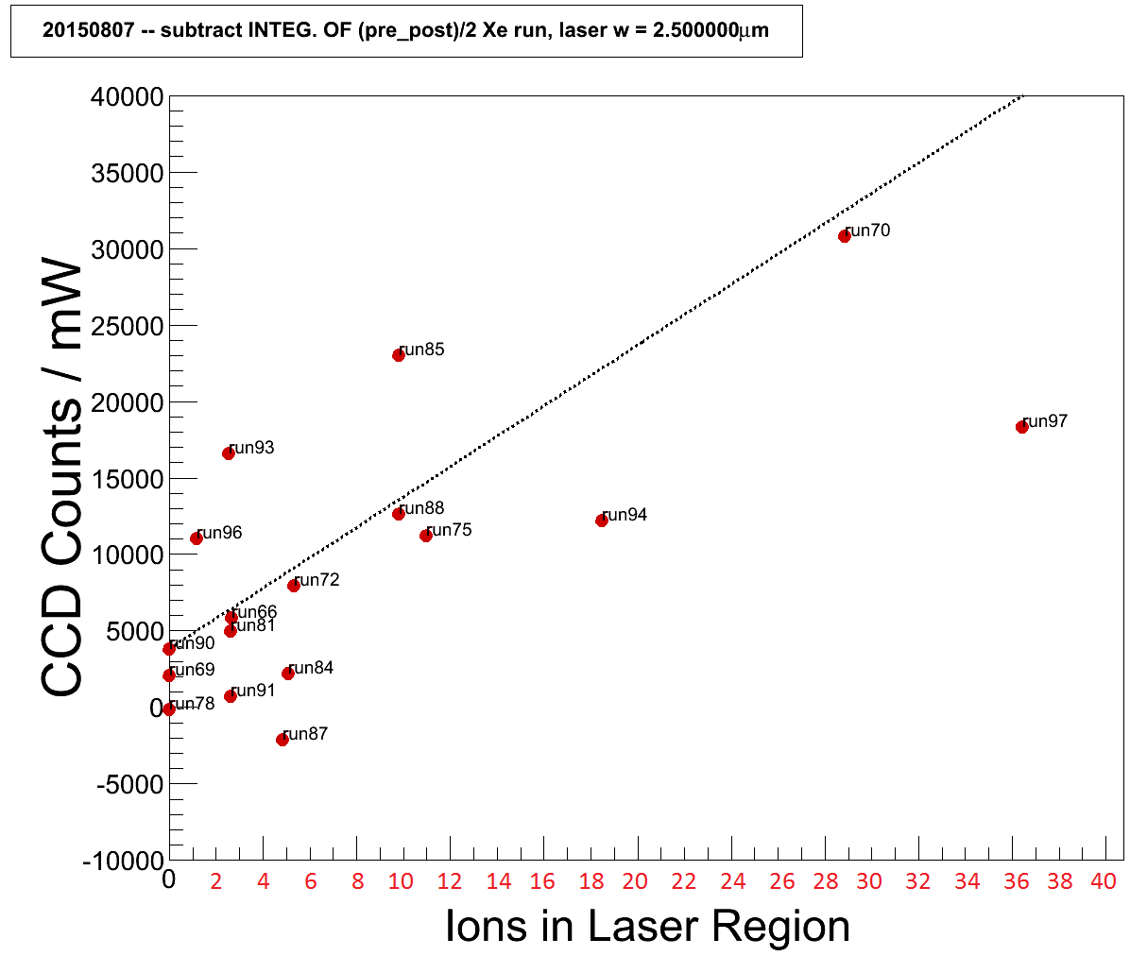
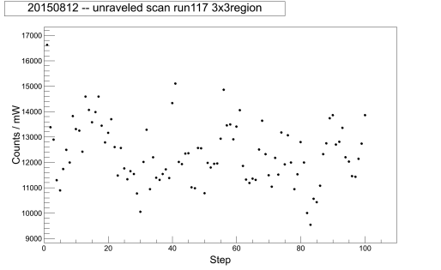
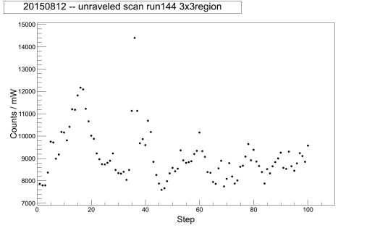
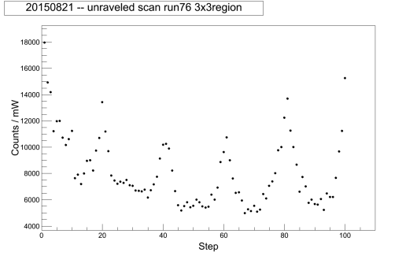
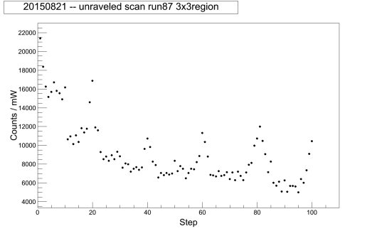
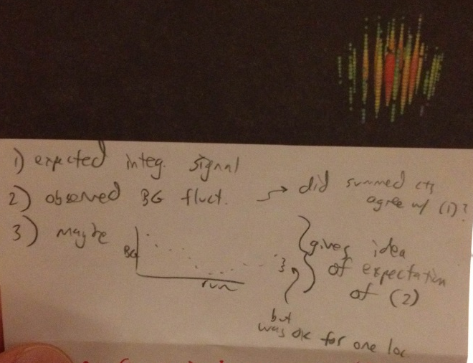
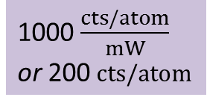
Expected and Observed in Scanning
Expected signal from 20150807, / mW,
with #atoms definition #2 (x2 2.06μm×2.06μm region):
Next: consider these (in 1D/ of 8-12 and 8-21), and you had a script that plots them on the same plot, and you could observe things like (a) failure to match up for BG sub – what does that mean? (b) fluctuations are lower than they appeared in the 2D plots, …(c) is it lower in the bleached region of 8-21? …
trend line:
1000 $\frac{cts/atom}{mW}$
or 200 cts/atom
Another question, since maybe the variations aren't as big as you thought, is are those peaks possibly actually atoms, in the ones that had a cool peak
Goal:
ation

Slide 11
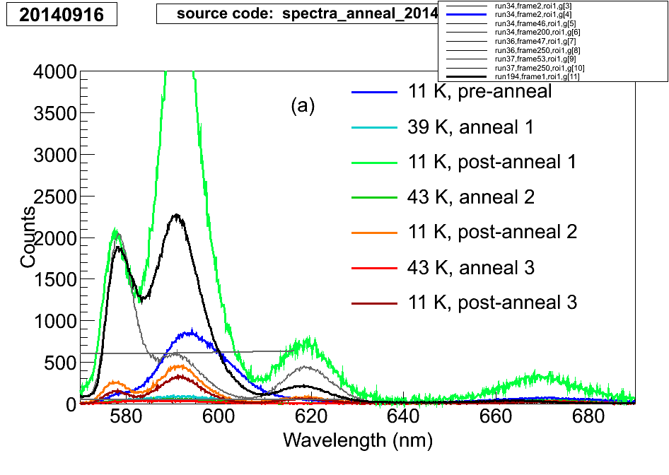
On calibration of 2014-06-26 (bleaching) data:
From this (20140916), just scaled up, and this is calibrated (by program, but permanently)
Spectrum from output I sent Brian (pretty sure) for the BaSpec paper
Graph-calibrated by recal_map.txt and function cal20140626() from spec_calibrate.C
It’s off a little bit on the 577 peak for some reason, but that’s just how it is.

Slide 12
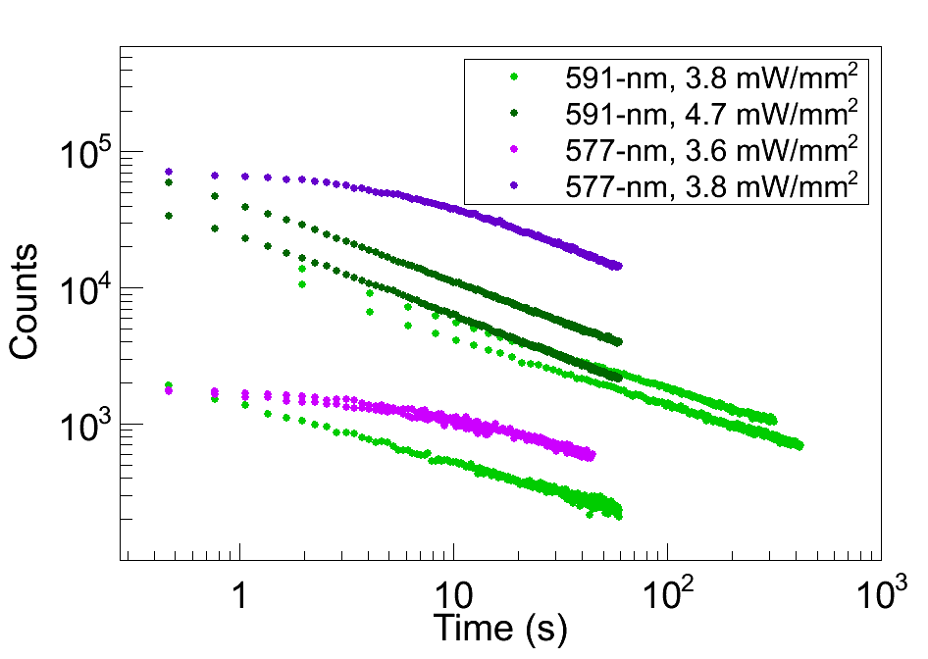
On the bleaching data:
They appear to be v2, which is integrals of the fit peaks, not power-scaled.

Slide 13
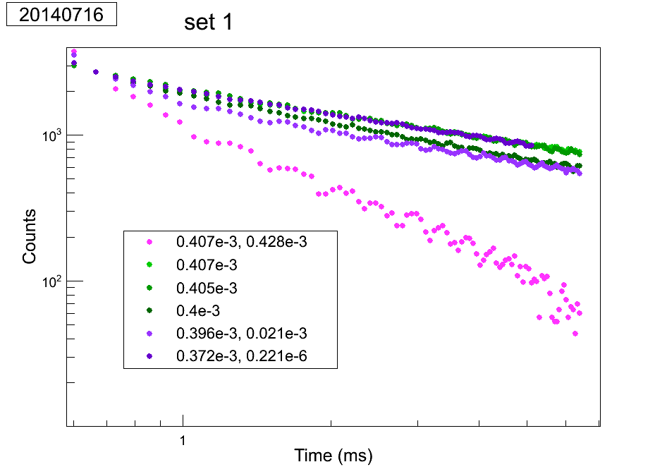
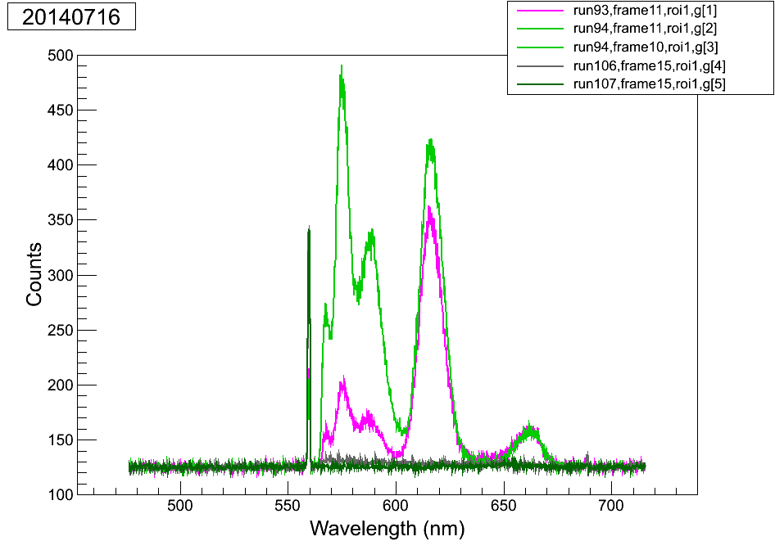
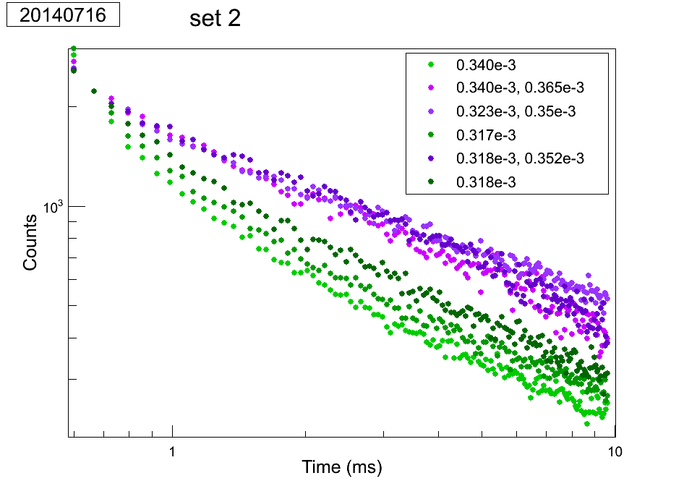
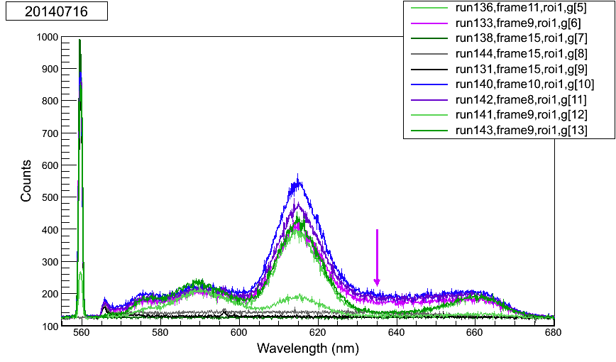
On re-pump using Kr laser:
Especially since the powers are supposedly similar between these “re-pumps” and the most destructive case in the earlier ones, this seems to be not real. One difference between sets 1 and 2 is the dep. temp., but this doesn’t explain the weird baseline thing – maybe there were differences I couldn’t easily pick out of the notes. Weird conditions were being tried to mimic those of the old separate Kr re-pumps.
These saw only the destruction w/ higher Kr
This thing does NOT appear in set 1 runs
…but is it actually due to a higher baseline?
Appears to be an effect!
Not sure what that is, cuz it’s not in the BG apparently… see above summary.

Slide 14
On power meter QE (2014-08-15):
~70% was obtained in the green, but this is consistent with the power meter’s sensitive area vs. the ~7-mm green w on the optical table. Blue was more like 50%, but I don’t know its size at the optical table. Basically the data is useless because we didn’t write down where the power meter was.

