Slide 1
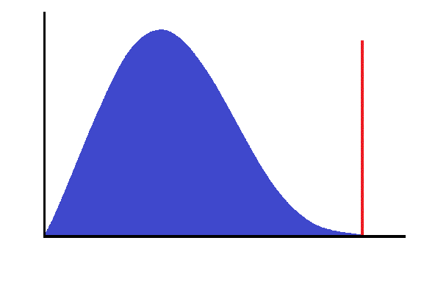
2νββ
0νββ
Counts
Summed Electron Energy

