Slide 1
Ba⁺ ion
source
2000 V
pulsing
plates
Sapphire
Window
EхB
mass filter
Faraday cup
Ba⁺
source
EхB
filter
decelerating
lens
deflection
plates
Faraday
cup
Einzel
lens
pulsing
plates
induction
plates
window
accelerating
lens
deflection
plates
Einzel Lens
Acceleration/
Einzel Lens
Einzel Lens
induction plates

Slide 2
Ba⁺ ion
source
2000 V
pulsing
plates
Sapphire
Window
EхB
mass filter
Faraday cup
Ba⁺
source
EхB
filter
Faraday
cup
Einzel
lens
induction
plates
window
accelerating
lens
pulsing
plates
deflection
plates
Einzel Lens
Acceleration/
Einzel Lens
Einzel Lens
induction plates

Slide 3
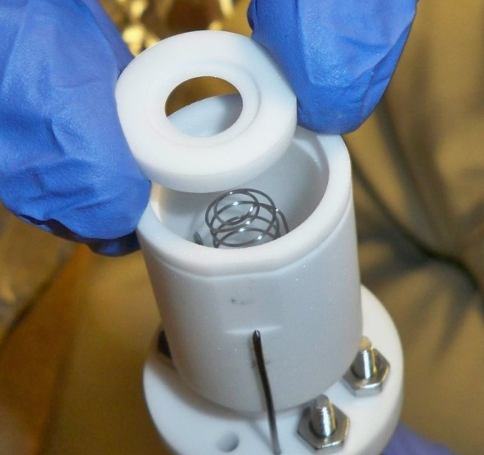
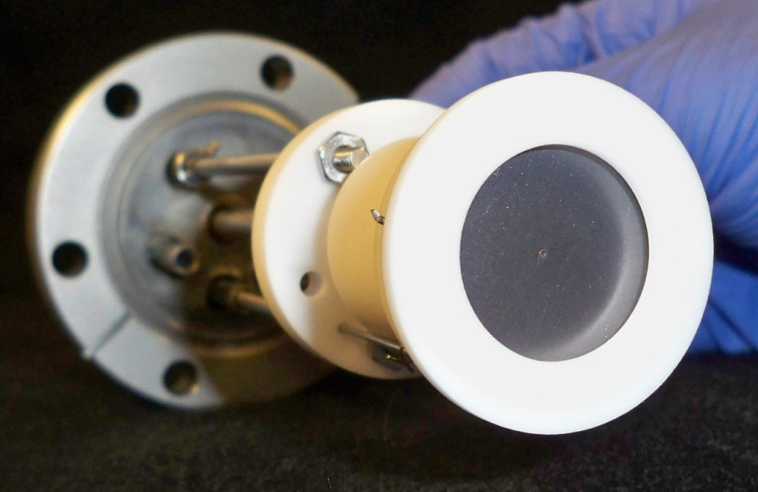
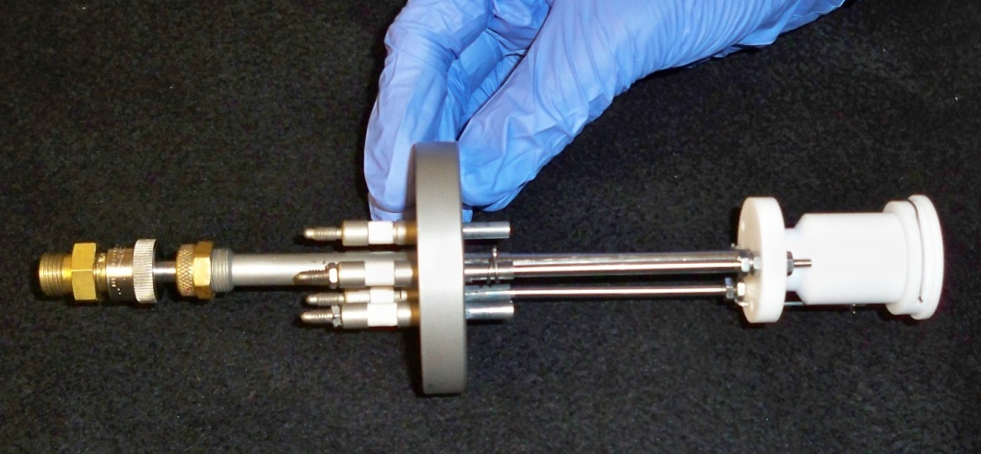
Ion Source

Slide 5
E x B Mass Filter for selecting Ba⁺
N
Only ions with velocity satisfying
qE = qvB
will move through filter undeflected, thus selecting specific m/q, which have different velocities due to initial acceleration.
ion beam
Electrode “shims” for shaping E-field
-
+
S

