Slide 1
Things thought about and decided on choosing certain plots, etc. also just production processes

Slide 2
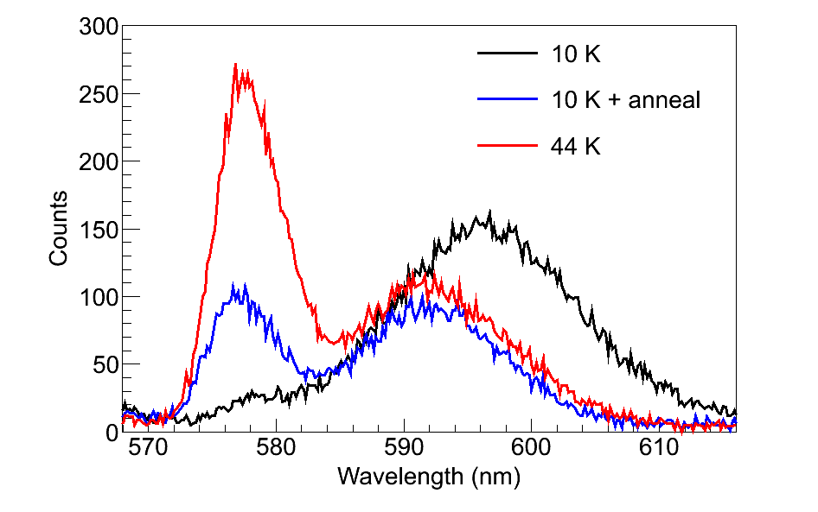
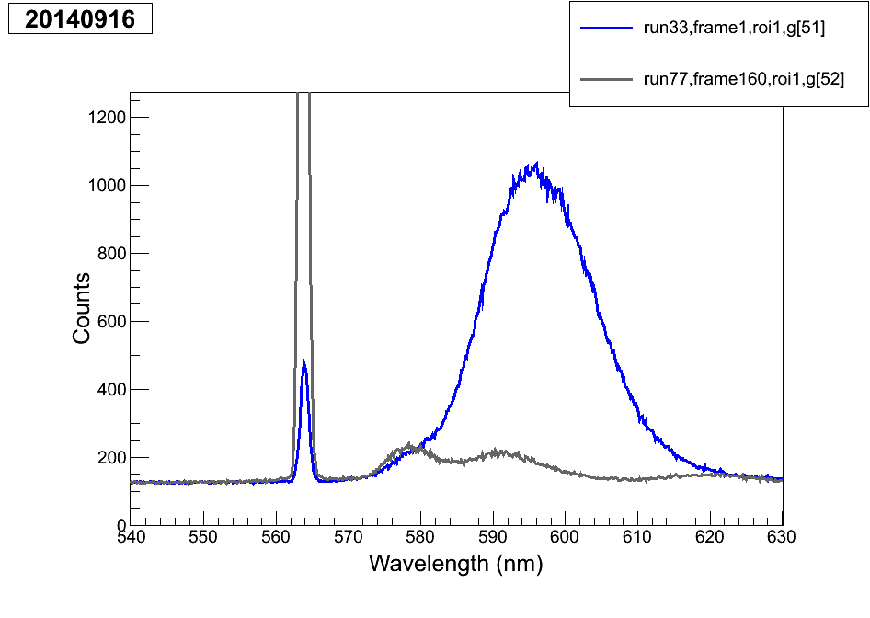
In considering a more comprehensive (including 619 etc.) version of this plot, I looked at the 2014-09-16 data, but nothing is quite as good. The 40K deposit for run 77 etc. is not similar to the other ones, because this day had long WL deposits. Here is a comparison of same-excitation for 11 K and 40 K, but again I don’t think they’re similar enough, and you should just use a separate day’s tests for seeing the 619 magnitude vs. deposit temp.

Slide 3
On deciding what to call the leak rate for leak44 (for 619 leak rate dependence):
2014-07-29, the data used for leak rates in BaSpec, give:
Leak50 120 nm/s
Leak48 55 nm/s
Leak46 30 nm/s
Leak44 8 nm/s but these are not exactly right due to neglect of SXe n
Those are at 11 K. For quoting at ~50 K, multiply by (31/37) based on recent test. Then, to get the real leak rate, multiply above numbers by (37/55) since leak 48 was measured to be 37 nm/s at 11 K in recent stuff (rather than 55 nm/s).
But since the thing in the thesis is describing the leak rate 44 at 11 K, just do:
(8 nm/s) х (37/55) ≈ 5 nm/s.

Slide 4
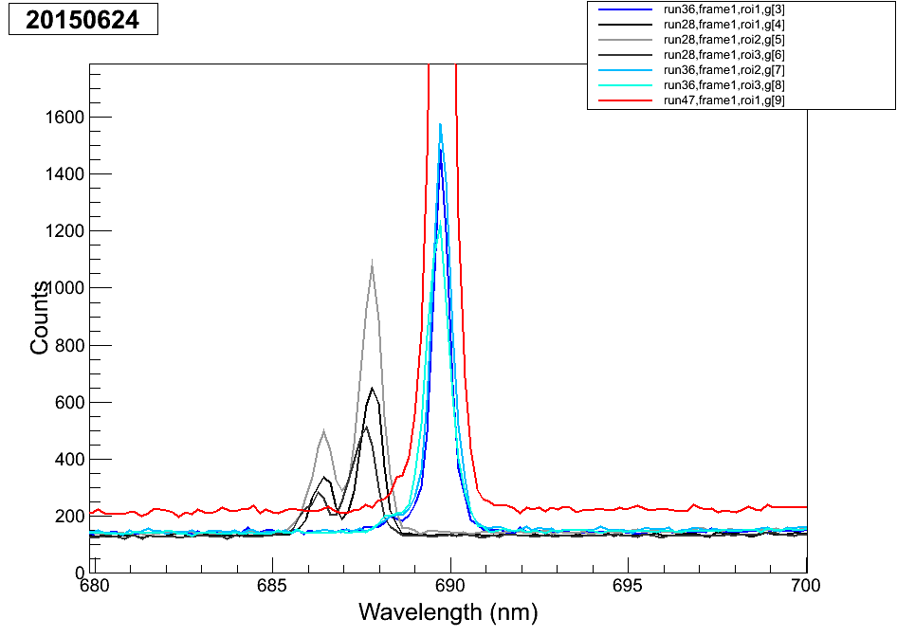
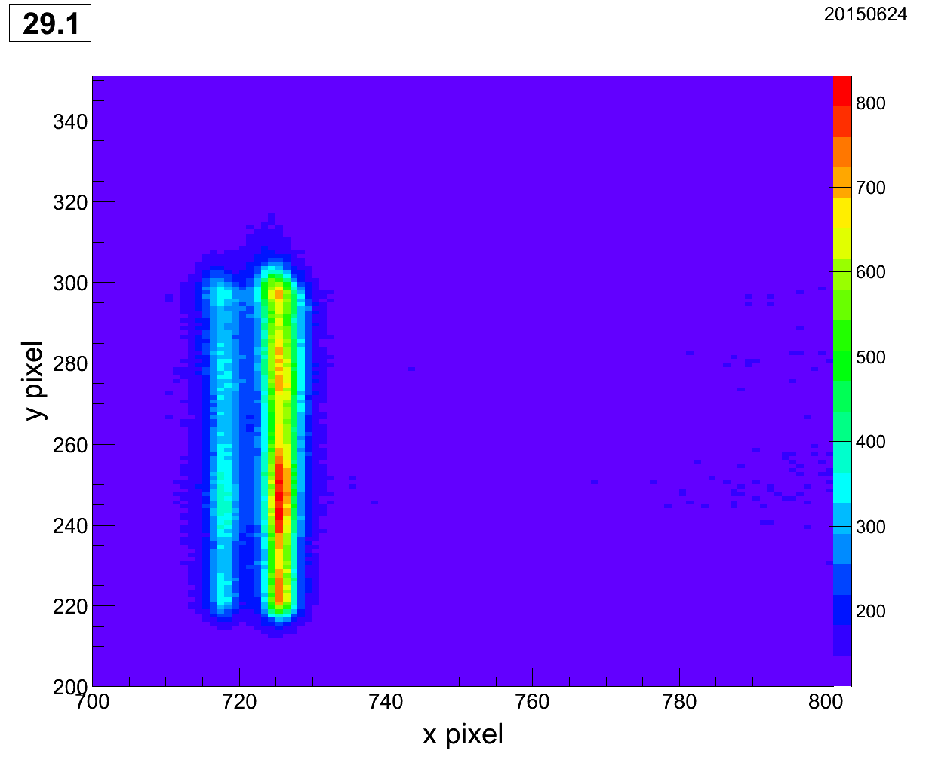
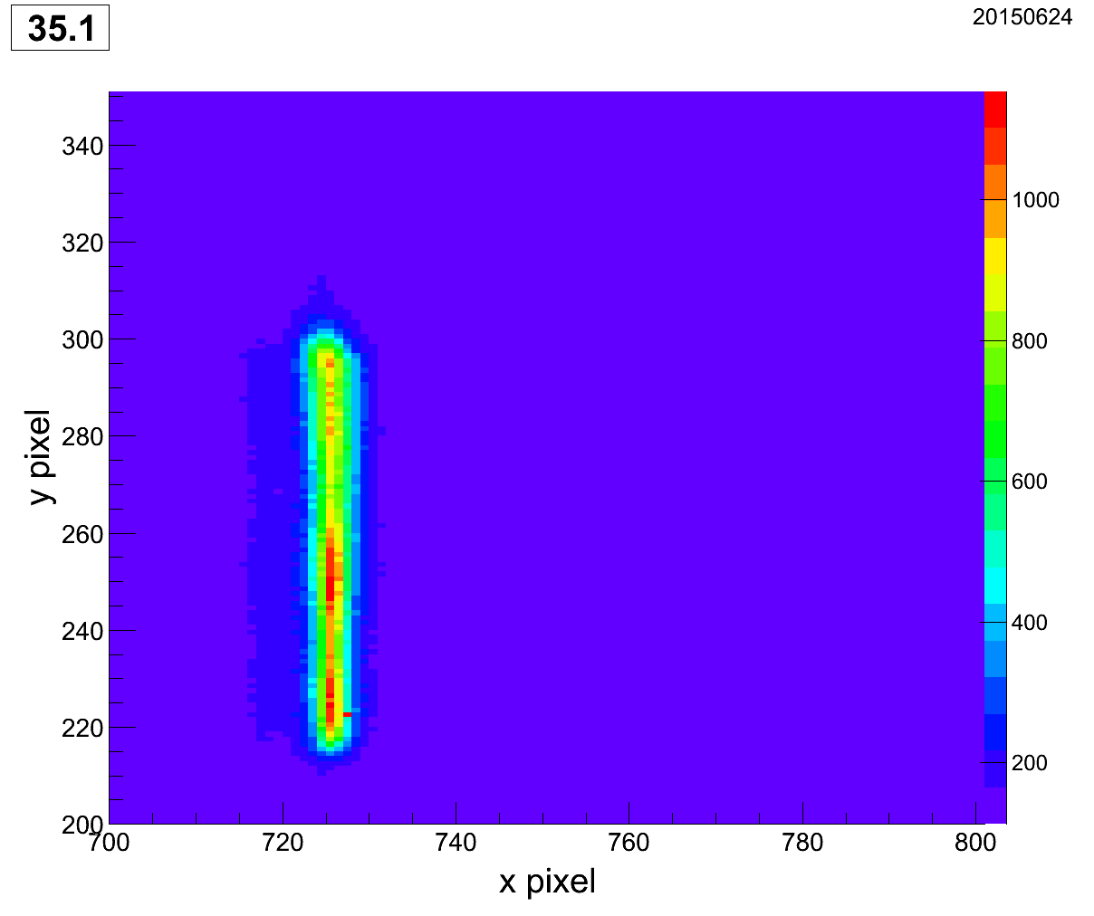
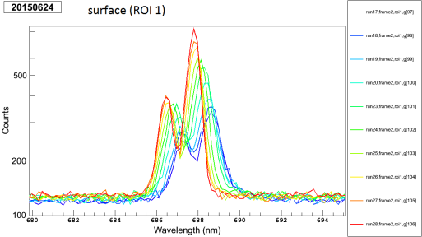
On 693 peak(s)
This was misleading because the grating
was at different places (and uncalibrated):
What really seems to happen is that the lower-wavelength one goes away between ~100 K and ~15 K (T measurements aren’t really good for this, but that’s close):
~100 K
~15 K
The old paper was at 77 K, so… idk
Cooling from room temp does this
See next slide

Slide 5
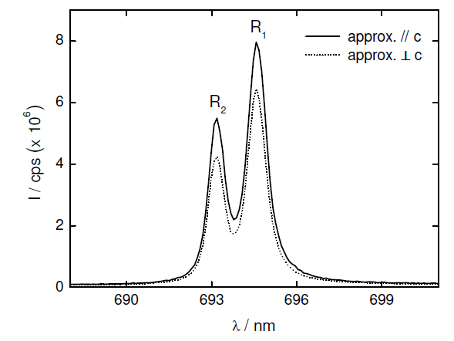
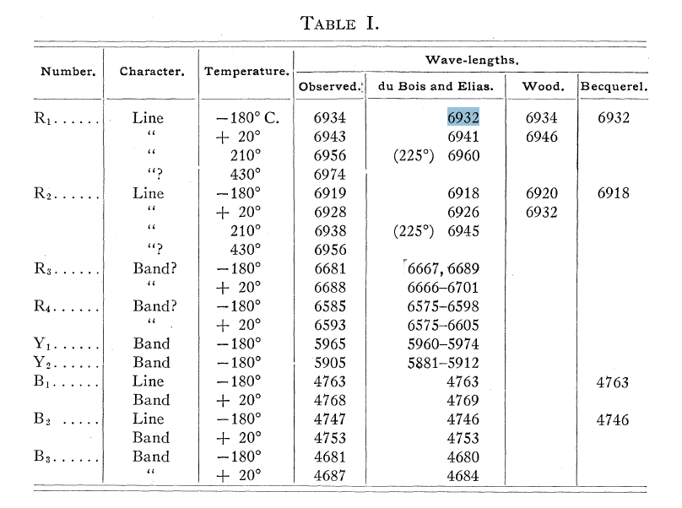
On 693 peak(s)
From Guguschev:
Ours (at 11 K) is R₁, so this table suggests that the real wavelength is more like 693 nm:
I think these are at room temp., but it’s hard to tell
From Gibson:

Slide 6
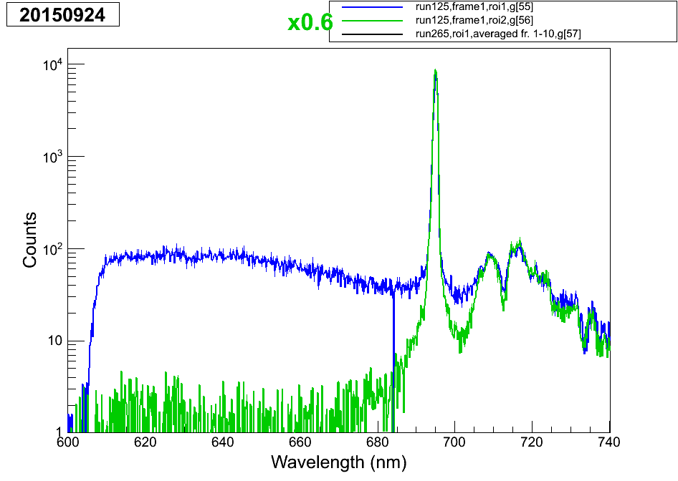
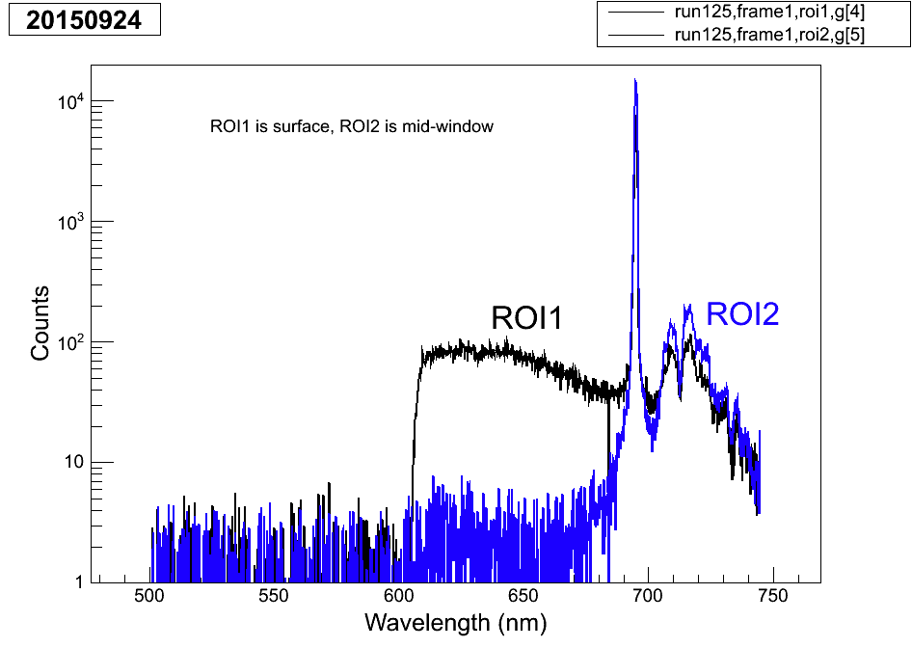
Achieving the surface BG spectrum:
unscaled
The reason to multiply the sapphire part by 0.6 is that it should not be larger than the black spectrum (which is surfBG + sapp). The surface part has less sapp in it because it is tapering off there, so it needs scaling, and this is sort of the best guess, albeit not necessarily correct – however, the sapp contribution in the region we care about is small anyway.

Slide 7
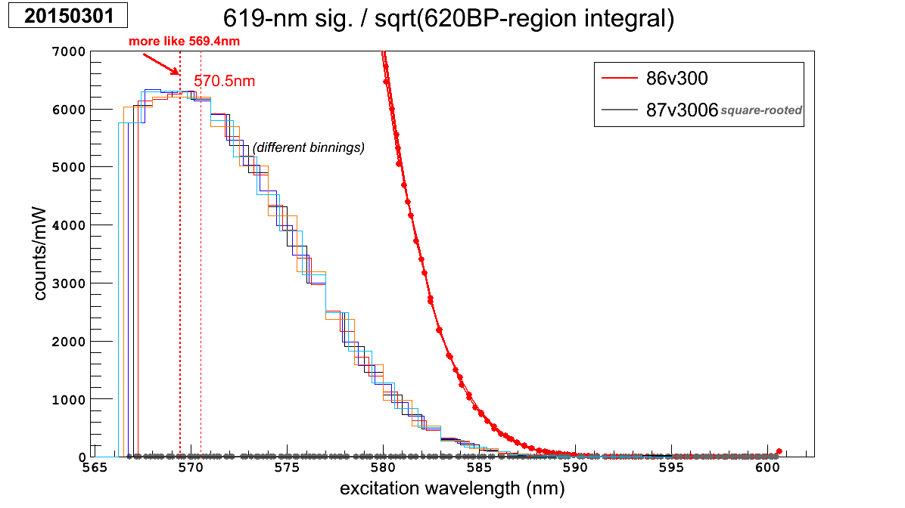
I cannot find the code for re-binning plots, so I for-went this one:

Slide 8
Determining the “typical variance” of laser position in image:
5 × average(abs(x/y pos minus that of previous run))
8-7 x .741 μm
9-16 x .484 μm y .62 μm
ignored 8-7 y due to cam warming

Slide 9
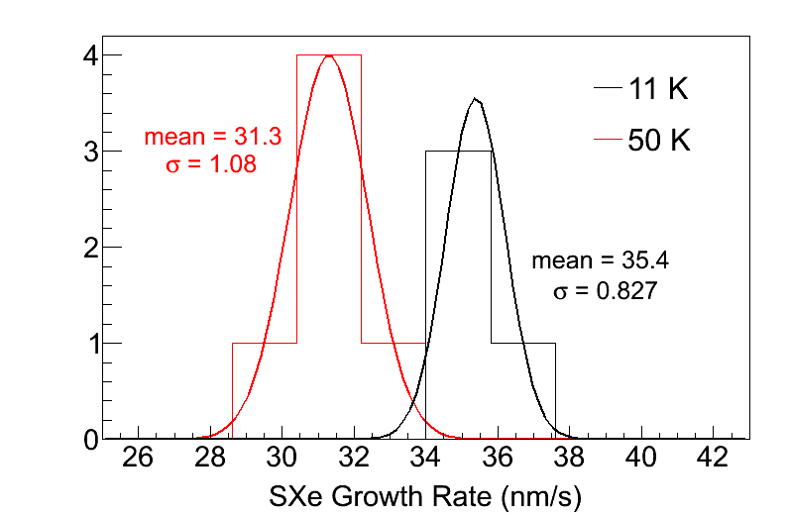
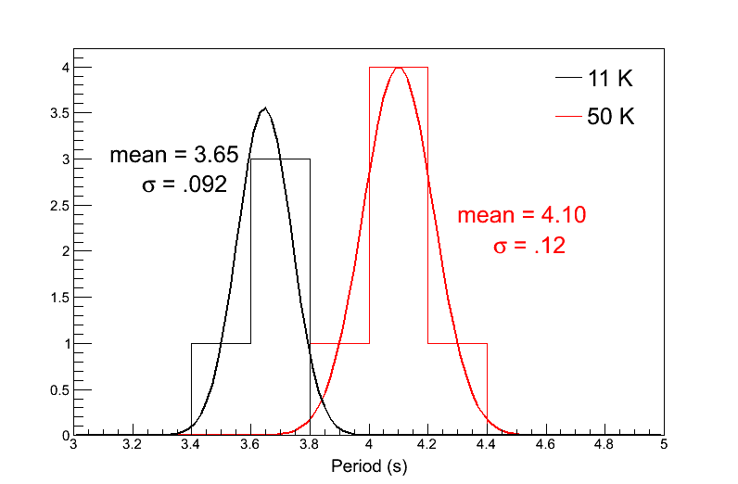
Determining stat. and syst. errors on these
Stat error = 1.08/sqrt(6) = 0.44
Stat error = 0.827/sqrt(4) = 0.41
Systematic errors come from the horrible equation in fringe_interference.xlsx, and come from just inputting the central values for T:
0.31 and 0.35
And for the full error I just did quadrature sum

Slide 10
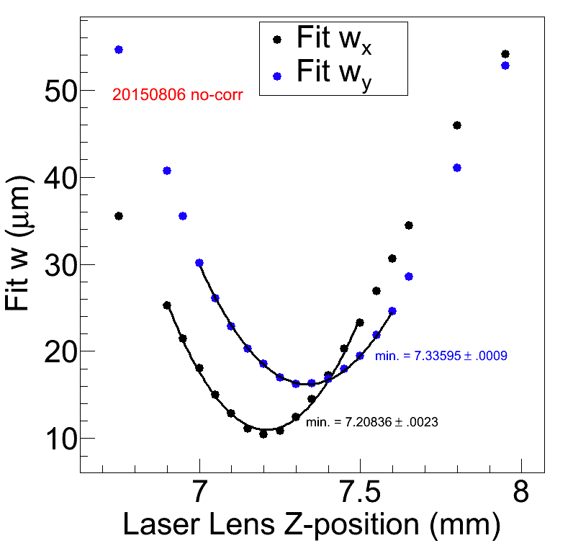
Value/uncertainty on difference between x and y focus w/ no astig. corr.
127.59 ± 2.5 μm
From quadrature adding of the two uncertainties

Slide 11
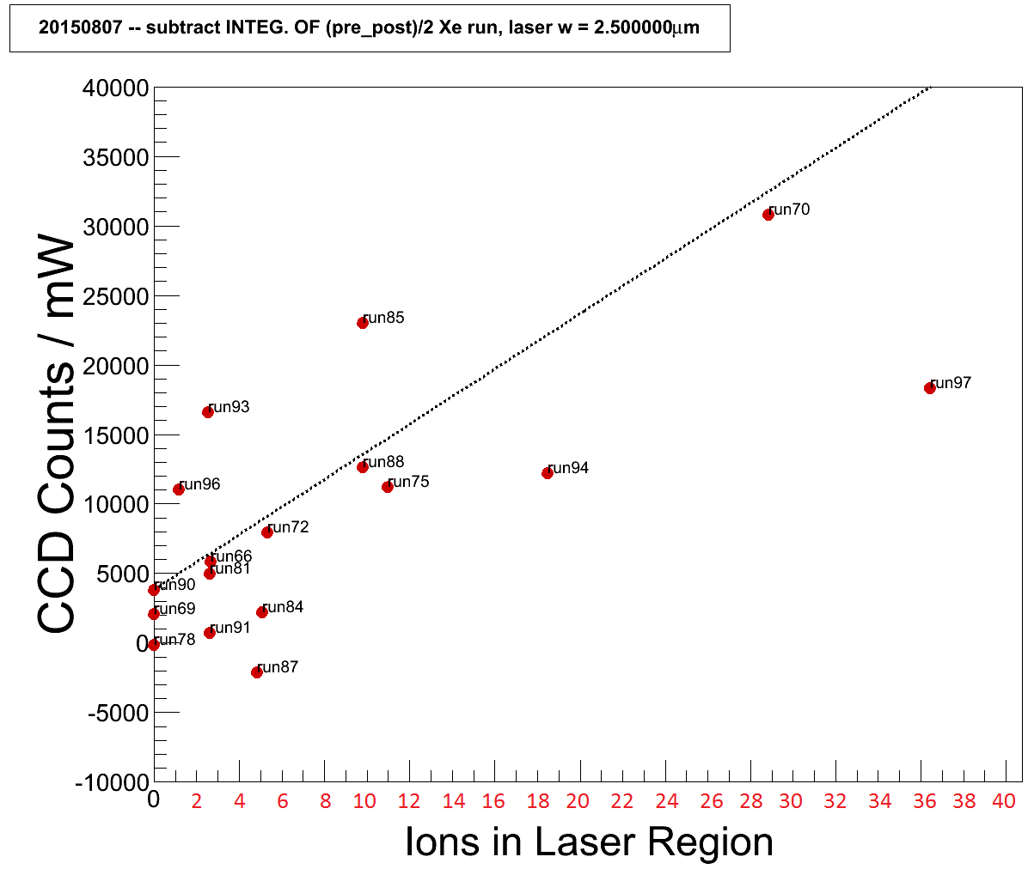
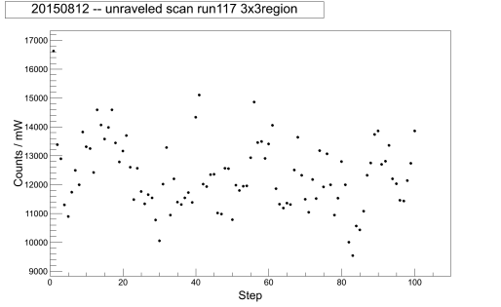
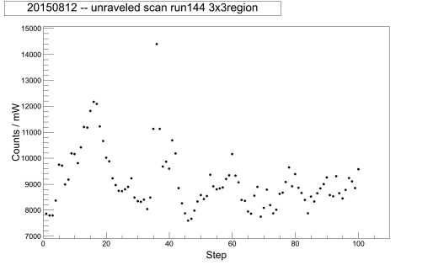
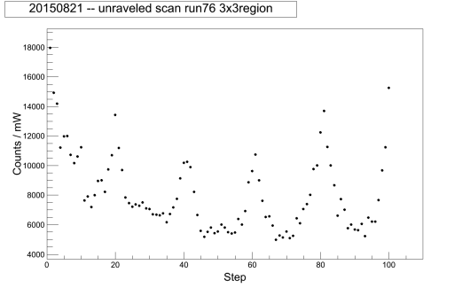
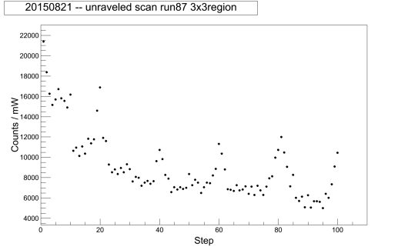
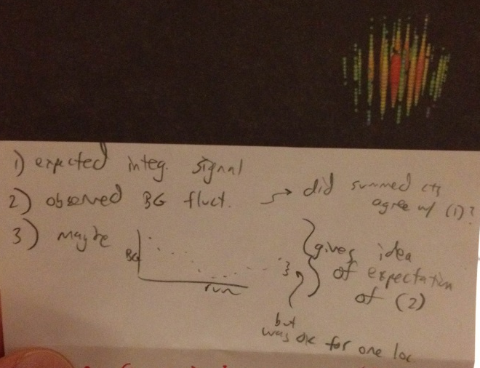
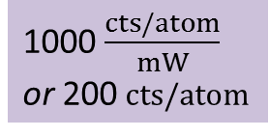
Expected and Observed in Scanning
Expected signal from 20150807, / mW,
with #atoms definition #2 (x2 2.06μm×2.06μm region):
Next: consider these (in 1D/ of 8-12 and 8-21), and you had a script that plots them on the same plot, and you could observe things like (a) failure to match up for BG sub – what does that mean? (b) fluctuations are lower than they appeared in the 2D plots, …(c) is it lower in the bleached region of 8-21? …
trend line:
1000 $\frac{cts/atom}{mW}$
or 200 cts/atom
Another question, since maybe the variations aren't as big as you thought, is are those peaks possibly actually atoms, in the ones that had a cool peak
Goal:
ation

Slide 12
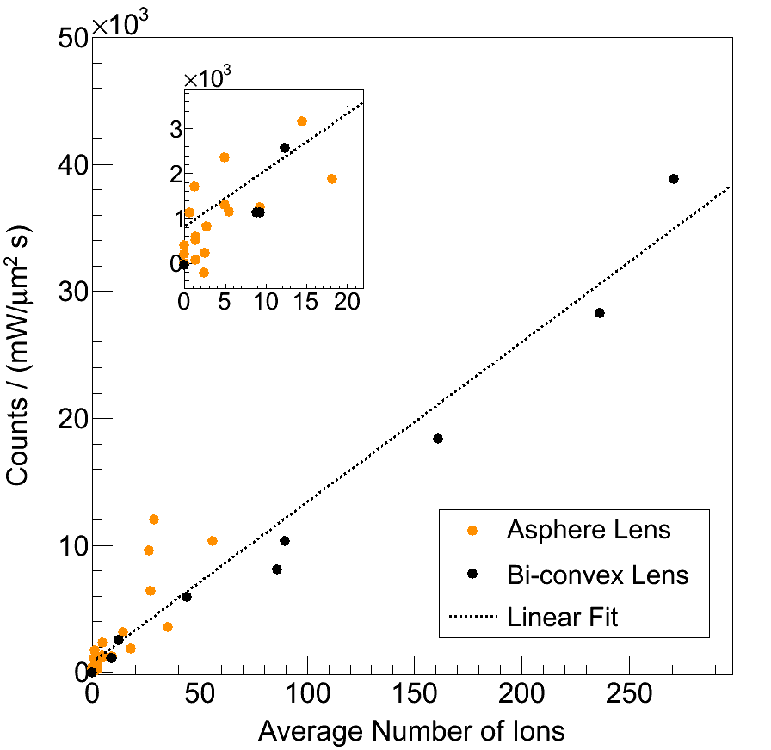
lin
2015-05-26 is plotted just for the ones before the Xe variations
(now have them split up)

Slide 13
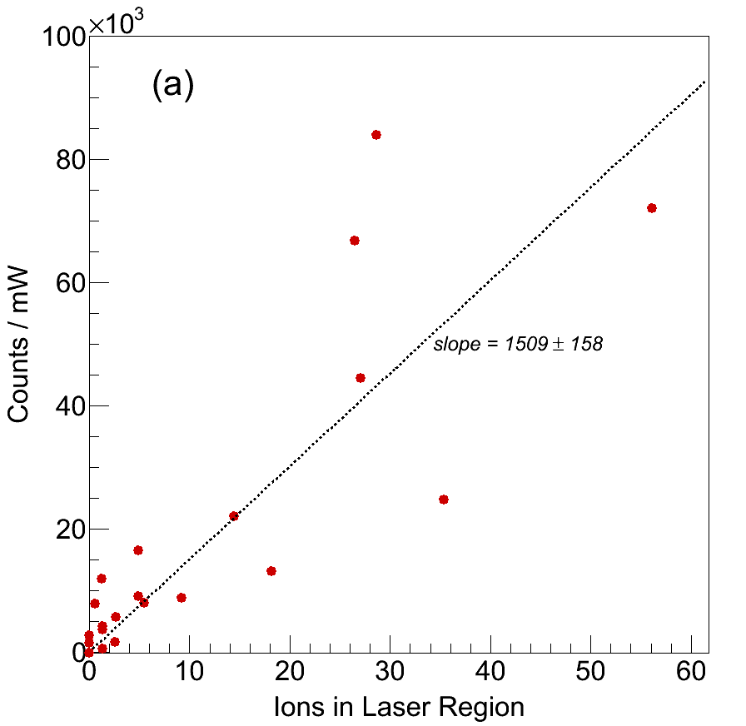
On slope vs. single-atom average:
Average of these 4 points around 1 atom give 5015.619 (script thesislin_just20150807() outputs this average and the numbers), with a STDERR of 2406.8.

Slide 14
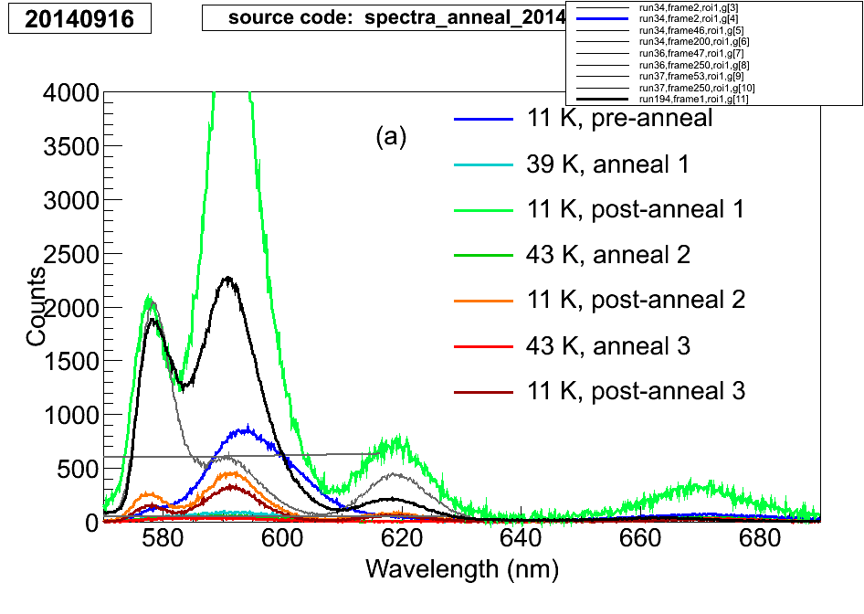
On calibration of 2014-06-26 (bleaching) data:
From this (20140916), just scaled up, and this is calibrated (by program, but permanently)
Spectrum from output I sent Brian (pretty sure) for the BaSpec paper
Graph-calibrated by recal_map.txt and function cal20140626() from spec_calibrate.C
It’s off a little bit on the 577 peak for some reason, but that’s just how it is.

Slide 15
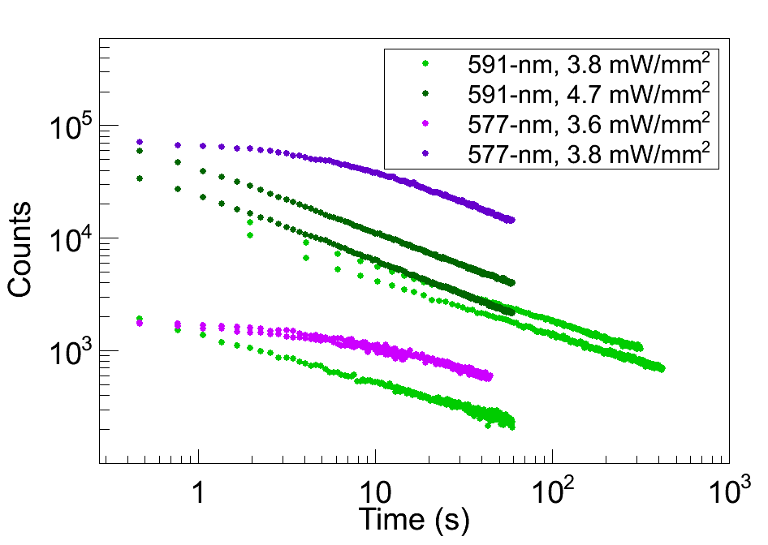
On the bleaching data:
They appear to be v2, which is integrals of the fit peaks, not power-scaled.

Slide 16
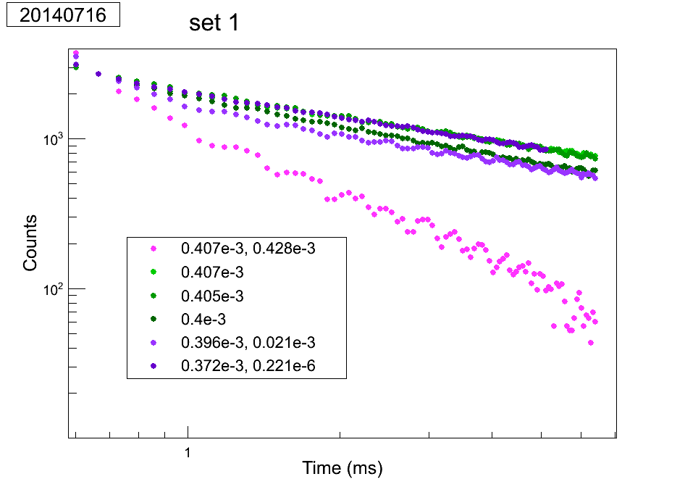
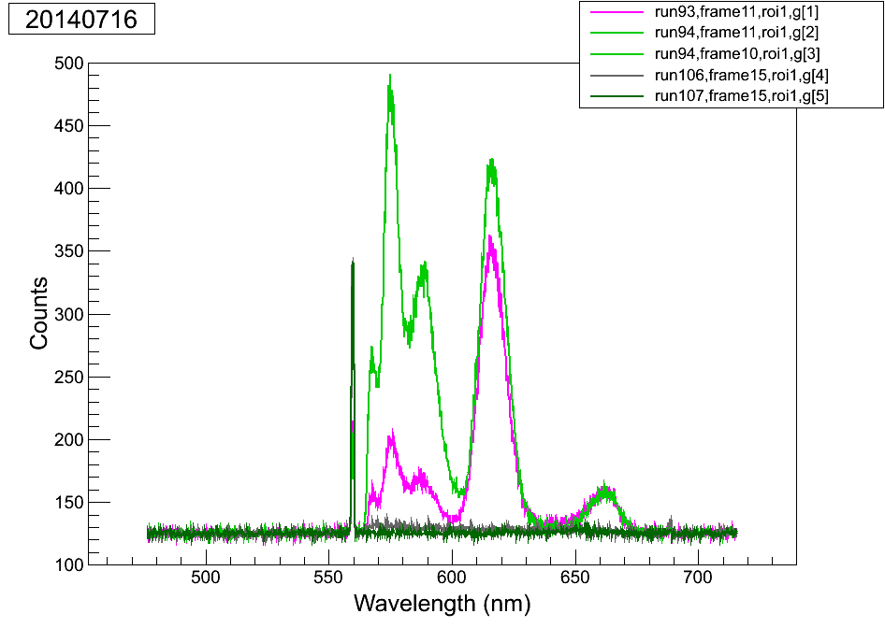
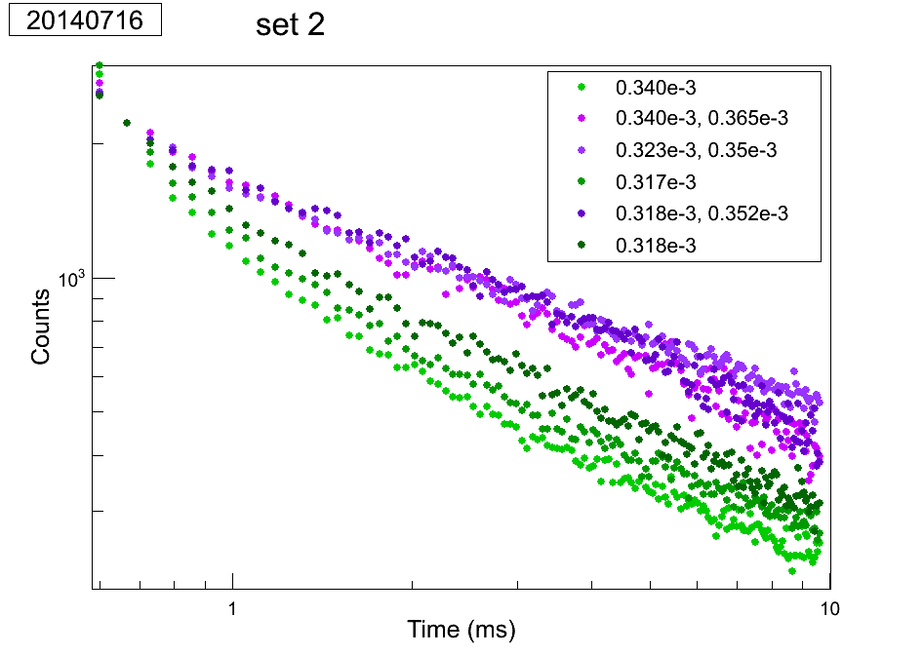
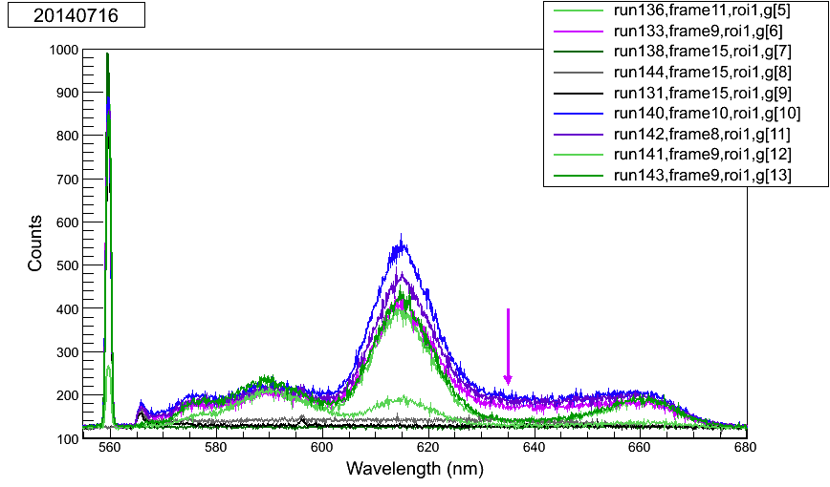
On re-pump using Kr laser:
Especially since the powers are supposedly similar between these “re-pumps” and the most destructive case in the earlier ones, this seems to be not real. One difference between sets 1 and 2 is the dep. temp., but this doesn’t explain the weird baseline thing – maybe there were differences I couldn’t easily pick out of the notes. Weird conditions were being tried to mimic those of the old separate Kr re-pumps.
These saw only the destruction w/ higher Kr
This thing does NOT appear in set 1 runs
…but is it actually due to a higher baseline?
Appears to be an effect!
Not sure what that is, cuz it’s not in the BG apparently… see above summary.

Slide 17
On re-pump: IR powers
There are zero notes on the IR power on 20131130. 20131216 saw no effect of the IR lasers, even though one run had no filters on it. This makes me suspect that it was not aligned properly, since a negative effect was evident on 20131130 with IR lasers
On re-pump: scaling and shifting of the ones use
The timing of 12-16 were shifted to begin at 96.whatev, like 11-30, which is more correct.
And the overall counts were scaled x3.5 to be more like the green-only run which compares more properly to 11-30 (Kr ones may start out lower due to fast bleaching). After that, it agrees more closely with the 3-s DC vs. 6-s DC.
On re-pump laser intensities
Assuming the same 600 micron w, which is probably OK since it’s defocused 10x more than the focal position differences.

Slide 18
On power meter QE (2014-08-15):
~70% was obtained in the green, but this is consistent with the power meter’s sensitive area vs. the ~7-mm green w on the optical table. Blue was more like 50%, but I don’t know its size at the optical table. Basically the data is useless because we didn’t write down where the power meter was.

Slide 19
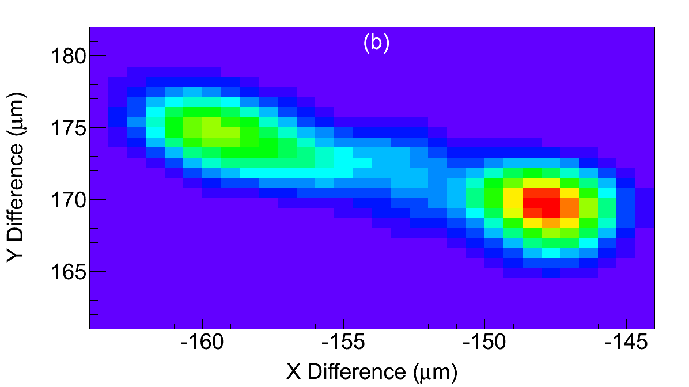
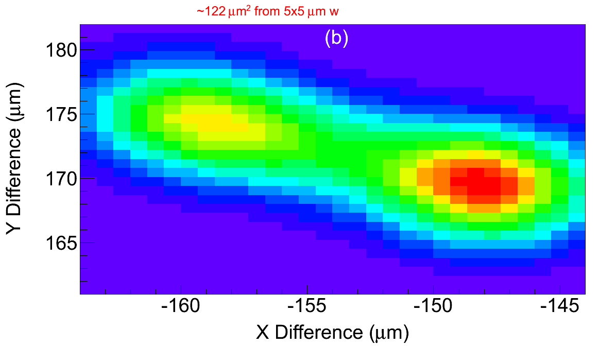
On cryo-vibration area multiplier:
2.06×2.66μm w is around 40 μm² over 1/e, which is 4.65× the laser spot size of 8.6 μm², and I wrote 5× in the thesis... May have changed to 4.7
(bi-convex lens)
5×5μm w is around 122 μm² over 1/e, which is 3.1× the laser spot size of 39.3 μm².
2.5× for 6.7×6.7μm

Slide 20
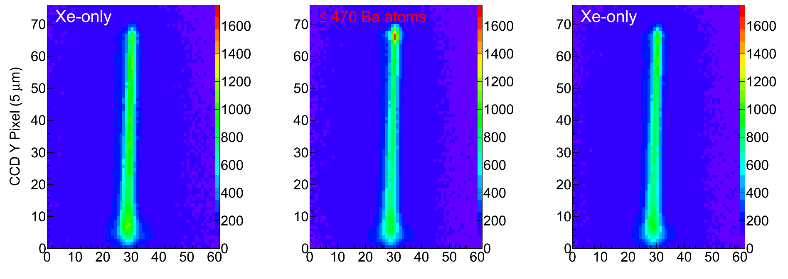
Not used
On signal level of 2015-02-11 data:
Gives about 32e3 counts/(mW/micron² s), about a factor of two lower than the other data

Slide 21
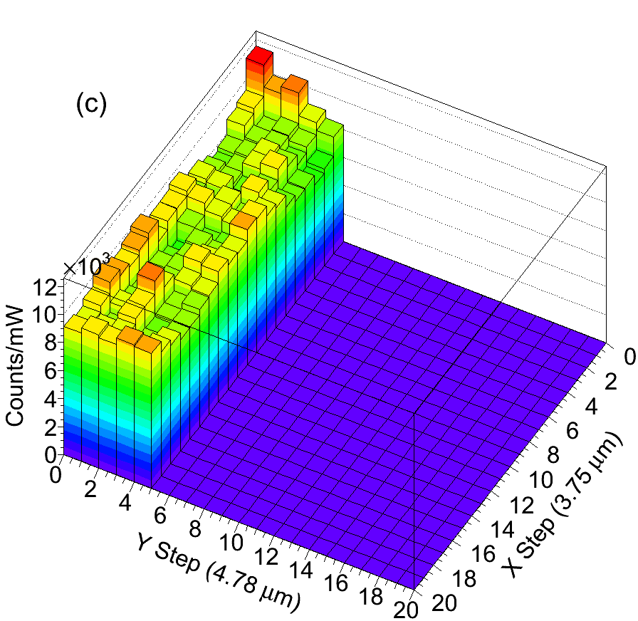
On scan signal levels
Totally corrected counts/mW, averaged over steps:
Run112(Xe): 4554
Run115(0.18 Ba/step): 4830
Run117(48.4 Ba/step): 8574
Run148(5.8 Ba/step): 7113
Remember Xe varied, so yeah

Slide 22
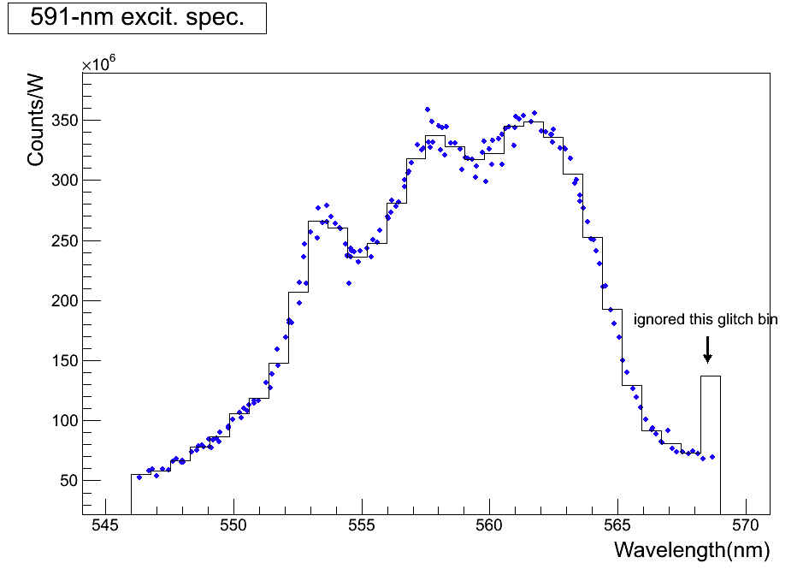
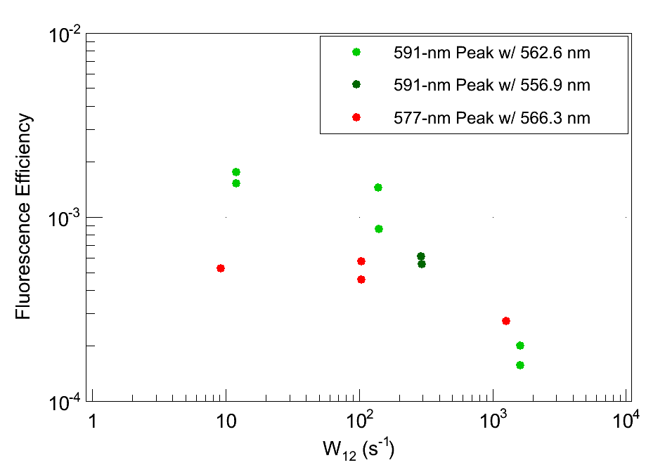
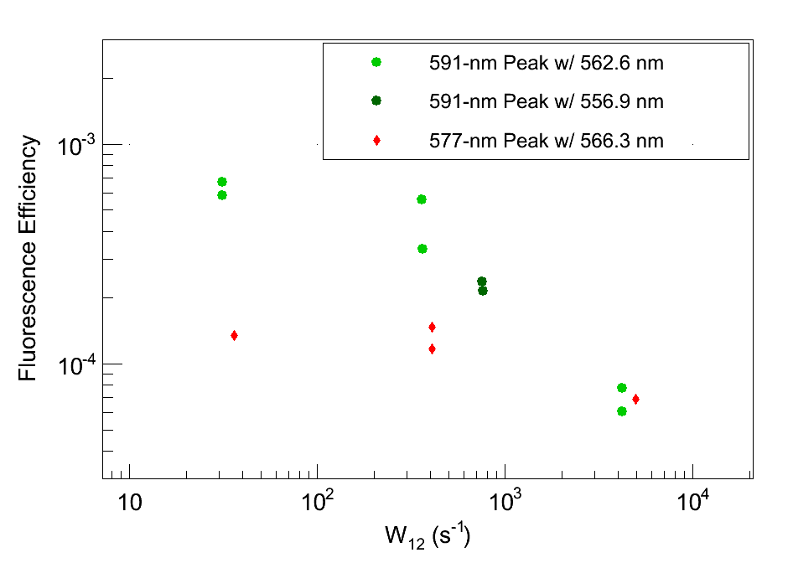
On Ba peak cross-section calcs:
Script is cross_section_calc() in spec_thesis.C
Uses Eqn. 2.8 in Shon’s thesis, with a normalization to put the peak at 1, though you don’t have to do this, but then you set E(nu_0) to 1.
I get (m²):
577nm: 5.24E-19
591nm: 3.35E-19
619nm: 3.11E-19
On cross-section used in (fixed) QE plot:
591 peak: ~91% of peak excitation at both of the used excitations (562.6 and 556.9 nm)
577 peak: ~90% of peak is probably good, with the used 566.3 nm excitation
correct with specific cross sections

Slide 23
CCD counts / photoelectron:
We have been on medium gain, which is 4 photons per 1 count according to the manual.
Checks:
No difference in # counts (after dark subtraction) between FAST and SLOW:
Proper difference in # counts (after dark subtraction) between Low, Medium, High gain:
(do this)
(do this)

Slide 24
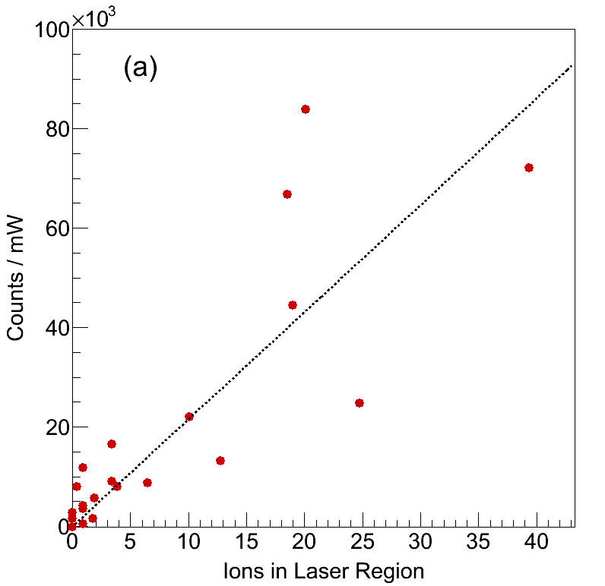
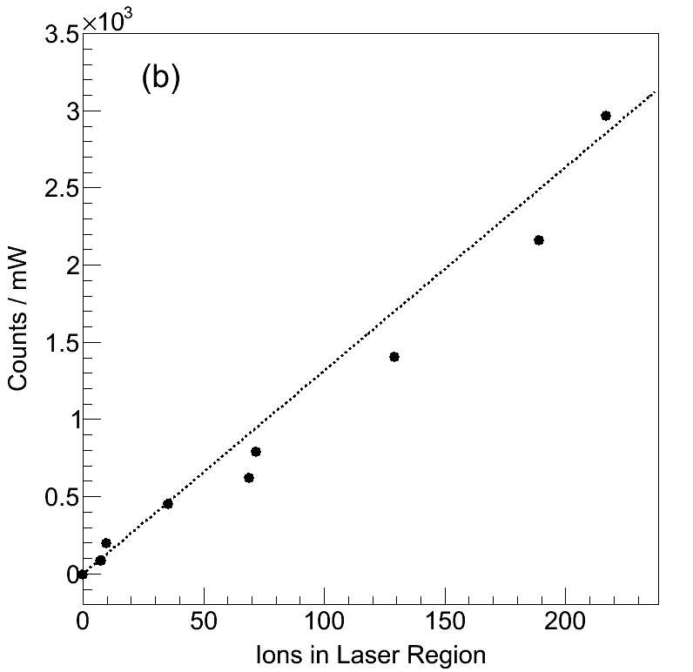
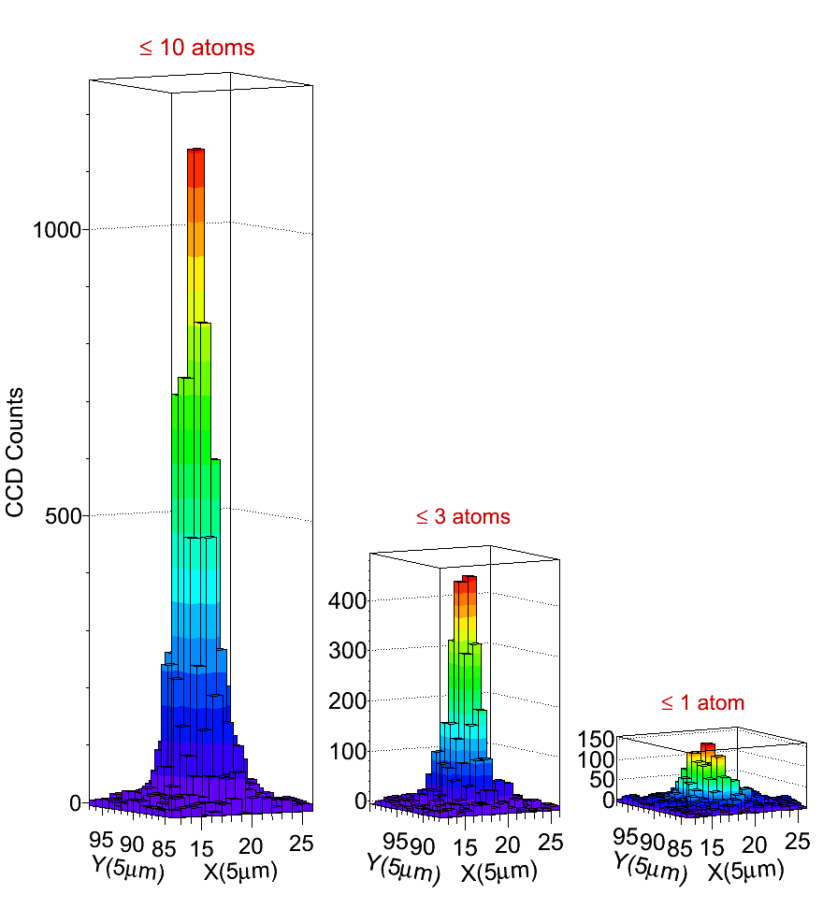
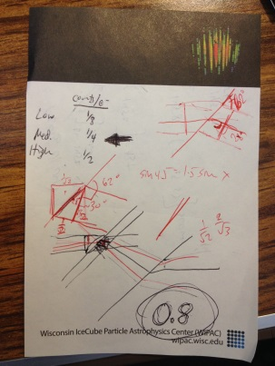
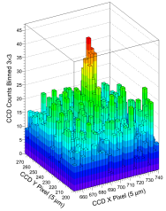
NUMBER OF ATOMS
slope = 2153 +- 226
slope = 13.2 +- 0.9
These are after a correction of 0.8 for the window angle. This would be negligible if the laser were going straight at the sample like the ion beam does, but refraction puts it at an angle, resulting in this correction.
2015-05-26 goes straight from counts_subbed_20150526.txt, which uses 5 micron w (and it does corrections on the number of counts), with the additional 0.8 correction. However, 2015-08-07 uses the 0.8 along with a correction of (2.34/2.5)², due to the file counts_subbed_20150807.txt having used 2.5 micron w.
The above plots are the result.
I just multiplied the numbers in counts_subbed_20150807.txt by 0.8 to get the number for, e.g., the train plot.
In case this helps in the event you need to re-trace how you got 0.8
I just multiplied 2700 by 0.8 to get 2200 for:
See next slide for higher-res

Slide 25

(from previous slide)

