Slide 1

Stopping Customer Churn Before It Happens
What I Learned from Telecom Customer Data
Presented by: [Karinge Yvonne Wambui]

Slide 2
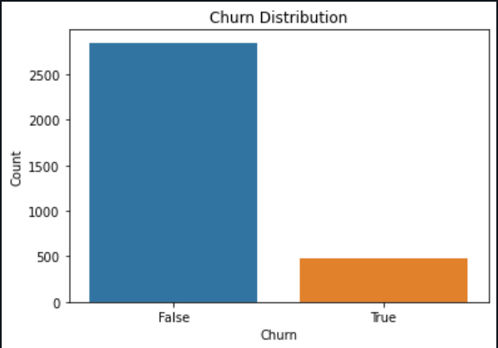
What is the customer churn rate?
Customer churn means your customers leaving your business. When your customer simply ends the relationship with you, that’s churn.

Slide 3
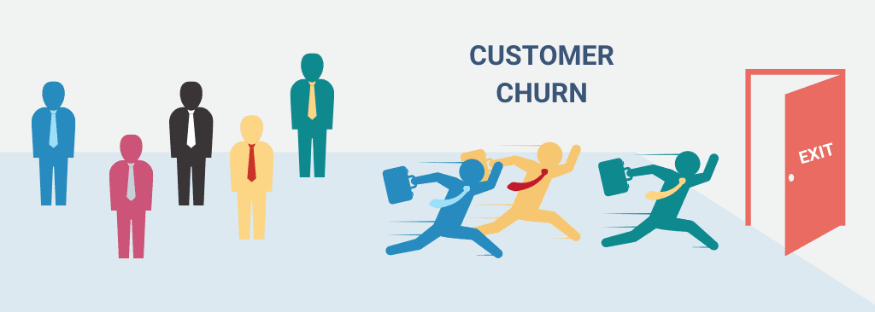
Why This Matters
Churn = Lost Revenue
Every customer we lose impacts the bottom line.
I want us to spot warning signs early.

Slide 4

Our Goal
Use customer data to predict who is likely to leave.
Help our teams act earlier to keep those customers.

Slide 5

How I Did It
Analyzed data from 3,333 customers.
Looked at call time, plans, and charges.
Used tools to build prediction models.

Slide 6
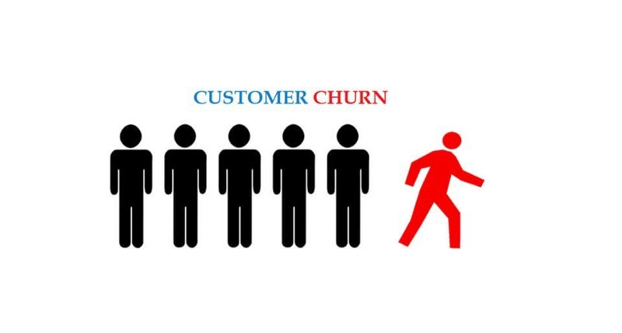
What I Found
Churned customers often:
- Talk more during the day
- Don’t use voicemail
- Don’t have an international plan
Only ~14% of customers left — but we want to catch them all.

Slide 7
How Accurate Is It?
I tested two prediction models:
Logistic Regression Model: Good — Fast, reliable baseline
Decision Tree Model: Better — Finds deeper patterns.
✅ Tree model is better at catching likely churners.

Slide 8
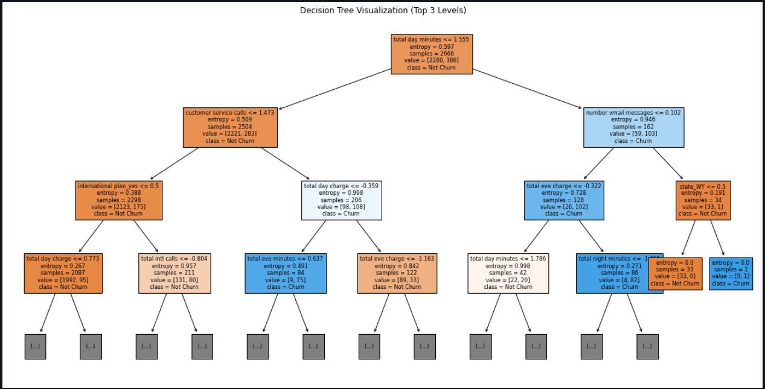
Decision Tree Model

Slide 9
What It Means for You
Sales & Retention Teams: Alerts on at-risk customers.
Marketing Team: Target campaigns more effectively.
Executives: Reduce churn and increase customer value.

Slide 10
What’s Next
Test this model in a real campaign.
Build alerts into dashboards.
Explore advanced methods for even better results.

Slide 11

Thank You
Excited to take this further!
Let’s talk about how we can put this into action.
❓ Questions?
Thanks for your time.

