Slide 1
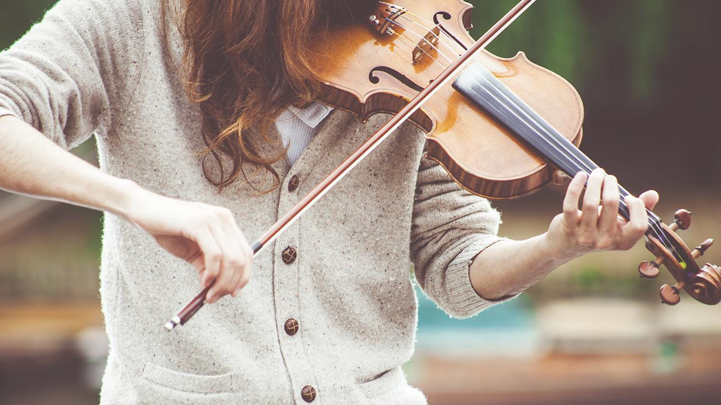
Hey! Meet THE TRIBE

Slide 2
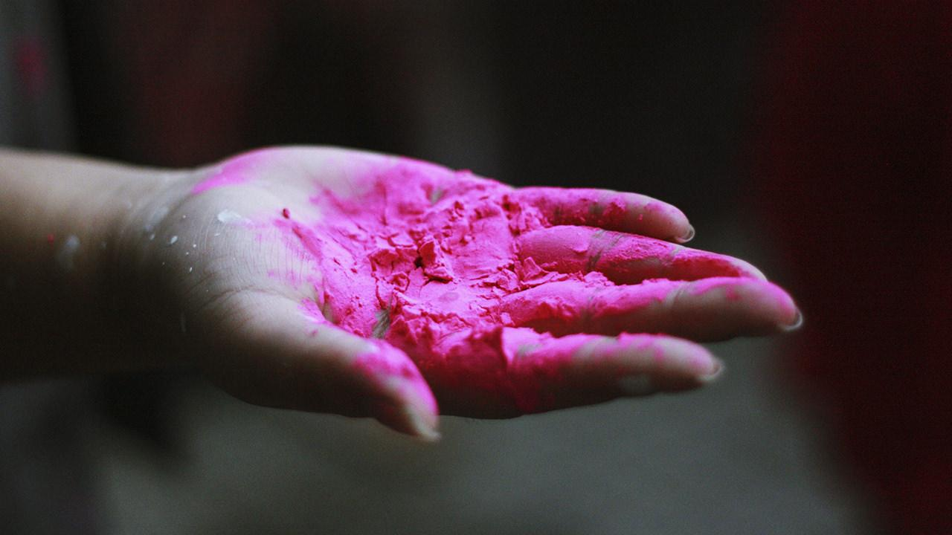
Hypothesis statement
Null Hypothesis:
Ho =. Videos released over the weekend have greater views on average than the ones released on weekdays.
Alternative Hypothesis:
Ho = There’s no difference in viewership between videos released on weekdays and those released on the weekends.

Slide 3
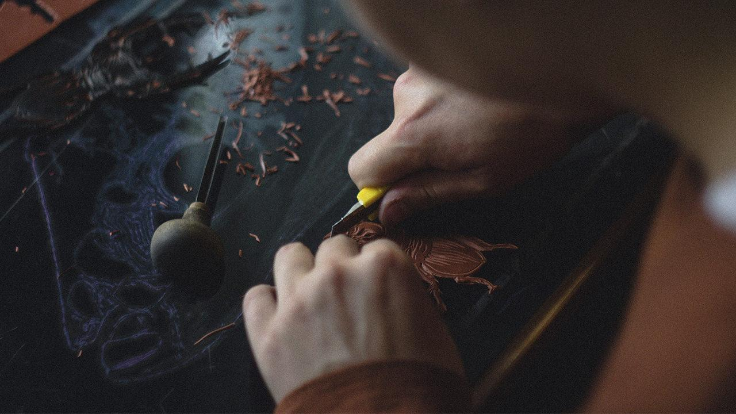
YouTube as a growth platform

Slide 4

AGENDA
Understanding the platform
Research Question
Competitive advantage
Challenges
Campaigns
Marketing strategy
Timeline
Projections
Measuring success

Slide 5
Goals
Searching for when it’s optimum to publish our videos so as to increase our viewership, brand awareness, social engagement and business development.

Slide 6
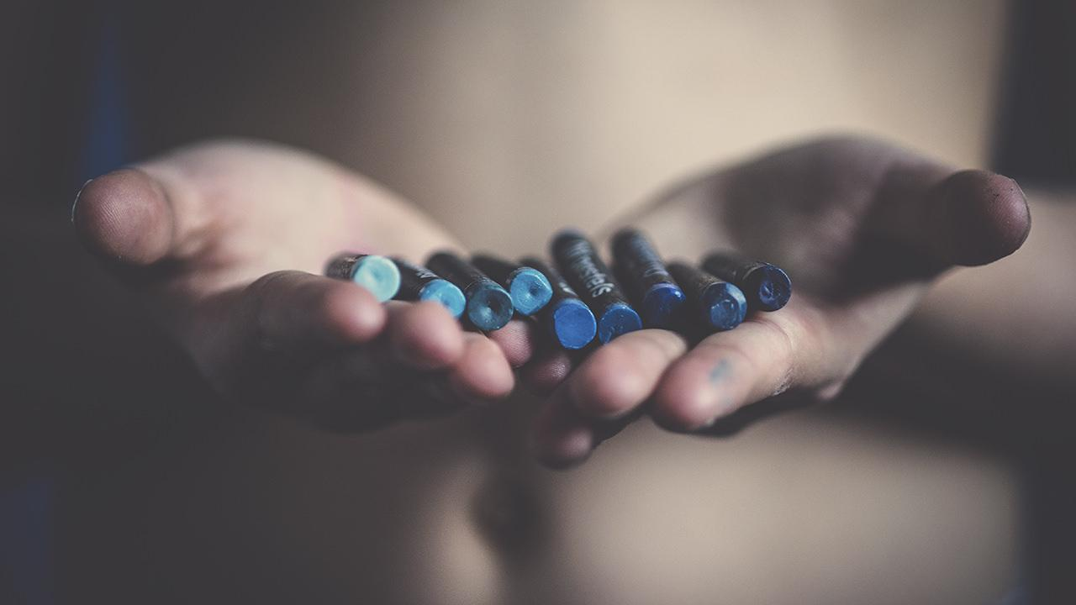
RESEARCH QUESTION
We would like to know when it’s optimum to publish our videos so as to increase our viewership, brand awareness, social engagement and business development.

Slide 7

Prime Upload Hours
From the analysis done, we found out that the most opportune time to upload any video was from 4pm onward.

Slide 8
Another observation was that majority of the videos that went on to trend had their comment sections enabled thus fostering social engagement and providing a feedback platform

Slide 9
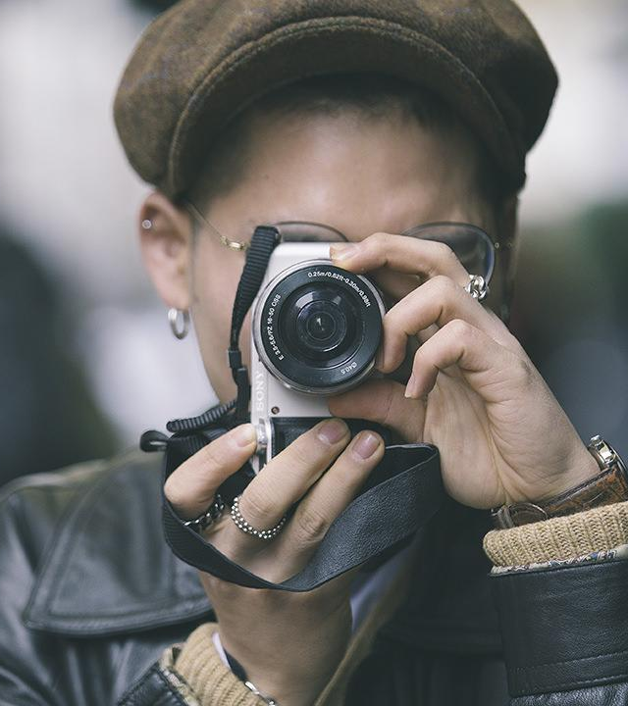
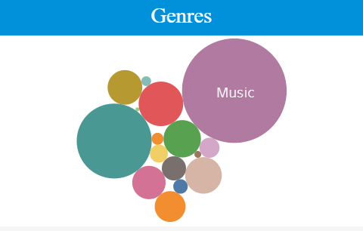
Music was the most viewed Genres

Slide 10
13,810,252,879
Average weekly views

Slide 11
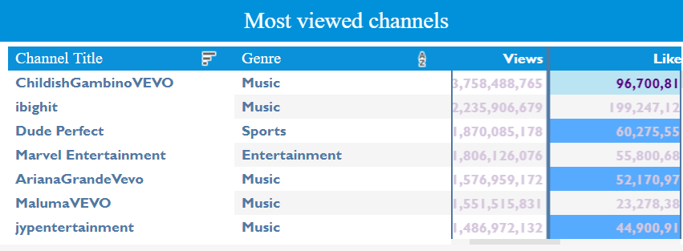
MAPS
Top seven viewed channels

Slide 12
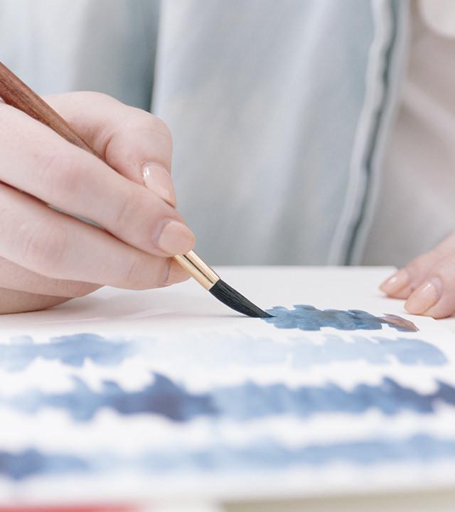
YOU CAN ALSO SPLIT YOUR CONTENT
White
Is the color of milk and fresh snow, the color produced by the combination of all the colors of the visible spectrum.
Black
Is the color of coal, ebony, and of outer space. It is the darkest color, the result of the absence of or complete absorption of light.

Slide 13
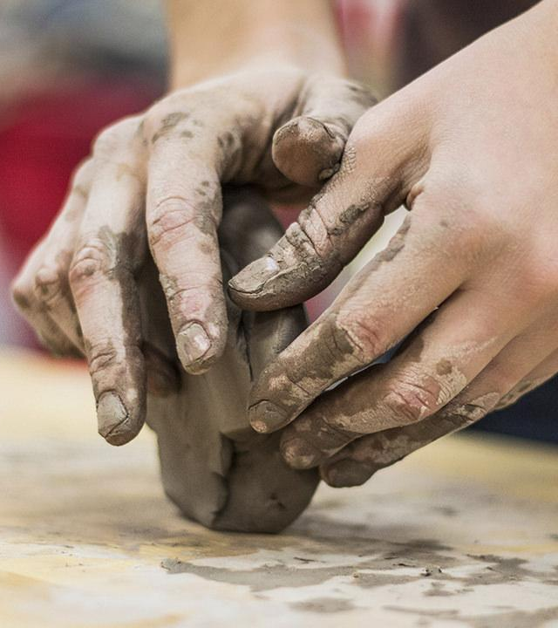
USE CHARTS TO EXPLAIN YOUR IDEAS
White
Black
Gray

Slide 14
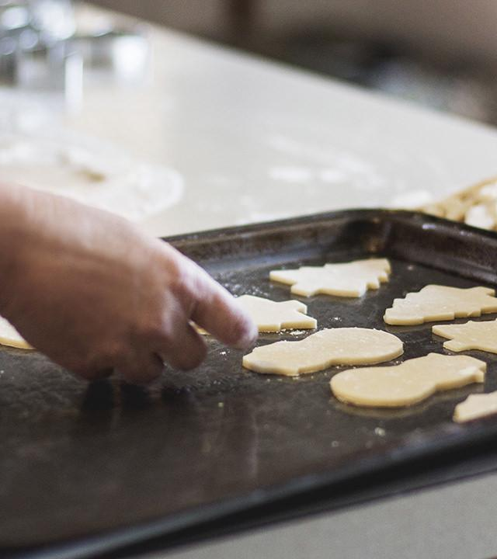
AND TABLES TO COMPARE DATA
 | A | B | C
Yellow | 10 | 20 | 7
Blue | 30 | 15 | 10
Orange | 5 | 24 | 16

Slide 15
89,526,124$
185,244 users
100%
That’s a lot of money
And a lot of users
Total success!

Slide 16
OUR PROCESS IS EASY
first
second
last

Slide 17
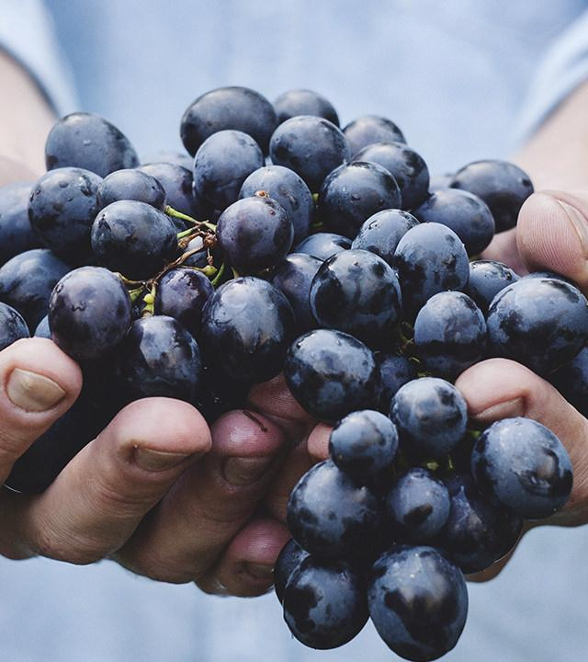
Yellow
Is the color of gold, butter and ripe lemons. In the spectrum of visible light, yellow is found between green and orange.

Slide 18
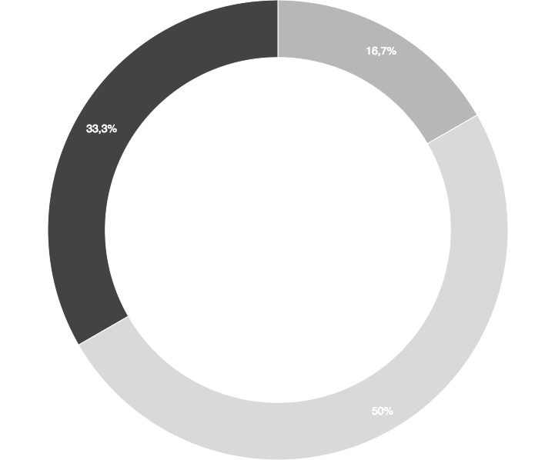
You can insert graphs from Google Sheets

Slide 19
Place your screenshot here
ANDROID PROJECT
Show and explain your web, app or software projects using these gadget templates.

Slide 20
iPHONE PROJECT
Show and explain your web, app or software projects using these gadget templates.
Place your screenshot here

Slide 21
Place your screenshot here
TABLET PROJECT
Show and explain your web, app or software projects using these gadget templates.

Slide 22
DESKTOP PROJECT
Show and explain your web, app or software projects using these gadget templates.
Place your screenshot here

Slide 23
THANKS!
Any questions?
You can find me at
@username · user@mail.me

Slide 24
CREDITS
Special thanks to all the people who made and released these awesome resources for free:
Presentation template by SlidesCarnival
Photographs by Unsplash

Slide 25
PRESENTATION DESIGN
This presentation uses the following typographies and colors:
Titles: Montserrat
Body copy: Raleway
You can download the fonts on these pages:
https://www.fontsquirrel.com/fonts/montserrat
https://www.fontsquirrel.com/fonts/raleway
Gray #576574
Dark gray #1d1d1b
You don’t need to keep this slide in your presentation. It’s only here to serve you as a design guide if you need to create new slides or download the fonts to edit the presentation in PowerPoint®

Slide 26
SlidesCarnival icons are editable shapes.
This means that you can:
Resize them without losing quality.
Change line color, width and style.
Isn’t that nice? :)
Examples:

Slide 27
😉
Now you can use any emoji as an icon!
And of course it resizes without losing quality and you can change the color.
How? Follow Google instructions https://twitter.com/googledocs/status/730087240156643328
✋👆👉👍👤👦👧👨👩👪💃🏃💑❤😂😉😋😒😭👶😸🐟🍒🍔💣📌📖🔨🎃🎈🎨🏈🏰🌏🔌🔑 and many more...

