Slide 1
Safety Evaluation of Aircraft Make and Models

Slide 2

Contents
The Aviation Industry
Problem Statement
Data Set & Methodology
Data Analysis
Recommendations
Next Steps

Slide 3
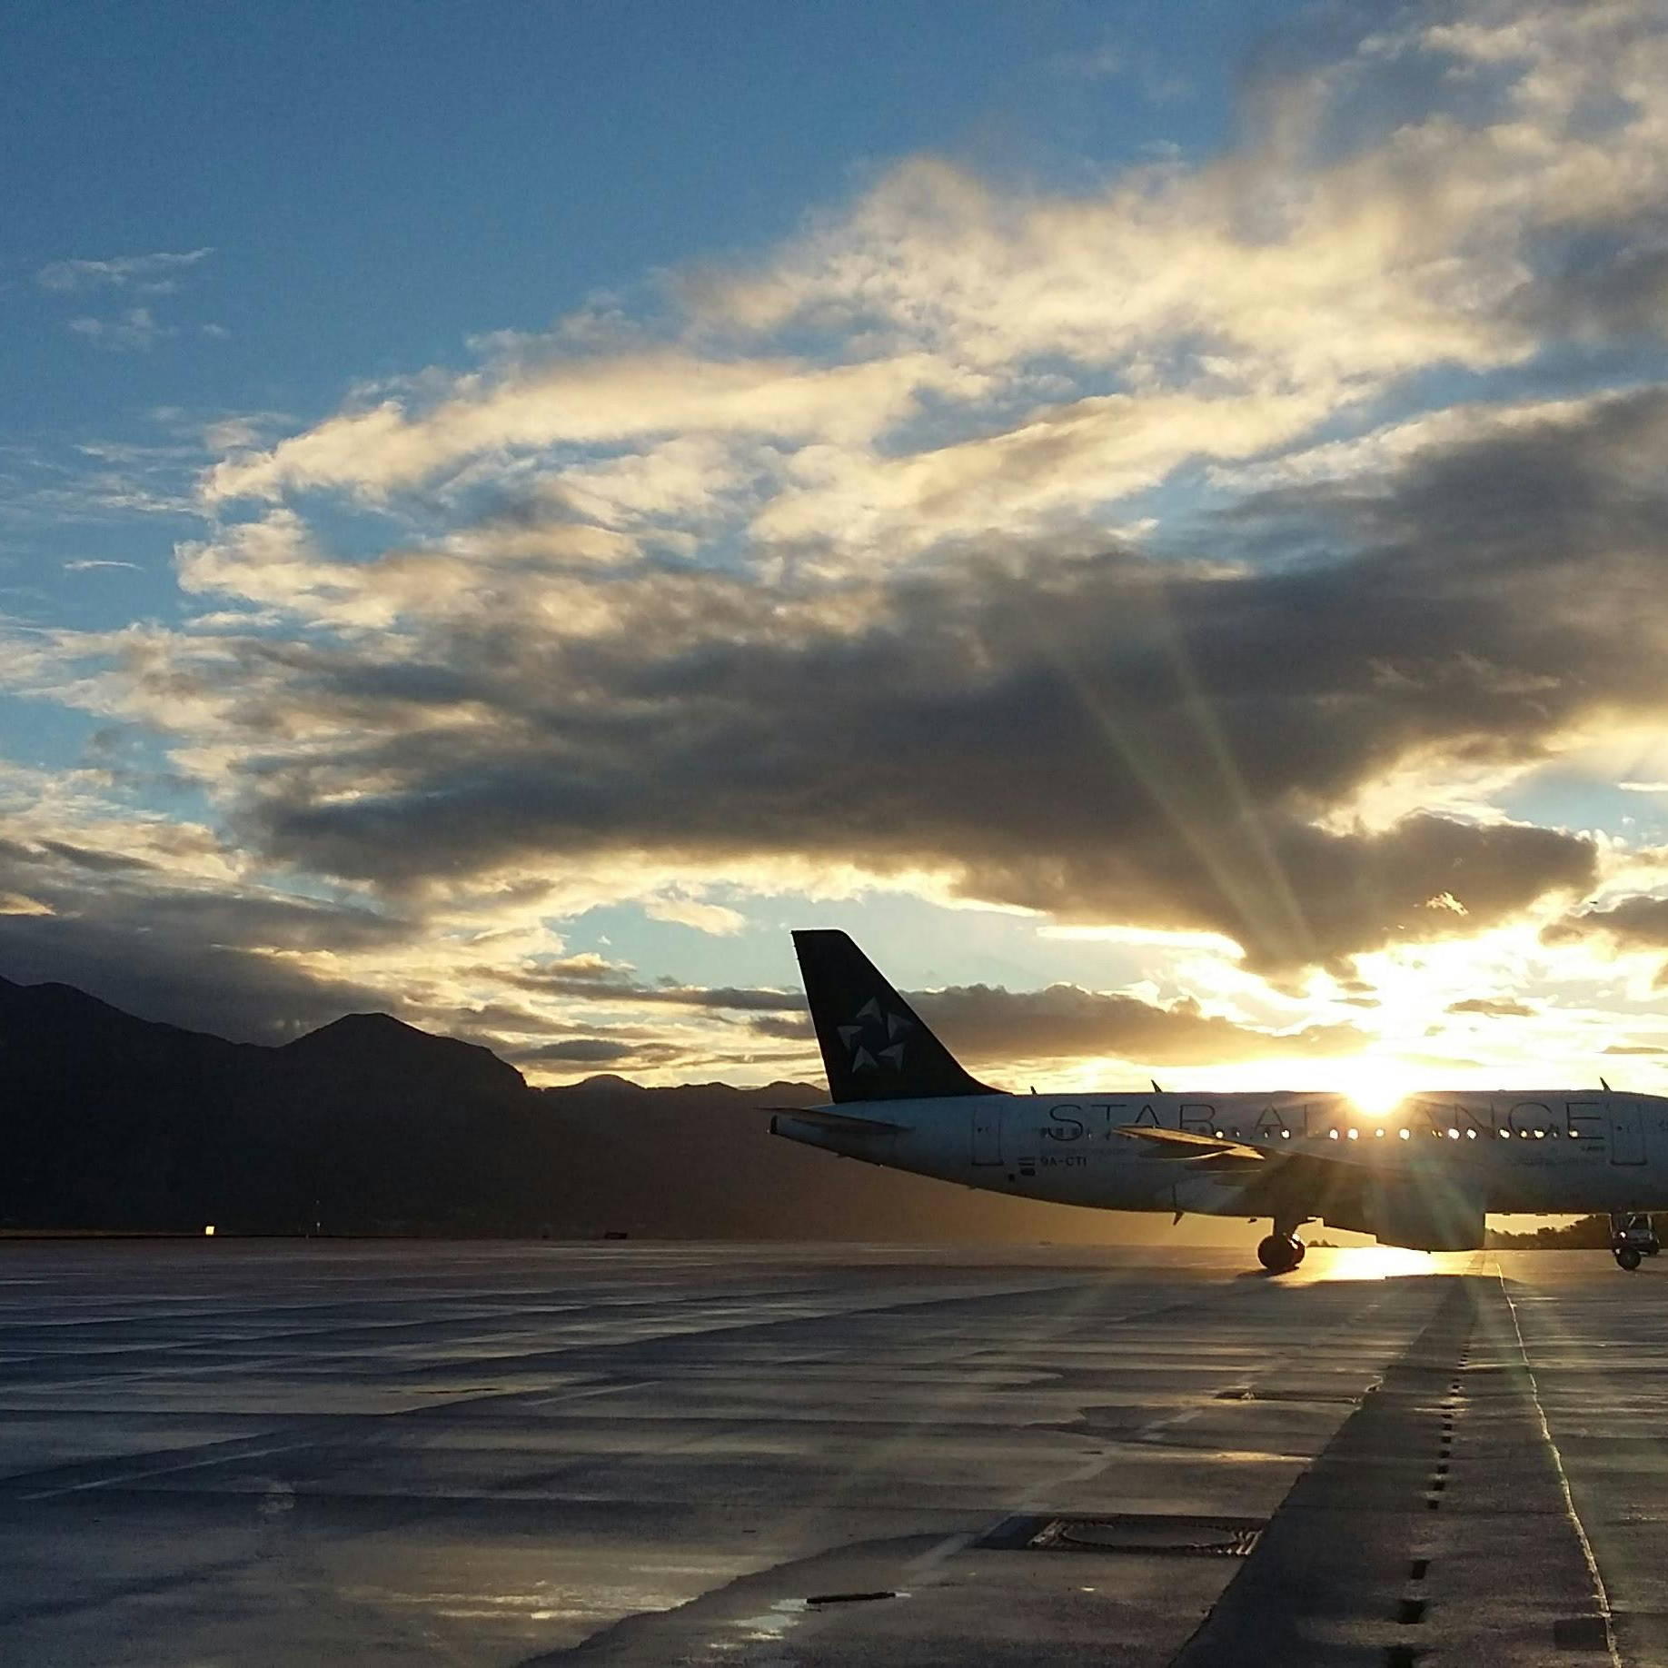
“ The worst form of business is one that grows rapidly, requires significant capital to engender the growth, and then earns little money. Think Airlines ” Warren Buffet

Slide 4
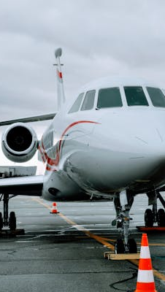
Industry Overview
The airline industry is one of the riskiest businesses in the world.
Huge capital outlays to acquire Aircraft
High maintenance costs to comply with the stringent safety standards, landing fees, parking and hanger costs.
Strong labor unions that increase cost of employment
The main commodity - fuel and oil is affected by various geopolitical factors increasing risks

Slide 5
Not all is gloom!
With strategic cost cutting measures and a customer centric business model, some airlines have achieved success where others have failed.
One of these companies is the Southwest Airlines, one of the most success airline businesses in the USA.
Its unique business model is based on keeping costs low by flying only one type of plane, makes maintenance and training easier, and by using a point-to-point system reducing the need for expensive airport infrastructure enabling it to offer flights for shorter routes with very few connecting flights.
Their customer centric culture and speed of execution (e.g. pilots helping in bag and cabin clearance) ensures quick plane turn around, more revenue and reduced costs.
This is the model my company need to emulate, and my task is to recommend the safest aircraft(s) make and model for deployment.

Slide 6
Data Set & Methodology
The analysis is based on the National Transportation Safety Board (NTSB) aviation accident database, which contains civil aviation accident and incident data from 1948 to 2023. The dataset covers the United States, its territories, and international waters. https://www.kaggle.com/datasets/khsamaha/aviation-accident-database-synopses
The dataset covers various aspects of accidents/incidents like flight stage, damage extent, location (latitude/longitude), flight purpose, fatalities, injuries, and weather conditions.
Aircraft characteristics are also documented, such as make, model, engine type, and number of engines. The dataset includes flight.
A noted limitation is missing or inconclusive values in important columns, like report status (which details if the cause was pilot error or technical failure).
Despite this, the large size of the dataset still allows for reasonable conclusions about safety relationships across different aircraft makes, models, and engine types.
I will use the CRISP-DM methodology and employ various Python libraries like Pandas, Numpy, Matplotlib and Seaborn for data analysis, data cleaning and visualization.

Slide 7
Problem Statement Metric of Success
Using the NTSB dataset, analyze different aircraft makes and models and accident history to provide recommendations to my company on the best make/model (s) for our proposed airline business. Also identify gaps in the data that may limit this analysis and propose a way forward to address those gaps.
Provide three solid recommendations to the Head of aviation to aid in the critical decision of which are the safest airplane makes/models to use in the proposed business and justify my recommendations using data and visualizations.

Slide 8
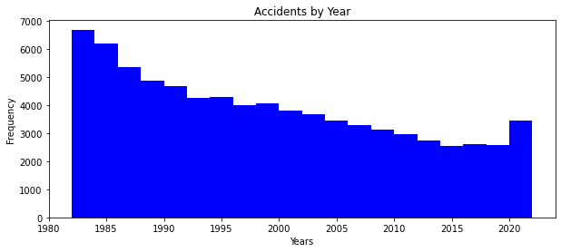
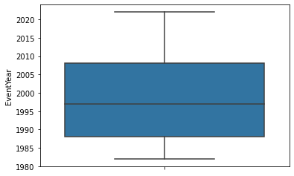
Data Analysis
Timeline of the data
The data shows that accidents progressively decreased in frequency with a surprising peak between 2020 and 2023

Slide 9
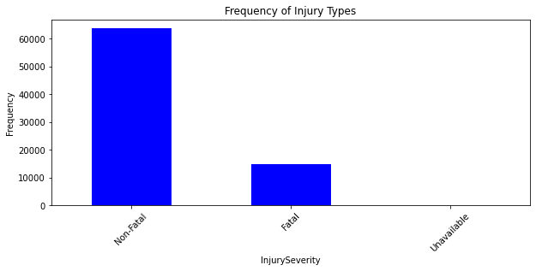
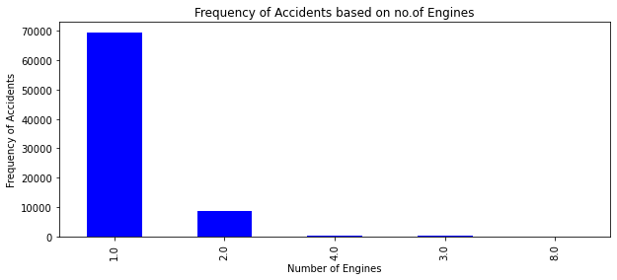
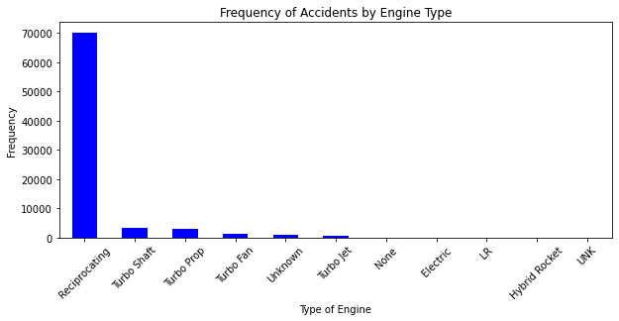
Data Analysis
Most accidents resulted in no fatalities – meaning air tavel is relatively safe.
Aircraft with reciprocating engines are the most unsafe.
Aircraft with 3 or more engines are the safest

Slide 10
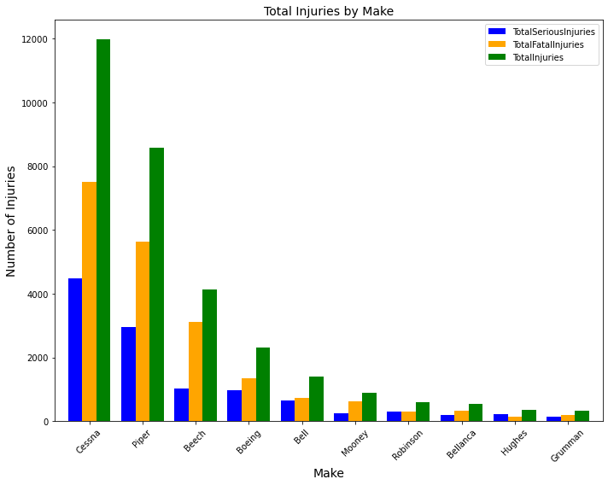
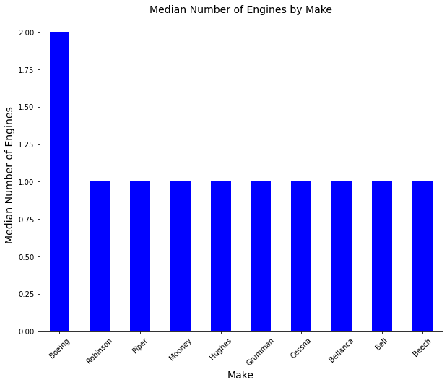
Determining the Safest Models (1)
To sharpen our analysis, I assessed the top 10 models against various safety parameters
Based on data on fatal and serious serious injuries, Cessna, Piper and Beech were the most dangerous models.
Boeing has the highest median number of Engines of all the top 10 models

Slide 11
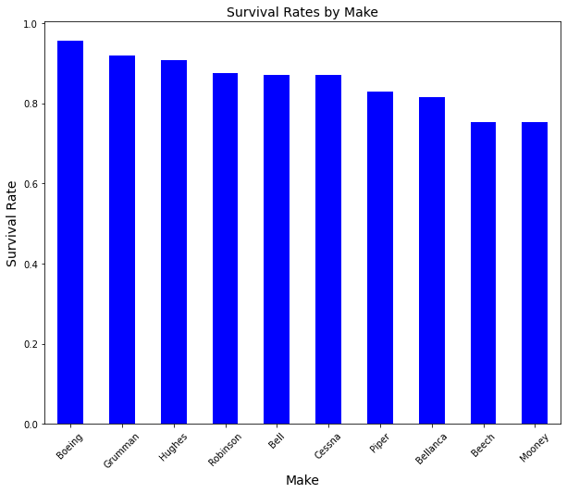
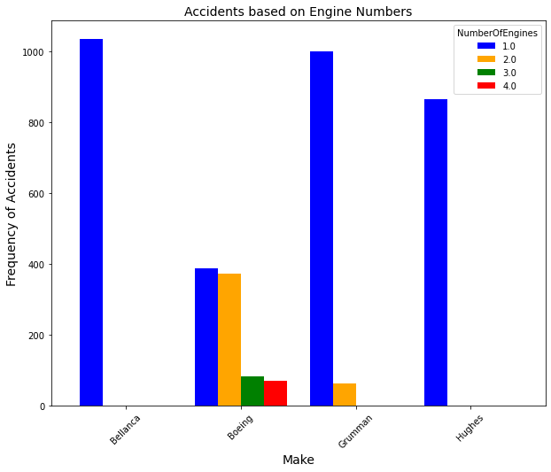
Determining the Safest Models (2)
Boeing, Grumman, Hughes and Robinson have the highest average survival rate.The survival rate reduces the bias of the no. of passengers that an aircraft can hold. Bigger airplanes will have more casualties when an accident occurs.
Assessing the frequency of accidents of the 4 models against no. of engines, Boeing has the least frequency of accidents We can conclude that the safest make is Boeing and the models with the best safety records are those with 3 and 4 engines.

Slide 12
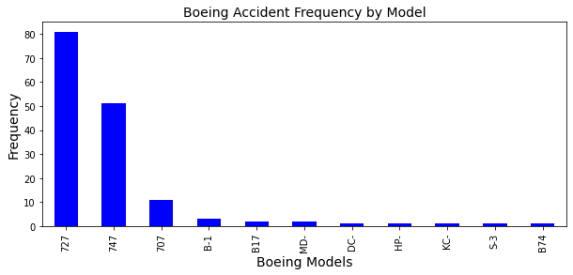
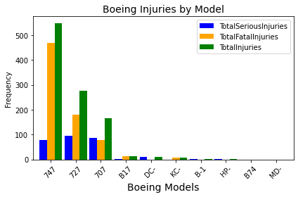
Determining the Safest Models (3)
This analysis only contains those Boeing Models with 3 or more engines.
The main Boeing Models are the 747, 727, and the 707. The other models such ad DC-10, B17 and B1 are either military planes and/or no longer in the market.
However, comparing the number Boeing's accidents for models with 3 engines and above(155) with the total accidents in the AviationData_Clean (over 78K), it is correct to say that Boeing Models are overall safe, and the company should consider Boeing as the make and chose the above models based on the level of usage e.g. no. of passengers, distance covered, maintenance costs etc.

Slide 13
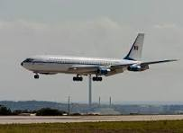
Recommendations
Comparing the number of Boeing’s accidents for models with 3 engines and above(155) with the total accidents in the cleaned dataset (over 78K), it is correct to say that Boeing is the safest Make.
The safest model overall from the dataset is Boeing 707. However, based on the intended use and range e.g.no. of passengers, distance covered, maintenance costs etc., the 747 and 727 models are still a safe option.
The company should not invest in any aircraft with less than 3 engines and /or with reciprocating engines as those have been determined to be unsafe according to the data.

Slide 14
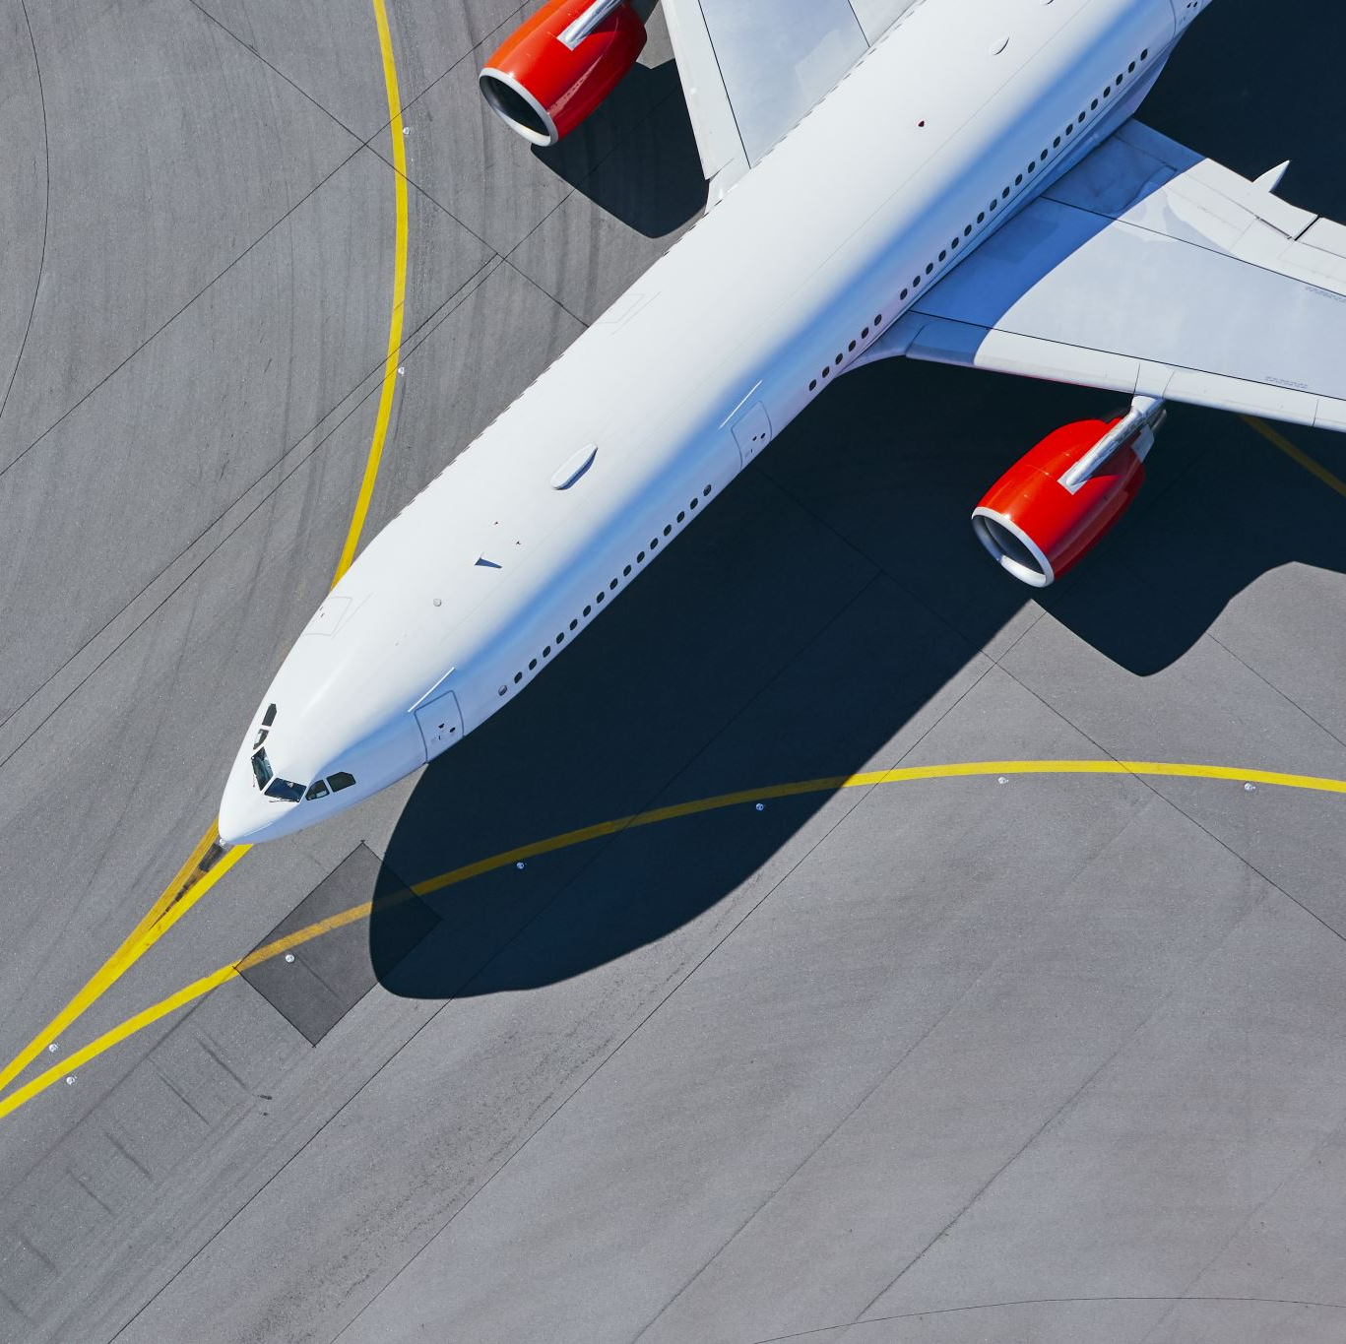
Next Steps
Perform further analysis of data available for all Boeing Makes and Models in operation .Data to answer the following questions:
Safety Record
Cost of Equipment
Cost of Maintenance
Range
Maximum no. of Passengers and Crew
This coupled with competitor and market analysis, customer preferences ,financial models, will help the company make the best decision on the mix and size of the fleet that will yield the best return on investment.

Slide 15
Thank you
Wambui Munene
ICFO Global Advisory
+254 722 629364
Wambui@icfoglobal.com

