Slide 1

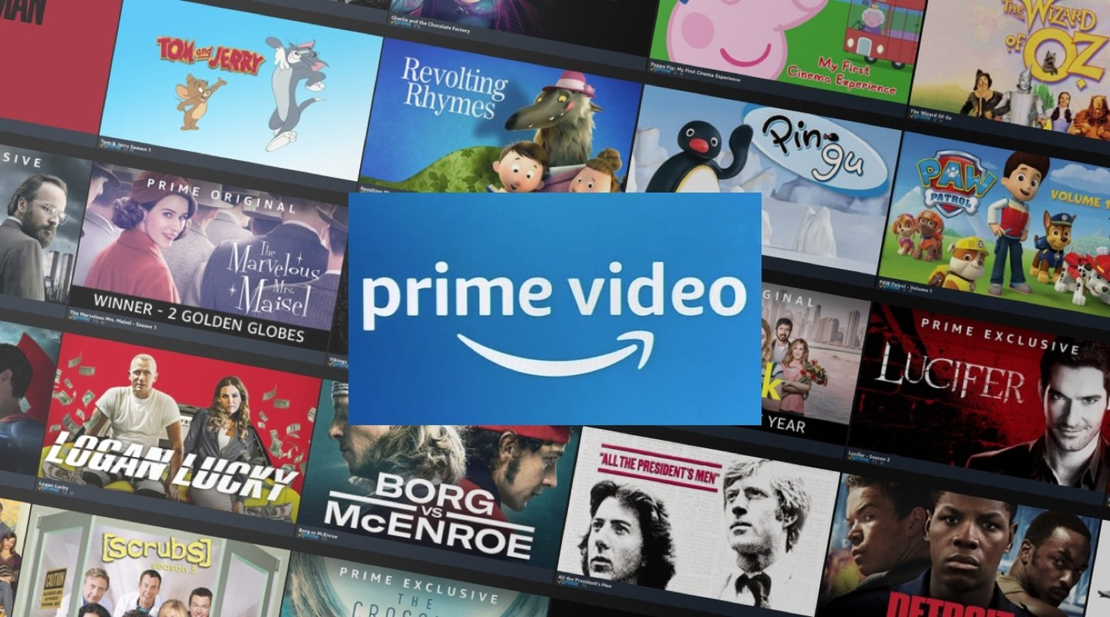
What Say You? A Amazon Prime Viewers’ Sentiment Analysis

Slide 2


PROBLEM STATEMENT
The challenge
The film industry is highly reviewed industry and from the reviews, they advise the next and viable options for investments and re-investment in the industry
Project Goal
The goal is to derive valuable insights into user sentiment, and addressing patterns of positive, neutral, and negative feedback. Understanding sentiment trends can help uncover critical insights into customer satisfaction and areas for improvement.

Slide 3


OBJECTIVES
Understanding Customer preferences
By analyzing reviews, Amazon Prime Video can identify specific content genres, themes, or features that audiences love or dislike. For instance, if a series receives overwhelmingly positive feedback for its storyline or casting, they can prioritize producing similar content.
Improving content quality
Feedback from negative sentiment can pinpoint areas of dissatisfaction, such as weak storylines, poor production quality, or technical issues. This information allows Prime Video to improve its offerings and avoid repeated mistakes.
Targeted Marketing Strategies
Positive sentiment analysis can help identify which content resonates most with users. These insights can guide marketing campaigns, focusing on promoting highly-rated shows and movies to attract new users and retain existing ones.

Slide 4



VISUALIZATION

Slide 5
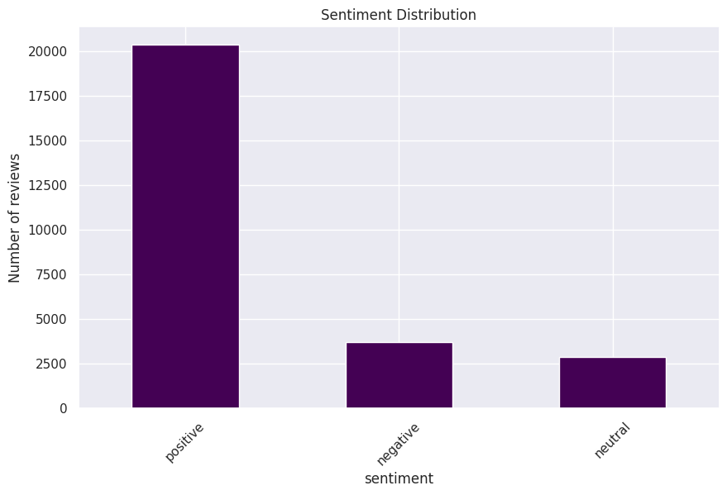


- Positive Reviews dominate, with significantly more reviews in this category (over 20,000). This suggests a strong leaning toward positivity in the dataset.
- Negative Reviews are far fewer, numbering around 3,000. This indicates fewer people expressed negative sentiments.
- Neutral Reviews are the least frequent, with around 2,500 reviews. This suggests a smaller portion of reviews are neither strongly positive nor negative.
This class imbalance could have implications for sentiment analysis, such as potential biases in a predictive model if the imbalance isn't addressed. Addressing these imbalances (e.g., via resampling, weighting, or other methods) will be considered during modeling.

Slide 6
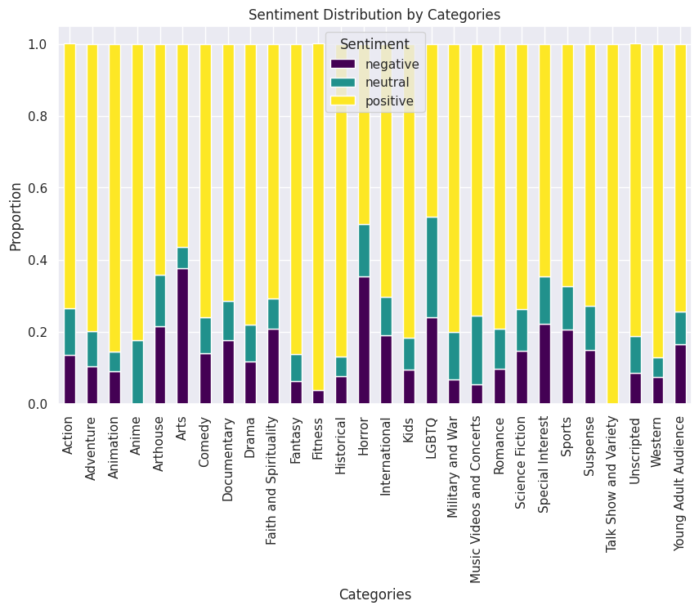

Key Insights
Audience Preferences: Categories like Animation, Kids, Fantasy, Fitness, Historical, Talk-show and Western are highly favored, while genres such as Horror and Arts often elicit critical feedback.
Balanced Reception: Categories with higher neutral sentiment, such as LGBTQ and Music content, suggest these genres may attract more nuanced reactions.
Categories with higher negative sentiment could benefit from analyzing specific user feedback to address shortcomings.

Slide 7
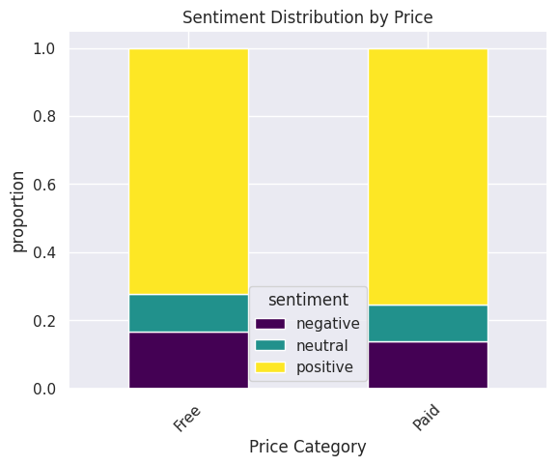
Both free and paid content have the highest proportion of positive sentiment, showing that users generally express more favorable opinions, regardless of whether the content was free or paid.
Negative sentiment appears slightly more in free content, possibly reflecting dissatisfaction with expectations when the content is free or of lower quality.

Slide 8

Modelling

Slide 9

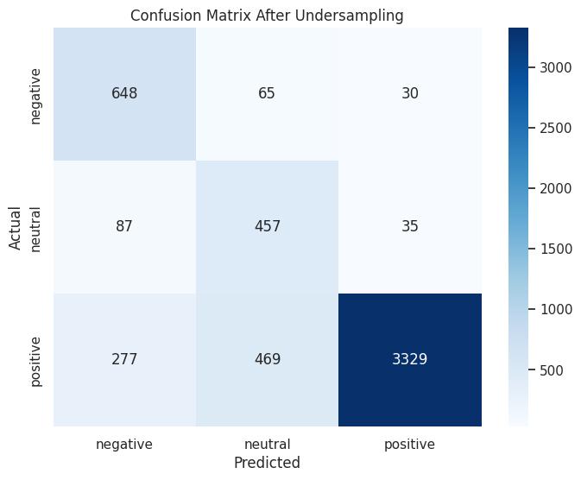

Slide 10


Positive Class
Precision: Slight improvement (`0.97 to 0.98`) after under-sampling, meaning there were fewer false positives.
Recall: Decreased slightly (`0.84 to 0.82`), indicating that the model captured slightly fewer true positives from the positive class after under-sampling.
The under-sampling caused a small trade-off in recall but improved precision.
F1-score: A minor drop (`0.90 to 0.89`), reflecting a balance between precision and recall.
Neutral Class
- Precision: Improved marginally (`0.43 to 0.46`).
- Recall: Significant improvement (`0.67 to 0.79`), meaning the model performed better at identifying true neutral instances post-under-sampling, a significant boost in recall.
- F1-score: Noticeable improvement (`0.53 to 0.58`).
Negative Class
- Precision: Slight improvement (0.63 to 0.64).
- Recall: Improved significantly (from 0.81 to 0.88), showing better identification of true negatives after under-sampling.
- F1-score: A minor improvement (from 0.71 to 0.74).
Overall, while accuracy stayed constant at 82%, the macro average scores improved, highlighting better balance across classes. This is especially critical when addressing class imbalance.
The under-sampling approach prioritized fairness across classes, slightly sacrificing performance on the majority class (positive) for better results in the minority classes.

Slide 11
Deep Dive into Positive Sentiment Drivers
- Perform in-depth analysis of positive sentiment drivers (e.g., genres, titles, or features) to maintain and replicate customer satisfaction strategies.
- Use topic modeling or keyword extraction to gain actionable insights into areas driving each sentiment class.
Actionable Insights from Negative Sentiment
- Identify and prioritize recurring themes or features associated with negative feedback (e.g. story lines, character development etc, streaming quality etc ).
- Work with relevant teams to address these pain points (e.g., refreshing the content library or improving user interface).
Boost Personalization Algorithms
- Incorporate sentiment insights into recommendation models to suggest content based on user sentiment patterns.
- Optimize for scenarios where users with negative feedback can receive tailored suggestions to re-engage them with the platform.
Visualize Sentiment Trends
- Develop dashboards to track sentiment trends over time, segmented by categories (e.g., genres, regions, or demographics), enabling data-driven decision-making.

Slide 12

THANK
YOU!

