Slide 1


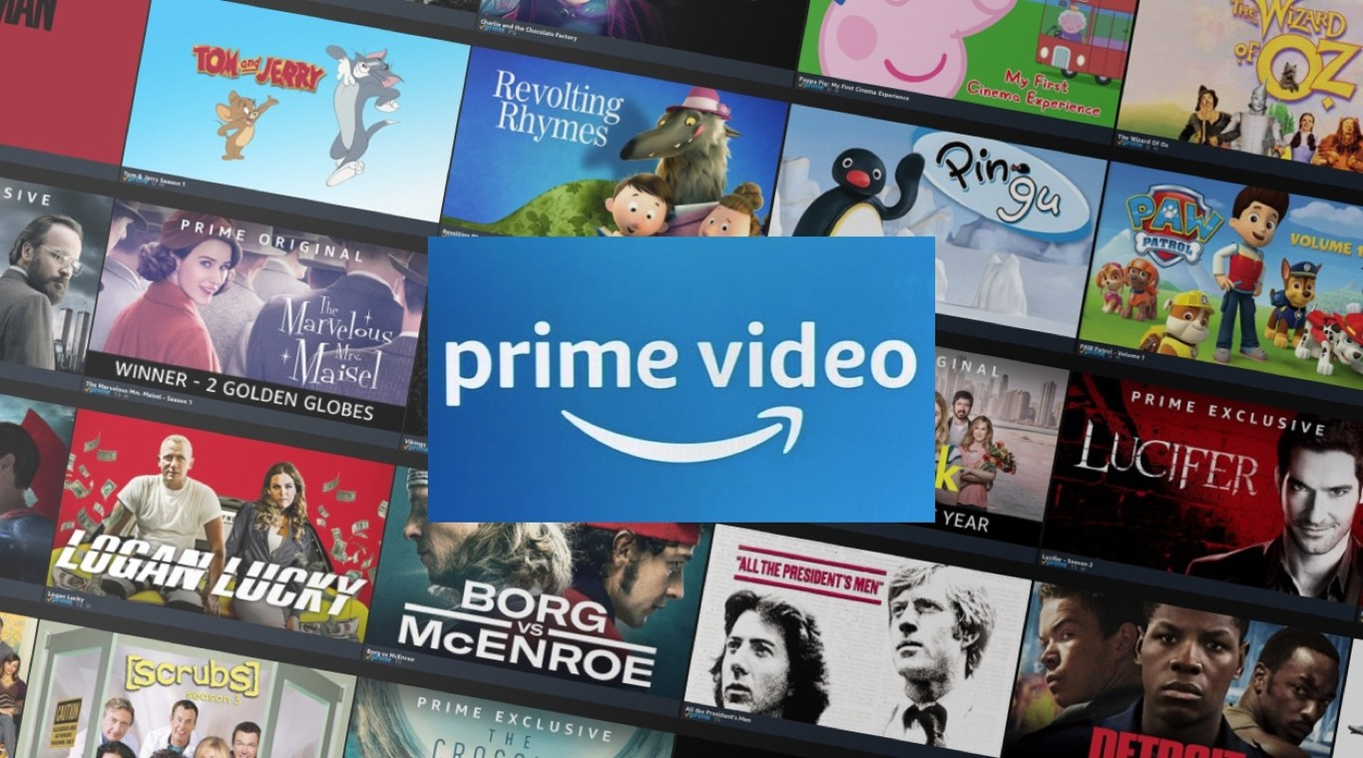
What Say You?
An Amazon Prime Video Sentiment Analysis

Slide 2


PROBLEM STATEMENT
The Challenge
The streaming industry is highly competitive. The challenge is maintaining and growing subscribers while delivering content tailored to audience preferences.
Project Goal
The goal is to derive valuable insights into user sentiment, and addressing patterns of positive, neutral, and negative feedback. Understanding sentiment trends can help uncover critical insights into customer satisfaction and areas for improvement.

Slide 3


OBJECTIVES
Understanding Customer preferences
By analyzing reviews, Amazon Prime Video can identify specific content genres, themes, or features that audiences love or dislike. For instance, if a series receives overwhelmingly positive feedback for its storyline or casting, they can prioritize producing similar content.
Improving content quality
Feedback from negative sentiment can pinpoint areas of dissatisfaction, such as weak storylines, poor production quality, or technical issues. This information allows Prime Video to improve its offerings and avoid repeated mistakes.
Targeted Marketing Strategies
Positive sentiment analysis can help identify which content resonates most with users. These insights can guide marketing campaigns, focusing on promoting highly-rated shows and movies to attract new users and retain existing ones.

Slide 4



Visualization

Slide 5
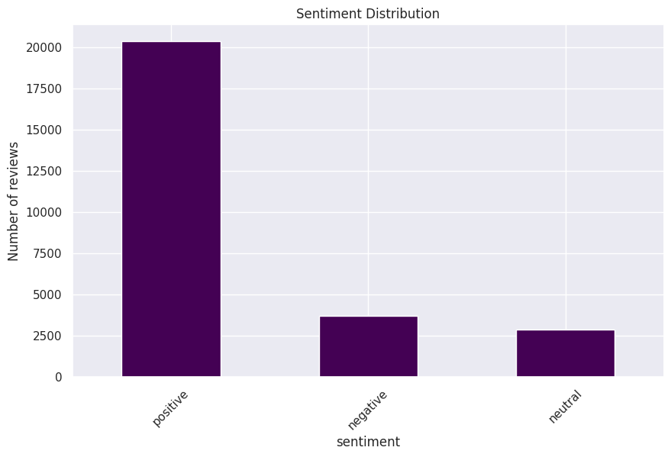

Positive Reviews The overwhelming dominance of positive sentiments suggests that most viewers are highly satisfied with Prime Video's content
Negative Reviews are far fewer; delving deeper into this category provides key feedback to identify specific pian points and enhance overall user experience.
Neutral Reviews while the least pose a unique challenge as well as opportunities. While they lack emotional intensity, they provide significant insights that can be deciphered by taking a deep dive on the specificities, tone and nuances.
Identifying specific aspects for each sentiment – such as content quality, streaming experience, story lines, can go along way in leveraging sentiment analysis to address key pain points, prioritize areas for improvement and develop targeted solutions

Slide 6
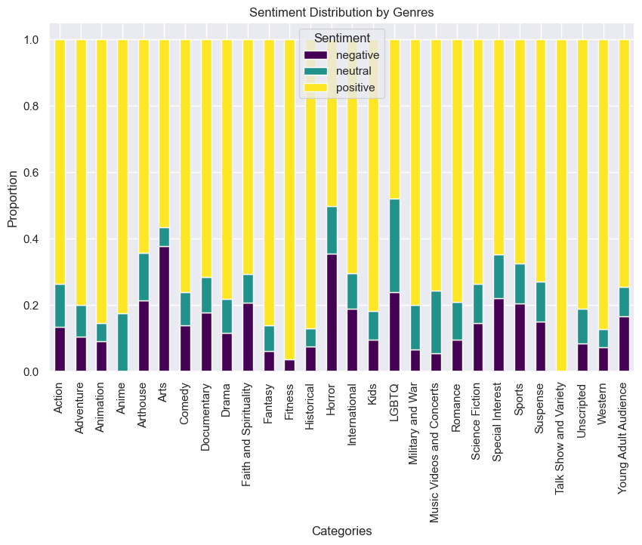

Key Insights
Audience Preferences: Categories like Animation, Kids, Fantasy, Fitness, Historical, Talk-show and Western are highly favored, while genres such as Horror and Arts often elicit critical feedback.
Balanced Reception: Categories with higher neutral sentiment, such as LGBTQ and Music content, suggest these genres may attract more nuanced reactions.
Categories with higher negative sentiment could benefit from analyzing specific user feedback to address shortcomings.

Slide 7
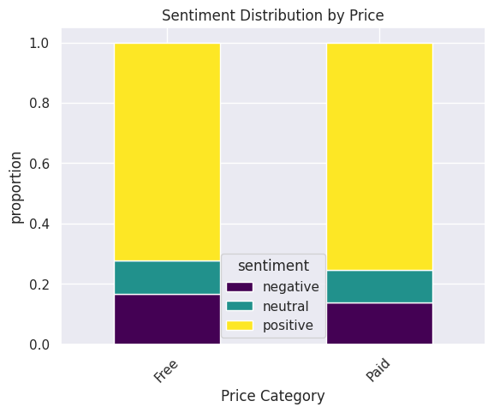
Both free and paid content have the highest proportion of positive sentiment, showing that users generally express more favorable opinions, regardless of whether the content was free or paid.
Negative sentiment appears slightly more in free content, possibly reflecting dissatisfaction with expectations when the content is free or of lower quality.

Slide 8

Modeling & Evaluation

Slide 9
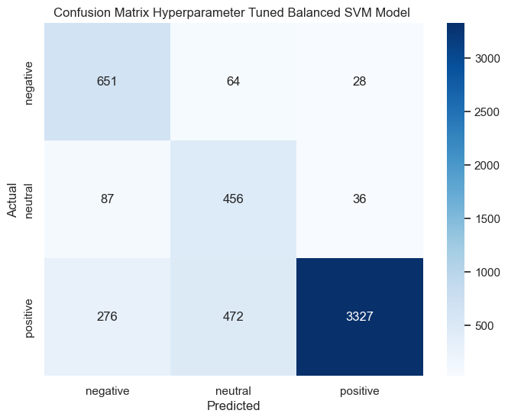
The Modeling Process
Choice of Models We trained models that are known to perform well in Natural Language Processing (NLP) tasks such as Sentiment Analysis. In this project, we trained Multinomial Naïve Bayes (NB), Support Vector Machine(SVM) and Random Forest (RF) models.
Iterative Process We trained the baseline models, evaluated the results and obtained the best baseline model- SVM. The best baseline was then taken through an optimization training process, until we got the best results from the validation data.
Model Optimization The SVM model was optimized using Machine Learning techniques – hyperparameter tuning (finding the best parameters) and class balancing – to reduce the bias of the majority positive class.
Model Evaluation We evaluated the models using various parameters such as confusion matrix, accuracy, recall (how well a model identifies true positives - the percentage of items that the model classifies correctly as belonging to a specific class)

Slide 10

Positive Class
The positive class included viewers who rated the content 4 or 5 stars. Our top-performing model accurately identified 3327 out of 4075 positive reviews, achieving a recall rate of 82%. However, 472 reviews were misclassified as neutral, while 279 were incorrectly labelled as negative. Such misclassification is expected in sentiment analysis, as neutral reviews often contain language with both positive and negative tones
Neutral Class
This class represent viewers who rated the content with 3 stars. Neutral class is often the most challenging to classify accurately. Our top-performing model correctly classified 456 out of 579 neutral reviews, achieving a recall of 79%. However, misclassifications were predominantly skewed towards the negative class (87 instances) compared to the positive class (36 instances). This trend suggests that viewers giving moderate ratings often leaned towards negative tones in their feedback
Negative Class
This class represent viewers who rated the content 1 or 2 stars. The model was able to identify 651 out of 743 reviews correctly a recall rate of 87%. Being able to identify negative sentiments is the main goal of a sentiment analysis and this model performed well on this class. 64 samples were mislabeled as negative wile only 28 were mislabeled as positive.
Overall
The model showed varied performance across sentiment classes. Negative sentiment had a recall of 87%, with occasional confusion between neutral and positive reviews. Neutral sentiment was harder to classify, achieving a recall of 78% due to subtle cues. Positive sentiment recall was 82%, with some misclassifications. Overall accuracy was 82%, indicating effectiveness but revealing challenges in generalizing across nuanced tones, especially for neutral reviews.

Slide 11

Recommendations

Slide 12
Leverage Positive Feedback and Popular Genres
Analyze positive sentiment drivers to identify and replicate effective strategies.
Showcase popular genres prominently, such as Animation, Kids, Fantasy, and more
Invest in original content within these favoured categories to sustain engagement and expand the audience
Address Negative Feedback
Identify and prioritize recurring themes or features associated with negative feedback (e.g. story lines, character development , streaming quality etc. ).
Focus on the most critical pain points that impact overall viewer experience. Use metrics like frequency of mentions or intensity of dissatisfaction to determine priority areas.
Collaborate with seasoned creators to develop fresh, engaging content that revitalizes these genres.
Refine Neutral Segment Categories
Categorize the neutral specific themes, such as content quality, casting, genre preferences, technical issues
Analyze the reasons behind neutral sentiment for genres like LGBTQ and Music. Look for patterns such as unrelatable content or lack of representation.
Develop programming that aligns with audience expectations—for example, content with authentic stories or introducing fresh concepts in Music, like concert documentaries or artist-focused series.
Boost Personalization Algorithms
Develop dashboards to track sentiment trends over time, segmented by categories (e.g., genres, regions, or demographics), enabling data-driven decision-making.
Incorporate sentiment insights into recommendation models to suggest content based on user sentiment patterns.
Optimize for scenarios where users with negative feedback can receive tailored suggestions to re-engage them with the platform.

Slide 13

Next Steps

Slide 14
Advanced Modeling Techniques
Explore advanced NLP models like LSTMs, BERT or GPT for real-time sentiment updates and granular analysis.
Aspect-Based Sentiment Analysis – Identify sentiment for specific aspects (e.g., content quality, streaming experience).
Emotion Detection – Extend sentiment analysis to classify emotions like joy, anger, and frustration.
Personalized Recommendations – Suggest movies/shows based on sentiment and user preferences.
Model Deployment and User Interface
For real-time sentiment analysis, use an API like a Flask-based API to support smooth integration of the trained sentiment analysis model, enabling it to handle incoming data efficiently.
To ensure scalability, deploy the API on the Amazon Cloud
Secure the API by incorporating authentication and data encryption measures.
Develop a user-friendly interface that can interact with the model and optimize it across devices, desktops, tablets, and mobile phones, ensuring it caters to diverse user needs.
Visualize Sentiment Trends
Develop dashboards to track sentiment trends over time, segmented by categories (e.g., genres, regions, or demographics), enabling data-driven decision-making.

Slide 15

THANK YOU!
Edwin George
Nelima Wanyama
Moses Musyoki
Spencer Lugalia
Wambui Munene

