Slide 1

Machine Learning Classification Model to Predict Customer Churn Recommendations to SyriaTel on Customers’ features that contribute to Churn

Slide 2

Contents
Overview
Business and Data Understanding
Modelling
Evaluation
Recommendations
Next Steps

Slide 3

Industry Overview
This project examines a dataset from SyriaTel, a telecommunications company with the aim of using classification prediction modelling, to predict the likelihood of a customer ceasing to do business with the company within a given period (churn)
Acquiring new customers involves huge marketing costs, that include huge advertising budgets and commissions to sales agents. It therefore becomes imperative to retain those customers once they are acquired.
It is the motivation of every telco company to understand the features or characteristics of a customer who is likely to 'churn’.
With this understanding, the company can get ahead of the problem and develop initiatives that target these specific customers to discourage them from ceasing doing business with the company.

Slide 4
Business and Data Understanding
The SyriaTel data set consist of straightforward and well formatted data and is available on https://www.kaggle.com/ It has customer usage (minutes/number of calls), customer choices of premium services columns, as well as other customer features like location, area code, phone number and account length https://www.kaggle.com/datasets/becksddf/churn-in-telecoms-dataset .
SyriaTel is intentional about reducing the high cost of churn. With this Model, their Data Analytics, Marketing and Revenue Assurance departments will be able to:-
Identify the customer characteristics (features) that have the most impact on churn.
Use the best model identified from the modelling iterative process test future customers' data to predict the likelihood of a customer leaving the network.
Develop proactive retention strategies specifically targeted to 'at risk' customers to discourage them from leaving the network.

Slide 5
The Modeling Process
Three machine learning algorithms, best suited for a classification problem like SyriaTel’s were trained on the dataset provided. These models are Logistic Regression, Decision Tree and Random Forest.
An iterative process was used on the split dataset with distinct training and test sets. Each of the model is trained on the training set and tested on the test set.
Starting with a baseline model logistic model, the models are systematically optimized with machine learning techniques suitable for each model.
In every step of the iterative modelling process, the following evaluation metrics are used to gauge the performance of each model:-
Accuracy – This metric measures how often the model gets the prediction right
Area Under the Curve(AUC) – This metric measures the ability of the model to distinguish between customers who churn and those who don’t.
ROC (Receiver Operating Characteristic) Curve is a graphical representation used to evaluate the performance of a binary classification model.
The model with the best metrics at the end of the iterative process will be used to predict the likelihood of a customer churn using new customer data, that the model has not seen before.

Slide 6
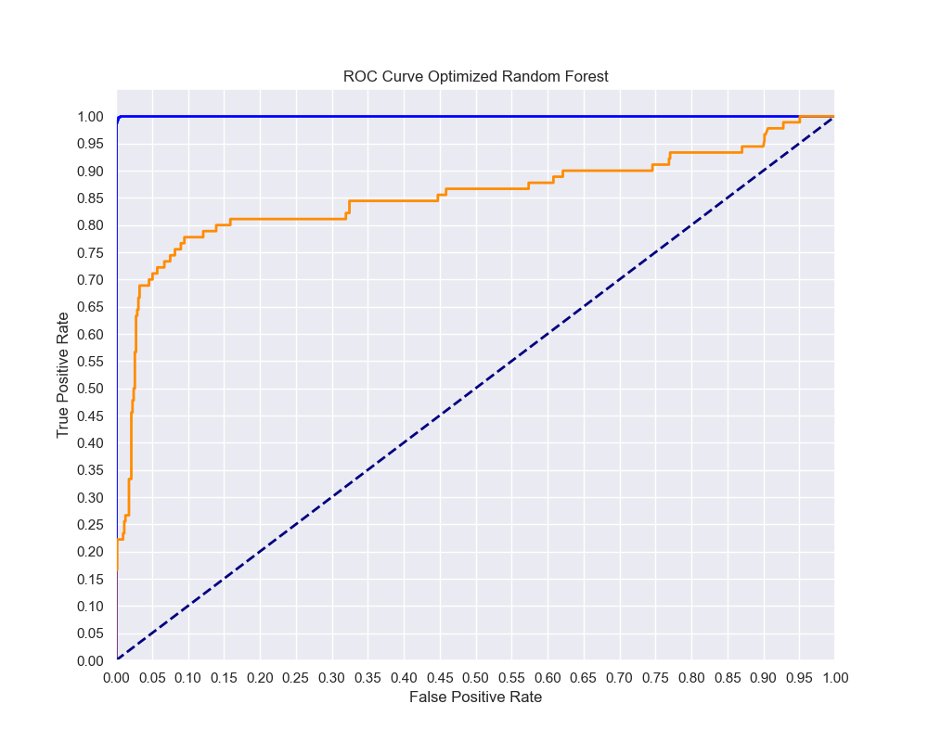
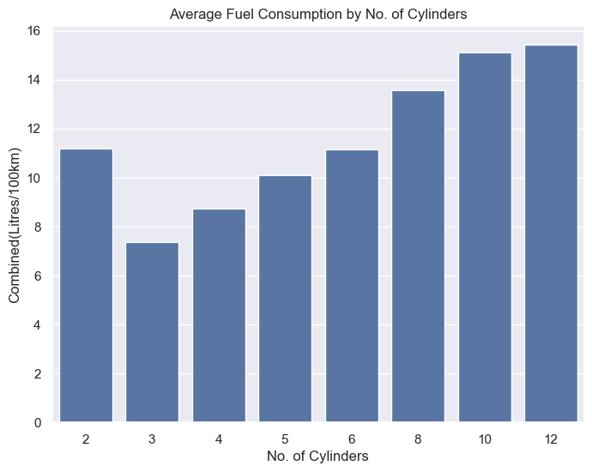
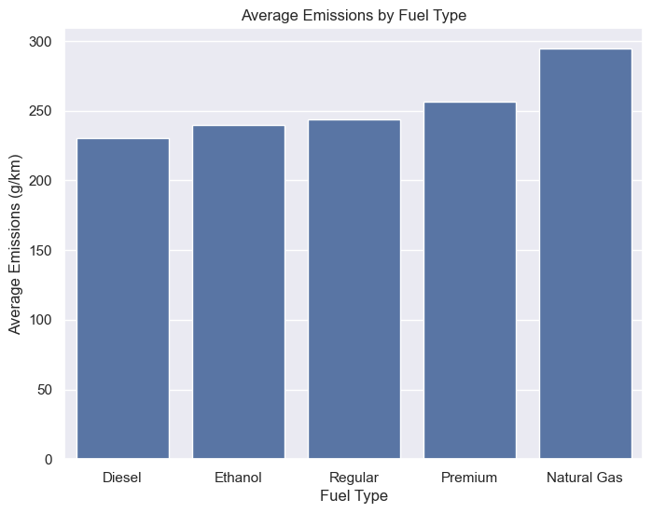
Model Evaluation
Metric | Best Logistic Model | Best Decision Tree Model | Best Random Forest Model
Train Accuracy | 0.83 | 0.95 | 1.0
Test Accuracy | 0.83 | 0.89 | 0.93
Train AUC | 0.90 | 0.99 | 1.0
Test AUC | 0.83 | 0.84 | 0.86
Auto Variable, Manual and Auto Manual transmissions have the best fuel efficiency.
Interesting to note that 2-cylinder vehicles do not necessarily have the best consumption! However, 3-5 cylinders on average give 10 litres per 100 km and below.
Diesel has the lowest average emissions with Natural Gas having the highest. Ethanol and Regular have moderate emissions

Slide 7
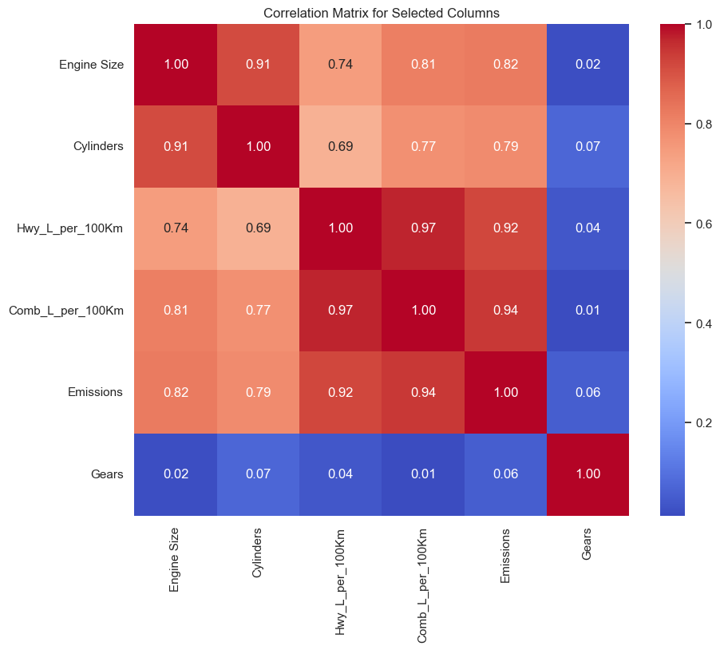
Summary of correlation between various vehicle attributes with 1 as highest and 0 the lowest.
Fuel consumption and emissions are very strongly positively correlated at 0.92 for highway and 0.94 combined highway & City driving
The size of the engine also has a strong positive correlation with both highway driving (0.74) and combined highway and city driving (0.81) fuel consumption and emissions (0.82).
The number of cylinders also show significant positive correlation with both highway and combined fuel efficiency (0.69/0.77) and emissions(0.79).
The number of gears have almost zero effect on fuel efficiency and emissions.

Slide 8
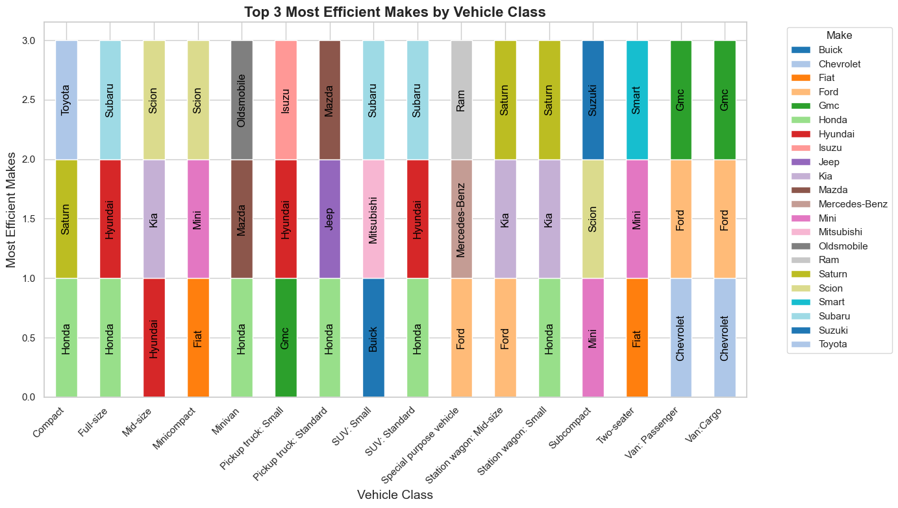
Recommendations
These are the vehicles in each class that give the best fuel economy and have the lowest CO2 emissions.

Slide 9
Recommendations
Vehicles with higher engine sizes affect both fuel economy and CO2 emissions. The smaller the engine the better the efficiency. Cars with cylinders of between 3 and 5 give the best fuel economy. This correlates with a smaller engine size
Where available, go for Auto Variable, Manual or Auto Manual transmission types as they have better fuel efficiency on average. The number of gears do not matter as these have no impact on both emissions and fuel consumption.
Diesel, Ethanol and Regular gasoline fuel types, in that order, have the lowest average emissions.. Natural gas has the highest average emissions, and we strongly advise to avoid models that use this type of fuel.
We have provided a fleet matrix for each Vehicle Class showing 3 Car Makes that have the lowest average fuel consumption and emissions. In choosing the model of the vehicle to buy, consider these vehicle characteristics that impact both fuel efficiency and CO2 emissions.

Slide 10
Thank you
ICFO Global Advisory
info@icfoglobal.com

