Slide 1
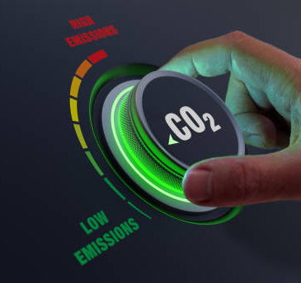
Data Driven Fleet Optimization for Fuel Efficiency and Emissions Reduction Recommendations for budget and eco-conscious vehicle fleet for EcoRentals Limited

Slide 2

Life is better with a full tank and an open road.

Slide 3

Contents
The Car Rental Industry
Problem Statement
Data Set & Methodology
Data Analysis
Recommendations

Slide 4

Industry Overview
The car rental industry is a highly competitive industry in Canada with dominant corporate players like TravelPerk and Hertz.
It requires high capital outlay to acquire a fleet and huge operating costs on vehicle maintenance.
For a start-up in this industry, identification of a niche market is crucial.
Equally important is the choice of cars that appeal to the chosen demographic.
An emerging demographic is young, budget and environmental conscious, that use car hailing services for their day-to-day travel but will occasionally hire vehicles for longer road trips and weekend getaways.

Slide 5

Problem Statement
EcoRentals Limited is a Canadian start-up that is venturing into the car rental business.
Their mission is to provide a low-priced car rental model to cater for a demographic that is price and environmental conscious.
Reduce capital investment and operational overheads by acquiring a fleet that consists of 3 models from each vehicle class. This will enable them get quantity discounts from dealers and reduce operating costs through bulk purchase of spare parts
Analyze different car makes, models for different vehicle classes to determine the most fuel effective models with the least carbon emissions.
Understand the factors that drive determine fuel usage and CO2 emissions

Slide 6
Data Set & Methodology
We have used a dataset from https://www.kaggle.com/ based on original data from https://open.canada.ca/data/en/dataset/98f1a129-f628-4ce4-b24d-6f16bf24dd64. The dataset details fuel consumption and emissions for various makes and models from 2000 to 2022. Using this data set we will:
Investigate car industry insights on fuel consumption, emissions, fuel types, engine sizes, and transmission types.
Analyze the dataset to identify the makes with optimal fuel efficiency and low emissions.
Perform statistical tests to understand how vehicle characteristics like fuel type and engine size influence fuel consumption and emissions.
Provide actionable recommendations for the company to build an efficient, low-emission fleet.

Slide 7
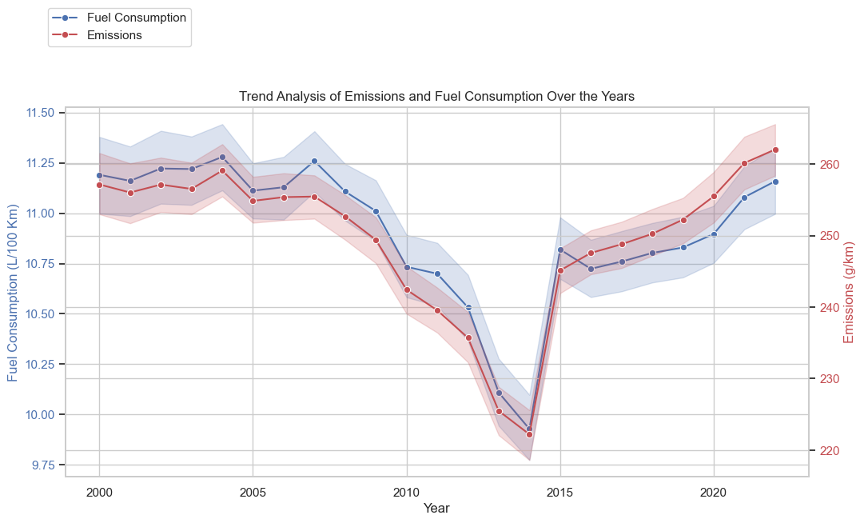
Data Analysis Insights
Trends in Average Fuel Consumption and CO2 Emissions between 2000 and 2022
Both Emissions and fuel consumption averages decreased from 2000 to 2023, then a sharp increase from 2013 to 2015, and a steady rise until 2020
This might be a reflection in policy and regulatory changes that changed over the years.
Canada has now committed to reducing greenhouse gas emissions by 40-45% below 2005 levels by 2030.
We expect to see a fall in the 2variables in the next few years.

Slide 8
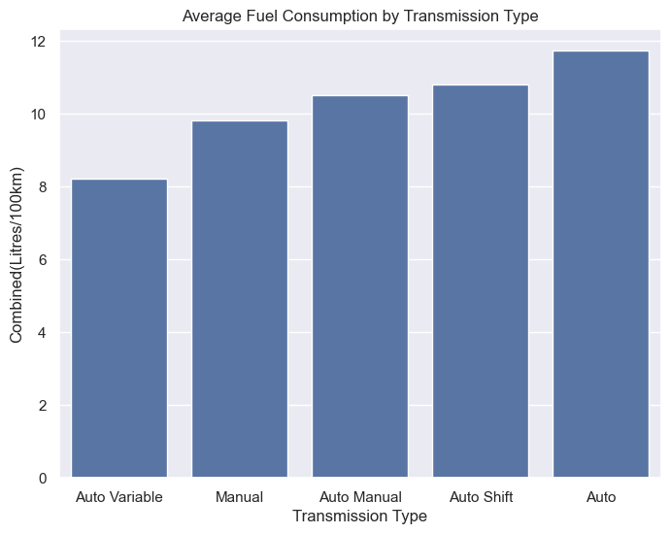
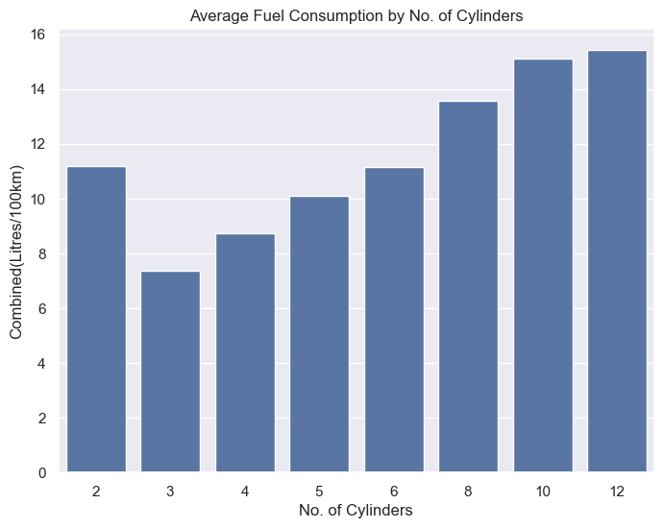
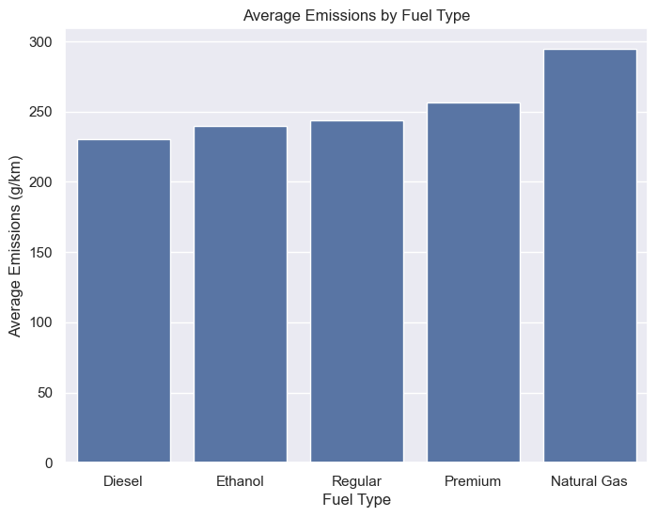
Impact of Transmission Type, Cylinders and Fuel Type on combined highway/city fuel usage and emissions
Auto Variable, Manual and Auto Manual transmissions have the best fuel efficiency.
Interesting to note that 2-cylinder vehicles do not necessarily have the best consumption! However, 3-5 cylinders on average give 10 litres per 100 km and below.
Diesel has the lowest average emissions with Natural Gas having the highest. Ethanol and Regular have moderate emissions

Slide 9
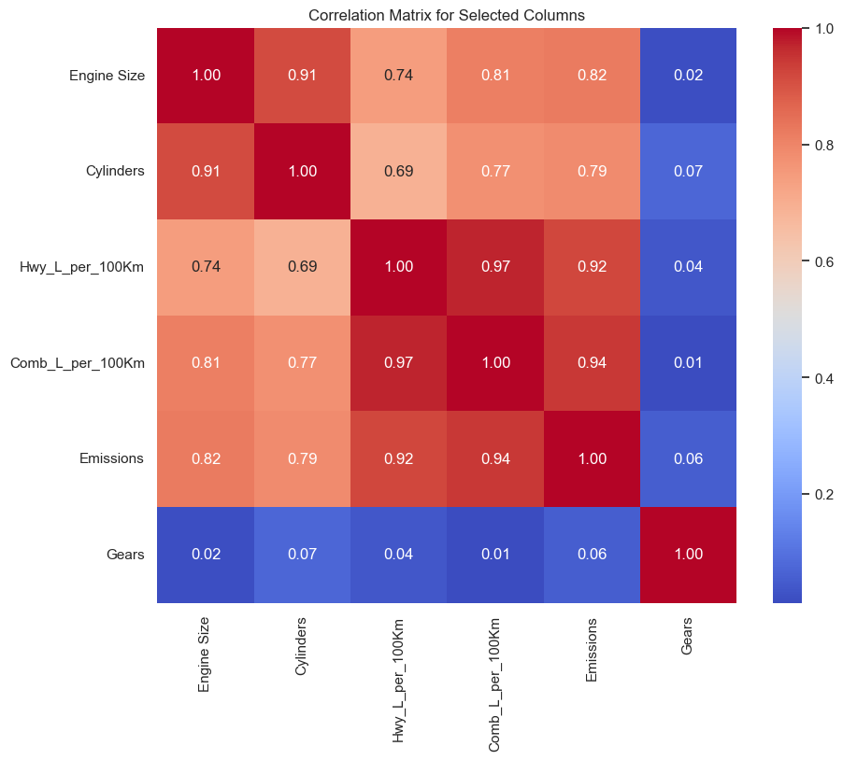
Summary of correlation between various vehicle attributes with 1 as highest and 0 the lowest.
Fuel consumption and emissions are very strongly positively correlated at 0.92 for highway and 0.94 combined highway & City driving
The size of the engine also has a strong positive correlation with both highway driving (0.74) and combined highway and city driving (0.81) fuel consumption and emissions (0.82).
The number of cylinders also show significant positive correlation with both highway and combined fuel efficiency (0.69/0.77) and emissions(0.79).
The number of gears have almost zero effect on fuel efficiency and emissions.

Slide 10
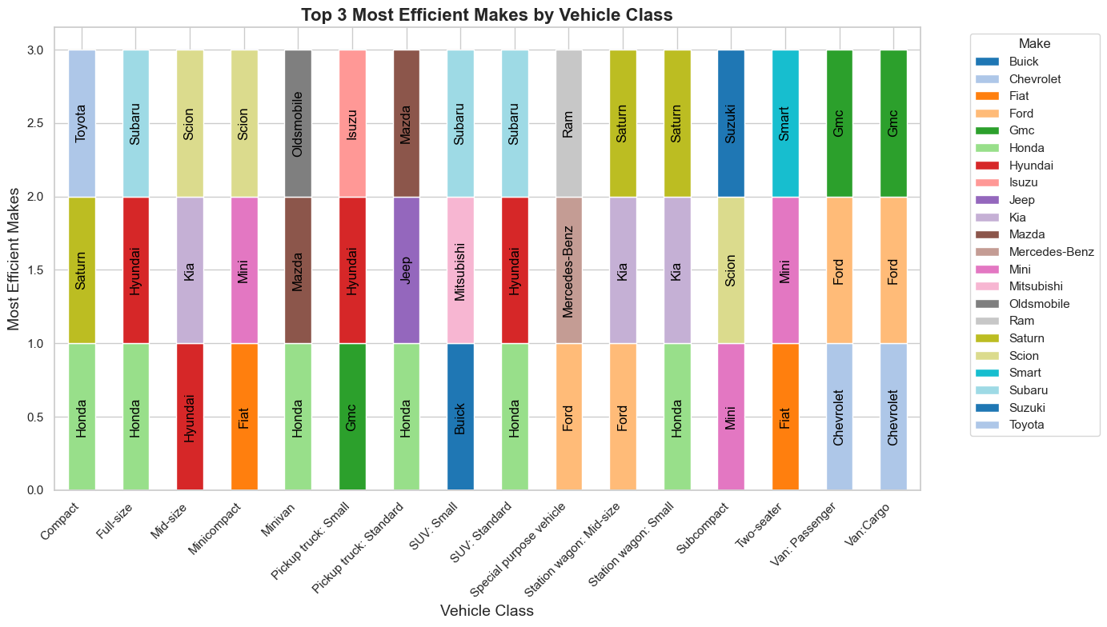
Recommendations
These are the vehicles in each class that give the best fuel economy and have the lowest CO2 emissions.

Slide 11
Recommendations
Vehicles with higher engine sizes affect both fuel economy and CO2 emissions. The smaller the engine the better the efficiency. Cars with cylinders of between 3 and 5 give the best fuel economy. This correlates with a smaller engine size
Where available, go for Auto Variable, Manual or Auto Manual transmission types as they have better fuel efficiency on average. The number of gears do not matter as these have no impact on both emissions and fuel consumption.
Diesel, Ethanol and Regular gasoline fuel types, in that order, have the lowest average emissions.. Natural gas has the highest average emissions, and we strongly advise to avoid models that use this type of fuel.
We have provided a fleet matrix for each Vehicle Class showing 3 Car Makes that have the lowest average fuel consumption and emissions. In choosing the model of the vehicle to buy, consider these vehicle characteristics that impact both fuel efficiency and CO2 emissions.

Slide 12
Thank you
ICFO Global Advisory
info@icfoglobal.com

