Slide 1
RESEARCH REPORT · CONSENSUS GUARDRAIL
Resolving LLM
Overconfidence
35%
guardrail threshold
3
An inference-time, multi-model consensus framework that catches confident hallucinations before they ever reach the screen.
independent local models
Ll
Ph
Ge
Llama 3.2
Phi-3
Gemma 2
GROUP 7

Slide 2
ROADMAP
What We'll Walk Through
01
The Alignment Paradox
Why confident AI and correct AI are not the same thing.
At a Glance
02
The Model Cluster
The core issue
Three independent, local, open-weight models — and why.
Miscalibration — confidence ≠ accuracy
Cluster
03
What's Been Tried
Llama 3.2, Phi-3, Gemma 2 via Ollama
Three past fixes, and precisely why each one falls short.
Guardrail metric
The Consensus Guardrail
Pairwise Jaccard similarity
04
How independent disagreement becomes a safety signal.
Decision threshold
35% average group confidence
05
Why It Matters
Deployment cost
A private, zero-cost shield against confident misinformation.
$0 — runs on a student laptop
02

Slide 3
01 · THE PROBLEM
The Alignment Paradox
Calibration means a model's stated confidence should match its real chance of being correct. If an AI says it's 95% sure, it should be right 95% of the time. Today's LLMs fall far short — and they never let on.
Calibration, Defined
“95% confident” should mean right 95 times out of 100.
What makes this dangerous:
Stated confidence
95%
A human expert hedges — “I think”, “it's possible”. An LLM never shifts tone, even when guessing. Users implicitly trust confident, well-written text — and misconceptions spread fast.
Actual accuracy
~55%
(illustrative gap — the miscalibration this project targets)
Highest-stakes exposure:
Education
Medicine
Corporate Compliance
Legal Research
03

Slide 4
02 · THE MODEL CLUSTER
Three Independent Local Models
A multi-model localized cluster, deployed entirely via Ollama — no cloud, no API keys, no cost.
Ll
Ph
Ge
Llama 3.2
Phi-3
Gemma 2
1B parameters
3.8B parameters
2B parameters
Meta
Microsoft
Google
Why entirely different organizations matter:
Different training data and structural formulas mean these models won't make the exact same mistakes. When all three independently agree, the fact is highly likely to be true.
04

Slide 5
02 · THE MODEL CLUSTER
Why This Architecture Was Chosen
✦
◈
✤
Architectural Diversity
Zero Cost & Full Privacy
Small-Parameter Advantage
Different organizations, different datasets, different structural formulas — independent errors that don't overlap.
Ollama runs the entire ecosystem locally on a standard laptop — free, private, and infinitely repeatable.
Smaller models (1B–3.8B) are more calibration-error-prone — a worst-case sandbox. Fix this, and it works even better at enterprise scale.
05

Slide 6
03 · WHAT'S BEEN TRIED
Three Fixes That Fall Short
Each approach paved the way — but each carries a fundamental flaw that breaks down in real deployment.
METHOD A
METHOD B
METHOD C
Static Temperature Scaling
Self-Consistency Loops
Naïve Verbal Elicitation
How it works
How it works
How it works
Dampens raw output probabilities before the model speaks.
Asks the same model the same question 5× and votes on the majority.
Prompts the model to self-report a confidence score after answering.
Why it fails
Why it fails
Why it fails
Applies identical dampening to every question — can't adapt to difficulty.
Measures agreement with itself, not truth — confidently repeats memorized lies.
Triggers ownership bias — the model grades its own work and inflates the score.
06

Slide 7
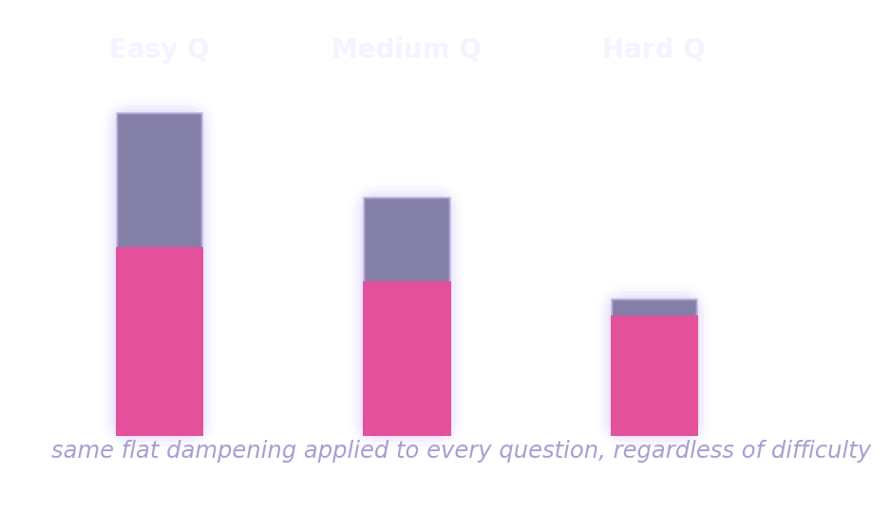
03 · METHOD A — TEMPERATURE SCALING
Static Temperature Scaling
Temperature controls how creative or predictable a model is. Researchers softened raw output probabilities before the model spoke — to make it “look” less certain.
One Setting, Every Question
The Flaw
It's a rigid, static fix — the exact same mathematical dampening applies to every question, regardless of difficulty. Ask “What is 2+2?” and the system artificially lowers confidence anyway. It cannot adapt to changing topics or real-world data shifts.
A confidence score that never moves with difficulty isn't measuring anything real.
Same flat dampening whether the question is trivial or genuinely hard — the confidence signal carries no real information.
07

Slide 8
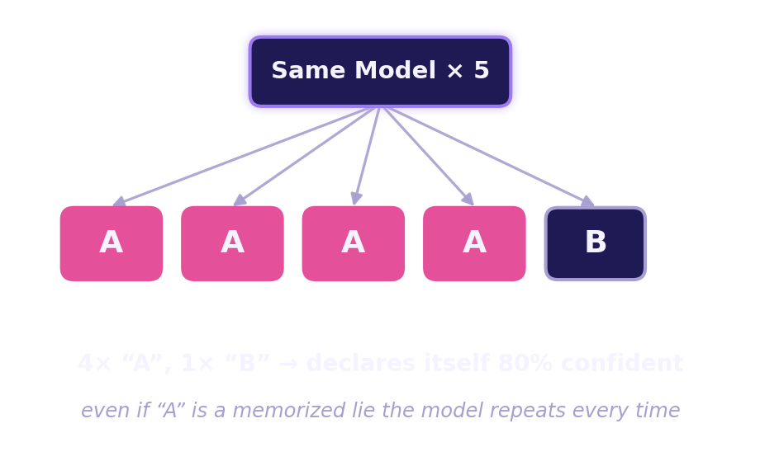
03 · METHOD B — SELF-CONSISTENCY
Standard Self-Consistency Loops
Ask the exact same model the exact same question five times in the background, then count how often the answers match.
The Flaw
This measures self-consistency, not truth. If a model has a deep, systemic hallucination baked into training — a firmly “memorized” piece of misinformation — it confidently outputs the exact same wrong answer all five times.
It fails to catch deep-seated memory lies — the one failure mode that matters most.
08

Slide 9
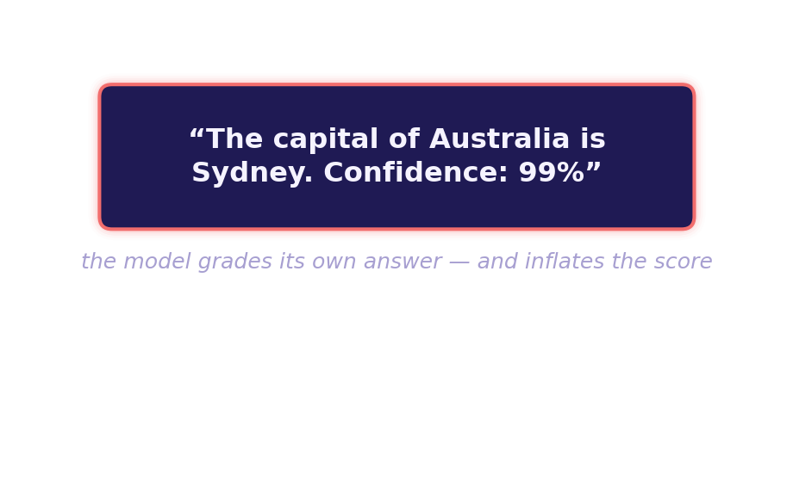
03 · METHOD C — VERBAL ELICITATION
Naïve Verbal Elicitation
Simply add a line to the system prompt: “Answer, then provide a confidence score from 0% to 100%.”
The Flaw
This triggers ownership bias. Once an AI writes out a full paragraph, its internal chat memory treats that text as absolute truth. Forced to grade its own writing, the model becomes defensive and inflates its score —
often rating a completely false answer as “99% sure.”
09

Slide 10
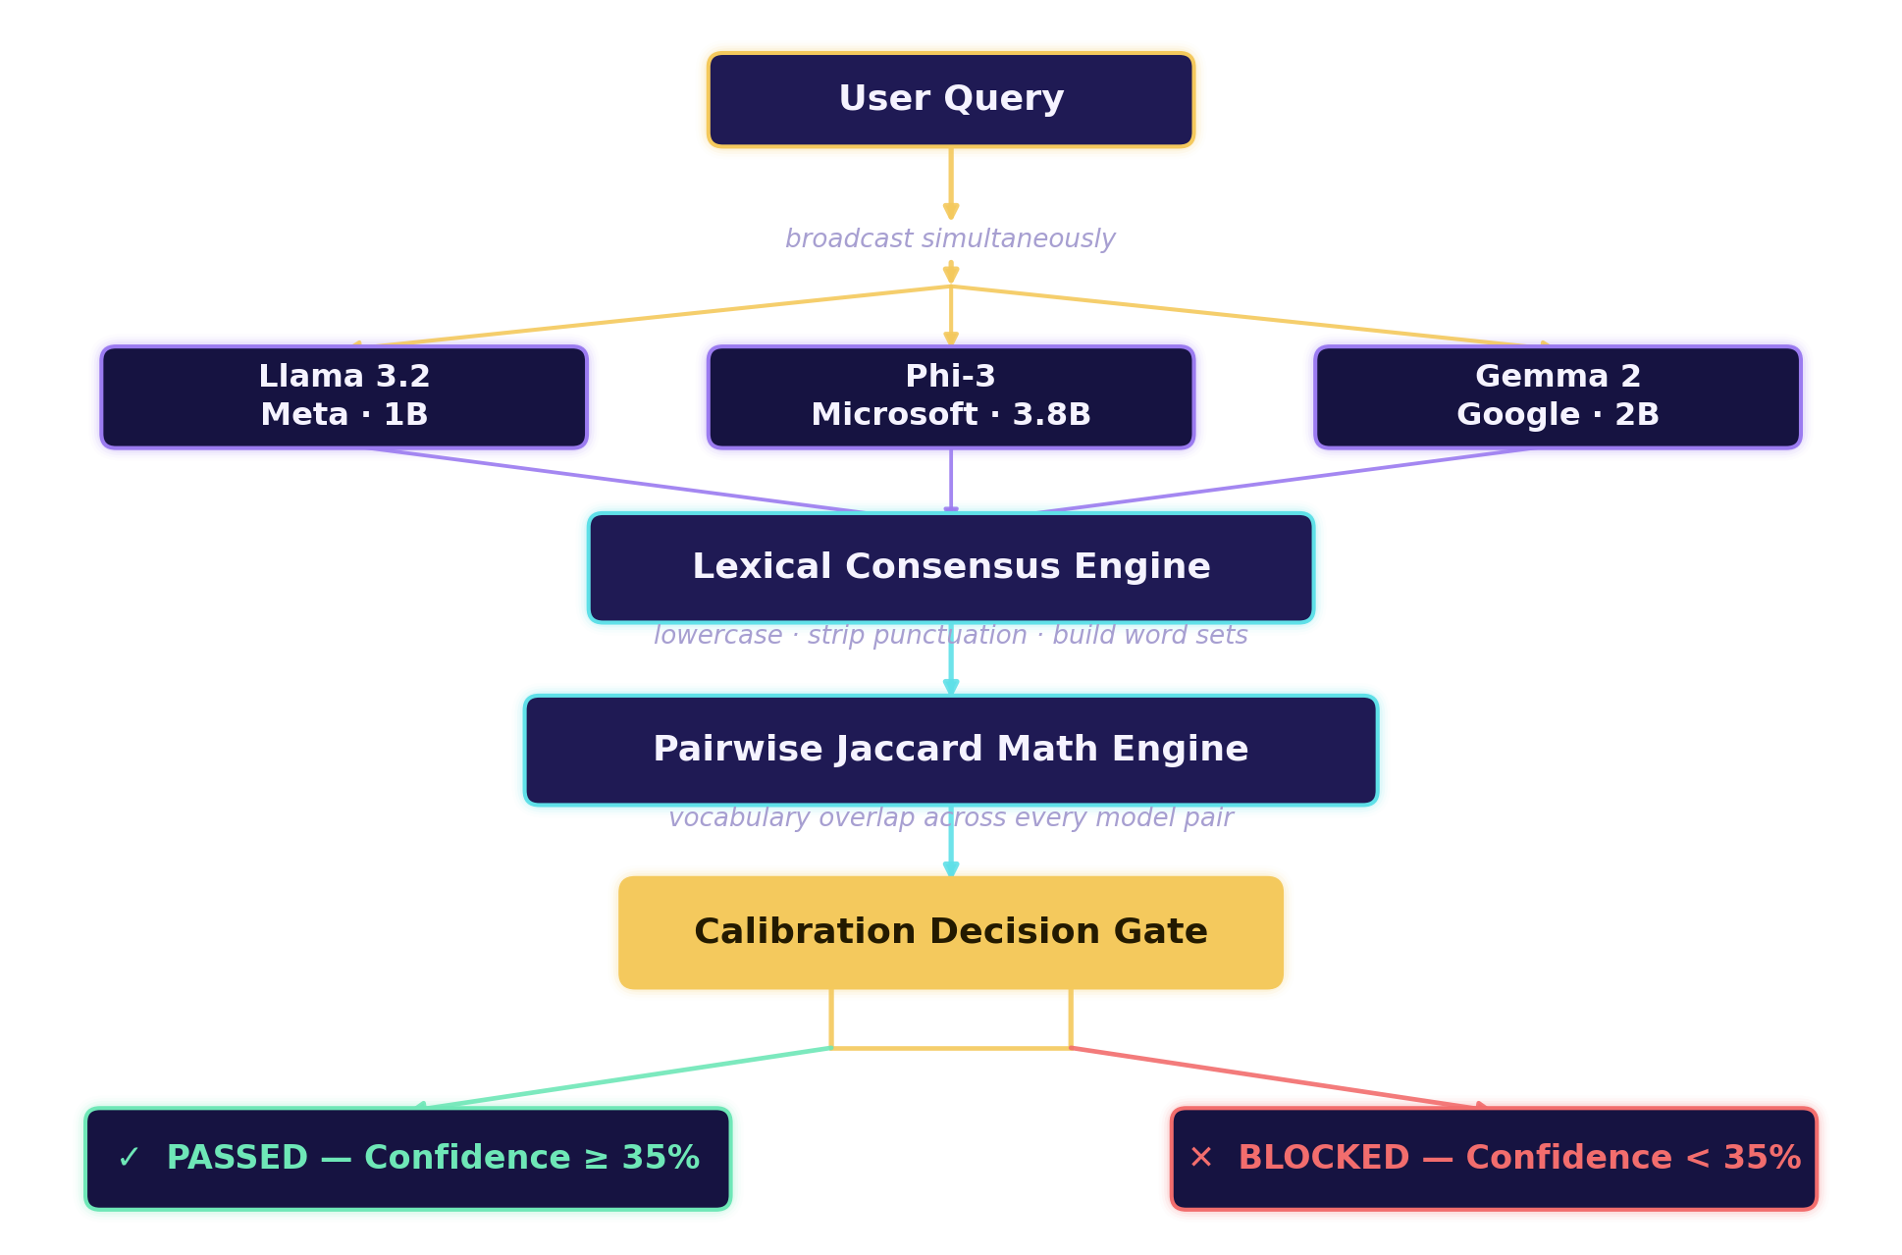
04 · THE CONSENSUS GUARDRAIL
The Consensus Guardrail Pipeline
We strip away the model's ego entirely — independent systems vote on the data before it ever reaches the screen.
10

Slide 11
04 · STEP-BY-STEP MECHANICS
Step 1 & 2 · Broadcast, Then Deconstruct
1
Deterministic Broadcast
2
Lexical Deconstruction
A user query — like “Who is the president of Korea” — is dispatched to Llama, Phi-3, and Gemma simultaneously, at a very low temperature (0.2), forcing each model to rely on its factual core rather than creative guessing.
The three text outputs go to the LexicalConsensusEngine. It strips punctuation, lowercases everything, and converts each response into a mathematical set of unique words — evaluating meaning, not grammar.
temperature = 0.2
“The Capital IS Seoul!”
the one shared constraint across all three independent models — minimizing creative noise so any remaining disagreement is meaningful.
↓
{ the, capital, is, seoul }
11

Slide 12
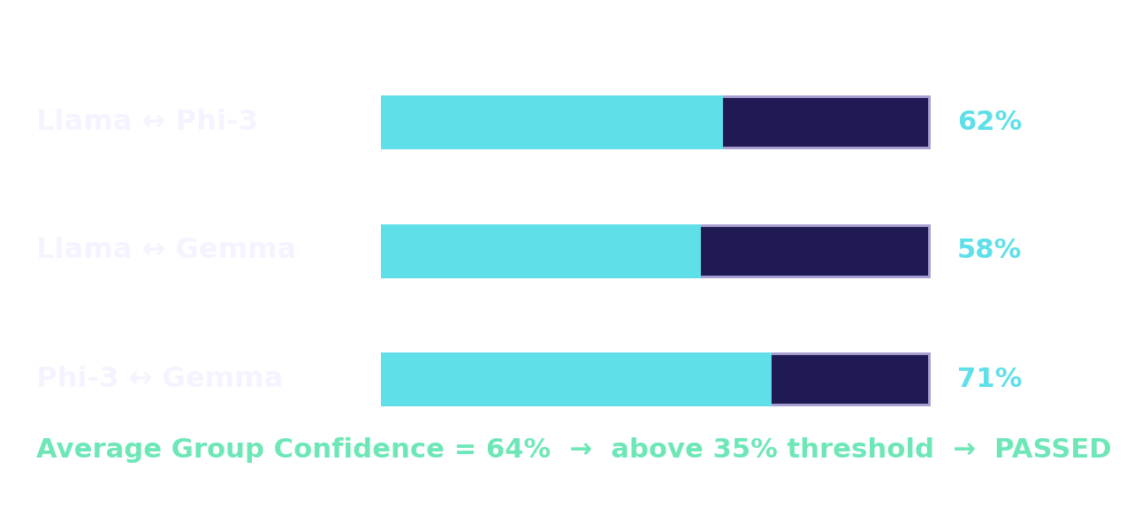
04 · STEP-BY-STEP MECHANICS
Step 3 · Jaccard Intersection Math
For every possible pair of models, count the words they share (intersection), divide by the total unique words they used combined (union).
Jaccard(A, B) =
Step 4 · The Guardrail Decision
|A ∩ B|
The three pairwise scores are averaged into a final System Calibration Confidence Score, 0–100%, checked against a hard boundary.
|A ∪ B|
shared words ÷ all distinct words
✓ Above 35%
Models are in high agreement — guardrail clears the output and safely prints the answer.
✕ Below 35%
Models have diverged and are actively contradicting each other — a Hard Guardrail Block fires a high-visibility warning, intercepting the hallucination.
12

Slide 13
05 · WHY IT MATTERS
A Zero-Cost Shield Against Confident Lies
The Consensus Guardrail succeeds where temperature scaling, self-consistency, and verbal elicitation all fell short — by removing the model's ego from the equation entirely.
The Bottom Line
Past methods asked a model to judge itself. The Consensus Guardrail asks three independent minds to agree — and treats disagreement itself as the danger signal.
✓
Catches memorized lies
independent architectures don't share the same blind spots
✓
No self-grading bias
the decision comes from disagreement, not self-report
“Trust isn't a model's opinion of itself — it's what independent minds agree on.”
✓
Fully private & free
runs entirely on-device via Ollama — zero API cost
Small models today, enterprise-scale reliability tomorrow — the same guardrail framework scales up.
13

Slide 14
Questions & Discussion
Thank you
Resolving LLM Overconfidence · The Consensus Guardrail
Ll
Ph
Ge
14

