Slide 1




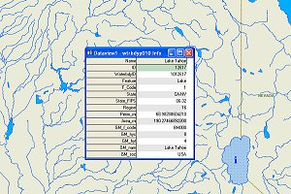
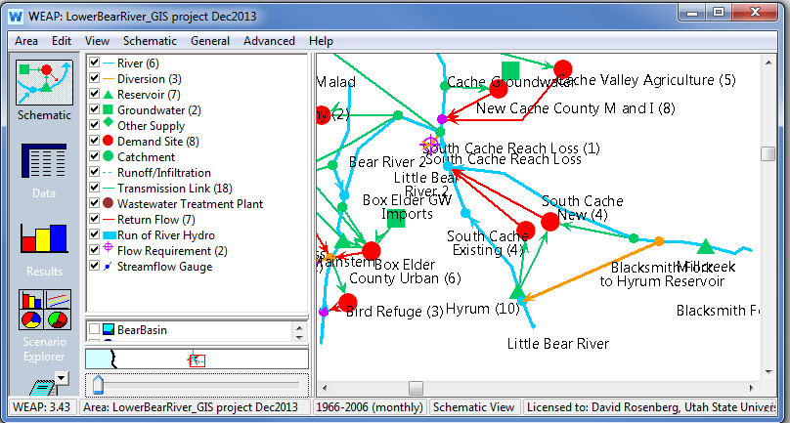

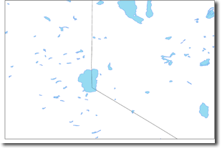
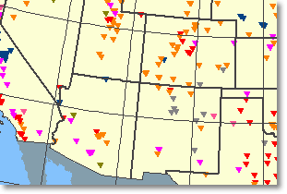





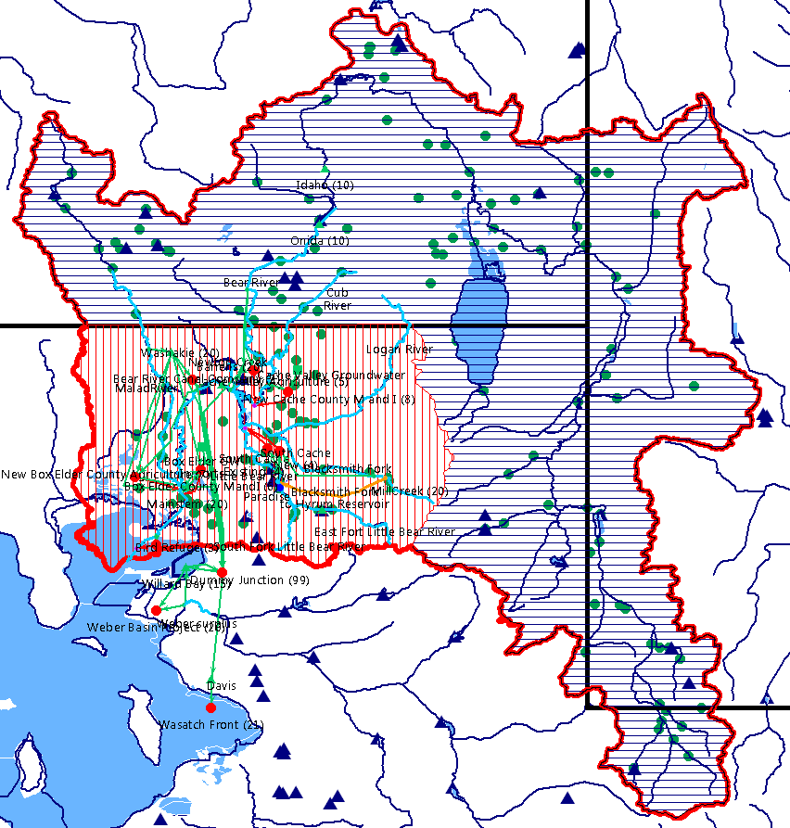
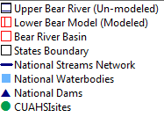

WaM-DaM: A Relational Model to Organize and Discover Systems Water Management Data
Adel M. Abdallah and David E. Rosenberg
Utah Water Research Laboratory, Utah State University - Logan, Utah, USA
3rd CUAHSI Conference on Hydroinformatics
Model and Data Interoperability: From Theory to Practice, July 15-17, 2015 Tuscaloosa, AL
Contributions
Prior Approaches and WaM-DaM Principles
Further Work
Propose a persistent Water Management Data Model (WaM-DaM) to synthesize systems water management data
Organize multiple data formats like time series, text, multi-column, and parameters from different sources
Overcome semantic and syntactic heterogeneity in water management data
Discover water management data for models
# | Principle | HEC- DSS | ODM | Hydro Platform | Arc Hydro | WEAP | River-Ware | WaM-DaM
1 | Flexible and extensible modular design |  | X | X |  |  |  | X
2 | Networks |  |  | X | X | X | X | X
3 | Scenarios | X |  |  |  | X | X | X
4 | Conditional query | X | X |  |  |  |  | X
5 | Dynamic controlled vocabulary |  | X |  | X |  |  | X
6 | Reusable descriptive & explicit metadata |  | X |  |  |  |  | X
7 | Multiple data formats for systems models | X |  | X |  | X | X | X
8 | Open-source environment |  | X | X | X |  |  | X
Automate the process to discover data for models
Develop web-services to publish water management data
Define WaM-DaM as a Resource in HydroShare
WaM-DaM to organize and serve your water management model data?
WaM-DaM Workflow
National Streams Network
WEAP Model for Lower Bear River, Utah
National Waterbodies Dataset
Your Model?
National Dams Dataset
CUAHSI sites
WaM-DaM Logical Data Model and Key Design Questions
Discover Data to Expand Bear River WEAP Model
Common data in lower (modeled) part of the Basin
Controlled Object Name | Native Object Name | Controlled Attribute Name | Native attribute Name | Unit Name | Parameter Value | Source
Reservoir | Water Body | Surface area | Area_mi | square mile | 0.705 | Water bodies
Reservoir | Dam | Surface area | SURF_AREA | acre | 480 | National Dams
Demand Site | Reservoir | Priority | Priority | NA | 5 | WEAP model
Site | NWIS CUAHSI | Precipitation | Precipitation | inch/year | 20.5 | CUAHSI HIS
River | Stream | Length | Length | mile | 10.5 | Streams Network
Available data in upper (un-modeled) part of the Basin
Idaho
Object Name | # Instances | # Attributes | Source
Gage Station | 44 | 3 | CUAHSI Sites
Reservoir | 11 | 20 | National Dams
Stream | 20 | 3 | National Streams
What are the available networks and scenarios and spatial reference?
No data present in upper Basin for:
Wyoming
What is the data value(s) of an attribute of a system component?
Object Name
Demand Site
Groundwater
Transmission Link
Diversion
Where did the data come from for an attribute, who reported them, and using what method?
Utah
Any opinions, findings, and conclusions or recommendations expressed in this material are those of the author(s) and do not necessarily reflect the views of the National Science Foundation
Follow and participate in WaM-DaM development: https://github.com/amabdallah/WaM-DaM

