Slide 1



A Relational Method to Synthesize and Integrate Fragmented and Inconsistent Water Resources Management Data
Adel M. Abdallah
2015 J. Paul Riley AWRA Utah Section
Student Paper Competition
April 13, 2015
Notes:
Thank everyone for attending the meeting
I will present the Water Management Data Model (WaM-DaM)
WaM-DaM is funded by the National Science Foundation through the CI-Water Project : Cyberinftastrcuture to Advance Water Resources Modeling.
My advisor David Rosenberg and he is on his sabbatical in Italy

Slide 2

Water Management Data Model (WaM-DaM)
Why Do We Need WaM-DaM?
Design Methods
WaM-DaM Schema
Results
Conclusions
WaM-DaM
Model quicker. Publish faster.
Notes:
The overarching contribution is: a New method to organize and synthesize network-based water management data

Slide 3
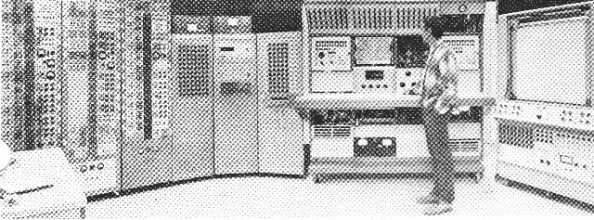
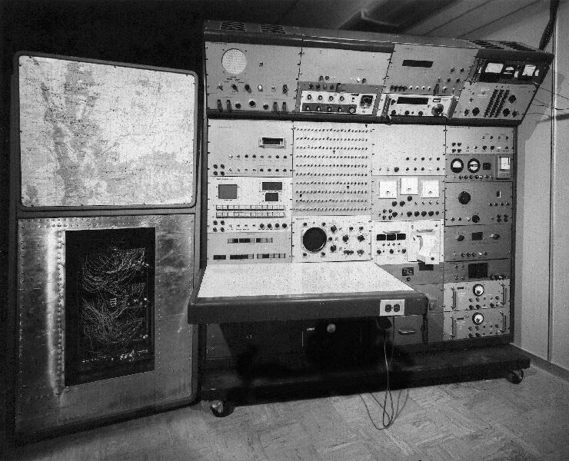
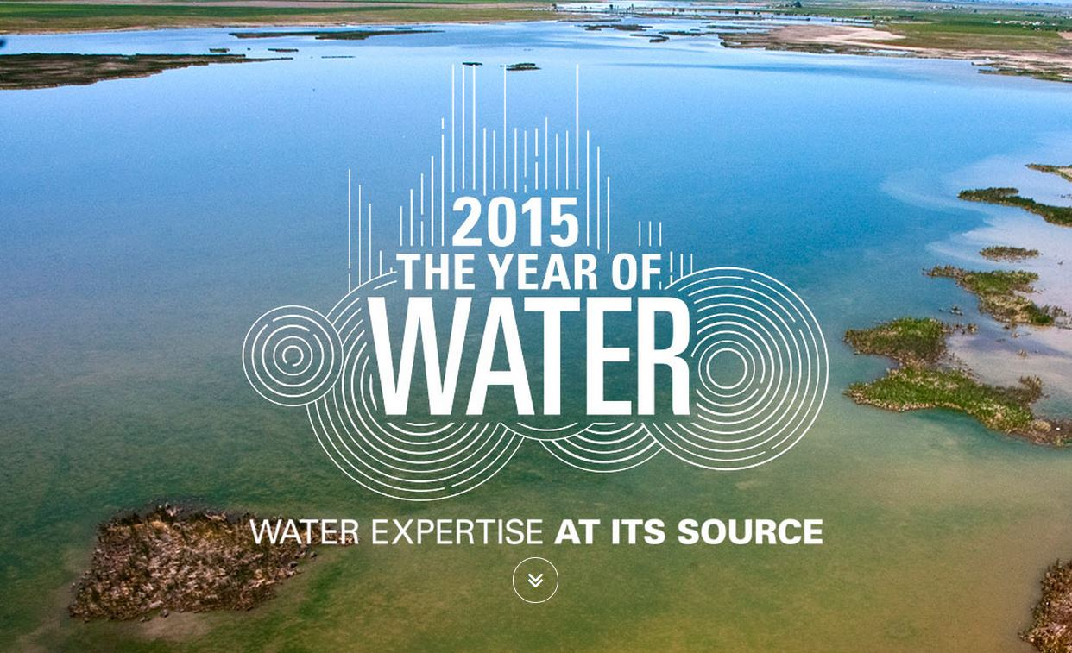
50 Years of Water Research

Slide 4
Real Challenges with Water Data
“Keeping track of our water data in text files is a royal headache”
“We want to access data from different sources through one standardize data hub”
“We want to query our data for quick analysis”
Notes:
Craig Miller a senior water resources engineer at the Utah Division of Water Resources shared his story about managing his water data, with his permission

Slide 5
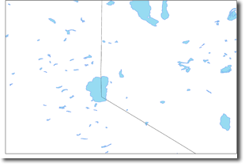
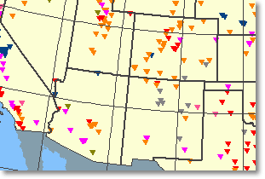
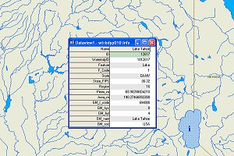


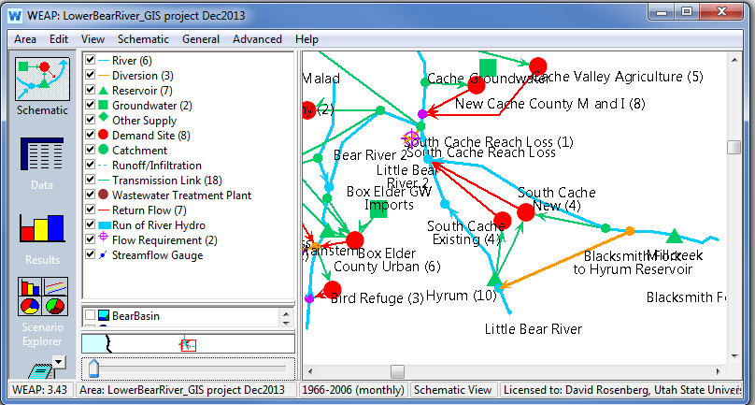
How to organize all these together?
US Water Bodies and Wetlands Dataset
15 attributes
26,872 instances
US Dams dataset
23 attributes
8,121 instances
Streams Network
22 attributes
76,976 instances
Time Series Data
32 attributes
WEAP Model
Lower Bear River, UT
111 instances
Notes:
Water management data resides in different data sources, uses different firmware, formats, terminology, and applies to various domains and contexts with various available metadata
Water management data is heterogeneous and resides in different places with different formats, terminology, and available metadata. These are example sources of data that are used in water management models. They come with different and overlapping attributes over various spatial scales.
To organize all of them in a data model, we need to use consistent semantic and syntactic structure that is generic to accommodate all of these data sources. We also need a supportive metadata to trace the lineage of data values, where they come from, how, and by whom
Organizing all this data together in a consistent way allows us to answer these key questions
What are the water system components and attributes in a geographic and domain area of interest?
How are these components physically connected to each other?
What data is available to run a particular model in a particular place?

Slide 6
We need a data model to support all these common features
Model | Flexible and extensible | Networks | Scenarios | Conditional query | Dynamic controlled vocabulary | Descriptive and explicit metadata | Multiple data formats | Open source envir.
WaDE
ODM-CUAHSI
WEAP
RiverWare
GSSHA
HEC-DSS
ArcSWAT
Arc Hydro
CALVIN
HydroPlatform
Notes:
These are fifteen example data management systems that support different organizing features of data. We found eight common features across these systems
1. Flexible and extensible: allows users to define new user customized objects and then create instances
2. Networks: represents connectivity between water system components
3. Scenarios: supports data changes in networks due to management alternatives
4. Relational and conditional query supports conditional data queries. Conditional queries are important to export pieces of data to others models
5. Dynamic controlled vocabulary: allows users to define vocabulary to control descriptive terms used
6. Descriptive and explicit metadata: uses descriptive and explicit metadata as methods, sources, and units
7. Multiple data types: accommodates multiple data formats like time series, multi-columns, parameters, and functions
8. Open source environment: has the data management system as an open source and non-proprietary, source code and schema are available to the public and uses free software environment.
Its important to note that many of these features may interact and WaM-DaM supports this interaction. For example, Arc Hydro separately supports conditional queries and metadata. But users cannot define metadata and share it in a relational way across different components.
So a generic data management system should support all these features to meet the diverse needs of water management systems.

Slide 7


Water Management Data Model (WaM-DaM)
Organize water management data
Synthesize data across domains and sources
Compare data from different scenarios
Serve data to run models
Notes:
The CI-Water Project is overcoming these challenges by developing a generic Water Management Data Model (WaM-DaM) to reduce the amount of time and effort water managers spend to find and organize the data required to execute water management models including on HPC resources.
WaM-DaM will…
Organize data into a work flow to help water managers and modelers focus on model use rather than data preparation.

Slide 8
Methods
Review data management systems for 22 existing water management models
Identify most important user questions
Design a generic relational data model to answer user questions
Verify functionality with use cases
Notes:
In developing WaM-DaM, we reviewed the 22 existing systems shown in the table on slide 4 to see how the systems organize their data in time, space, and data formats
Second, they listed the most important questions that water resources managers and modelers need WaM-DaM to answer. These questions include:
1) What are the water management instances and attributes in a geographic and domain area of interest?
2) How are these instances physically connected to each other?
3) What are the differences between the input data for two model scenarios?
4) What data is available to run a particular model in a particular place?
The design was made to efficiently answer these and several other key questions. The design proceeded iteratively as feedback from colleagues and testing through the use cases raised several issues.

Slide 9
WaM-DaM Conceptual Design
Notes:
WaM-DaM is set of related tables divided into four components: (45 tables)
A core structure shown in light blue allows users to define custom data structures, object types, and properties for a model and it’s components. The user can also create instances and populate the instances with data for specific networks and scenarios.
2) Metadata shown in orange provide information to correctly interpret the attributes, instances, and stored data values.
3) Controlled Vocabulary in purple imposes consistency in the terms used. Users must use terms to describe their data from a pre-defined list of vocabularies if they choose to share or publish their data. The controlled vocabulary table is connected to tables like Object Types, Attributes, and units (connections are not shown for simplicity).
4) Data Values in light red allow users to store data values in the multiple data formats that water resources managers and modes use.
This design has been implemented both as a logical data model (shown in the last slide) and as a physical MySql database.

Slide 10
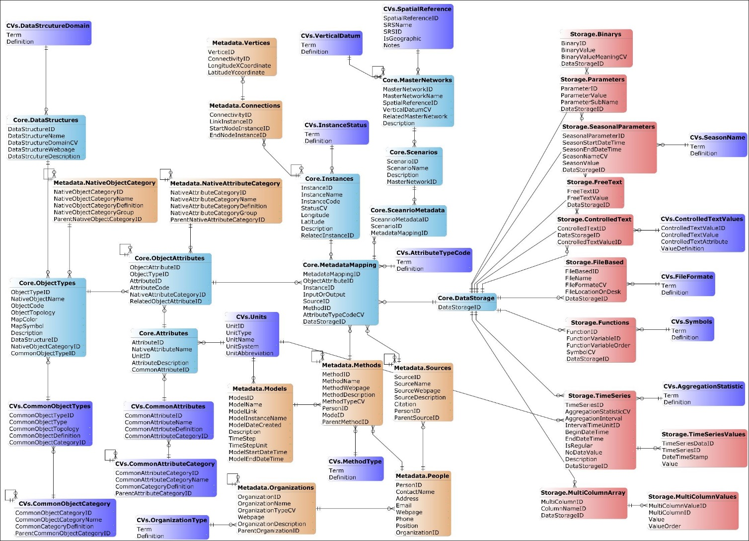

Slide 11
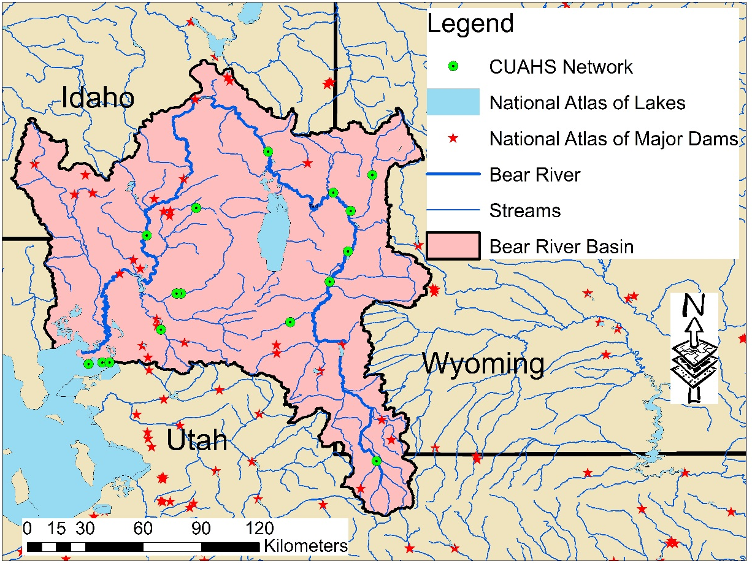
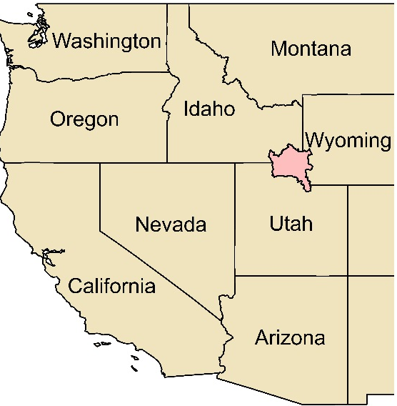
Integrate disparate water management data for the Bear River Basin, Utah
Notes:
Four use cases are verifying and demonstrating WaM-DaM.
1. The first use case is integrating data for the Bear River Watershed from multiple providers including the CUAHSI HIS network, National Atlas of Lakes, National Atlas of Major Dams, and an existing WEAP model for the lower Bear River to give a synthetic view of the data available within the watershed as well as still needed to run a water management model.

Slide 12
What are the water management infrastructure in the Bear River Watershed, Utah?
Native Object Types | Instances | Source Name
Dam | PORCUPINE | Dams Dataset
Dam | Cutler | Dams Dataset
Dam | Hyrum | Dams Dataset
Water Body | Bear Lake | Water Bodies
Water Body | Mantua Reservoir | Water Bodies
Reservoir | Mainstem | WEAP Model
Demand Site | Bird Refuge | WEAP Model
Groundwater | Box Elder GW Imports | WEAP Model
Site | Little Bear River at Paradise, UT | CUAHSI
Atmosphere | Logan Cache AP, UT | CUAHSI
Notes:
One of the important questions for researchers is like: What are the water management instances in the Bear River Watershed, Utah?
Here is part of the query result where we find out the instances and their object types and which data source they come from. In this case, we found ten instances that are located in four data sources

Slide 13
What is the "surface area" of an object type "Reservoir" within a boundary of lat. and long. ?
Instance Name | Source Name | Common Object Name | Native Object Name | Common Attribute Name | Native Attribute Name | Unit Name | Parameter Value
Hyrum Reservoir | Water Bodies Dataset | Reservoir | Water Body | surface area | Area_mi | square mile | 0.705559 ~452 acre
Hyrum (10) | WEAP/Lower Bear River Network | Reservoir | Reservoir | surface area | Area | Acre | 480
HYRUM | Dams Dataset | Reservoir | Dam | surface area | SURF_AREA | Acre | 480
Notes:
Another important question is What is the "surface area" of an object type "Reservoir" within a boundary of lat. and long. ?
The table shows the results of the query. There are three instances of Hyrum Reservoir that come from three difference data sources. The use of common vocabulary and registering native vocabulary against them allows us to search different terms like surface area by using the common name.
The user can identify discrepancies among the data sources and incorporate them in their model uncertainity

Slide 14
What are the supply and discharge links for “Box Elder County Urban” Demand Site Object?
from Washakie
from Mainstem
to Withdrawal Node 4
from withdrawal Node 3
from Box Elder GW Imports
Transmission Link
Return Flow
Data Structure Name | Native Object Name | Supply Link Instances
WEAP | Transmission Link | from Washakie
WEAP | Transmission Link | from Mainstem
WEAP | Transmission Link | from withdrawal Node 3
WEAP | Transmission Link | from Box Elder GW Imports
 |  | Discharge Link Instances
WEAP | Return Flow | to Withdrawal Node 4
Notes:
The last question here is like: What are the supply and discharge links for “Box Elder County Urban” Demand Site Object? The Table below shows the query result but I plot it in a schematic. Here Box Elder County recives water from four sources that have a transition link Object Type. The County discharges water as a return flow

Slide 15
Benefits of WaM-DaM
Provide a synthetic view of the data available within a watershed
Overcome sematic heterogeneity of water management data
Compare datasets, identify discrepancies and uncertainties, and include uncertainties in preparing model input data
Answer questions that previously required significant effort and manipulations among multiple data sets
Notes:
To conclude, here the benefits that WaM-DaM brings to us

Slide 16
Thank you!
Questions?
WaM-DaM
Model quicker. Publish faster.

