Slide 1



WaM-DaM: A Data Model to Synthesize and Organize Water Management Data
EWRI CONGRESS
June 4, 2014
Adel M. Abdallah
David E. Rosenberg

Slide 2

Water Management Data Model (WaM-DaM)
Why Do We Need a Data Model?
Design Methods
WaM-DaM Schema
Results
Conclusions
WaM-DaM
Model quicker. Publish faster.
Notes:
The overarching contribution is: a New standard/method to organize network-based water management data
I’m keeping the logo but I’m not going to talk about the Walmart joke

Slide 3
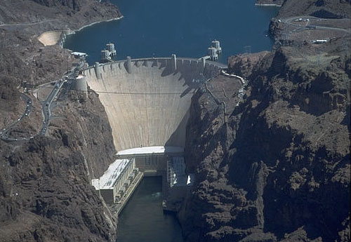



Why a Data Model? Different sources and descriptions
Hoover Dam
Lake Mead
e.g., release
e.g., outflow
Reservoir? Water body?
Scientists and managers spend up to 75% of their time to build models
HydroDesktop
Notes:
Spend 30 seconds on this slide

Slide 4
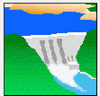


Similar Data => Different Models
Reservoir Simulation (HEC-ResSim)
Simulates reservoir operation and management
Requires river network, diversions, reservoir physical & operational data
Water Evaluation and Planning system Allocates water to meet basin demands
Requires river network, diversions, reservoir physical data, supplies, delivery
requirements, allocation priorities, etc.

Slide 5
Prior approaches to organize water data
Feature | Arc Hydro | ODM | Hydro Platform | WEAP | HEC-DSS
Generic, relational, and open source environment |  | x
Create dynamic networks | x |  | x | x | x
Controlled vocabulary | x | x |  | x | x
Descriptive and explicit metadata |  | x
Supports multiple data types (e.g., time series, tabular, text, parameters, binary, and file- based) | x |  | x | x | x

Slide 6
Objectives
Design a data model to organize and synthesize water management data
Integrate data from different sources
Support consistent metadata descriptions
Open-source, generic, programming language and technology independent

Slide 7
Design Methods
1. Identify the essential data for water management - 184 fields
2. Represent fields in tables according to Relational Model Theory and Jim Gray’s rule - 58 tables
Categories of questions
WaM-DaM will answer:
i) Build a network
ii) Compare datasets
iii) Query data

Slide 8
WaM-DaM 0.2 Schema
Notes:
This figures shows how the 184 columns are represented in 58 tables (boxes) grouped into five themes: Project metadata, network metadata,
Controlled vocabulary, attribute metadata and data values storage. I will give a high level walk-through to show how the data model works. First the user creates objects in the Project metadata, then the user creates instances of their objects, choose metadata, and finally populate their attributes with data. In the meanwhile, values for some attributes have controlled vocabulary

Slide 9

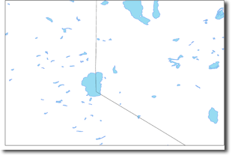
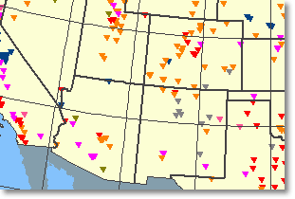

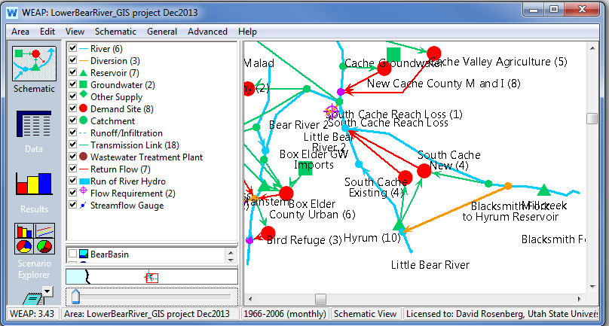
Load Different Data to WaM-DaM
US Dams dataset
23 attributes
8,121 instances
US Water Bodies and Wetlands Dataset
15 attributes
26,872 instances
WEAP Model
Lower Bear River, UT
53 instances
Time Series data
32 attributes
Notes:
Focus more on WEAP model as a data source of networks for WaM-DaM

Slide 10
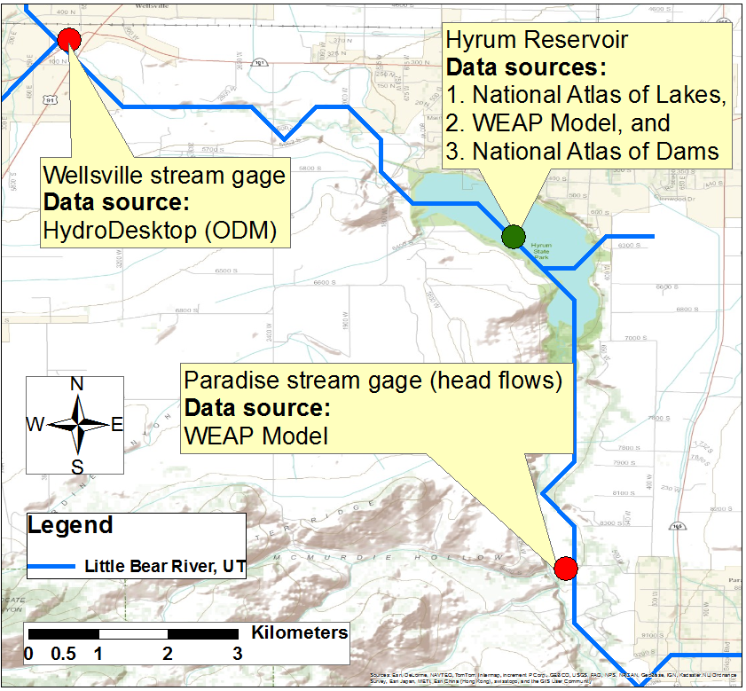
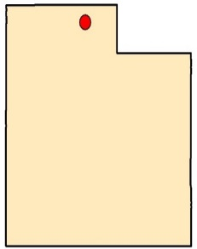
Represent the Little Bear River Network, Utah in WaM-DaM
Site
(node object)
Utah
Reservoir (node object)
River Reach
(link object)
Site
(node object)
Notes:
I want to show how we used the node and link objects to create instances of them. Also I want to show the different data sources for each instance

Slide 11
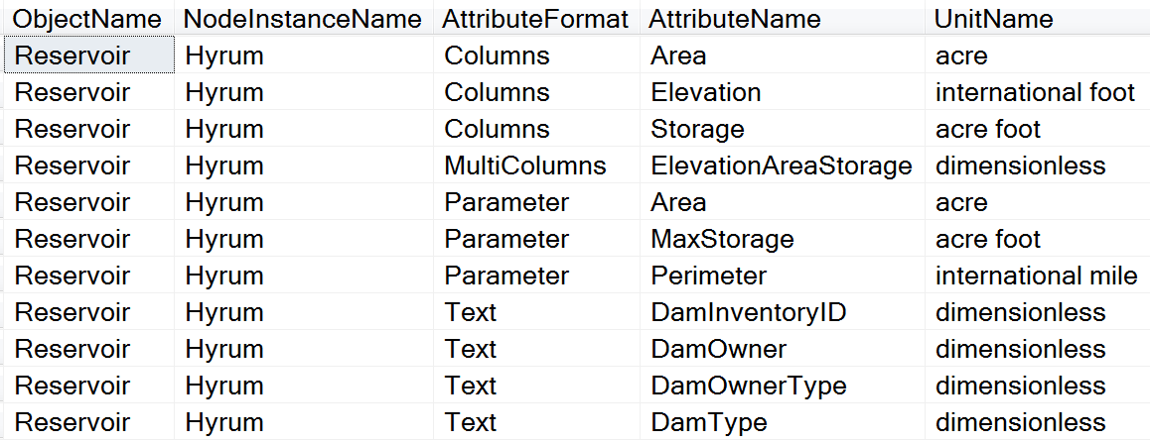
What are the attributes for Hyrum Reservoir and their units?
Object name
Node instance name
Attribute format
Attribute name
Unit name
Organize multiple data formats and maintain consistent metadata
Notes:
Object name enforces a controlled vocabulary on original terms dam, reservoir, water body, lake from multiple data sources

Slide 12
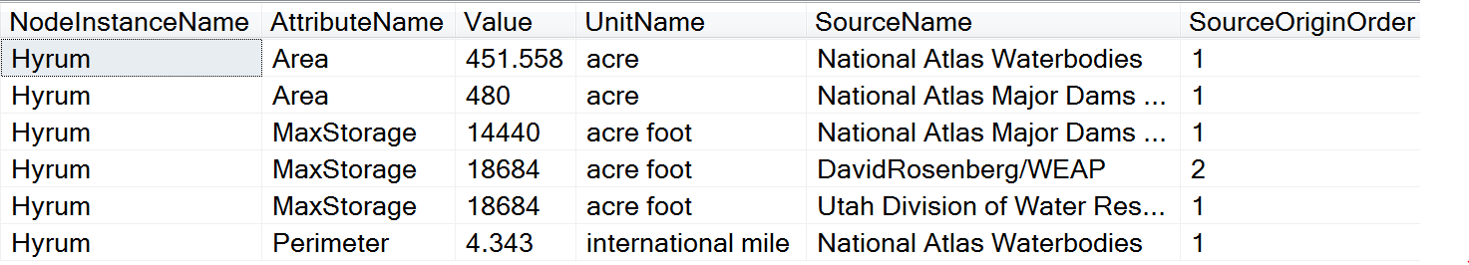
What are the reservoir attributes and their values, units, and sources?
Node instance name
Attribute name
Value
Unit name
Source
Controlled vocabulary => MAX_STOR, Total Capacity
Integrate data sources and support explicit descriptive metadata
Incorporate uncertainty in models
Foster integrated understanding of systems data
Notes:
MAX_STOR and Total Capacity

Slide 13
Ongoing Work
Finalize the data model design and test it with larger networks and national datasets
Automate data loading, retrieval, and use WaM-DaM to populate and run models
Integrate WaM-DaM with Hydra software to visualize and edit networks
Notes:
Spend a bit of time on this figure and mention my recommendation of implementing this with CUHASI

Slide 14
Conclusions
Proposing WaM-DaM to organize network-based water management data
Organize multiple data formats like time series, text, multi-column, and parameters from different sources
Foster integrated analysis and understandings of water systems
Future work will automate the ability to discover, transform, and publish of data plus populate models

Slide 15

Acknowledgements
http://ci-water.org/
This project is funded through EPS – 1135482 and EPS – 1135483. Any opinions, findings, and conclusions or recommendations expressed in this material are those of the author(s) and do not necessarily reflect the views of the National Science Foundation

Slide 16
Thank you!
Questions?
For more info: Adel Abdallah
amabdallah@aggiemail.usu.edu
http://www.engr.usu.edu/cee/faculty/derosenberg/students.htm
WaM-DaM
Model quicker. Publish faster.

Slide 17
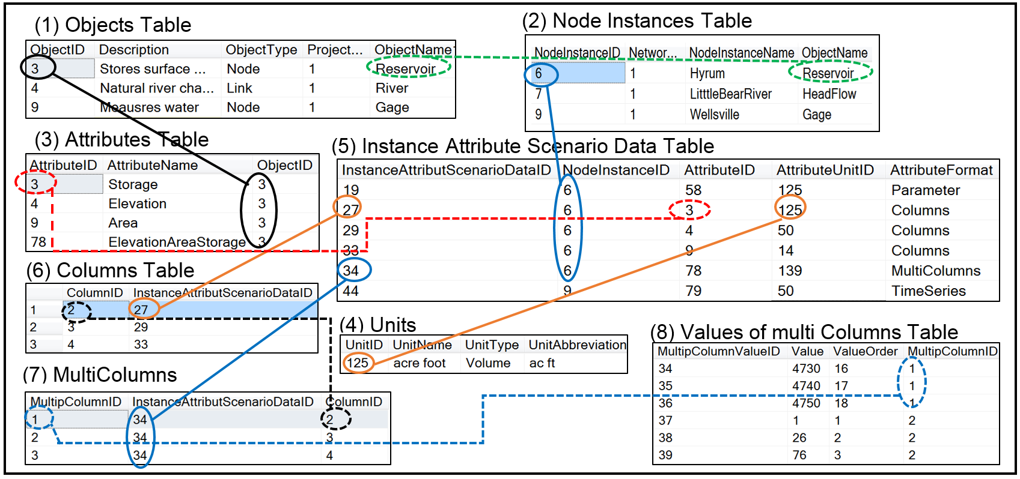
How WaM-DaM organizes tabular data

