Slide 1


Applying Best Data Practices to Work with Water Management Data (WaM-DaM)
Adel M. Abdallah & David E. Rosenberg
UC Davis Workshop
Dec. 10, 2015

Slide 2
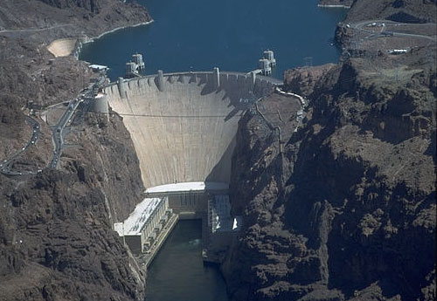


Working with our data is hard!
Semantic differences
Syntactic differences
Inconsistent metadata
Hoover Dam
Lake Mead
e.g., release
e.g., outflow
Reservoir? Water body? Site

Slide 3
Paradigm Shift

Slide 4
Key Desirable Features
# | Feature | HEC- DSS | ODM | Hydro Platform | SWAT | WEAP | River-Ware | WaM-DaM
1 | Flexible and extensible modular design |  | X | X |  |  |  | X
2 | Multiple data formats for systems models | X |  | X | X | X | X | X
3 | Extensible controlled vocabulary |  | X |  |  |  |  | X
4 | Reusable descriptive & explicit metadata |  | X |  |  |  |  | X
5 | Networks |  |  | X | X | X | X | X
6 | Scenarios | X |  |  |  | X | X | X
7 | Relational organization |  | X |  |  |  |  | X
8 | Open-source environment |  | X | X |  |  |  | X
Notes:
In developing WaM-DaM, we reviewed the 30 existing systems shown in the table on slide 4 to see how the systems organize their data in time, space, and data formats
We found eight common features across these systems
1. Flexible and extensible: allows users to define new user customized objects and then create instances
2. Networks: represents connectivity between water system components
3. Scenarios: supports data changes in networks due to management alternatives
4. Relational and conditional query supports conditional data queries. Conditional queries are important to export pieces of data to others models
5. Dynamic controlled vocabulary: allows users to define vocabulary to control descriptive terms used
6. Descriptive and explicit metadata: uses descriptive and explicit metadata as methods, sources, and units
7. Multiple data types: accommodates multiple data formats like time series, multi-columns, parameters, and functions
8. Open source environment: has the data management system as an open source and non-proprietary, source code and schema are available to the public and uses free software environment.
Its important to note that many of these features may interact and WaM-DaM supports this interaction. For example, Arc Hydro separately supports conditional queries and metadata. But users cannot define metadata and share it in a relational way across different components.
So a generic data management system should support all these features to meet the diverse needs of water management systems.

Slide 5
WaM-DaM Conceptual Design
What object types and attributes does a model require?
What are the data values for an object instance?
What was the data source for an attribute? Who provided the data?
Notes:
Animation highlights five key controlled vocabulary tables among the 17 in WaM-DaM.
The design was made to efficiently answer these and several other key questions. The design proceeded iteratively as feedback from colleagues and testing through the use cases raised several issues.
WaM-DaM is set of related tables divided into four components: (45 tables)
A core structure shown in light blue allows users to define custom data structures, object types, and properties for a model and it’s components. The user can also create instances and populate the instances with data for specific networks and scenarios.
2) Metadata shown in orange provide information to correctly interpret the attributes, instances, and stored data values.
3) Controlled Vocabulary in purple imposes consistency in the terms used. Users must use terms to describe their data from a pre-defined list of vocabularies if they choose to share or publish their data. The controlled vocabulary table is connected to tables like Object Types, Attributes, and units (connections are not shown for simplicity).
4) Data Values in light red allow users to store data values in the multiple data formats that water resources managers and modes use.
This design has been implemented both as a logical data model (shown in the last slide) and as a physical SQLite database.

Slide 6

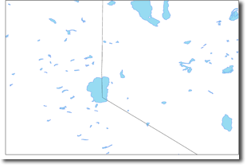
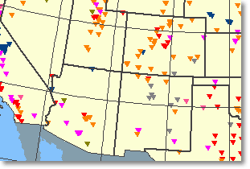
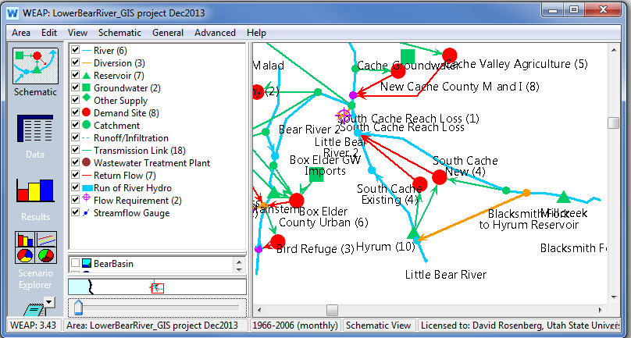
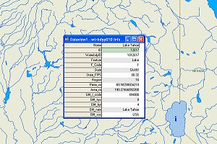




WaM-DaM Workflow
Time series
Water bodies
Dams
Your model?
Infrastructure
Streams
Notes:
Talk about testing and demonstrating the WaM-DaM design…
Integrate 1 Utah and 4 National data sets
Uses to Date
Identify available data to expand an existing model for the lower Bear River, Utah to the entire Bear River basin
Reveal discrepancies across data sources in reservoir attribute values
Show physical connectivity of water system components
Retrieve and show differences in input data values for two scenarios

Slide 7
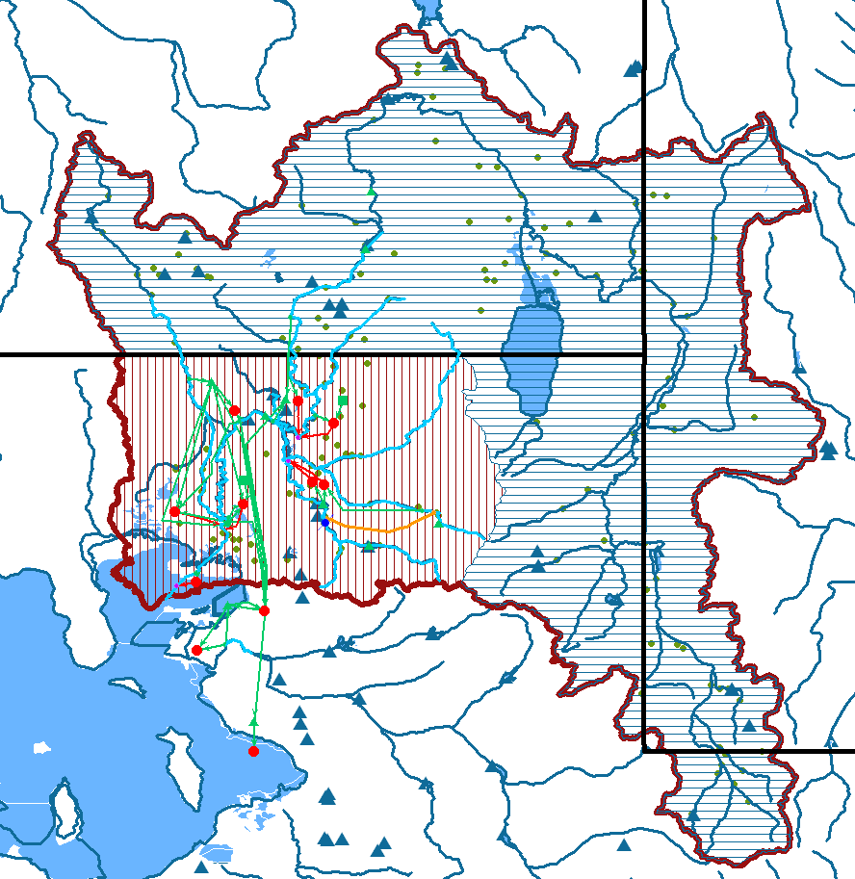
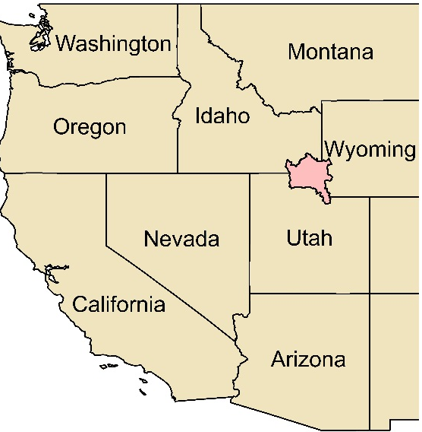
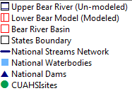
Search the integrated data to build a WEAP model
Object Name | # Instances | # Attributes | Source
Gage Station | 44 | 3 | CUAHSI Sites
Reservoir | 11 | 20 | National Dams
Stream | 20 | 3 | National Streams
Notes:
In both examples, make the focus of the spoken words on explaining how the various key design principles are implemented.
What are the available instances to expand the Lower Bear River model to the entire Watershed?
Types in Use Case #1 to search for instances within the boundary of the Upper Bear River. The query result lists 44 Stream Gages, 20 Stream segments, 11 reservoirs, and seven water bodies that are available in WaM-DaM for the upper Bear River Basin boundary that matches the WEAP required Object Types

Slide 8
Harnessing the power of controlled vocabulary
Instance Name | Source | Controlled Object Name | Native Object Name | Controlled Attribute Name | Native Attribute Name | Unit Name | Value
Hyrum (10) | WEAP/ Lower Bear River | Reservoir | Reservoir | surface area | Surface Area | Acre | 480
HYRUM | Dams Dataset | Reservoir | Dam | surface area | SURF_AREA | Acre | 480
Hyrum Reservoir | Water Bodies Dataset | Reservoir | Water Body | surface area | Area_mi | square mile | 0.706 (452 acre)
Instance Name | Source | Controlled Object Name | Native Object Name | Controlled Attribute Name | Native Attribute Name | Unit Name | Value
Hyrum (10) | WEAP/ Lower Bear River | Reservoir | Reservoir | surface area | Surface Area | Acre | 480
Notes:
Another important question is What is the "surface area" of an object type "Reservoir" within a boundary of lat. and long. ?
The table shows the results of the query. There are three instances of Hyrum Reservoir that come from three difference data sources. The use of common vocabulary and registering native vocabulary against them allows us to search different terms like surface area by using the common name.
The user can identify discrepancies among the data sources and incorporate them in their model uncertainty

Slide 9
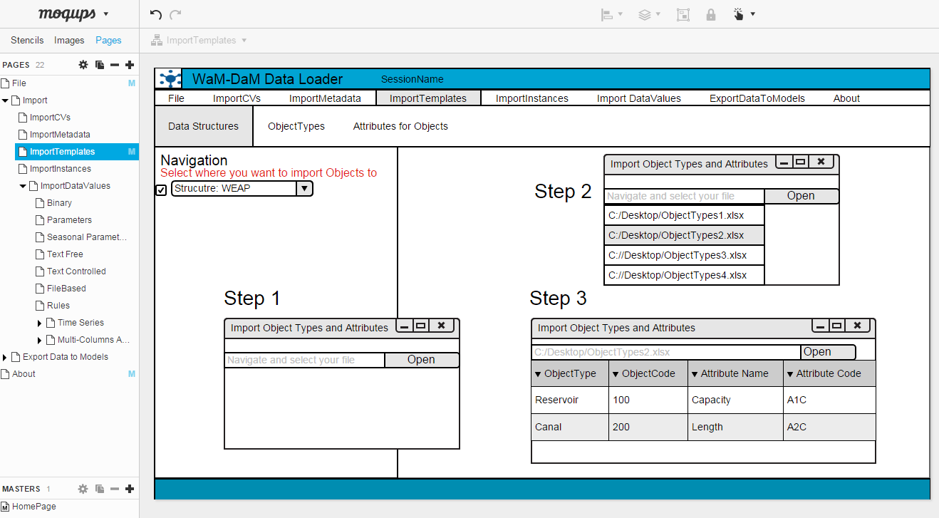
Next Steps
Build generic data loader and exporter (GUI)
Notes:
1. Build generic data loader (GUI to register native vocabulary against WaM-DaM controlled vocabulary)
2. Build generic data exporter (GUI to select relevant data and serve to a registered model in appropriate formatting)

Slide 10
Benefits of WaM-DaM
Integrate and synthesize data sources into a consistent structure
Potentially use it to serve data to models
Notes:
To conclude, here the benefits that WaM-DaM brings to us

Slide 11
Discussion Questions
How could this method be useful to your research?
How could we move forward towards using controlled vocabulary in water management data?
Notes:
To conclude, here the benefits that WaM-DaM brings to us

Slide 12
Further info
WaM-DaM GitHub
https://github.com/amabdallah/WaM-DaM
WaM-DaM Fact Sheet
http://bit.ly/1SUlSql
Workshop Comments Doc
http://bit.ly/1Z5nKQI
Contacts:
David E. Rosenberg Adel M. Abdallah

Slide 13
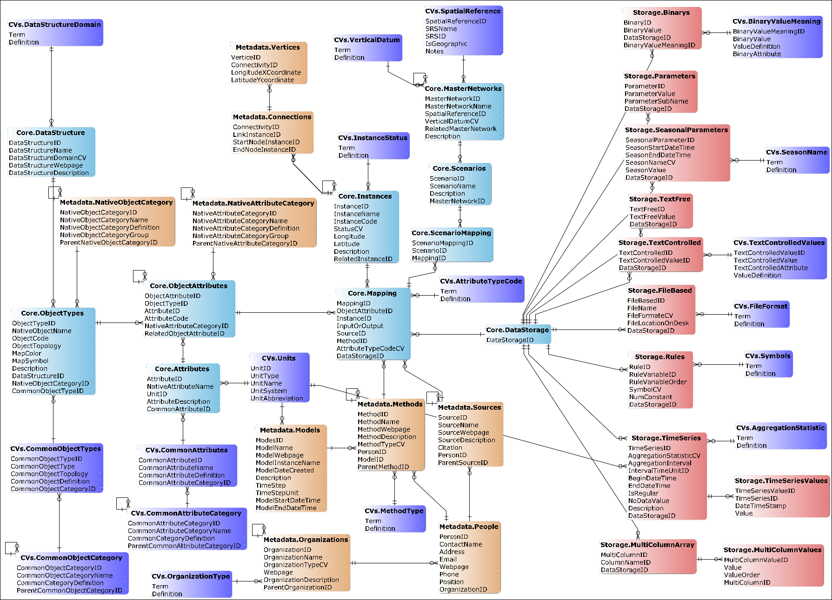
WaM-DaM Logical Data Model
RDBMS
Notes:
The Logical Data Model of WaM-DaM.
We implemented it into four relational database systems: SQL Server, PostgreSQL, SQLite, and MySQL

