Slide 1




WaM-DaM Workshop Discover what water management data is available to run a WEAP model
Workshop Material https://goo.gl/TT5sGh
Adel M. Abdallah and David E. Rosenberg
3rd CUAHSI Conference on Hydroinformatics
July 15, 2015
Notes:
Thank everyone for attending the meeting
I will present the Water Management Data Model (WaM-DaM)
WaM-DaM is funded by the National Science Foundation through the CI-Water Project : Cyberinftastrcuture to Advance Water Resources Modeling.
My advisor David Rosenberg and he is on his sabbatical in Italy

Slide 2

Water Management Data Model (WaM-DaM)
Why WaM-DaM?
WaM-DaM Workflow
Activities
Future Work
Discussion
WaM-DaM
Model quicker. Publish faster.
Notes:
The overarching contribution is: a New method to organize and synthesize network-based water management data

Slide 3
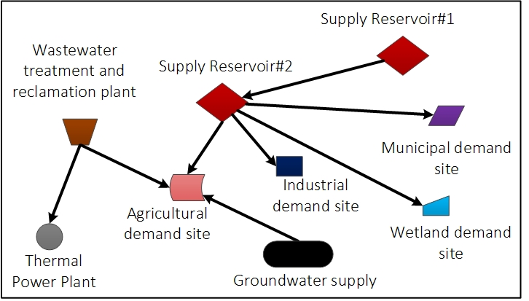
Why WaM-DaM? Systems Analysis
Notes:
In developing WaM-DaM, we reviewed the 22 existing systems shown in the table on slide 4 to see how the systems organize their data in time, space, and data formats
Second, they listed the most important questions that water resources managers and modelers need WaM-DaM to answer. These questions include:
1) What are the water management instances and attributes in a geographic and domain area of interest?
2) How are these instances physically connected to each other?
3) What are the differences between the input data for two model scenarios?
4) What data is available to run a particular model in a particular place?
The design was made to efficiently answer these and several other key questions. The design proceeded iteratively as feedback from colleagues and testing through the use cases raised several issues.

Slide 4
Why WaM-DaM? Multiple data types

Slide 5
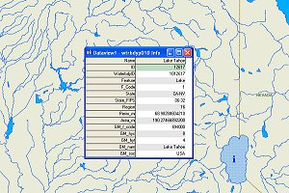
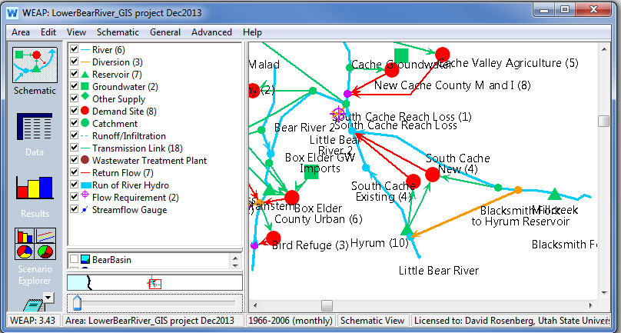

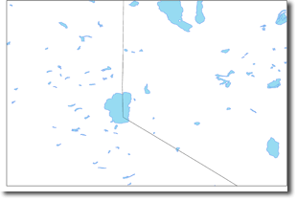
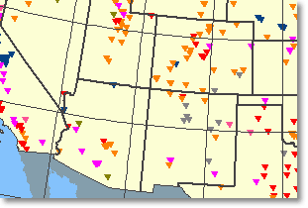
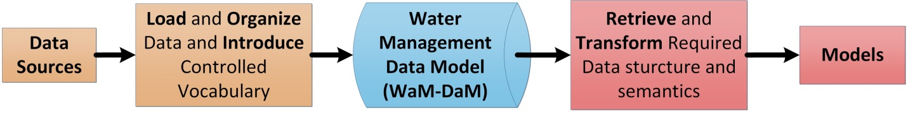





WaM-DaM Workflow
National Streams Network
WEAP Model for Lower Bear River, Utah
CUAHSI sites
National Waterbodies Dataset
National Dams Dataset
Notes:
The CI-Water Project is overcoming these challenges by developing a generic Water Management Data Model (WaM-DaM) to reduce the amount of time and effort water managers spend to find and organize the data required to execute water management models including on HPC resources.
WaM-DaM will…
Organize data into a work flow to help water managers and modelers focus on model use rather than data preparation.

Slide 6
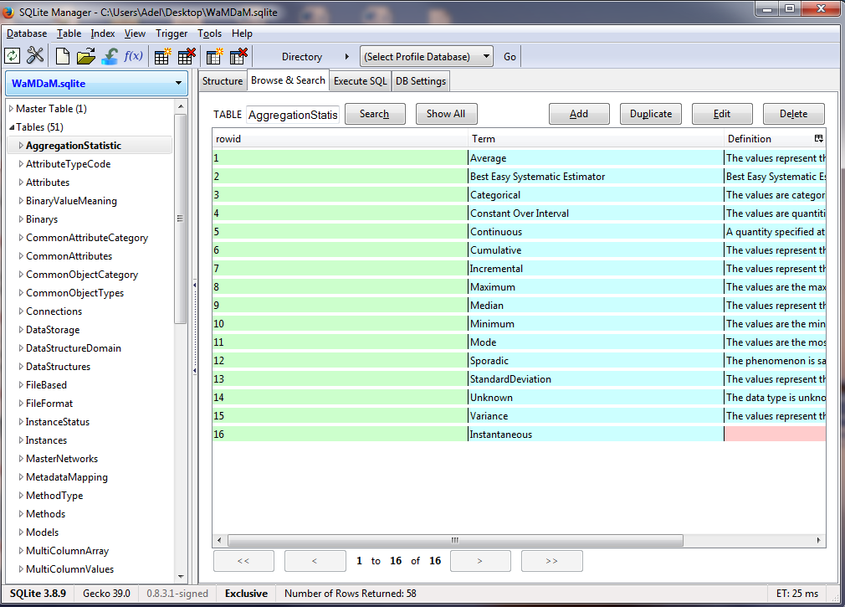
Activity (Get Started)
Connect to WaM-DaM database in SQLite Manager

Slide 7
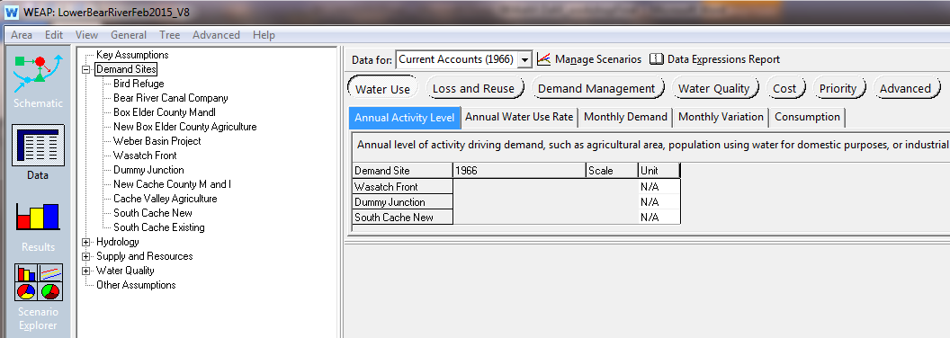
WEAP Model
1. What are the required attributes for the WEAP model? SQL query https://goo.gl/4L57yI

Slide 8
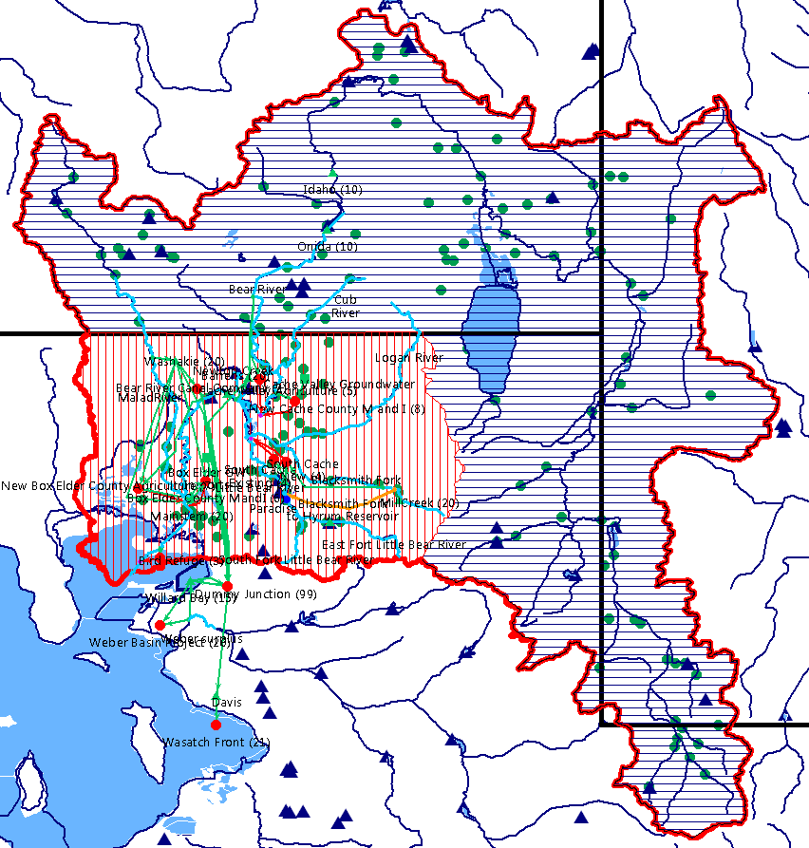
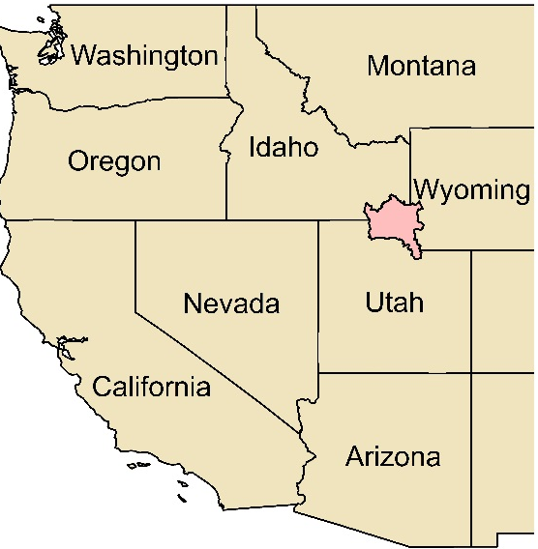
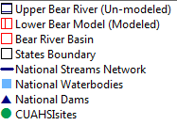
2. Discover available data to expand the Lower Bear River Model to the entire Basin
https://goo.gl/c0hkp7

Slide 9
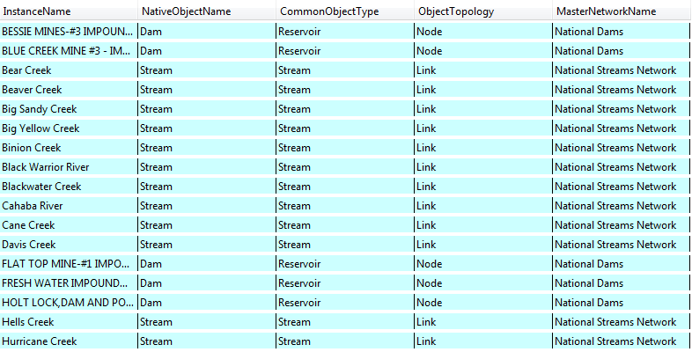
3. Discover available data for a WEAP model in the Tuscaloosa Region, AL
https://goo.gl/BCPZoq

Slide 10
Future Work
Automate the process to import data to WEAP and SWAT models
Develop web-services to publish water management data
Define WaM-DaM as a Resource in HydroShare

Slide 11
Thank you!
Questions?
Feedback
https://goo.gl/SLS8vD
WaM-DaM
Model quicker. Publish faster.

Slide 12
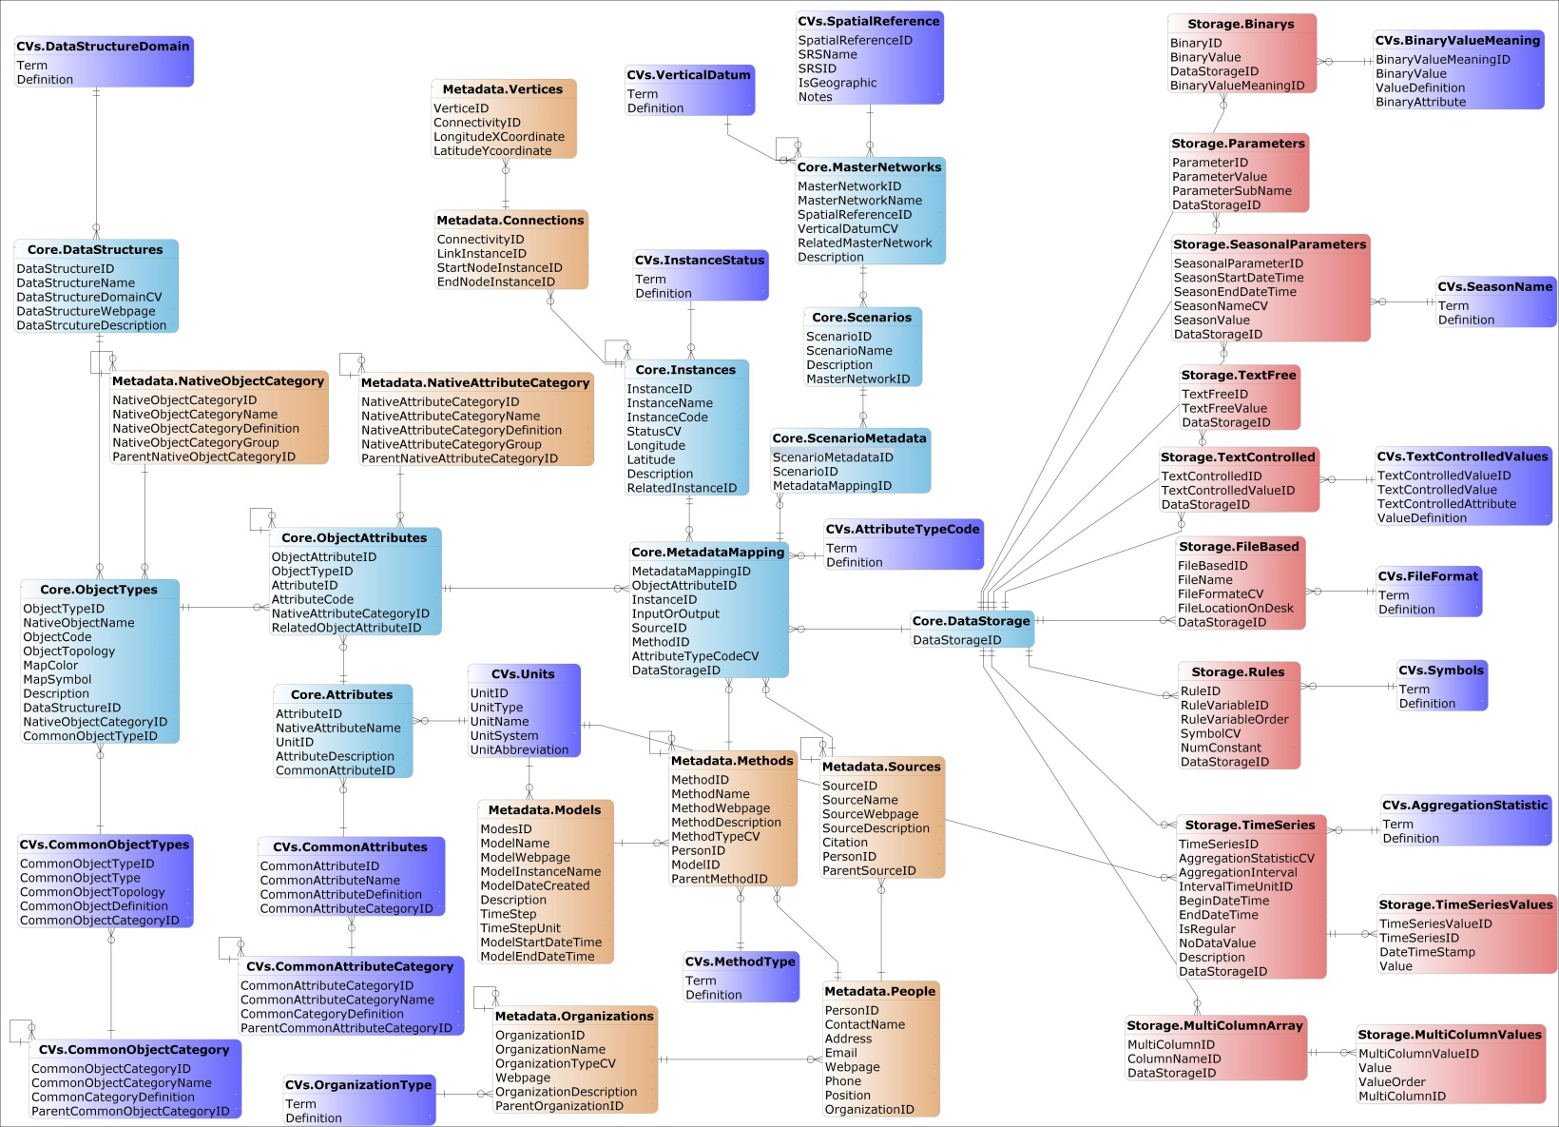
WaM-DaM Logical Data Model
Notes:
Only if really need.

