Slide 1


The Road to C: From Wires to Words
Wameedh SC

Slide 2
Agenda
01
What Is a Computer?
07
Where We Find C Today
02
Why We Need Computers
08
Showing Output: printf
03
The Binary Number System
09
Datatypes & Placeholders
04
Computer Anatomy
10
Variables & const
05
Machine Code to Assembly
11
Reading Input: scanf
06
What Is a Compiler?
12
Arithmetic Operators
Wameedh SC
2

Slide 3
Who can tell me what a computer actually is?
Question
Wameedh SC
3

Slide 4

Answer:
A machine that processes information according to instructions.
Every computer system performs: Input → Processing → Output
Input device(s)
Processor (CPU)
Output device(s)
Receive input
Process information
Produce output
“Every computer, from your phone to a supercomputer, follows this same logic.”
Wameedh SC
4

Slide 5
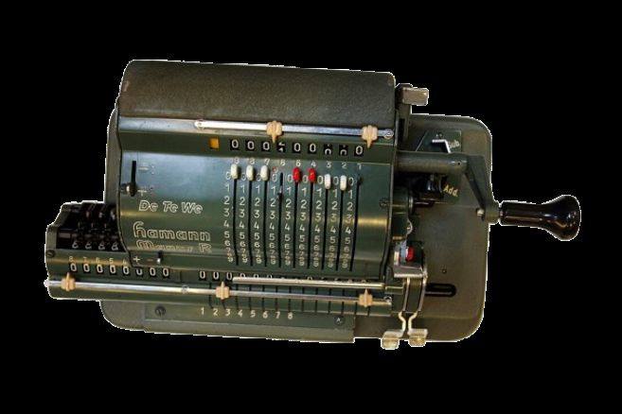
Why We Need Computers?
Humans needed and created computers primarily to automate difficult, time-consuming, and error-prone tasks, particularly complex calculations, and to enhance human capabilities in managing information and solving problems.
During World War II, military needs drove early computer development — machines like Colossus and Bombe broke enemy codes, while ENIAC computed artillery trajectories.
Mechanical Computer
Wameedh SC
5

Slide 6
What is the binary number system?
Question
Wameedh SC
6

Slide 7
Answer:
Humans use base 10 → because of 10 fingers.
ON / OFF
Machines use base 2 → because of two stable states (ON/OFF).
Binary fits perfectly with electronic switches.
1
0
1
0
Examples (decimal → binary):
2 → 10
1 → 01
3 → 11
0 → 00
Wameedh SC
7

Slide 8
Information:
60
20
Babylonians: used base 60 (sexagesimal) — that’s why we still have 60 seconds in a minute and 360 degrees in a circle.
Mayans: used base 20 (vigesimal) — likely because they counted on fingers and toes.
Wameedh SC
8

Slide 9
Let’s discover together computer anatomy
Wameedh SC
9

Slide 10
What is a program?
Question
Wameedh SC
10

Slide 11


From Machine Code to Assembly
Early programming = writing 0s and 1s.
Assembly introduced symbols easier for humans.
Both are low-level and hardware-specific.
Example :
Machine : 10110000 00000001
Assembly : MOV AL, 01h
Wameedh SC
11

Slide 12
What is a compiler?
Question
Wameedh SC
12

Slide 13

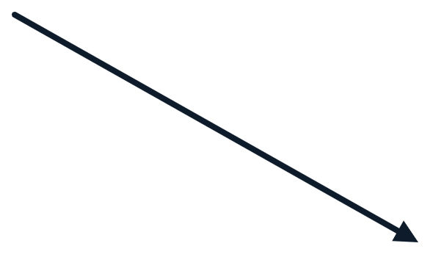
Compiler for Computer A
Machine Code for Computer A
C
Source Code
Compiler for Computer B
Machine Code for Computer B
Wameedh SC
13

Slide 14




Where We Find C Today?
Operating systems
Embedded System
High-Performance Systems
Windows and Linux kernel.
Cars, IoT, controllers
Game engine, compilers, Databases
Wameedh SC
14

Slide 15
Let’s make a small demo
> _
Don’t forget to download the C compiler on your machine (windows)
Wameedh SC
15

Slide 16
How do we show something on the screen?
Question
Wameedh SC
16

Slide 17
printf: Showing Output
printf is a function from the stdio.h library. It prints text and values to the screen.
Everything inside the quotes is printed exactly as written.
The \n at the end moves the cursor to the next line.
Every program that uses printf starts with: #include <stdio.h>
#include <stdio.h>
int main() {
printf("Hello, World!\n");
return 0;
}
Output
Hello, World!
Wameedh SC
17

Slide 18
What kinds of data can a program store?
Question
Wameedh SC
18

Slide 19
The Four Basic Datatypes
Every value in C has a datatype. It tells the computer what kind of value it is and how much memory it uses.
int
float
char
bool
Whole numbers
Decimal numbers
One character
True or false
42, -7, 0
3.14, -0.5, 2.0
'A', 'z', '7'
true, false
Print with %d
Print with %f
Print with %c
Print with %d
usually 4 bytes
usually 4 bytes
usually 1 byte
usually 1 byte
true prints as 1 and false prints as 0. bool needs #include <stdbool.h>. Sizes are typical and can vary.
Wameedh SC
19

Slide 20
printf: Placeholders with %
Use % followed by a letter to mark where a value will be printed. The values are written after the text, in the same order.
%d
%f
%c
%%
int
float
char
percent
Whole numbers
Decimal numbers
One character
Literal % sign
prints 42
prints 3.14
prints A
prints %
Tip: %.2f prints a float with exactly 2 digits after the dot. 3.14159 is printed as 3.14.
Wameedh SC
20

Slide 21
int and float: Numbers
int
float
Stores whole numbers. There is no decimal point.
Stores numbers with a decimal point. It keeps about 7 digits of precision.
printf("%d\n", 30);
printf("%d\n", -5);
printf("%f\n", 19.99);
printf("%f\n", 3.14);
The decimal part is lost: 3.9 becomes 3 when stored as an int.
Print with %d.
Print with %f, or %.2f for 2 decimals.
Use float when the value has a fraction.
Wameedh SC
21

Slide 22
char and bool
char
bool
Stores one character, written in single quotes.
Stores true or false. It needs the stdbool.h library.
printf("%c\n", 'A');
printf("%c\n", '$');
#include <stdbool.h>
printf("%d\n", true);
printf("%d\n", false);
'A' is a char, but "A" is text, not a char.
Behind the scenes each char is a number. For example, A is 65.
Print with %c.
true is stored as 1 and false as 0.
Print with %d to see 1 or 0.
Used for yes or no questions, like "did the student pass?"
Wameedh SC
22

Slide 23
How do we keep a value to use later?
Question
Wameedh SC
23

Slide 24

Variables: A Named Container
A variable is a named box in memory. It has two parts:
age
age
20
change
21
Name: the label used to find the box, like age
Value: what is stored inside the box, like 20
The value can be changed at any time. The name stays the same.
before: age = 20
after: age = 21
The label stays. The content can change.
Wameedh SC
24

Slide 25
Declare, Assign and Change
Syntax
#include <stdio.h>
int main() {
int age = 20; // declare and assign
printf("%d\n", age); // prints 20
age = 21; // change the value
printf("%d\n", age); // prints 21
return 0;
}
datatype name = value;
You can also declare first and give a value later: int age; then age = 20;
Naming rules
Letters, digits and _ only
Cannot start with a digit
No spaces. Use student_age or studentAge
Case-sensitive: Age and age are different
Cannot be a keyword like int
Output
20
21
Wameedh SC
25

Slide 26
printf: Mixing Text and Values
#include <stdio.h>
int main() {
int age = 20;
float height = 1.75;
char grade = 'A';
printf("Age: %d\n", age);
printf("Height: %.2f\n", height);
printf("Grade: %c\n", grade);
return 0;
}
Output
Age: 20
Height: 1.75
Grade: A
Each % is replaced by a value, in order.
%d for int, %f for float and %c for char.
%.2f limits a float to 2 digits after the dot.
Wameedh SC
26

Slide 27
const: A Value That Cannot Change
Adding const before the datatype makes a variable read-only. Once it has a value, it can never change.
Normal variable
int score = 10;
score = 11; // allowed
A const must get its value when it is created.
If the program tries to change it, the compiler stops with an error.
Use it for values that never change, like PI or a maximum score.
const variable
const int score = 10;
score = 11; // error
Wameedh SC
27

Slide 28
const: Examples
#include <stdio.h>
const float PI = 3.14;
const int MAX_STUDENTS = 30;
int main() {
float radius = 2.0;
float area = PI * radius * radius;
printf("Area: %.2f\n", area);
printf("Max: %d\n", MAX_STUDENTS);
// MAX_STUDENTS = 40; // ERROR: cannot change a const
return 0;
}
Output
Area: 12.56
Max: 30
Why use const?
Protects values from accidental changes.
Easy to update in one place.
Makes the code easier to read.
Wameedh SC
28

Slide 29
How can the user give us a value?
Question
Wameedh SC
29

Slide 30
scanf: Reading Input
scanf reads what the user types on the keyboard and stores it in a variable.
#include <stdio.h>
int main() {
int age;
printf("Enter your age: ");
scanf("%d", &age);
printf("You are %d years old\n", age);
return 0;
}
Syntax
scanf("format", &variable);
The format works like printf: %d, %f or %c.
The & (address of) tells scanf where to store the value.
Needs #include <stdio.h>, like printf.
Sample run
Enter your age: 20
You are 20 years old
The user types 20 and presses Enter.
Wameedh SC
30

Slide 31
scanf with Each Datatype
int
scanf("%d", &students);
Use %d for int values.
whole numbers
float
scanf("%f", &price);
Use %f for float values.
decimal numbers
char
scanf(" %c", &grade);
The space before %c skips the Enter key left over from the last input.
one character
bool
scanf("%d", &answer);
passed = answer;
scanf cannot store into a bool directly. Read a 1 or 0 into an int, then copy it into the bool.
true or false
Wameedh SC
31

Slide 32
Full Example
#include <stdio.h>
#include <stdbool.h>
int main() {
int age;
float height;
char grade;
int answer;
bool passed;
printf("Age: ");
scanf("%d", &age);
printf("Height: ");
scanf("%f", &height);
printf("Grade: ");
scanf(" %c", &grade);
printf("Passed (1 or 0): ");
scanf("%d", &answer);
passed = answer;
printf("%d %.2f %c %d\n", age, height, grade, passed);
return 0;
}
One program that reads all four datatypes. Each scanf stores its value in a variable.
The space in " %c" skips the Enter key left over from the previous input.
bool is read as an int, then copied into the bool.
Sample run
Age: 20
Height: 1.75
Grade: A
Passed (1 or 0): 1
20 1.75 A 1
Wameedh SC
32

Slide 33
What can we do with values?
Question
Wameedh SC
33

Slide 34
Arithmetic Operators
Given a = 10 and b = 3
Operator | Name | Example | Result
+ | Addition | a + b | 13
- | Subtraction | a - b | 7
* | Multiplication | a * b | 30
/ | Division (whole numbers) | a / b | 3
% | Remainder | a % b | 1
printf("%d\n", a / b); // 3
printf("%d\n", a % b); // 1
Division of two int values drops the decimal part. 10 / 3 gives 3, not 3.33. For decimals, use a float: 10.0 / 3 gives 3.33.
Wameedh SC
34

Slide 35
Thank you for your attention!
Wameedh SC

