Slide 1

Optimizing Customer Engagement and Inventory Management at a Small Supermarket
Presented by: Wamiq Mushtaq
Roll Number: 22f1001807
BDM Capstone Project
IIT Madras BS Degree Program

Slide 2
Organization Background
City Mall Holdings
Growing supermarket chain operating in Myanmar
Three branches located in:
Yangon
Mandalay
Naypyitaw
Offers diverse product lines:
Food and beverages
Fashion accessories
Electronic accessories
Health and beauty
Home and lifestyle
Sports and travel
Balanced customer base of members and non-members

Slide 3
Business Challenges
Customer Engagement
Limited understanding of customer segments and purchasing patterns
Need for targeted engagement strategies
Inventory Management
Irregular sales patterns causing potential stockouts
Inefficient inventory replenishment practices
Payment Method Optimization
Unclear payment preferences across branches
Need to optimize payment processing efficiency

Slide 4
Data & Analytical Approach
Dataset: 1,000 sales records (Jan-Mar 2019)
17 variables capturing transaction details
No missing values or duplicates
Analytical Methods:
Customer Segmentation: K-means clustering with segment profiling
Time Series Analysis: Decomposition (trend, seasonality, residuals)
Payment Utilization: Comparative statistical analysis
Tools: Python (Pandas, Scikit-learn, Statsmodels)
Limitations:
Transaction-based analysis due to absence of unique CustomerIDs in data

Slide 5
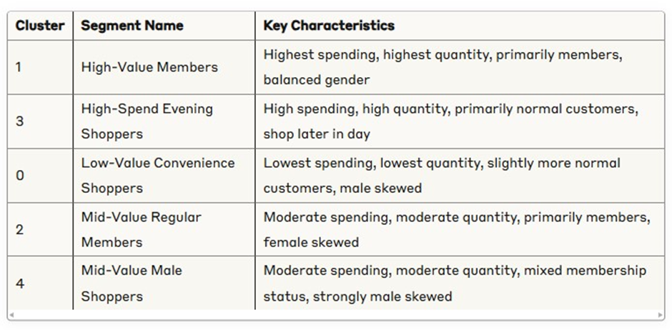
Customer Segmentation
Identified 5 distinct transaction segments using K-Means.
Segments differ significantly in spending, quantity, and associated demographics/time.

Slide 6
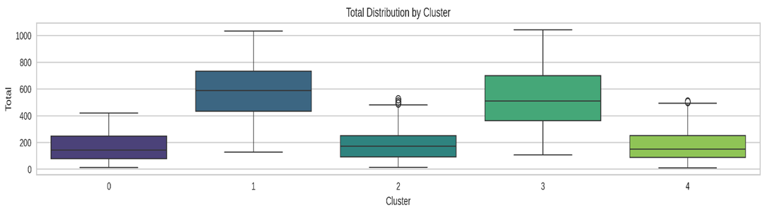
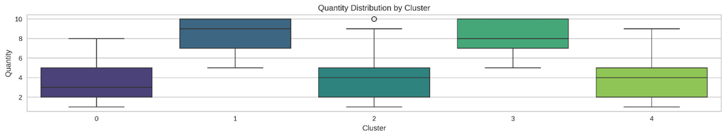
Customer Segmentation - Box Plots

Slide 7
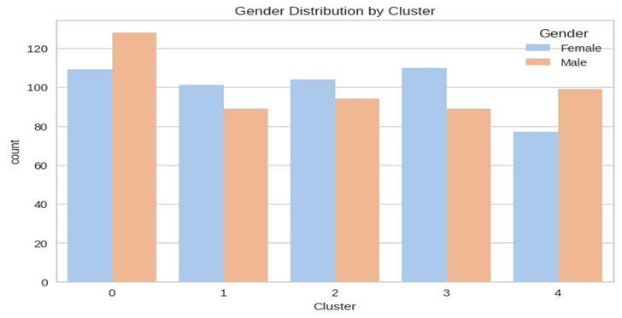
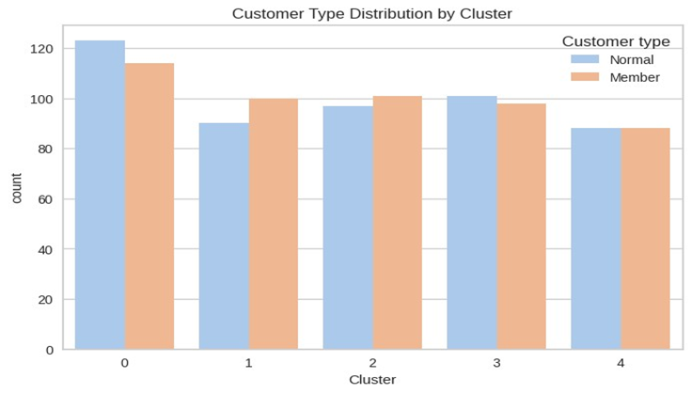
Customer Segmentation - Who & When
Differences seen in Customer Type (Member/Normal) and Gender associations."
Cluster 3 transactions occur later in the day.

Slide 8
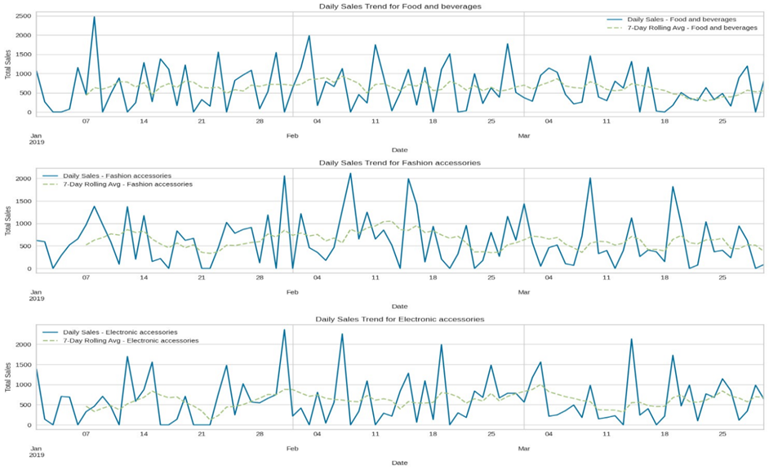
Inventory Insights: Sales Patterns
Significant daily sales volatility across product lines.
Prominent weekly seasonality observed.
Potential stockout periods identified (Jan 23-24, Feb 10-11 for F&B; Jan 18-19, Feb 5-6 for Electronics).

Slide 9
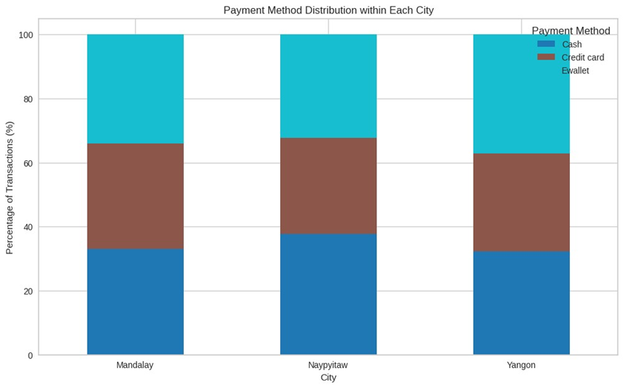
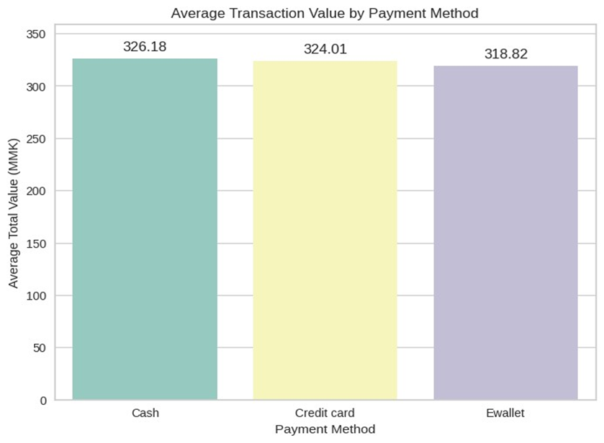
Payment Method Preferences & Value
Overall usage: E-wallet, Cash most frequent (nearly even).
Value: Cash & Credit Card have slightly higher average transaction value.
Regional & Customer Type variations exist." (e.g., Naypyitaw Cash, Yangon E-wallet; Members lean CC)
Member Credit Card transactions have highest avg value (335.88 MMK)

Slide 10
Recommendations: Customer Engagement
High-Value Members ( Cl 1 ): Tiered loyalty, exclusive offers. KPI: Repeat purchase rate.
High-Spend Normals ( Cl 3 ): Investigate, promote membership value (large baskets). KPI: Conversion rate.
Low-Value Transactions ( Cl 0 ): Impulse items near checkout, bundle deals. KPI: Avg quantity per transaction.
Core Members ( Cl 2 , 4): Maintain engagement, consider gender-specific promos ( Cl 4 ). KPI: Transaction frequency

Slide 11
Recommendations: Inventory & Payment
Inventory Optimization:
Implement seasonality-adjusted ordering (esp. weekends).
Investigate identified zero-sales periods (Crucial step!).
Establish safety stock for frequently stockout products.
KPI: Reduction in stockout incidents.
Payment Optimization:
Conduct cost analysis per payment type (First step!).
Adapt operations to local preferences.
Leverage Member CC usage (contingent on cost/value analysis).
KPI: Transaction efficiency & cost reduction.

Slide 12
Strategic Assessment: SWOT Analysis
Strengths: Balanced demographics, Identifiable segments, Consistent weekly patterns.
Weaknesses: Inventory gaps, High daily volatility, Limited historical data.
Opportunities: Targeted marketing, Improved forecasting, Payment optimization.
Threats: Changing consumer preferences, Continued stockouts (if not addressed), Competition.

Slide 13
Conclusion & Thank You
Analysis provides actionable insights for Customer Engagement, Inventory, and Payment.
Implementing recommendations can lead to improved efficiency, customer satisfaction, and revenue.
Thank You

