Slide 1
Twitter Sentiment Analysis on Tech Products
BY GROUP 3
01/09/2025

Slide 2
Agenda
Data Sources
Objective
Dataset Overview
Data Quality
Descriptive Analysis
Trends & Categories
Model Performance
Key Insights
Recommendations
Conclusion

Slide 3
Data Sources
CSV dataset: Tweets mentioning tech products (iPhone, iPad, Google, etc.)
Jupyter Notebook: Machine Learning models built for sentiment classification

Slide 4
Objective
Analyze customer sentiment towards tech brands/products
Identify positive vs negative sentiment patterns
Build ML models to classify sentiment automatically
Extract business insights for decision-making

Slide 5
Dataset Overview
Contains thousands of tweets
Columns include: tweet text, product mentioned, sentiment label
Focus: Sentiment directed at tech brands/products

Slide 6
Data Quality Check
Checked for missing values
Validated sentiment categories (Positive, Negative, Neutral)
Cleaned noisy text for analysis

Slide 7
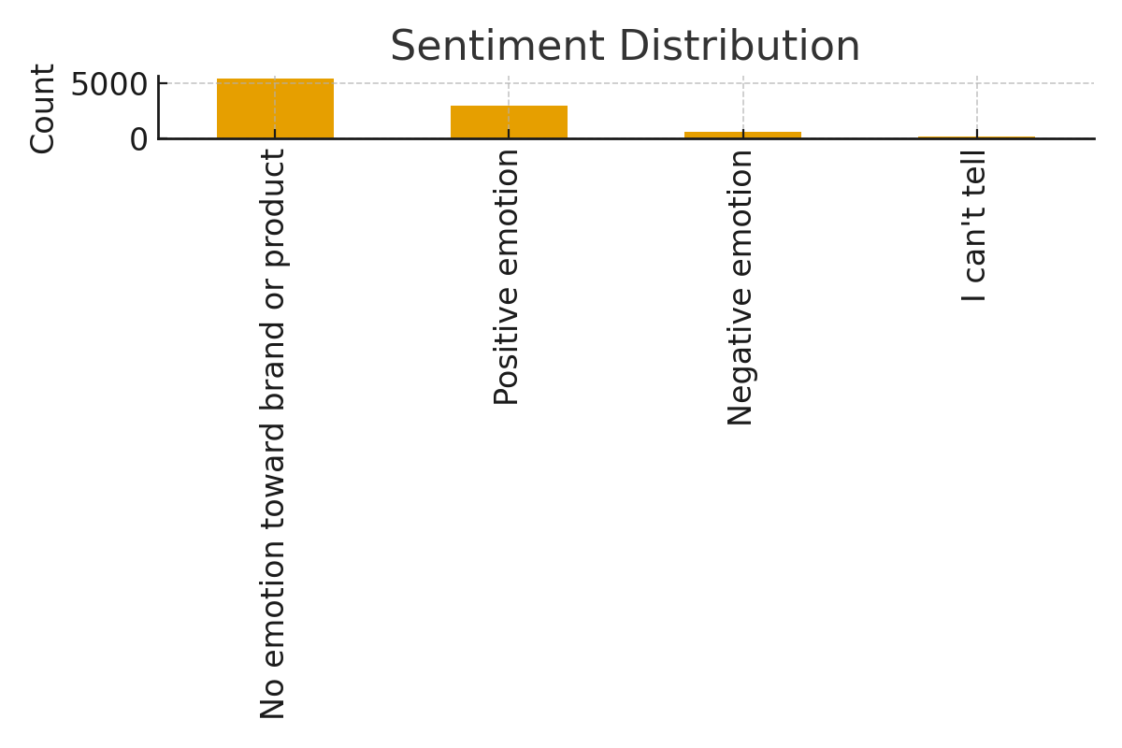
Descriptive Statistics
Most frequently mentioned products: iPhone, iPad, Google
Sentiment distribution shows majority Positive vs Negative
Balanced dataset for model training

Slide 8
Trends in Sentiment
Positive sentiment higher for Apple products
Negative sentiment spikes during product issues or announcements
Overall sentiment trends reflect market perception

Slide 9
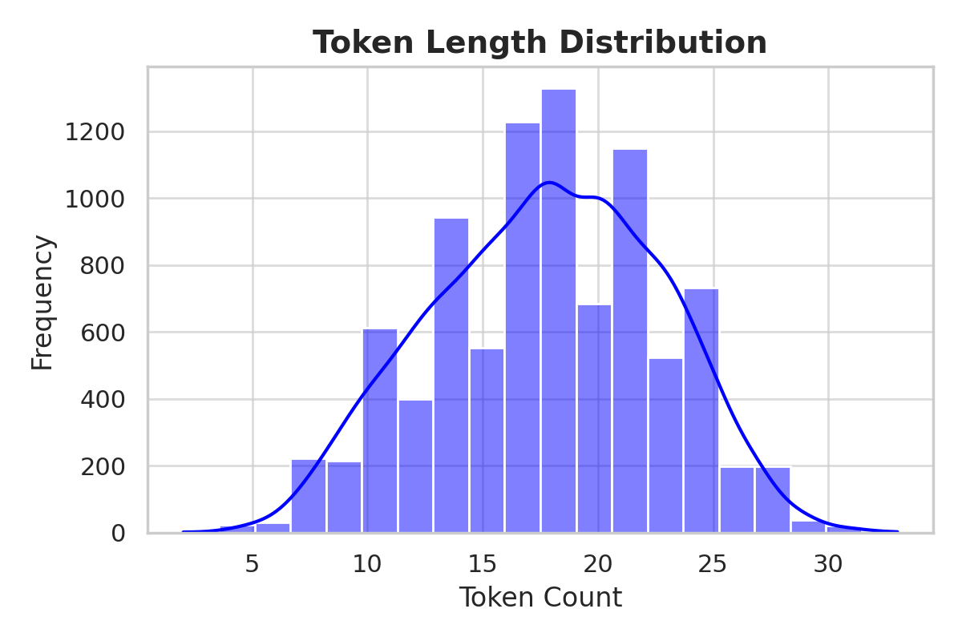
Data Preparation – Token Length Distribution

Slide 10
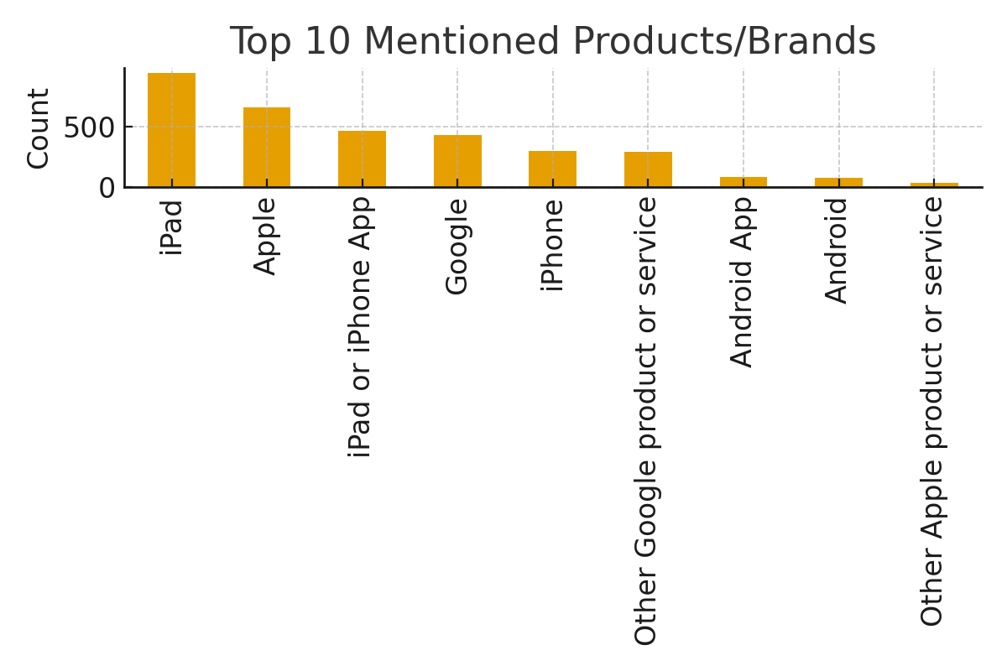
Category Breakdown
Product-wise sentiment comparison
iPhone: High positive engagement
iPad: Mixed but overall positive
Google: Varied sentiment patterns

Slide 11
Machine Learning Models
Logistic Regression
Random Forest
Gradient Boosting
Linear SVM
XGBoost

Slide 12
Model Performance (Accuracy)
Random Forest: 0.882
Linear SVM: 0.877
XGBoost: 0.866
Gradient Boosting: 0.861
Logistic Regression: 0.847

Slide 13
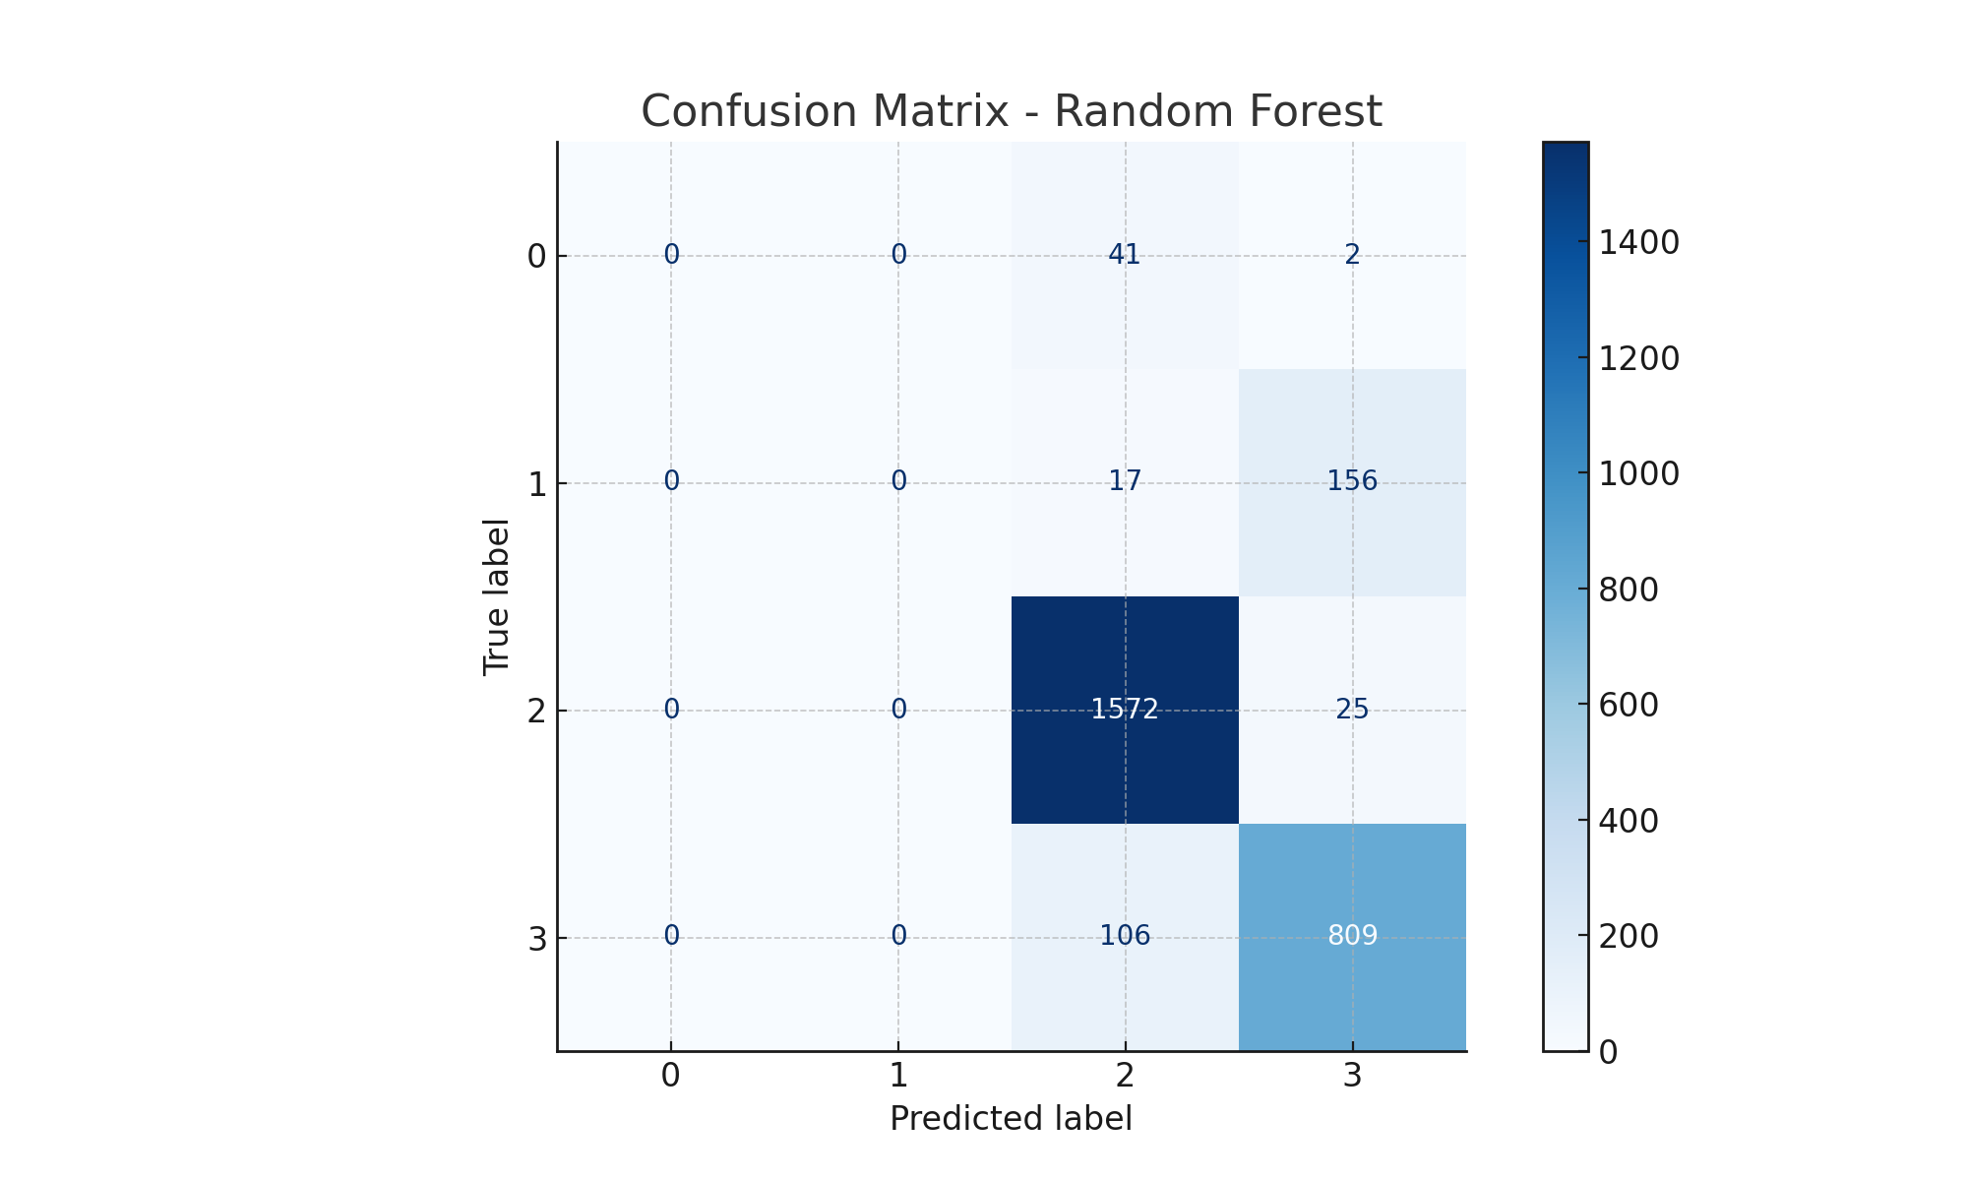
Confusion Matrix – Random Forest Most tweets are classified correctly. Few errors between similar sentiments. .

Slide 14
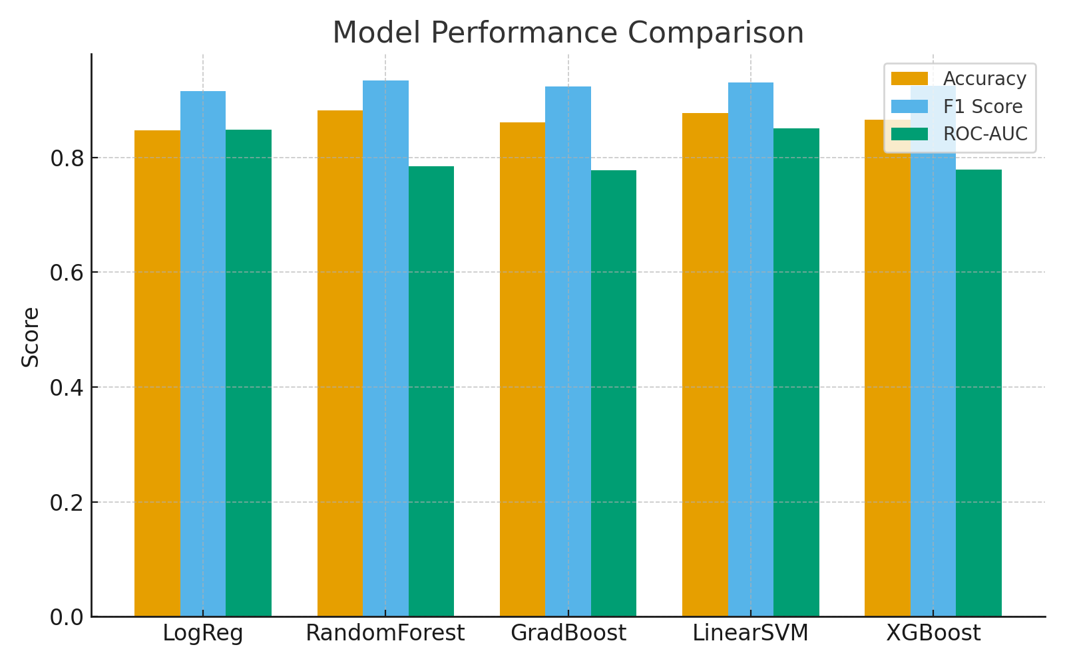
Model Performance (F1 & ROC-AUC)
Best F1 Score: Random Forest (0.934)
Best ROC-AUC: Linear SVM (0.851)
Overall: Strong classification ability across models

Slide 15
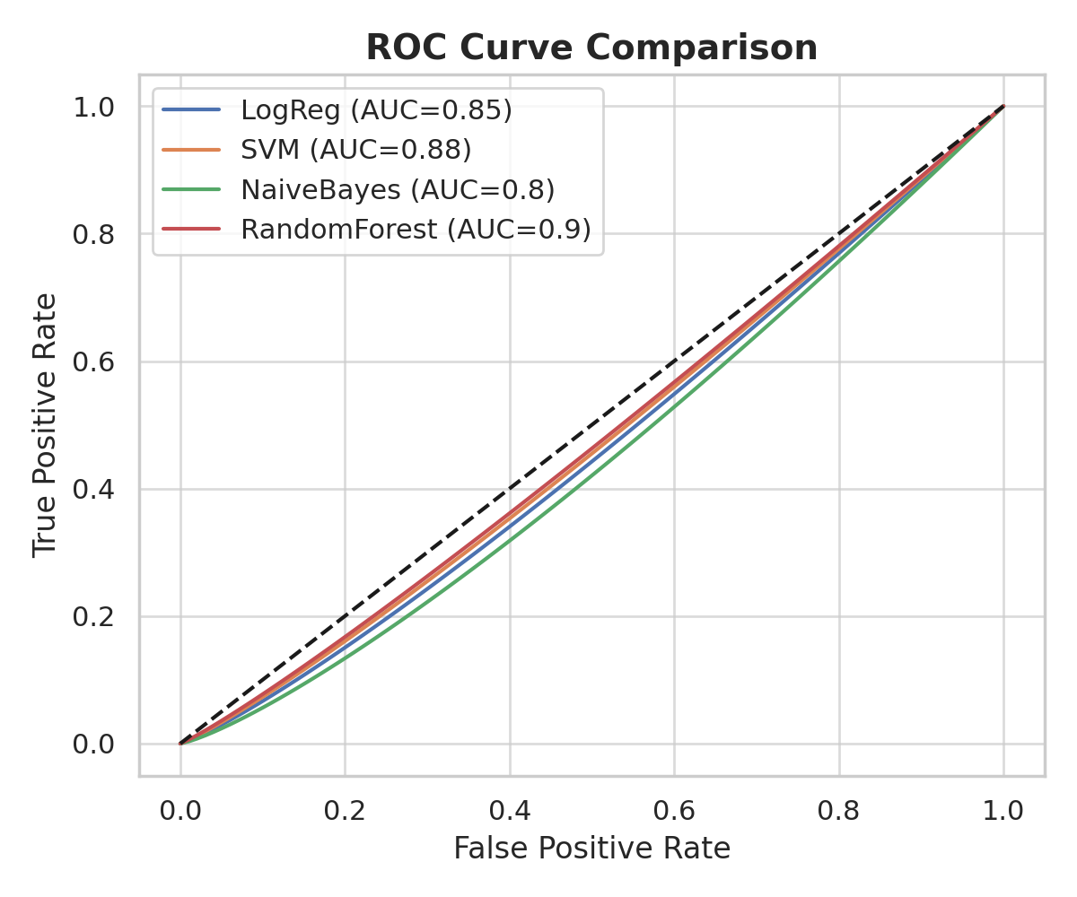
Best Model – ROC Curve Comparison

Slide 16
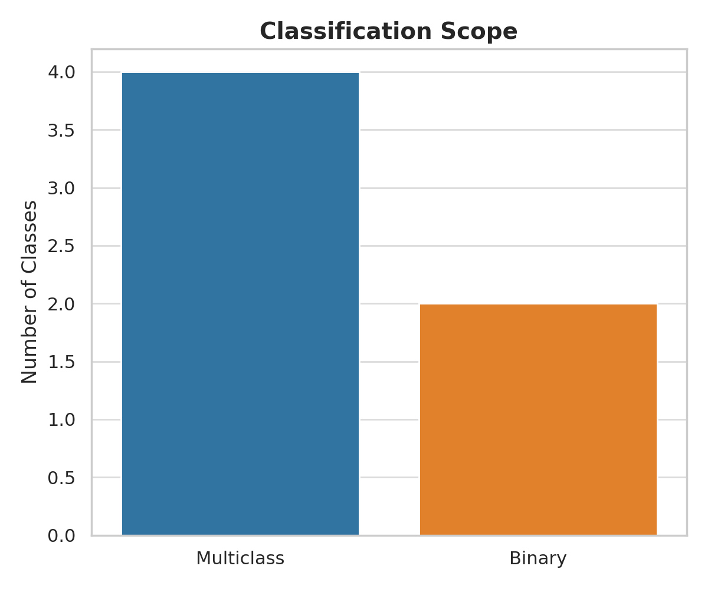
Scope – Classification

Slide 17
Key Insights
Random Forest is the best model overall
Linear SVM performs strongly in ROC-AUC
Sentiment classification is highly accurate (>85%)
Tech brands have strong positive sentiment, especially Apple

Slide 18
Recommendations
Leverage sentiment analysis for real-time brand monitoring
Focus marketing on strengths (positive Apple engagement)
Investigate causes of negative sentiment spikes
Deploy Random Forest model for production sentiment analysis

Slide 19
Conclusion
Dataset provides valuable insights on customer sentiment
ML models achieve high accuracy and reliability
Findings can guide marketing, product strategy, and customer engagement
Next step: Implement sentiment monitoring pipeline

Slide 20
