Slide 1

Computer
Architecture & Networks
N-Bit Microprocessors

Slide 2

Flags Register
Flags indicate the condition of the microprocessor as well as its operation
The flag bits change after many arithmetic and logic instructions execute
Example flags,
CF(carry) indicates carry after addition or a borrow
after subtraction
OF(overflow) is a condition that can occur when signed numbers are added or subtracted
ZF(zero) indicates that the result of an arithmetic or logic operation is zero (1 = yes)

Slide 3

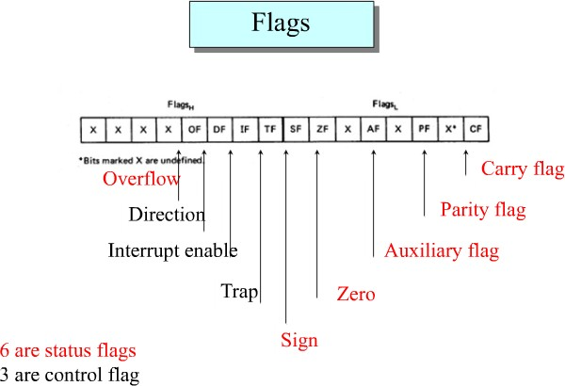
Flags Register

Slide 4

Flags Register
DF(direction) indicates left or right for moving or comparing string data.
IF(interrupt) indicates whether external interrupts are being processed or ignored.
TF(trap) permits operation of the processor in single step mode.
SF(sign) contains the resulting sign of an arithmetic
operation (1 = negative)
AF(auxiliary carry) contains carry out of bit 3 into bit 4
for specialised arithmetic.
PF(parity) indicates the number of 1 bits that result
from an operation.

Slide 5

Self-Test 1: Flags Condition
Assume the following register conditions:
AX = AB00H, BX = 200CH, CX = 3003H, DX = DEFFH
Find the status of the CF, PF, AF, ZF and SF for the following operations:
MOV BX, 3FH
ADD BL, 45H
ADD BX, DX
CMP AX, DX
NOT DX

Slide 6

Self-Test 1: Answers
1. MOV BX, 3FH ADD BL, 45H
BL = 84H (3FH + 45H)
3FH:
45H:
0011 1111
0100 0101 +
[SF = 1]
1000 0100 [AF = 1, ZF = 0, CF = 0, PF = 1]
2. ADD | BX, DX
200CH: | 0010 | 0000 | 0000 | 1100
DEFFH: | 1101 | 1110 | 1111 | 1111 | +
 | 1111 | 1111 | 0000 | 1011 | (FF0BH)
[AF = 1, ZF = 0, CF = 0, PF = 0, SF = 1]

Slide 7
Self-Test 1: Answers (cont)
3. CMP AX, DX
AB00H:
DEFFH:
1010 1011 0000 0000
1101 1110 1111 1111 –
1100 1100 0000 0001 (CC01H)
[AF = 1, ZF = 0, CF = 1, PF = 0, SF = 1]
4. NOT DX
DEFFH:
NOT:
1101 1110 1111 1111
0010 0001 0000 0000 (2100H)
[AF = 0, ZF = 0, CF = 0, PF = 0, SF = 0]

Slide 8

Self-Test 2: Arithmetic & Logical
Assume the following register conditions:
CF = 1, AX = ABCDH, BX = EF01H, DX = 2345H
Perform the following operations. Indicate the result and the register where it is stored. The operations are independent of each other.
XOR AL, 79H
MOV CL, 4H
ROR DX, CL
OR BX, DX
AND AX, BX
MOV CL, 3H
RCL BH, CL

Slide 9
Self-Test 2: Answers
1. XOR AL, 79H
CDH:
79H:
1100 1101
0111 1001 ⊕
1011 0100 [AL = B4H]
MOV CL, 4H
ROR DX, CL
2345H: 0010 0011 0100 0101
After 4 rotations: 0101 0010 0011 0100 ⇨ 5234H = DX
OR BX, DX
EF01H:
2345H:
1110 1111 0000 0001
0010 0011 0100 0101
1110 1111 0100 0101 ⇨ EF45H = BX

Slide 10

Self-Test 2: Answers (cont)
4. AND AX, BX
ABCDH: EF01H:
1010 1011 1100 1101
1110 1111 0000 0001
1010 1011 0000 0001 ⇨ AB01H = AX
5. MOV CL, 3H
RCL BH, CL CF = 1
EFH: | 1110 | 1111
After 1st rotation: | 1101 | 1111, | CF = 1
After 2nd rotation: | 1011 | 1111, | CF = 1
After 3rd rotation: | 0111 | 1111 | ⇨ 7FH = BH, CF = 1

Slide 11
Self-Test 3: Physical Address
The register content for an Intel 8086 microprocessor is as
follows:
CS = 1000H, | DS = 2000H, | SS = 3000H, | SI = 4000H, DI = 5000H
BX = 6080H, | BP = 7000H, | AX = 25FFH, | CX = 8791H, DX = 1299H
Calculate the physical address of the memory where the operand is stored and the contents of the memory locations in each of the addresses shown below:
MOV [SI], AL
MOV [DI+6H], BX
MOV [SI+BX–8H], AX
MOV [DI][BX]+28H, CX
MOV [BP][SI]+10H, DX

Slide 12
Computer Architecture
& Networks
N-Bit Microprocessors

Slide 13

Content
Memory Address Space and Data Organization
Data Types
Segment Registers and Memory Segmentation

Slide 14

In computer architecture, a register is a small amount of storage (memory) available on the CPU whose contents can be accessed more quickly than storage available elsewhere (cache, RAM, etc.).

Slide 15

Software Model of the 8088/8086 Microprocessor
The purpose of developing a software model is to help the programmer to understand the operation of microprocessor in software point of view.
Thus, hardware architectural is not necessarily need to know. But it is important to know various registers, external memory and I/O peripherals.
The figure illustrates the software architecture of 8088
microprocessor.

Slide 16

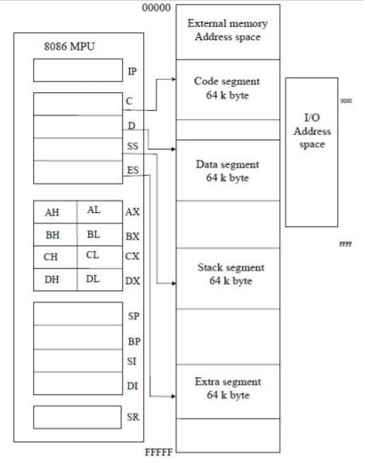
The 8088 microprocessor
includes 13 16 bit internal registers:
Instruction pointer (IP)
Four data registers
( AX, BX, CX, DX)
Two pointer registers
(BP and SP)
Two index registers
(SI and DI)
Four segment registers
(CS, DS, SS and ES)
Status register (SR)
I/O Address space 64Kbyte s
Independent memory
address space
1 Mbytes
Software model of the 8086/8088 microprocessor

Slide 17
Memory Address Space and Data Organization
Lets see how information stored in memory.
Individual bytes of data stored at consecutive addresses over the address range 00000₁₆ to FFFFF_{16.}
Thus, memory organized as 8 bit bytes not as 16 bits words.
The 8088 can access any two consecutive bytes as a word of data. The lower addressed byte is the least significant byte of word, and the higher-addressed byte is its most significant byte.

Slide 18

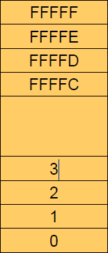
Memory Address Space and Data Organization
Memory address space

Slide 19

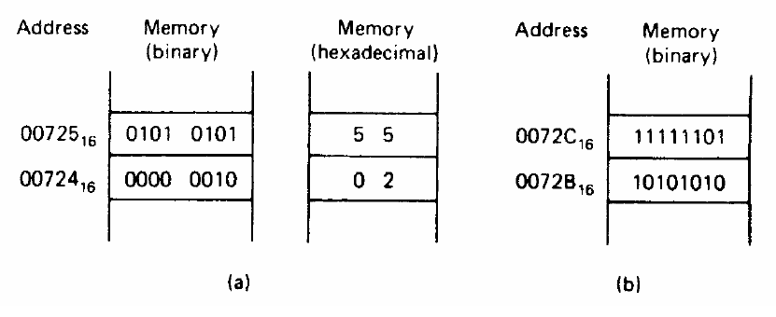
Memory Address Space and Data Organization
Lower address byte and higher address byte
How a word of data is stored in memory for Figure (a)?
The two bytes represent the word, Higher-add storage + Lower
address storage
0101 0101 0000 0010₂ = 5502₁₆

Slide 20
Memory Address Space and Data Organization
To permit efficient use of memory, words are stored at even- or odd-
address boundaries (memory bank)
The LSB of the address determines the type of word
boundary
‘0’ : even address
2 consecutive bytes with lower byte at an even address
Bytes and words at even-addressed boundaries can be accessed by 1
bus cycle
Bytes and words at odd-addressed boundaries require 2 bus cycles to
access
A double word is another data form that can be processed by the 8088 microcomputer. A double word corresponds to four consecutive bytes of data stored in memory.

Slide 21
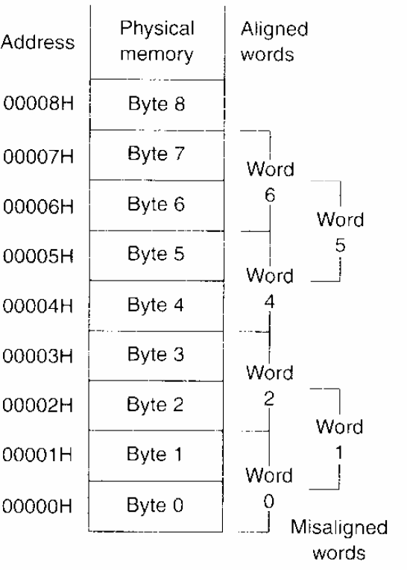
Aligned word or misaligned word
A word of data stored at an even address boundary – 00000₁₆, 00002₁₆, 00004₁₆… aligned word
A word of data stored at an odd address boundary – 00001₁₆, 00003₁₆, 00005₁₆… misaligned word
A double word corresponds to four consecutive bytes of data stored in memory.
Note* When expressing addresses and data in hexadecimal form it is common to use the letter H to specify the base.

Slide 22
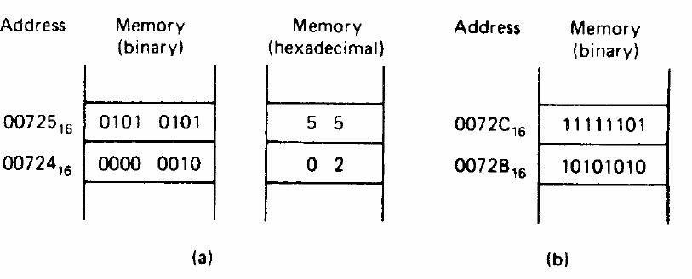
Memory Address Space and Data Organization
EXAMPLE:
What is the data shown in the Figure (b)?
Express the result in hexadecimal form. Is it stored at an even or odd addressed word boundary? Is it aligned or misaligned word of data?

Slide 23
Memory Address Space and Data Organization
SOLUTION:
11111101₂ = FD₁₆ = FDH
10101010₂ = AA₁₆ = AAH
Together the two bytes give the word 1111110110101010₂ = FDAA₁₆ = FDAAH
Expressing the address of the least significant byte in binary form
gives 0072BH = 0072B₁₆ = 0000 0000 0111 0010 1011₂
The rightmost bit(LSB) is logic 1. Therefore, it is misaligned word of data.

Slide 24
Memory Address Space and Data Organization
8086 processor has a 20-bit address bus, thus can address up to 2²⁰ or 1,048,576 memory locations. Since each memory location stores one byte, 8086 systems support up to 1,048,576 bytes or 1Mbyte of memory.
The range of the memory address are from 0000 0000 0000 0000 0000 to 1111 1111 1111 1111 1111. To simply it, we normally write the address in hexadecimal : 00000H – FFFFFH.
The memory subsystem can access one or two bytes, where any 2
consecutive bytes can be accessed as a word
The lower byte is less significant while the higher byte is more significant (Little Endian Byte Ordering).

Slide 25
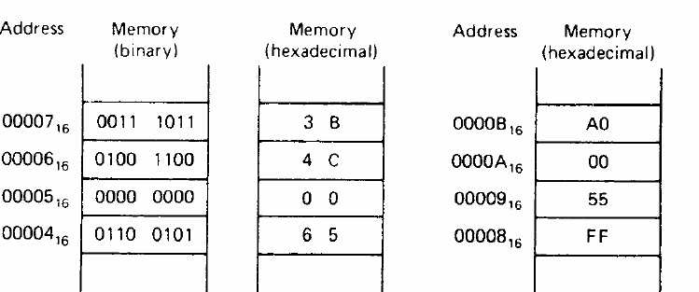
Memory Address Space and Data Organization
A pointer is a double word (multiple of 4) used to access data or code in memory. The higher address word represents the segment base address while the lower address word represents the offset.

Slide 26
Memory Address Space and Data Organization
Example: Storage of a pointer in
memory
Combine both MSB [00007H ]+ [LSB
00006H]
Higher-addressed word : Segment base address = 3B4C₁₆ = 0011101101001100₂
Lower- addressed word :
Offset value =
0065₁₆ = 0000000001100101₂
The complete double word is 3B4C0065₁₆. Since the double word is starts at address 00004₁₆, is an example of aligned double word of data.

Slide 27
SELF TEST
How should the pointer with segment base address equal to A000H and offset address 55FFH be stored at an even- address boundary starting at 00008H? Is the double word aligned or misaligned?

Slide 28
SELF TEST
How should the pointer with segment base address equal to A000H and offset address 55FFH be stored at an even-address boundary starting at 00008H? Is the double word aligned or misaligned?
Solution:
Storage of the two-word pointer requires four consecutive byte locations in memory, starting at address 00008₁₆. The least- significant byte of the offset is stored at address 00008₁₆ and is shown as FF₁₆ in the previous figure. The most significant byte of the offset, 55₁₆ is stored at address 00009₁₆. These two bytes are followed by the least significant byte of the segment base address, 00₁₆, at address 0000A₁₆, and its most significant byte, A0₁₆, at address 0000B₁₆. Since the double word is stored in memory starting at starting at address 00008₁₆, its is aligned.

Slide 29
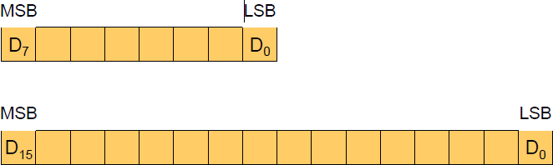
Data Types
Integer data type
Unsigned or signed integer
Byte-wide or word-wide integer
Byte : 8 bits Word : 16 bits
Double word :32 bits
Unsigned byte and unsigned word integer

Slide 30
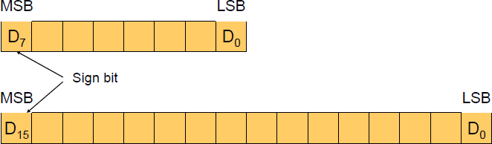
Data Types
The most significant bit of a signed integer is a sign bit. A zero in
this bit position identifies a positive number.
The range of a signed byte integer is +127 ~ -128. The range of a
signed word integer is +32767 ~ -32768.
The 8088 always expresses negative number in 2’s complement.

Slide 31
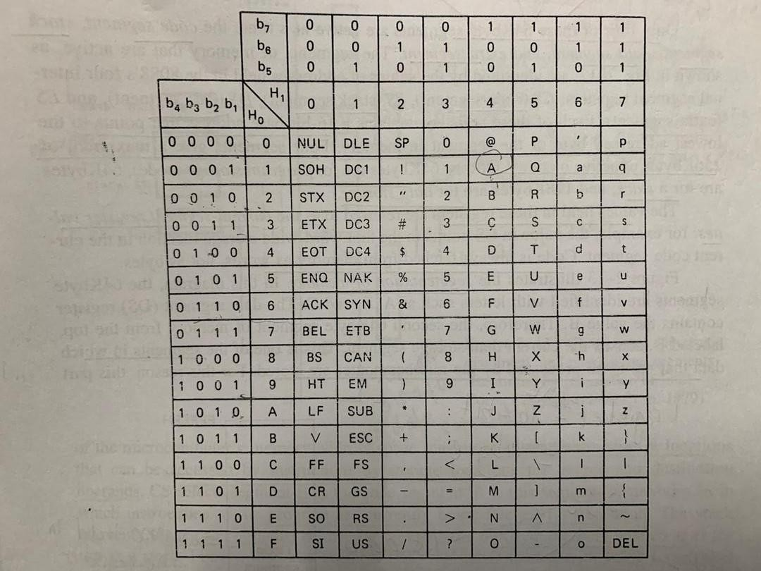
ASCII Table
The ASCII ( American Standard Code for Information Interchange) – information expressed here can be directly processed by 8088 microprocessor.
Table shows how numbers, letters, characters coded in ASCII

Slide 32
Data Types
EXAMPLE”
Byte addresses 01100₁₆ through 01104₁₆ contain the ASCII data 01000001, 01000011, 01001001 and 01001001 respectively. What do the data stand for?
Solution:
Using the ASCII table, the data are converted to ASCII code.
(01100H) = 01000001₂ = A (01101H) = 01010011₂ = S (01102H) = 01000011₂ = C (01103H) = 01001001₂ = I (01104H) = 01001001₂ = I

Slide 33
Instruction Pointer
The instruction pointer (IP) identifies the location of the next word of instruction code to be fetched from the current code segment of memory.
Contains offset of the word of instruction code instead of its actual address.
This is because both IP and CS are 16 bits in length, 20 bits is require to access the memory.
The offset in IP is combined with the current value in CS to generate te address of the instruction code. Thus denoted as CS:IP.
During normal operation, the 8088 fetches instrcutions from the code segment of memory, stores them in its instruction queue and executes them one after the other.

Slide 34

Data Registers
Data registers are used for temporary storage of frequently used intermediate results.
The contents of the data registers can be read, loaded or modified
through software.
The four registers are:
Accumulator register, A
Base register, B
Counter register, C
Data register, D

Slide 35
Data Registers
Each register can be accessed either as a whole (16 bits) for word data or as 8 bit data for byte wide operation.
The advantage of storing data in internal registers instead of memory during processing is that they can be accessed much faster.

Slide 36

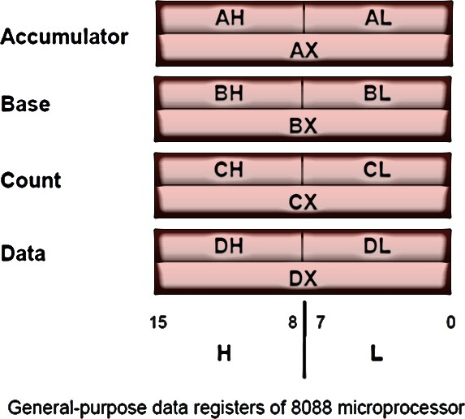
Data Registers
An X after the register letter identifies the reference of a register as a word.
When referencing one of these registers on a byte wide basis, with H and L. H -> high byte (MSB)
L-> Low byte (LSB)

Slide 37
Multipurpose Registers
AX (Accumulator)
Exists as 16-bit register or as either two 8-.bit registers (AH
and AL)
Used for instructions such as multiplication, division and
some of the adjustment instructions.
BX (Base index)
Can be appear as BH or BL as well.
Holds the offset address of a location in the memory
systems in all versions of the microprocessor.
CX (Count)
Includes CH and CL
Holds the count for various instructions including repeated
string instructions and shift, rotate and LOOP instructions.

Slide 38
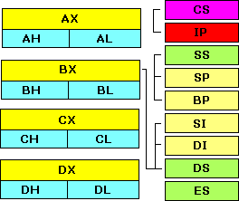
Pointer & Index Registers
SP (stack pointer) used to address data in a LIFO (last-in, first-out)
stack memory
BP (base pointer) often used to address an array of data in the stack
memory
The default segments:
CS:IP
SS:BP or SP
DS:SI or DI or BX

Slide 39
Multipurpose Registers
DX (Data)
Holds a part of the result from a multiplication or
part of the dividend before a division.
BP (Base Pointer)
Points to a memory location in all versions of the
microprocessor for memory data transfers.
DI (Destination Index)
Addresses string destination data for the string
instructions.
SI (Source Index)
Addresses source string data for the string instructions.

Slide 40

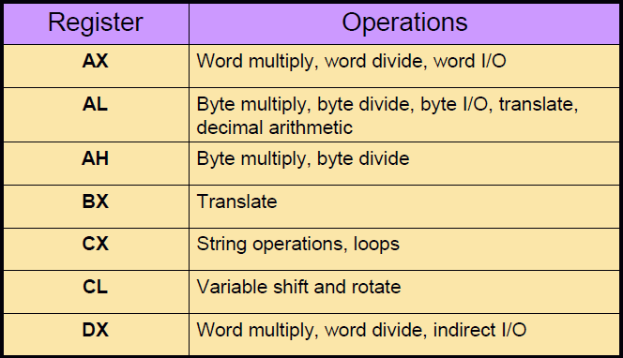
Data Registers
Dedicated register functions

Slide 41
Pointer and Index Register
The pointer registers and index registers are used to store
offset addresses.
Values held in the index registers are used to reference data
relative to the data segment or extra segment.
The pointer registers are used to store offset addresses of
memory location relative to the stack segment register.
Combining SP with the value in SS ( SS:SP) results in a 20
bit address that points to the top of the stack (TOS).
BP is used to access data within the stack segment of memory. It is commonly used to reference subroutine parameters.

Slide 42
Segment Registers
CS Register
Starting address of the memory segment that contains instructions of the program
The contents are combined with the values in IP to generate a physical address
DS Register
Starting location of the data segment which is where data can be stored, and operands are fetched from
Combined with values in SI or DI

Slide 43
Segment Registers
SS register
Starting address of the stack segment, a segment where the values of IP, status flags and other registers are pushed whenever and interrupt or subroutine calls
After the completion of the interrupt service routine or subroutine, the original system status is restored from the stack using the pop and return instructions
Combined with the value in SP to identify the next location a word is to be pushed or popped

Slide 44
Segment Registers
ES Register
Starting address of the extra segment, which is usually used for data storage
The contents may be used with the contents of DI to specify a destination address

Slide 45

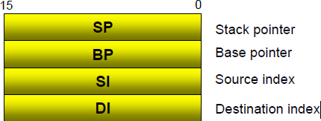
Pointer and Index Register
The index register are used to hold offset addresses for
instructions that access data in the data segment.
The source index register (SI) is used for a source operand and the destination index (DI) is used for a destination operand.
The four registers must always be used for 16 bit
operations.

Slide 46
Status Register
The status register, also called the flags register, indicate conditions that are produced as the result of executing an instruction.
Only nine bits of the register are implemented. Six of these bits represent status flags and the other three bits represent control flags.
The 8088 provides instructions within its instruction set that are able to use these flags to after the sequence in which the program is executed.

Slide 47
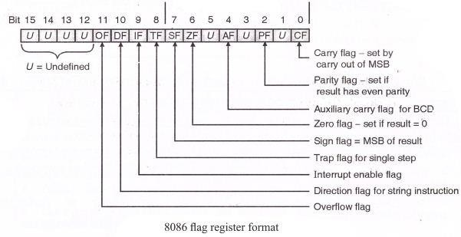
Status Register
Status and control bits maintained in the flags register
Generally Set and
Tested individually
9 1 bit flags in 8086; 7 are unused

Slide 48
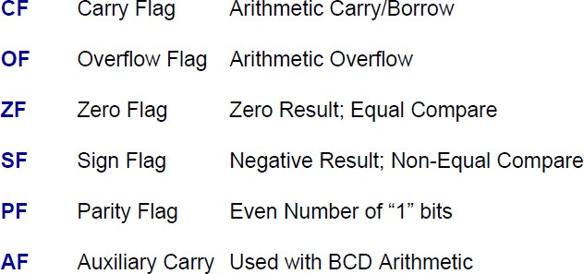
Status Register
Status flags indicate current processor status.

Slide 49
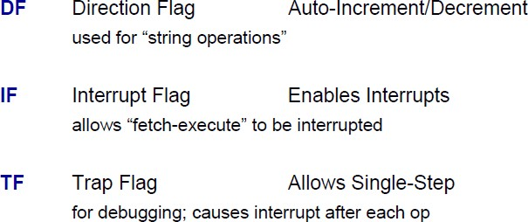
Status Register
Control flags influence the 8086 during execution phase.

Slide 50
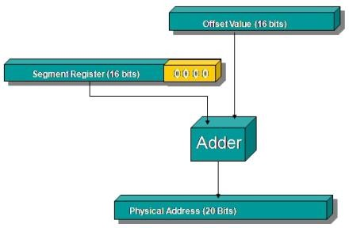
Segmentation
Memory Address Generation: The BIU has a dedicated adder for determining physical memory addresses.

Slide 51
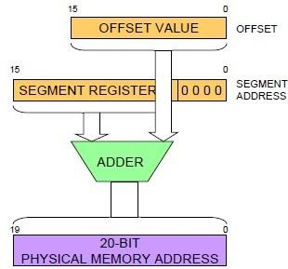
Memory Address Generation
Offset value denote the number of address locations added to the based address in order to get a specific absolute address
Segment register stores the starting addresses of a segment. To get the exact location of data or instruction within a segment, an offset value (or displacement) is required
Adder perform addition of number
Physical address- real address or binary address

Slide 52
Memory Address Generation
The base value can be from
CS (code segment), DS (data segment), SS (stack
segment) or ES (extra segment)
The point to note is that the beginning segment address is not arbitrary - it must begin at an address divisible by 16, Another way of saying this is that the low-order hex digit must be 0.
Type of memory reference | Default segment | Alternate segment | Offset (logical address)
Instruction fetch | CS | None | IP
Stack operation | SS | None | SP
General data | DS | CS, ES, SS | Effective address
String source | DS | CS, ES, SS | SI
String destination | ES | None | DI
BX used as pointer | DS | CS, ES, SS | Effective address
BP used as pointer | SS | CS, ES, DS | Effective address

Slide 53
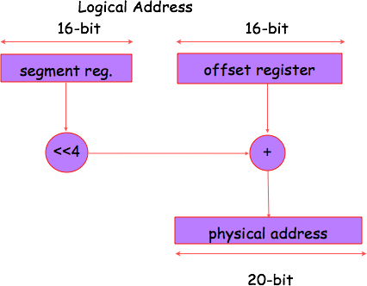
Physical & Logical Address

Slide 54
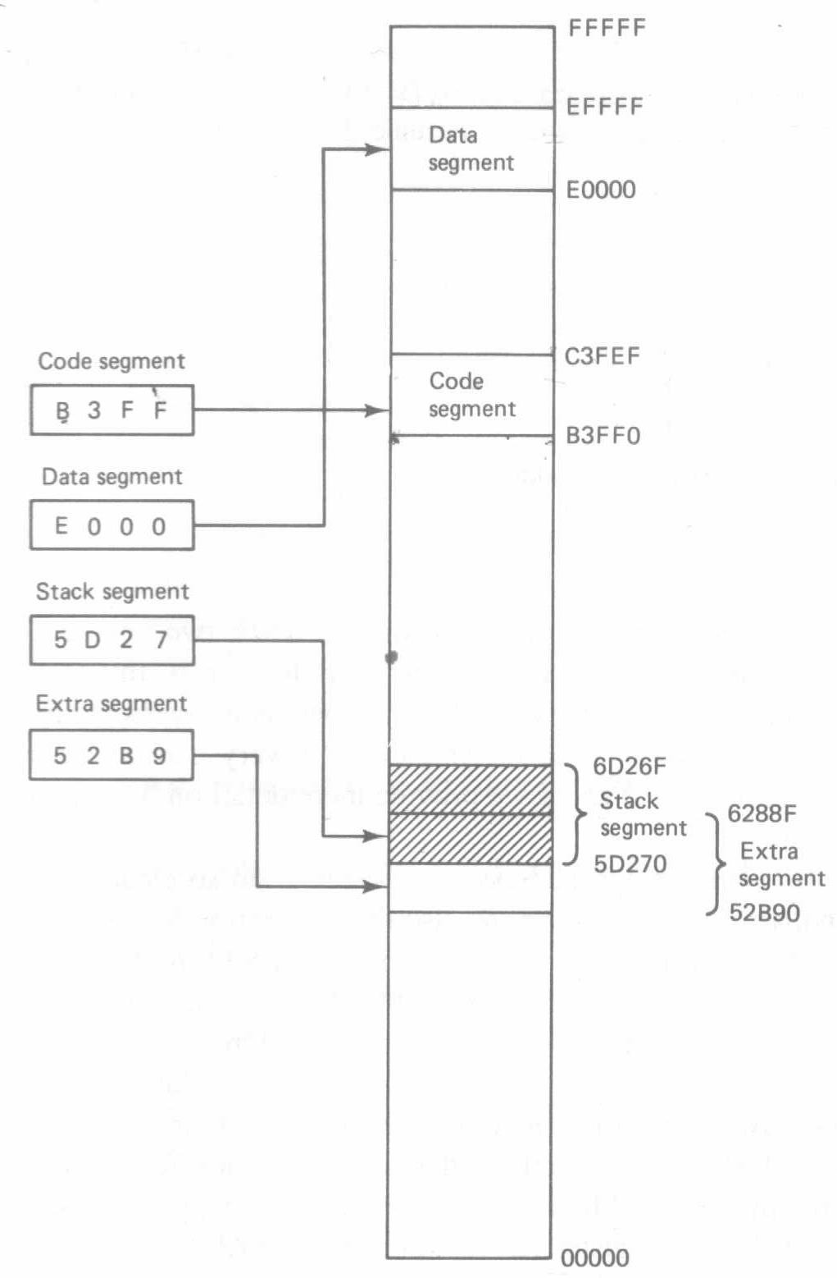
Physical & Logical Address
Example:
Calculate the physical address corresponding to logical address D470H in the extra segment. Repeat for logical address 290AH in the stack segment.
Assume the segment definitions shown in Figure A above.
Solution
For the extra segment
52B90H (base address)
+ D470H (offset)
60000H
and for the stack segment
5D270H (base address)
+ 290AH (offset)
5FB7AH

Slide 55
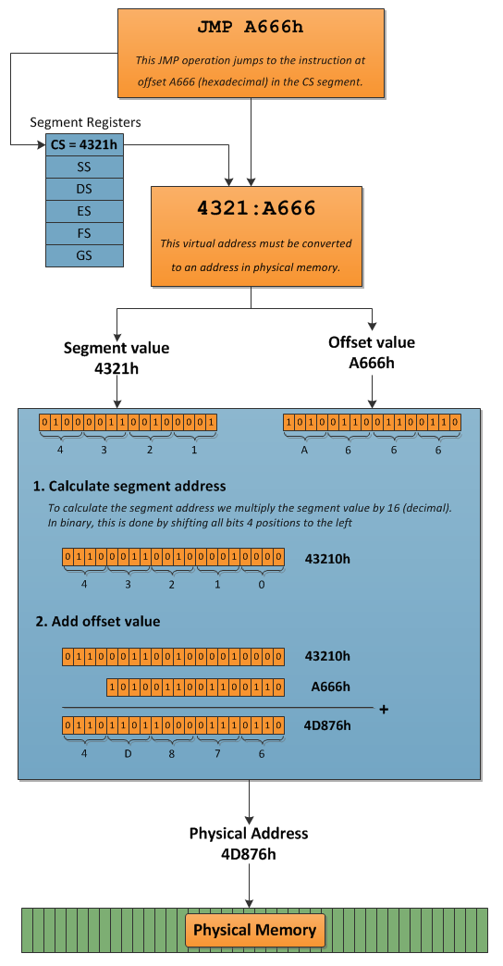
Physical & Logical Address
Logical Address (offset) = 4321H: A666H
Physical Address =
4D876H
Physical Address is also known as Absolute Address.
Calculation:
CS × 10H + Offset = 4321H × 10H + A666H = 4D876H.

Slide 56
Advantages of Segmented Memory
Program op-codes will be fetched from the code segment, while program data variables will be stored in the data and extra segments. Stack operations use registers BP or SP and the stack segment.
Program can work on several different sets of data. This is done by reloading-register DS to point to the new data.
Reference logical addresses can be loaded and run anywhere in memory. This is because the logical addresses always range from 0000 to FFFFH, independent of the code segment base.

Slide 57

Advantages of Segmented Memory
Consider a multitasking environment in which the 8086 is doing several different jobs at once.
An inactive program can be temporarily saved on a magnetic disk and a new program brought in to take its place - without concern for the physical location of this new program.
Such programs are said to be relocatable, meaning that they will run at any location in memory.
The requirements for writing relocatable programs are that no references be made to physical addresses, and no changes to the segment registers are allowed.

Slide 58
Segment Registers and Memory Segmentation
8088 has 1 Mbyte of memory but not all are active at one time.
Is partitioned into 64Kbyte (65536) segments
Each segment represents independently addressable units of
memory of 64K consecutive byte storage locations
Each segment is assigned a base address that identifies its starting
point.
Only 4 of these 64Kbyte segments are active at a time
Code – stores program or instruction codes
Data – stores data for the program
Stack - store interrupt and subroutine return addresses
Extra – additional data segment.

Slide 59
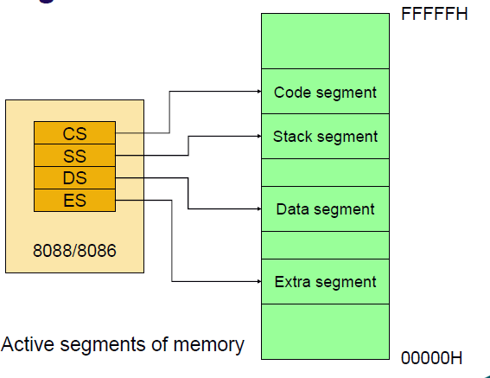
Segment Registers and Memory Segmentation
The addresses of the active segments are stored in the four internal
segment registers: CS, SS, DS, ES.
Each pf these registers contains a 16 bit base address that points to the lowest addressed byte of the segment in memory.

Slide 60
Segment Registers and Memory Segmentation
Four segments give a maximum of 256Kbytes of active memory.
Code segment -64K
Stack - 64K
Data Storage – 128K
The base address of a segment must reside on a 16-byte address boundary.
User accessible segments can be set up to be contiguous,
adjacent, disjoint or overlapping

Slide 61

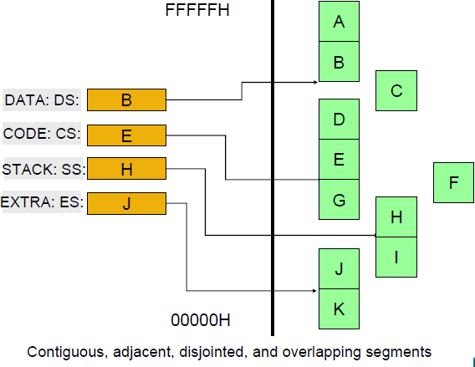
Segment Registers and Memory Segmentation

Slide 62

Dedicated, Reserved and Generel-Used Memory
The dedicated memory (00000₁₆ ~ 00013₁₆) are used for stirage of the pointers to 8088’s internal interrupt service rountines and exceptions.
The reserved memory (00014₁₆ ~ 0007F₁₆) are used for storage of the pointers to user-defined interrupts.
The 128- byte dedicated and reserved memory can contain 32 interrupt pointers.
The general-use memory (00080₁₆ ~ FFFEF₁₆) store data or instructions of the program.
The dedicated memory (FFFE0₁₆ ~ FFFEB₁₆) are used for hardware reset jump instruction.

Slide 63
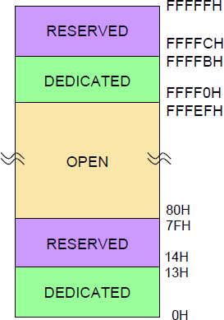
Dedicated, Reserved and Generel-Used Memory
For use with future products
Dedicated functions such as
hardware reset
Storage of pointer to interrupt service routines
- each pointer is 4 bytes long,
(offset + segment base)
Storage of hardware reset jump instrcution

Slide 64
Generating a Memory Address
A logical address in the 8088 microprocessor system is described by a segment base and an offset which is 16 bits.
The physical addresses that are used to access
memory are 20 bits in length.
The generation of the physical address involves combining a 16 bit offset value that is located in the instruction pointer, a base pointer, an index register, or a pointer register and a 16 bit segment base value that is located in one of the segment register.

Slide 65

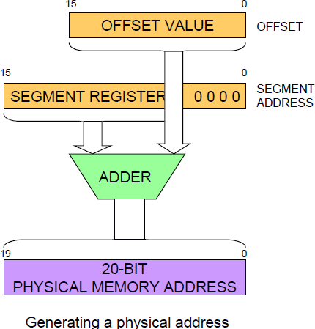
Generating a Memory Address

Slide 66

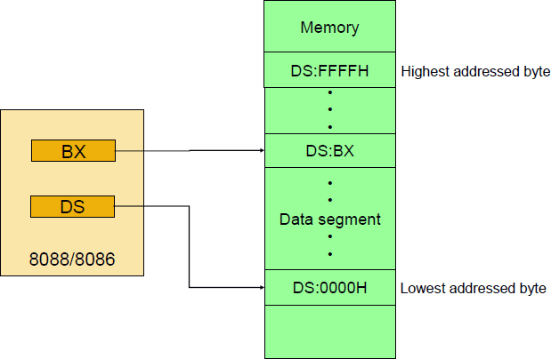
Generating a Memory Address
Boundary of a segment

Slide 67
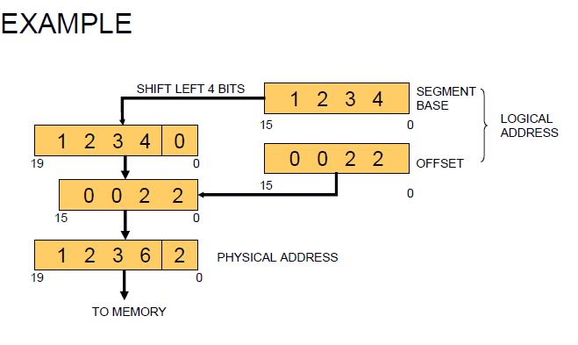
Generating a Memory Address
A segment base value of 1234₁₆ and offset value of 0022₁₆.

Slide 68
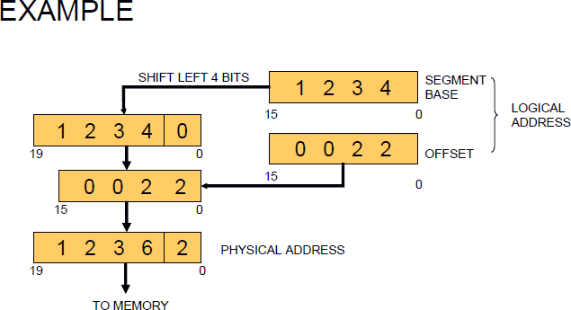
Generating a Memory Address
A segment base value of 1234₁₆ and offset value of 0022₁₆.
First express base value in binary form.
1234₁₆ = 0001001000110100₂
Shifting left with four positions and filling with zeros results in the segment address.
00010010001101000000₂ = 12340₁₆
The offset address in binary form is
0022₁₆ = 0000000000100010₂
Adding the segment address and the offset gives
00010010001101000000₂ +
0000000000100010₂ =
00010010001101100010₂ = 12362₁₆ = 12362H

