Slide 1
NT219- Cryptography
Week 11: Hash Function and Message Authentication Codes (P2)
PhD. Ngoc-Tu Nguyen
tunn@uit.edu.vn

Slide 2
Outline
Motivations
Hash function
CRC
Cryptographic Hash function
SHA2
SHA3
Message authentication code
Notes:
Cipher=a secret system of writing;

Slide 3
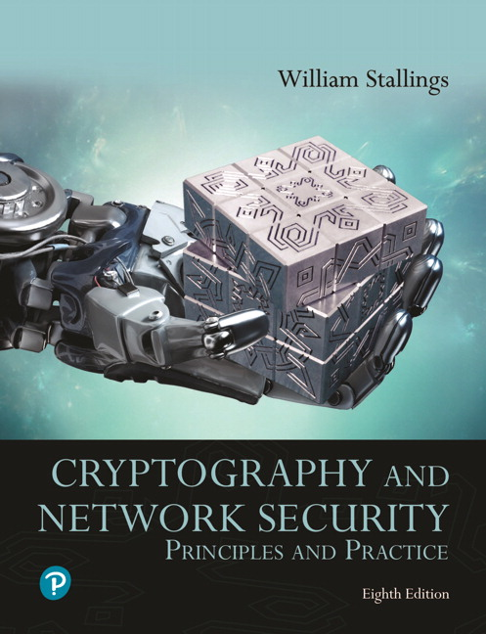
Textbooks and References
Text books
[1] Chapter 11,12

Slide 4
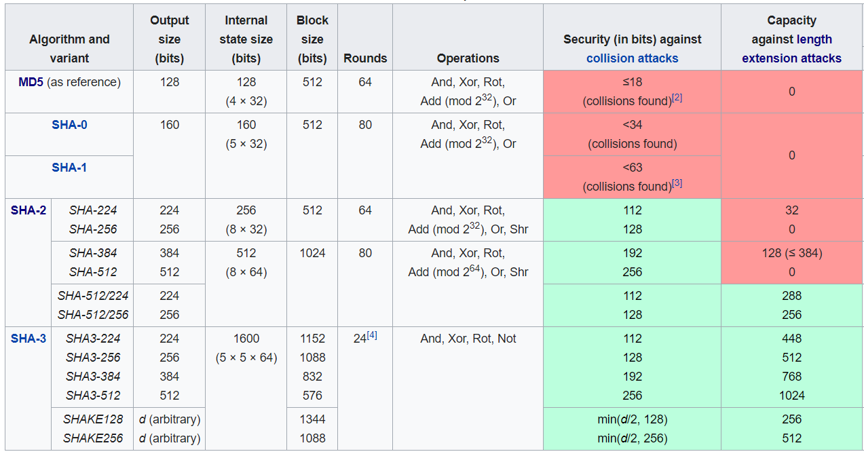
SHA-1, SHA-2, SHA-3
https://en.wikipedia.org/wiki/Secure_Hash_Algorithms

Slide 5
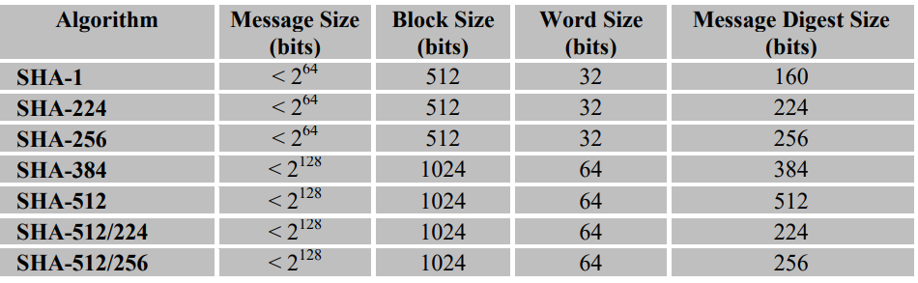
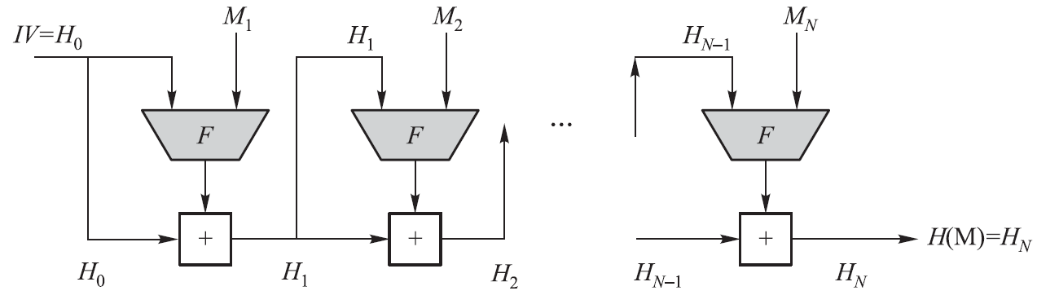
SHA-1, SHA-2
Merkle-Damgard Construction

Slide 6





Length extension attack on SHA2
$$EX$$
$$H_{N}$$
$$H^{∗}$$
$$H$$
$$H(K||M)=H(K||M||padded)$$
$$H(K||M||padded||EX) =H^{∗}(EX)$$
can compute $H(M||padded||EX)$without knowing the input $M$

Slide 7
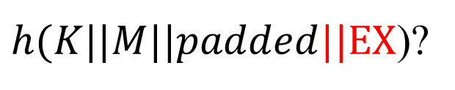



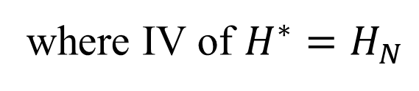
Length extension attack on SHA2
$h(K||M||padded||EX$)?
$$EX=M_{ex1}|\left|M_{ex2}\right||…$$
$$M_{ex1}$$
$$H(K||M)=H(K||M|\left|padded\right)=H_{N}$$
Compute $H(K||M||padded||EX)$without knowing the input $K, M$
$$H\left(K||M\left|\left|padded\right|\right|EX\right)=H^{∗}\left(EX\right),$$
where IV of $H^{∗}=H_{N}$

Slide 8



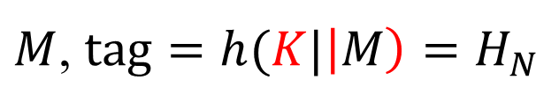
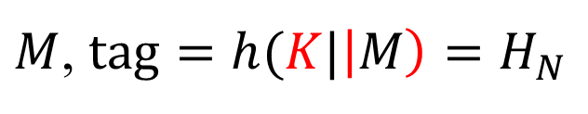







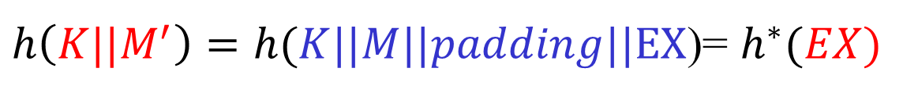


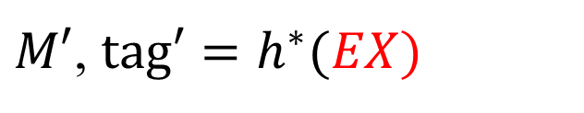
Length extension attack on SHA2
$$K$$
$$K$$
$M$, $tag=h(K|\left|M\right)=H_{N}$
${M→M}^{′}=M\left|\left|padding\right|\right|EX$, ${tag}^{′}=h\left({K||M}^{′}\right)=h^{∗}(EX)$
$$K$$
$$K$$
$M$, $tag=h(K|\left|M\right)=H_{N}$
$M′$, $tag′=h^{∗}(EX)$
$$H_{N}$$
$$M_{ex1}$$
$$M_{ex2}$$
$h\left({K||M}^{′}\right)=h(K||M||padding||EX$)= $h^{∗}(EX)$
$$EX=M_{ex1}|\left|M_{ex2}\right||…$$
$$H_{N+1}$$

Slide 9
SHA3 Standard
SHA-3 provides an alternative to SHA-2, and is drop-in compatible with any system using SHA-2
SHA-3 uses a sponge construction, instead of the CBC mode of repeated compressions used by SHA-1, SHA-2, and Whirlpool
https://nvlpubs.nist.gov/nistpubs/FIPS/NIST.FIPS.202.pdf

Slide 10
NIST SHA-3
2007: Request for submissions of new hash functions
2008: Submissions deadline. Received 64 entries. Announced first-round selections of 51 candidates.
2009: After First SHA-3 candidate conference in Feb, announced 14 Second Round Candidates in July.
2010: After one year public review of the algorithms, hold second SHA-3 candidate conference in Aug. Announced 5 Third-round candidates in Dec.
2011: Public comment for final round
2012: October 2, NIST selected SHA3
Keccak (pronounced “catch-ack”) created by Guido Bertoni, Joan Daemen and Gilles Van Assche, Michaël Peeters

Slide 11
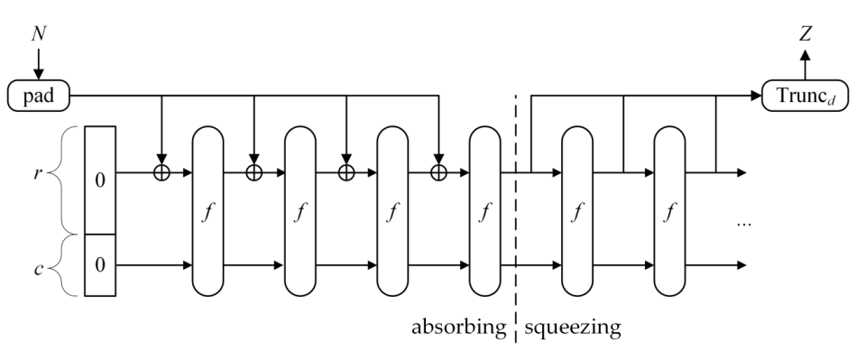
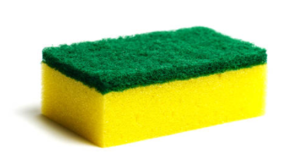
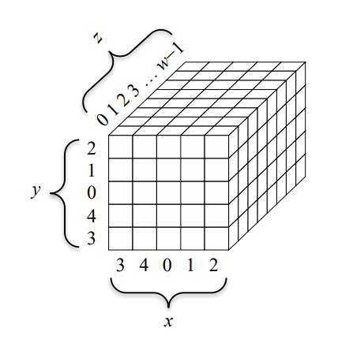




SHA3 Standard
Sponge construction (Keccak)
$$P_{0}$$
$$P_{1}$$
$$…$$
$$P_{N−1}$$
r (block size)
c=2d = 2.(output length)
Let M be the input string; d = the hash length.
b = r + c, where c = 2d
r is called rate and c capacity
Where
Bertoni, G., Daemen, J., Peeters, M., Van Assche, G., & Van Keer, R. (2012). Keccak implementation overview. URL: http://keccak. neokeon. org/Keccak-implementation-3.2. pdf.

Slide 12
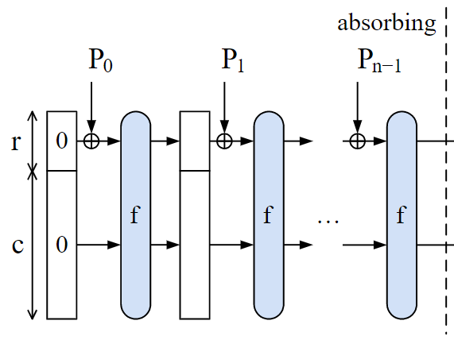
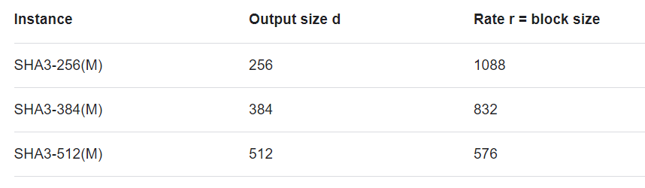
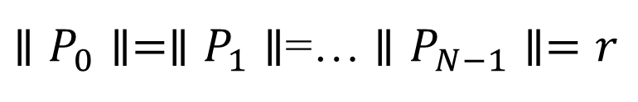
Example
Let M be the input string; d = the hash length.
b = r + c, where c = 2d
r (block size) is called rate, and c=2d capacity
Where
Ex. d = 512, then c = 1024.
Choose b = 1600, then r = 576.
2d
$∥P_{0}∥=∥P_{1}∥$=… $∥P_{N−1}∥=r$

Slide 13
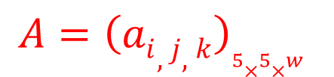
Setup
Pad M by appending 1{0}*1 to produce M’ such that |M’| is divisible by r.
Divide M’ into N = |M’|/r blocks: M₁, …, M_{N}
Let A be a b-bit string and denote A as a 5X5 matrix
Let a_{i,j,k} denote the k^{th} bit in a_{i,j}
Let f_{b} be a fixed-length permutation on b-bit inputs
Let p_{r} = pfx_{r}, s_{c} = sfx_{c}
$$A={\left(ai,j,k\right)}_{5×5×w}$$

Slide 14
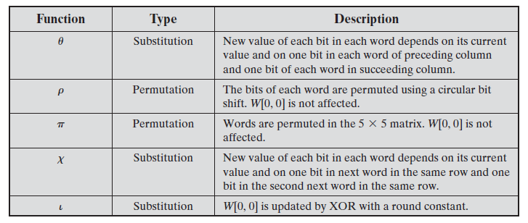
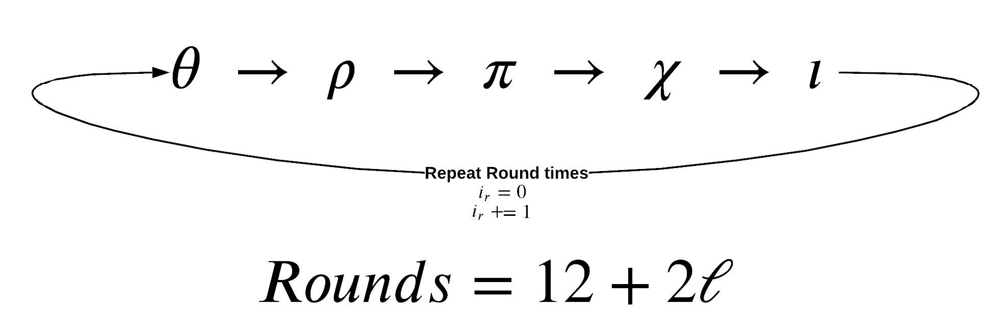
Absorb and Squeeze
https://chemejon.io/sha-3-explained/

Slide 15

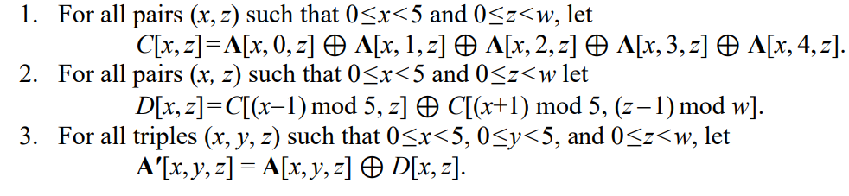
Absorb and Squeeze
A
https://nvlpubs.nist.gov/nistpubs/FIPS/NIST.FIPS.202.pdf

Slide 16


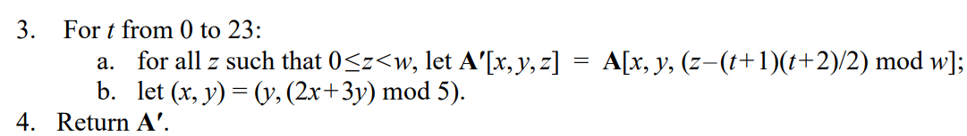
Absorb and Squeeze
A
https://nvlpubs.nist.gov/nistpubs/FIPS/NIST.FIPS.202.pdf

Slide 17

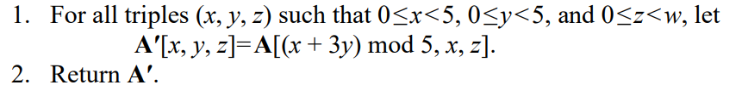
Absorb and Squeeze
A
https://nvlpubs.nist.gov/nistpubs/FIPS/NIST.FIPS.202.pdf

Slide 18

Absorb and Squeeze
A
“.” “ integer multiplication
https://nvlpubs.nist.gov/nistpubs/FIPS/NIST.FIPS.202.pdf

Slide 19

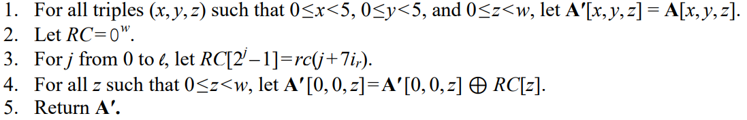
Absorb and Squeeze
A
https://nvlpubs.nist.gov/nistpubs/FIPS/NIST.FIPS.202.pdf

Slide 20

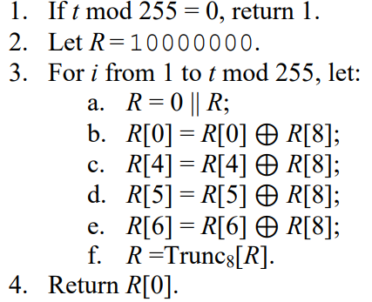
Absorb and Squeeze
round constant
A

Slide 21



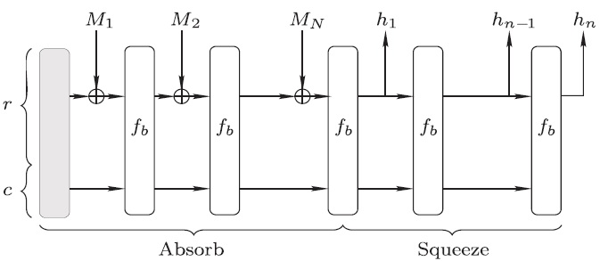
Absorb and Squeeze
Absorb:
Squeeze:

Slide 22
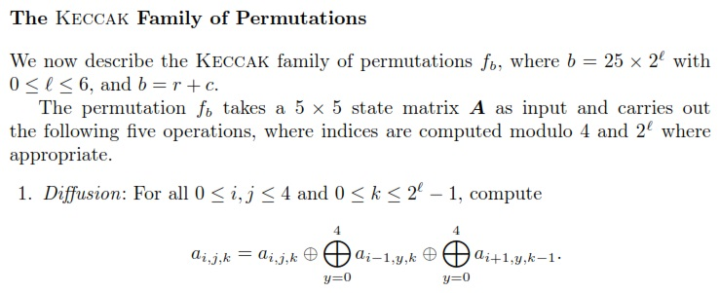
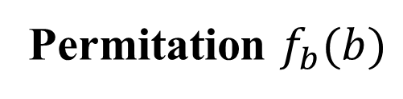
SHA-3 Hash
Permitation $f_{b}(b)$

Slide 23
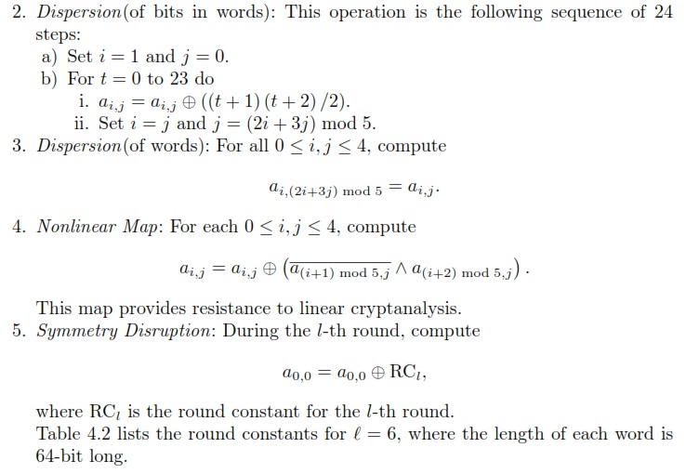
SHA-3 Hash

Slide 24
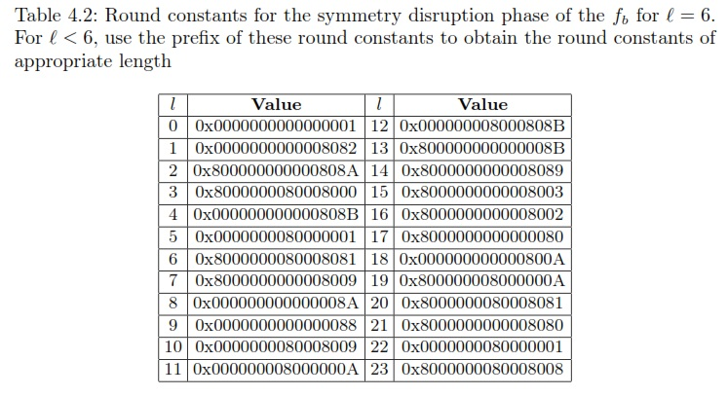
SHA-3 Hash

Slide 25
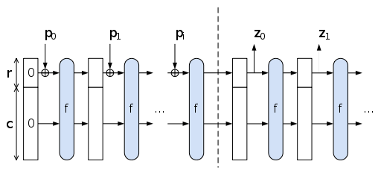
The Sponge Construction: Used by SHA-3
Each round, the next r bits of message is XOR’ed into the first r bits of the state, and a function f is applied to the state.
After message is consumed, output r bits of each round as the hash output; continue applying f to get new states
SHA-3 uses 1600 bits for state size

Slide 26
Choosing the length of Hash outputs
The Weakest Link Principle:
A system is only as secure as its weakest link.
Hence all links in a system should have similar levels of security.
Because of the birthday attack, the length of hash outputs in general should double the key length of block ciphers
SHA-224 matches the 112-bit strength of triple-DES (encryption 3 times using DES)
SHA-256, SHA-384, SHA-512 match the new key lengths (128,192,256) in AES
SHAKE: ouput length d
Notes:
Which hash function to use?

Slide 27


Limitation of Using Hash Functions for Authentication
Is this secure scheme (M cannot be modified)?
Case 1:
$$M, h(M)$$
$$h\left(M\right) (secure channel)$$
UBUNTO 20 ISO
Require an authentic channel to transmit the hash of a message
Without such a channel, it is insecure, because anyone can compute the hash value of any message, as the hash function is public
Such a channel may not always exist
How to address this?
use more than one hash functions
use a key to select which one to use

Slide 28
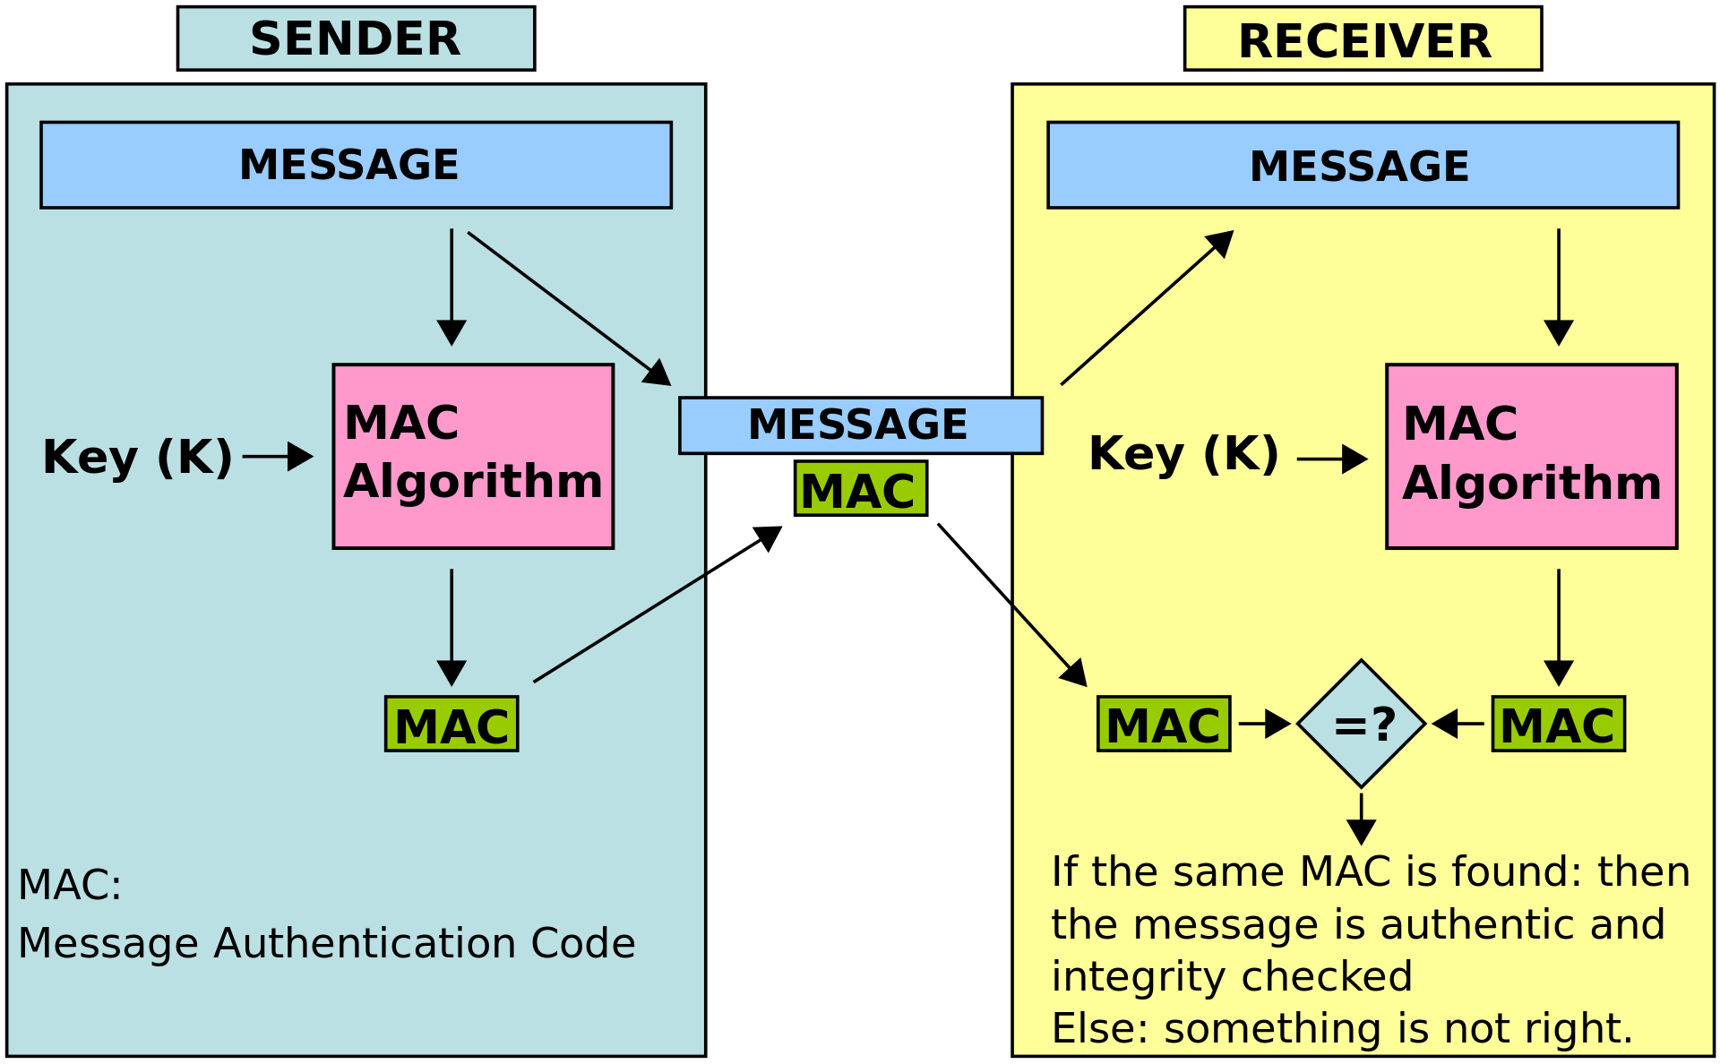
Message Authentication Code
tag
Collision
resistance
https://en.wikipedia.org/wiki/Message_authentication_code

Slide 29
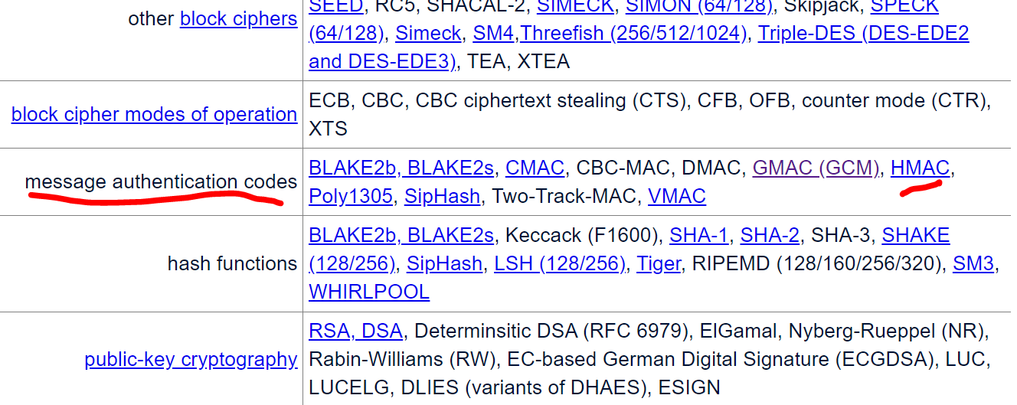
Message Authentication Code
CMAC: https://csrc.nist.gov/pubs/sp/800/38/b/upd1/final

Slide 30
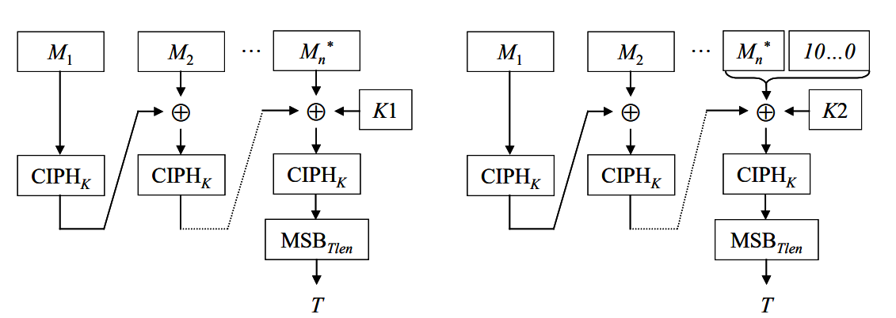
Message Authentication Code CMAC

Slide 31
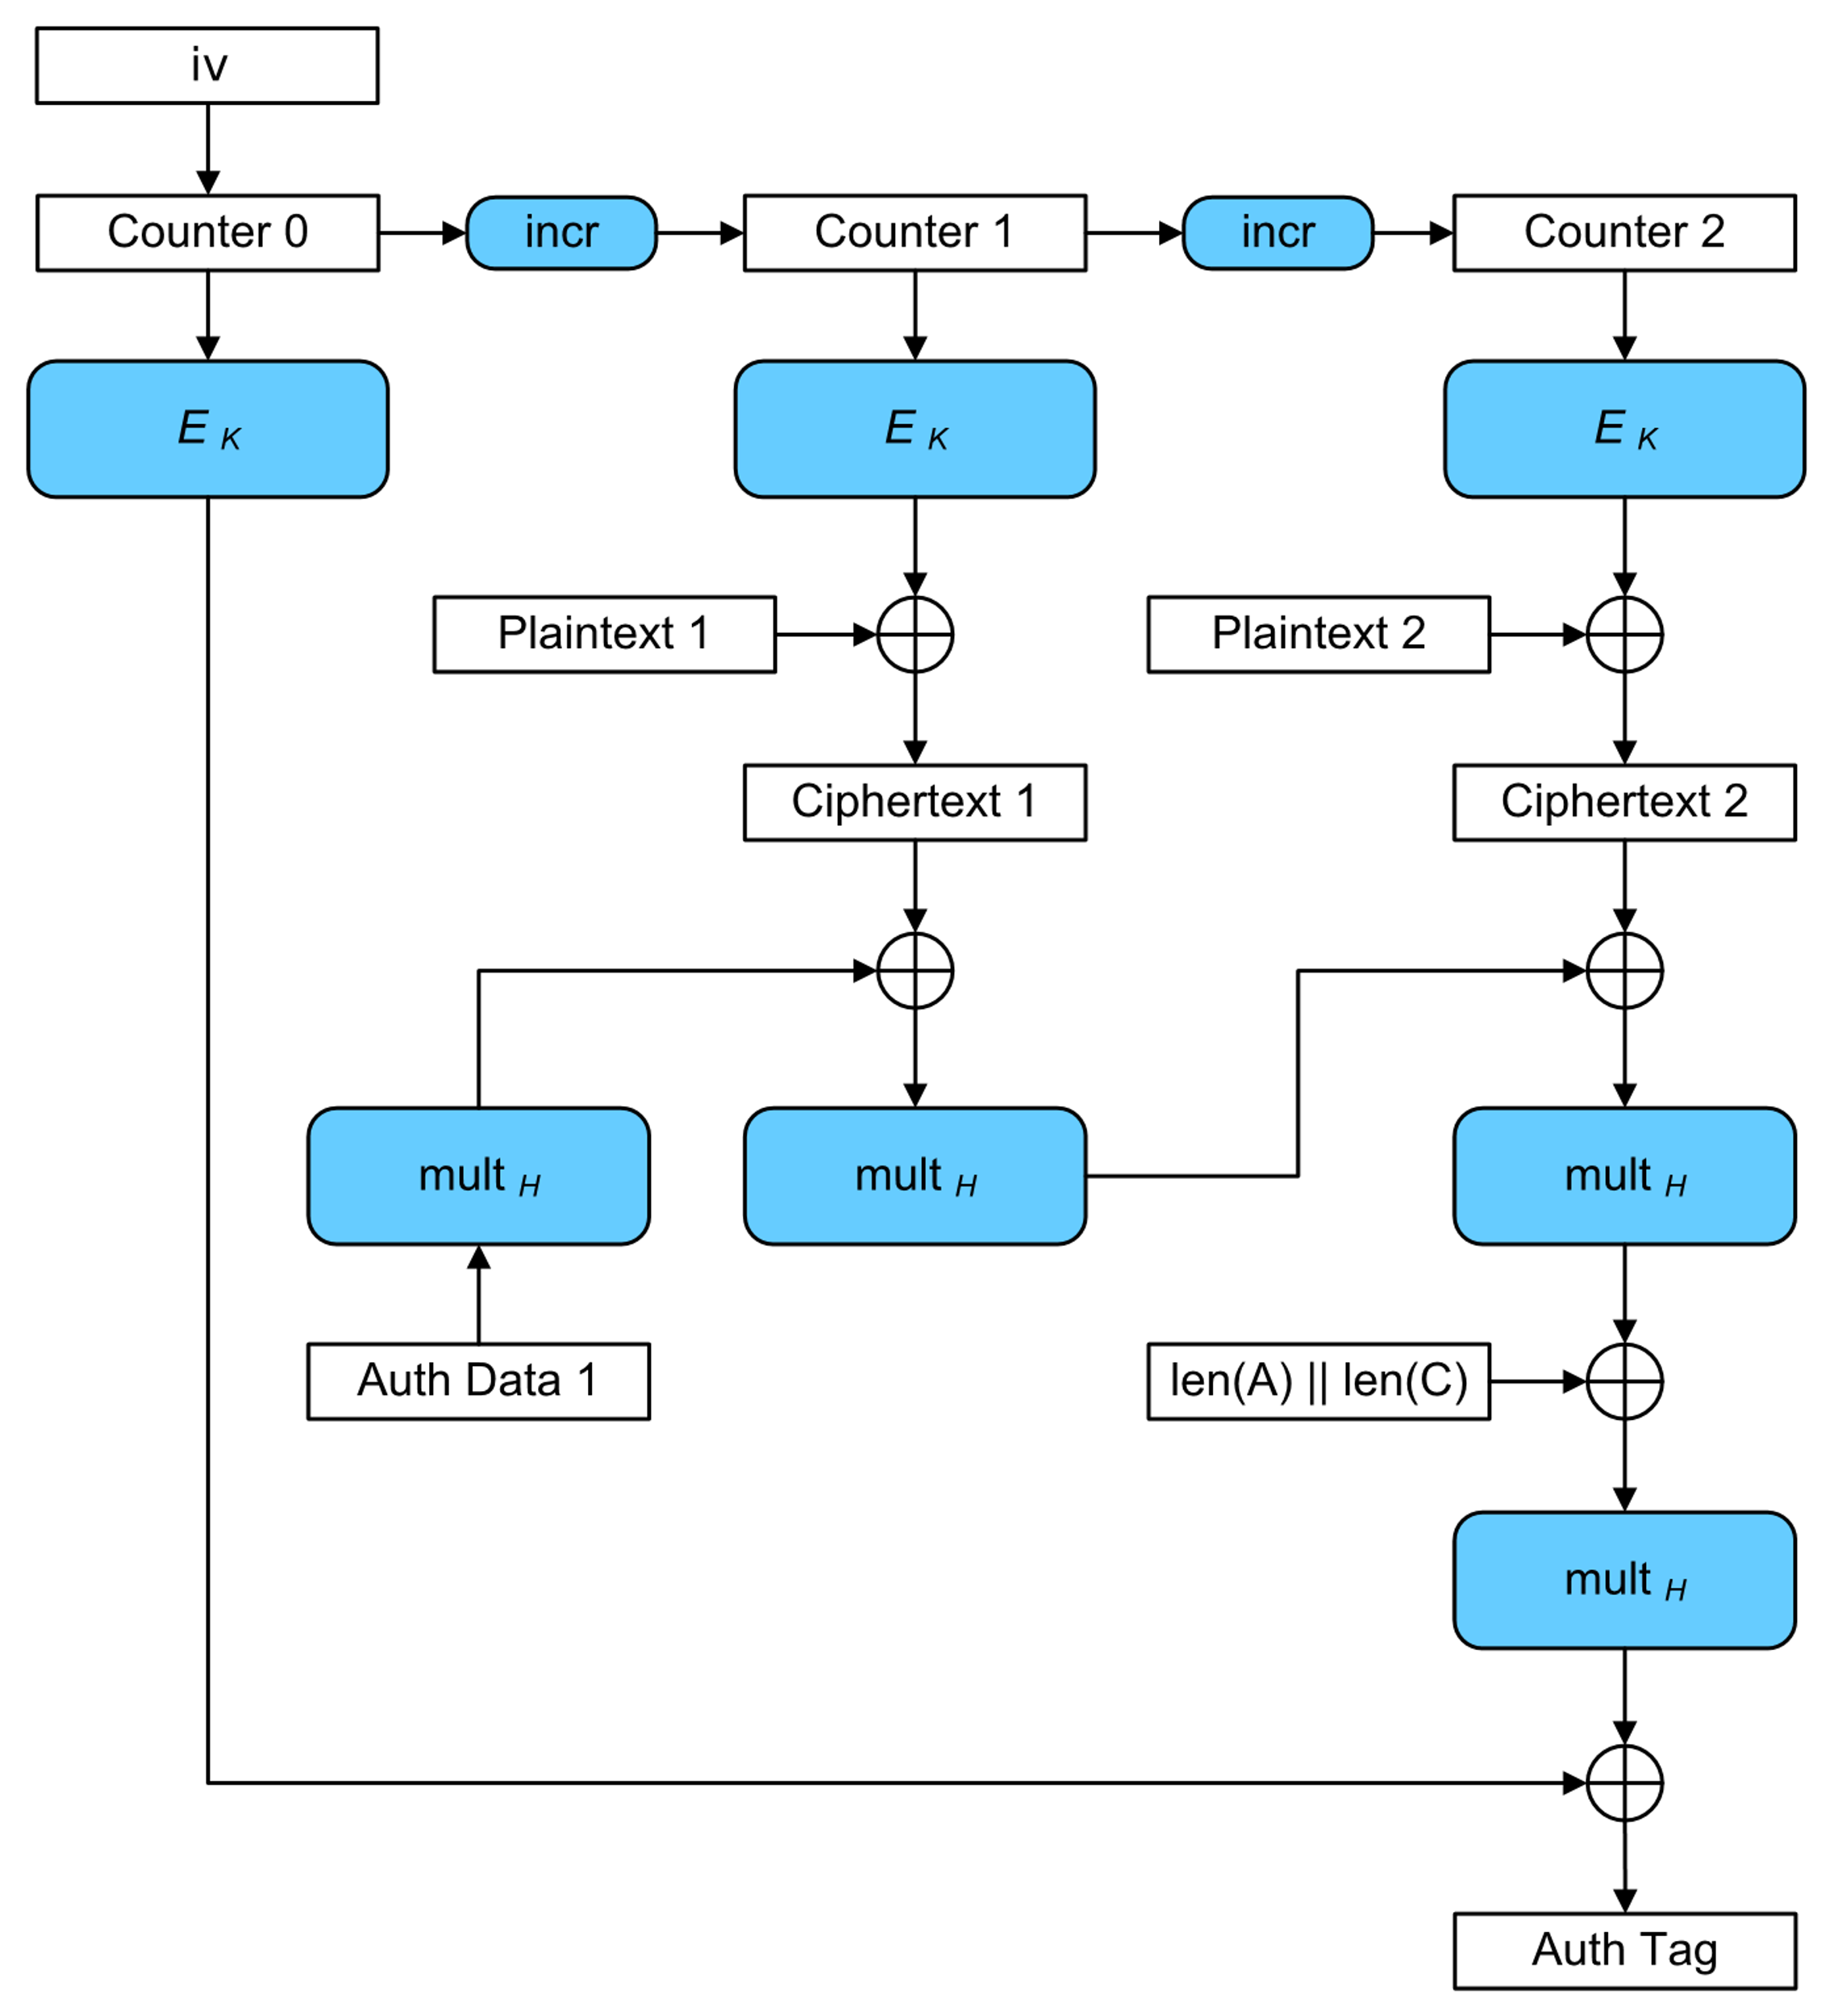
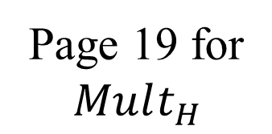

Message Authentication Code GMAC
….
n
….
n
….
n
GCM
….
….
Page 19 for
$$Mult_{H}$$
$$C=C_{1} || …||C_{n}$$
(C, auth tag)
https://csrc.nist.gov/pubs/sp/800/38/d/final
https://csrc.nist.gov/projects/crypto-publication-review-project

Slide 32
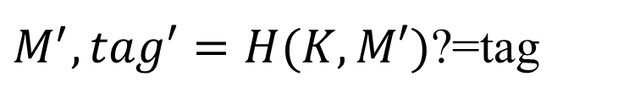


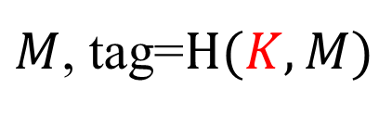
Keyed-Hash Message Authentication Code HMAC
A hash family (H) use for message authentication
MAC(K,M) = H_{K}(M)
The sender and the receiver share secret K
The sender sends (M, H_{k}(M))
The receiver receives (X,Y) and verifies that H_{K}(X)=Y, if so, then accepts the message as from the sender
To be secure, an adversary shouldn’t be able to come up with (X’,Y’) such that H_{K}(X’)=Y’.
$$K$$
$$K$$
$M$, tag=$H(K, M)$
$M^{′}, tag′=H(K,M′)$?=tag

Slide 33
Security Requirements for MAC
Resist the Existential Forgery under Chosen Plaintext Attack
Challenger chooses a random key K
Adversary chooses a number of messages M₁, M₂, .., M_{n}, and obtains t_{j}=MAC(K,M_{j}) for 1≤j≤n
Adversary outputs M’ and t’
Adversary wins if ∀j M’≠M_{j}, and t’=MAC(K,M’)
Basically, adversary cannot create the MAC for a message for which it hasn’t seen an MAC
Notes:
Good homework problem, break simple MAC constructions.
MAC uses shared secret key to bootstrap integrity/authenticity.

Slide 34
Constructing MAC from Hash Functions
Let h be a one-way hash function (SHA2)
MAC(K,M) = h(K || M), where || denote concatenation
Insecure as MAC
Because of the Merkle-Damgard construction for hash functions, given M and t=h(K || M), adversary can compute M’=M||Pad(M)||X and t’, such that h(K||M’) = t’

Slide 35
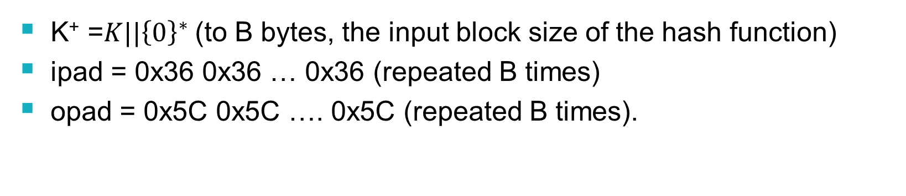
Constructing MAC from Cryptographic Hash Functions HMAC
HMAC_{K}[M] = Hash[(K⁺ ⊕ opad) || Hash[(K⁺ ⊕ ipad)||M)]]
K⁺ =$K||{\left\{0\right\}}^{∗}$(to B bytes, the input block size of the hash function)
ipad = 0x36 0x36 … 0x36 (repeated B times)
opad = 0x5C 0x5C …. 0x5C (repeated B times).
At high level, HMAC_{K}[M] = H(K || H(K || M))

Slide 36
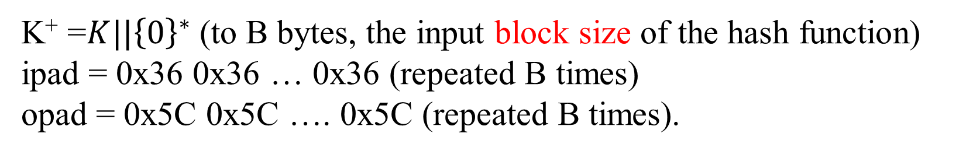


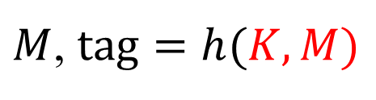
Authentication and Integrity checking
$$K$$
$$K$$
$M$, $tag=h(K,M)$
h(K, M) = h[(K⁺ ⊕ opad) || Hash[(K⁺ ⊕ ipad)||M)]]
K⁺ =$K||{\left\{0\right\}}^{∗}$(to B bytes, the input block size of the hash function)
ipad = 0x36 0x36 … 0x36 (repeated B times)
opad = 0x5C 0x5C …. 0x5C (repeated B times).
Pros and Cons?

Slide 37



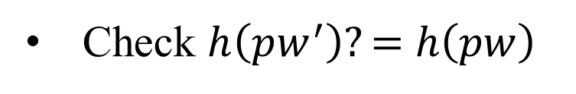
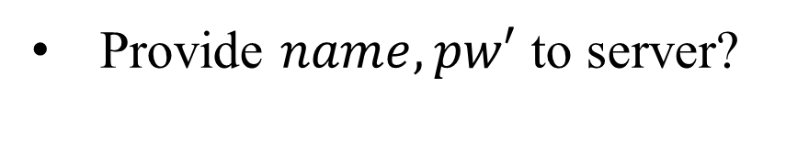


Authenticate user/end-devices case
(1) Password-based Authentication
$store:name, h(pw)$
$name, pw$
Login
Provide $name, pw′$ to server?
Locate the row using name
Check $h\left(pw^{′}\right)?=$ $h\left(pw\right)$
authenticate the user
Notes:
authentication factors= Các yếu

Slide 38
HMAC Security
If used with a secure hash functions (e.g., SHA3-256) and according to the specification (key size, and use correct output), no known practical attacks against HMAC

Slide 39
Dictionary attacks on hash function
h(password)= b1b6a3de29ab907153614683d357b2db943a317d036ff25f7022d4707109005a
password=?
Guest password | sha256 | sha384 | sha512 | …
abc123 | … | … | ….. | …
abcd1234 | … | …. | … | …
….
Rainbow table
https://hashkiller.io/

