Slide 1



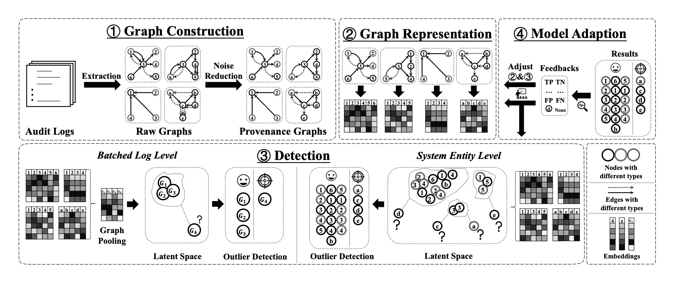
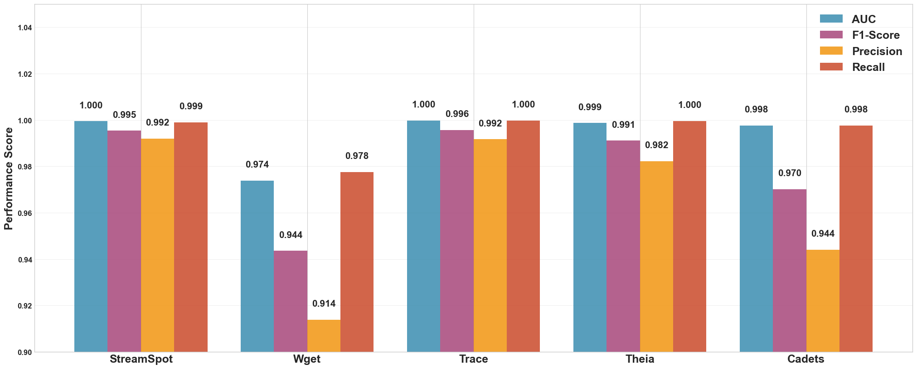
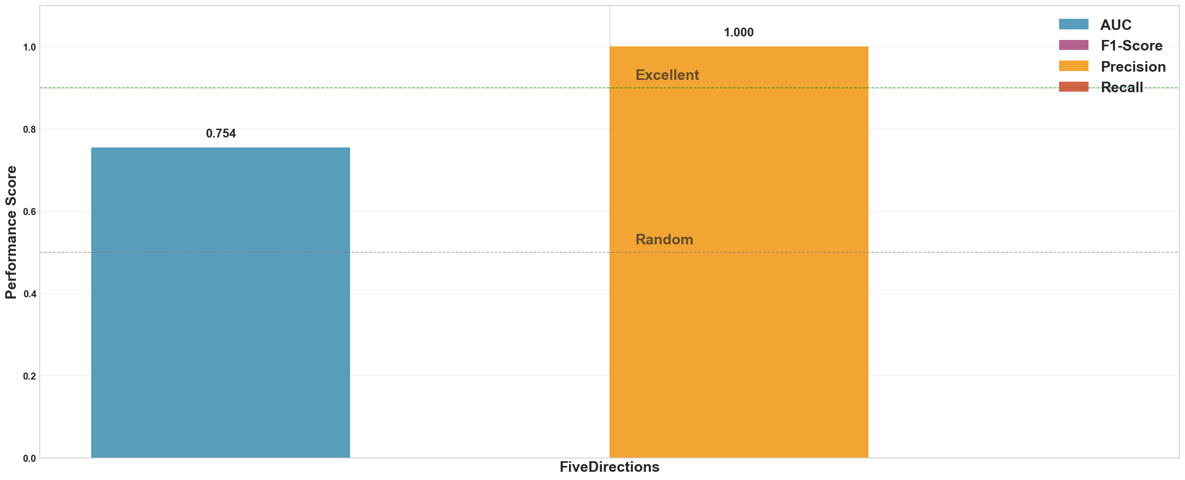
Final Project in NT230 course: Malware’s Modus Operandi
APT Attack Detection
Lại Quan Thiên - 22521385, Trần Thế Hữu Phúc - 22521143
Mai Nguyễn Nam Phương - 22521164, Hồ Diệp Huy - 22520541
Group ID: G03 - Project ID: S20
Introduction
The content discusses Advanced Persistent Threats (APTs) — stealthy and sophisticated cyber-attacks that are hard to detect. A common detection method is data provenance analysis using provenance graphs, which extract contextual data from audit logs for fine-grained analysis. To improve detection, the paper proposes MAGIC, a self-supervised APT detection method. MAGIC uses masked graph representation learning and outlier detection to identify malicious entities. It supports multi-granularity detection, models normal behaviors, extracts deep features efficiently and detects anomalies in provenance graphs.
Experiments and Results
1. Evaluation with Model Trained on Streamspot Wget and DARPA Datasets (as in the Paper)
MAGIC showed excellent performance on the 5 original datasets (Streamspot, Wget, D.Trace, D.Theia, D.Cadets), with AUC > 0.97 (avg. ~0.99), F1-score between 0.94–0.99, and consistently high Precision (>0.91) and Recall (>0.97). This confirms its strong anomaly detection in both batch-level and entity-level scenarios.
2. Evaluation with Model Trained on FiveDirections Dataset (Group-Added)
On the custom dataset (FiveDirections), MAGIC reached AUC ~0.75 but Recall = 0 (no malicious nodes detected), despite Precision = 1.0. This suggests a major feature distribution gap and highlights the need for improved masking or self-supervision to generalize on real-world data.
In summary: MAGIC is highly effective on standard datasets, but applying it to enterprise data like FiveDirections requires parameter and masking adjustments to preserve both Precision and Recall.
Fig.1 Overview of MAGIC’s detection pipeline
Methodology
The methodology of MAGIC outlines a self-supervised APT detection framework that combines masked graph representation learning with outlier detection. It includes four key components:
1. Provenance Graph Construction
Log Parsing: Extracts system entities and interactions; labels are generated and encoded.
Initial Embedding: Converts labels into fixed-size feature vectors.
Noise Reduction: Merges redundant edges to simplify the graph while preserving key information.
2. Graph Representation Module
Feature Masking: Randomly hides node embeddings during training.
Graph Encoder: Uses Graph Attention Networks (GATs) to aggregate features and generate node and system state embeddings.
Graph Decoder: Reconstructs masked features and graph structure, guided by two self-supervised loss functions—feature reconstruction loss (Lfr) and structure reconstruction loss (Lsr). The total loss is L = Lfr + Lsr.
3. Detection Module
Stores benign embeddings in a K-D Tree.
During inference, calculates anomaly scores based on nearest neighbors.
Supports: Batched detection - Identifies potential APT activity across batches of logs and Entity-level detection - Pinpoints specific malicious entities.
4. Model Adaptation Mechanism
Uses analyst feedback (e.g., false positives) to retrain the model.
Continuously updates benign behavior patterns.
Employs a discounting mechanism to remove outdated embeddings.
Fig.2 Standard Datasets Performance
Fig.3 Custom Dataset Performance
A project at NT230 course – Semester 2 – School Year of 2024-2025, UIT-VNUHCM – Copyright: UIT InSecLab

