Slide 1
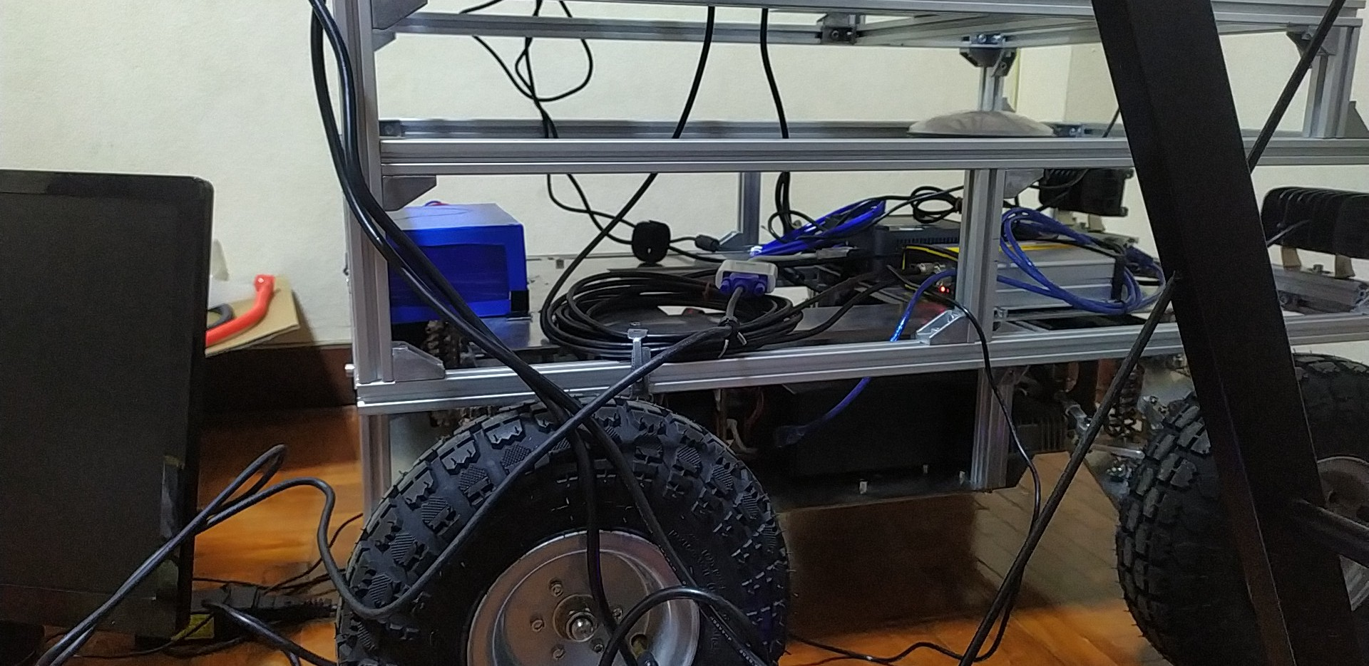
cam
usb
GNSS
usb
NUC .102
lan
Lidar
Can bus X-> right, Y->forward, Z
STM32
ระบบขับเคลื่อนล้อ

Slide 2
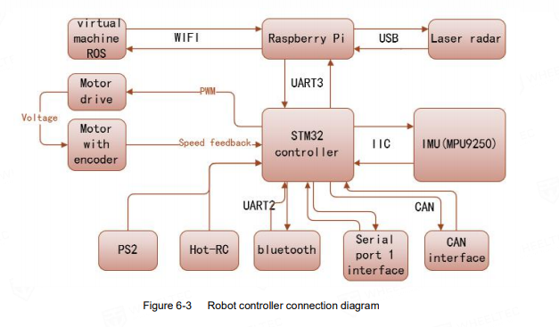

Slide 3
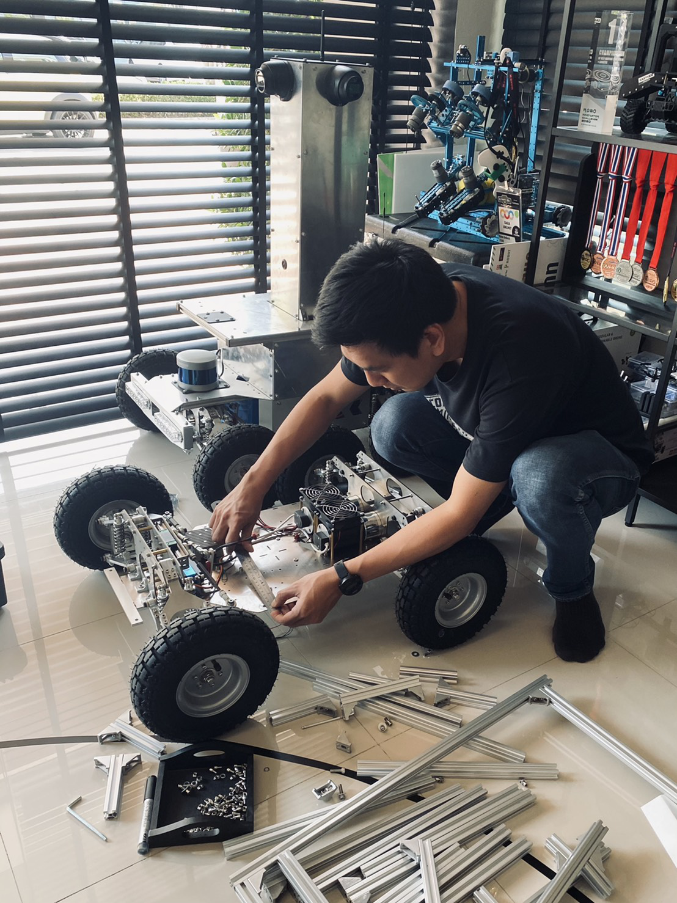

Slide 4
Master mapviz .111
waypoint
stop
ROS bridge wifi
position
button
usb
Slave NUC .102

Slide 5
mapviz
waypoint
stop
ROS bridge
position
selfdriving NUC
Can bus X-> right, Y->forward, Z-> XtoY

