Slide 1
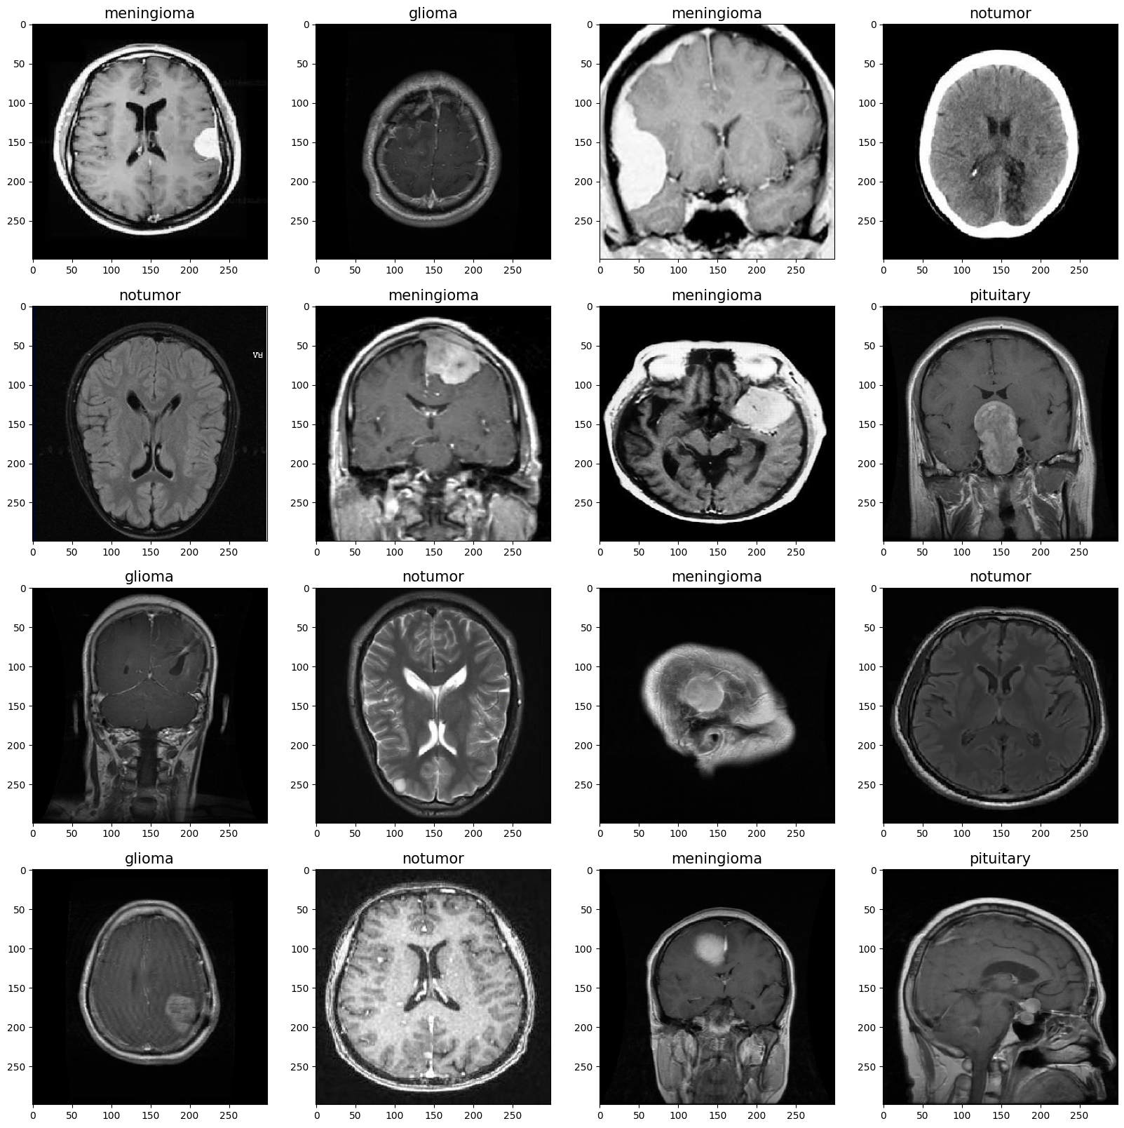
Leveraging Machine Learning and Deep Learning for Brain Tumor Detection and Classification from MRI Images
Wanda Handal February 2024

Slide 2
About our Dataset
This dataset contains 7023 images of human brain MRI images which are classified into 4 classes: glioma - meningioma - no tumor and pituitary.
Dataset is divided into 2 folders:
Training set: has a total of 4569
Testing set has a total of 1311

Slide 3
Classification with ML Classifiers and Feature Descriptors
Importing Necessary Libraries: These libraries encompass prominent tools for machine learning, image processing, and visualization, such as Scikit-learn, NumPy, OpenCV, Matplotlib, and TensorFlow.
Function for Extracting Labels: We define a function dedicated to extracting labels from image filenames. This function plays a crucial role in associating each image with its corresponding class, facilitating supervised learning tasks.
Function for Extracting Features: Another pivotal function is introduced for extracting features using various descriptors. This function iterates through each image, resizes it, and computes features based on the selected descriptor type.
For instance, the HOG (Histogram of Oriented Gradients) feature descriptor is suitable for capturing gradient information in images, which is effective for identifying texture and shape patterns in brain tumor images.
Similarly, the LBP (Local Binary Patterns) descriptor is adept at encoding local texture information, making it valuable for discerning texture variations indicative of different tumor types.
The inclusion of 'img' as a feature type allows for directly using raw pixel values as features, which might capture more nuanced information specific to each image.
Data Preparation: This stage involves unzipping and preparing the dataset for subsequent processing. The dataset is partitioned into training, validation, and testing sets, ensuring an effective distribution of data for model training, validation, and evaluation phases.

Slide 4
Classification with ML Classifiers and Feature Descriptors
Classifier | Feature Descriptor | Image Size (pixels) | Accuracy | Elapsed Time (seconds)
SVM | HOG | 32 | 0.769 | 1.797
RF | HOG | 32 | 0.753 | 4.276
Adaboost | HOG | 32 | 0.658 | 11.041
SVM | LBP | 32 | 0.683 | 6.518
RF | LBP | 32 | 0.792 | 5.640
Adaboost | LBP | 32 | 0.694 | 14.227
SVM | HOG | 64 | 0.829 | 10.374
RF | HOG | 64 | 0.770 | 8.663
Adaboost | HOG | 64 | 0.679 | 44.203
SVM | LBP | 64 | 0.745 | 61.649
RF | LBP | 64 | 0.787 | 11.668
Adaboost | LBP | 64 | 0.685 | 65.366
SVM | HOG | 128 | 0.838 | 72.986
RF | HOG | 128 | 0.779 | 17.836
Adaboost | HOG | 128 | 0.729 | 172.434
SVM | LBP | 128 | 0.770 | 453.243
RF | LBP | 128 | 0.773 | 23.382
Adaboost | LBP | 128 | 0.719 | 267.866
Comprehensive Evaluation of Machine Learning Classifiers:
SVM, RF, and AdaBoost classifiers were evaluated across different image sizes and feature descriptors.
Performance metrics included accuracy and elapsed time.
Comparison of Results:
The SVM classifier consistently achieved the highest accuracy across various configurations.
Particularly, the SVM classifier with HOG feature descriptor and a larger image size (128x128) demonstrated the best performance.
Conclusion:
Based on the evaluation results, the SVM classifier, especially with HOG features and larger image sizes, is recommended for accurate classification of brain tumor images.
Despite requiring slightly more computational time than RF, SVM's superior accuracy makes it the preferred choice for this classification task.
Notes:
The SVM classifier consistently achieved the highest accuracy across various configurations.
Particularly, the SVM classifier with HOG feature descriptor and a larger image size (128x128) demonstrated the best performance.
SVM outperformed RF and AdaBoost in terms of accuracy, albeit with slightly longer computational time.

Slide 5
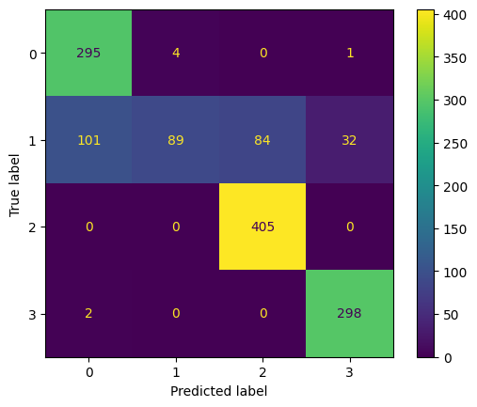
Classification with ML Classifiers and Feature Descriptors
Example of Confusion Matrix for SVM Classifier with HOG Feature Descriptor
Class 0 (glioma): 295 correct predictions, 4 misclassifications as class 1, 0 misclassifications as class 2, and 1 misclassification as class 3.
Class 1 (meningioma): 89 correct predictions, 101 misclassifications as class 0, 84 misclassifications as class 2, and 32 misclassifications as class 3.
Class 2 (notumor): 405 correct predictions, no misclassifications.
Class 3 (pituitary): 298 correct predictions, 2 misclassifications as class 0.
Notes:
Class 0 (glioma): 295 correct predictions, 4 misclassifications as class 1, 0 misclassifications as class 2, and 1 misclassification as class 3.
Class 1 (meningioma): 89 correct predictions, 101 misclassifications as class 0, 84 misclassifications as class 2, and 32 misclassifications as class 3.
Class 2 (notumor): 405 correct predictions, no misclassifications.
Class 3 (pituitary): 298 correct predictions, 2 misclassifications as class 0.

Slide 6
Classification with Deep Learning: Convolutional Neural Networks
Importing libraries for DL
Preprocessing and loading datasets:
Validation Split: 20% of the training data was reserved for validation to evaluate model performance.
Model architecture :
MobileNet CNN: A lightweight CNN architecture designed for mobile devices.
Adaptation: The MobileNet model was adapted for brain tumor classification by replacing the final dense layer with 4 neurons corresponding to the 4 tumor classes.
Number of Epochs and Callbacks:
Epochs: The model was trained for 7 epochs.
Compilation of the Model:
Optimizer: Here, SGD with a learning rate of 1e-3 was used. Determines how the model is updated based on the loss function.
Loss Function: For Categorical classification (categorical_crossentropy): measures the difference between the model's predictions and the actual labels.
Metrics: Accuracy is used to evaluate model performance during training as it is a common metric.

Slide 7
CNN Model Training and Evaluation
Training Process:
Epoch-wise Performance:
Epoch 1: Initial loss of 0.6134 and accuracy of 80.28%, with validation loss of 0.5424 and validation accuracy of 81.79%.
Epoch 2: Loss reduced to 0.2216 and accuracy improved to 92.17%, with validation loss of 0.2242 and validation accuracy of 92.21%.
Epoch 3: Further improvements in loss (0.1336) and accuracy (95.40%), with validation loss of 0.1914 and validation accuracy of 93.26%.
Epoch 4-7: Continuing trend of decreasing loss and increasing accuracy, with final epoch achieving a loss of 0.0335 and accuracy of 99.32%.
Model Evaluation:
Testing Dataset: The trained model was evaluated on the testing dataset to assess its performance on unseen data.
Evaluation Metrics: Achieved a testing accuracy of approximately 94.4%, indicating effective classification of brain tumor images.

Slide 8
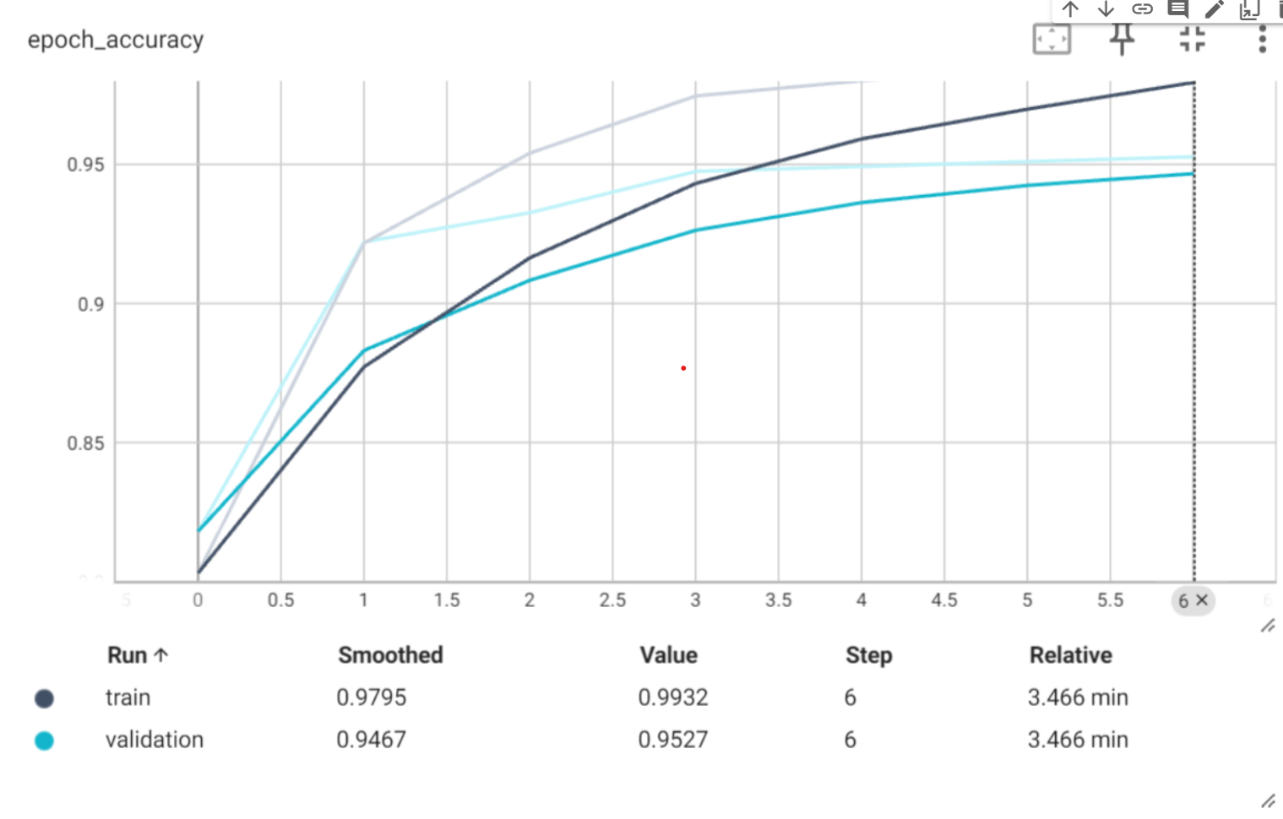
CNN Model Evaluation: Epoch Accuracy
Increasing Trend: indicating that the model's ability to predict the correct labels improves with each training iteration.
Alignment with Loss: The increase in accuracy aligns well with the decrease in loss, suggesting that as the model learns to reduce its prediction errors
Plateau: Towards the later epochs, specifically from Epoch 5 to Epoch 7, the accuracy appears to plateau around 95%, suggesting that the model's performance may not improve significantly beyond this point, at least with the current training configuration.

Slide 9
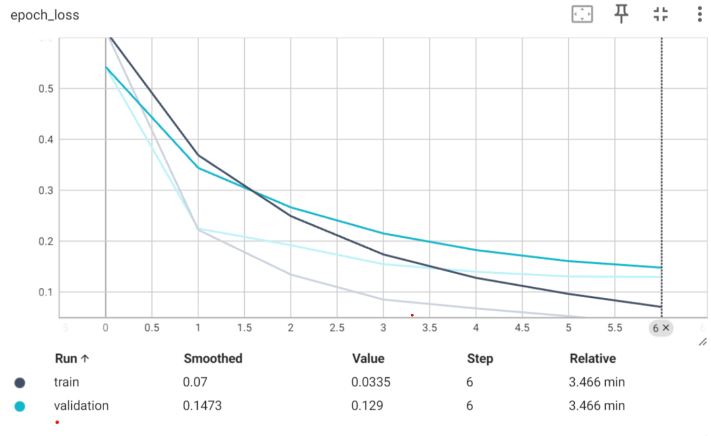
CNN Model Evaluation: Epoch Loss
Decreasing Trend: The epoch loss consistently decreases from Epoch 1 to Epoch 7, indicating that the model's predictions become progressively closer to the actual labels in the training data.
Overfitting: There are no evident signs of overfitting, as the loss continues to decrease without significant fluctuations or sudden increases, which would suggest that the model is memorizing the training data.
Notes:
this indicates that the model is improving its ability to make accurate predictions on the training data without encountering sudden increases in loss, which could signal overfitting.

Slide 10
ML Classifier & Feature descriptors VS CNN
Overall Comparison:
Accuracy: CNN outperformed traditional classifiers, demonstrating superior accuracy in classifying brain tumor images.
Training Time: Traditional classifiers generally had faster training times compared to CNN, particularly for smaller image sizes.
Resource Requirements: CNN models require more extensive datasets and computational resources for training but offer the potential for higher accuracy and automated feature learning.
While traditional machine learning classifiers provide reasonable performance, CNNs offer a compelling alternative with their ability to learn complex features directly from image data. The choice between traditional classifiers and CNNs depends on factors such as dataset size, computational resources, and the desired balance between accuracy and efficiency in brain tumor classification tasks.

