Slide 1
PONGTASTIC
LADDER
PLAYER PROFILE
PONG STATS
FIND OPPONENT NEAR ME
FRIENDS
all time games recored: 602
users online: 6

Slide 2
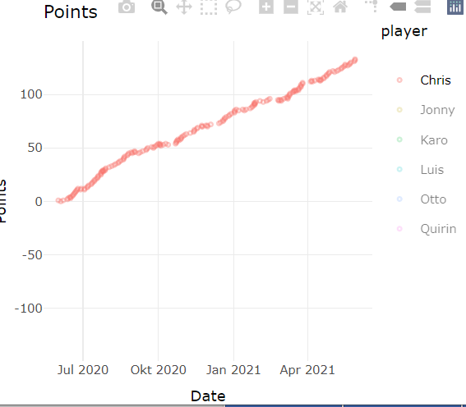

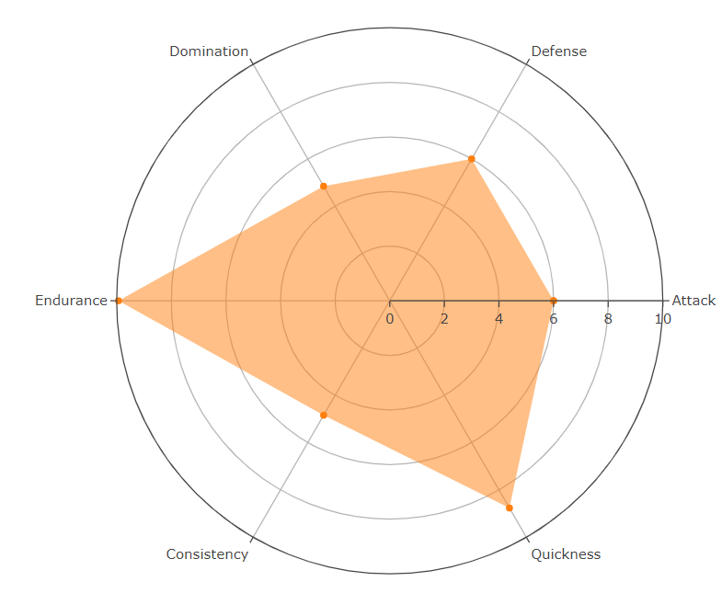
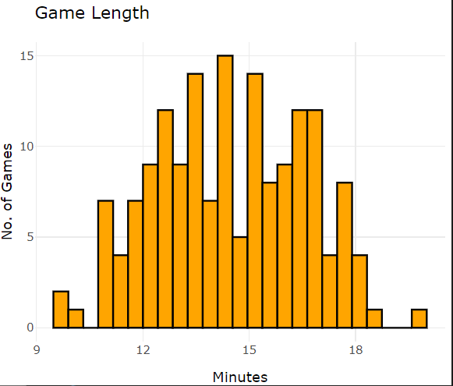
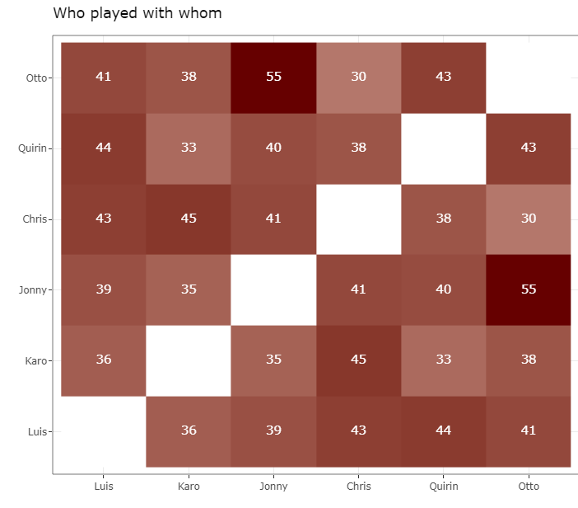

PONGTASTIC
PLAYER PROFILE
PLAYED: 197
WON: 165
LOST: 32
Ø GAMES/SESSION: 1.54
LONGEST
WINNING STREAK
19
YOUR CANNON FODDER
KARO
FOR THAT PLAYER YOU ARE CANNON FODDER
JONNY
LONGEST ACTIVITY STREAK
8
LONGEST LOSING STREAK
2

