Slide 1


The Fundamentals of GitHub: Part 2!
A Special Presentation for Franklin's ACM Special Interest Groups
Notes:
Last time in Part 1, we covered the foundations of GitHub—what it is, how Git compares to GitHub, creating accounts and repositories, setting up a profile, and the basics of commits, pushes, pulls, and READMEs. That gave us the groundwork.
For today, we’re moving into collaboration features: issues, pull requests, projects, discussions, wikis, and teams.
As we go, don’t be shy about questions. Raise your hand here in Teams, or just paste your question into the chat. I’ll answer it live. Interruptions are welcome—it keeps the session interactive.

Slide 2

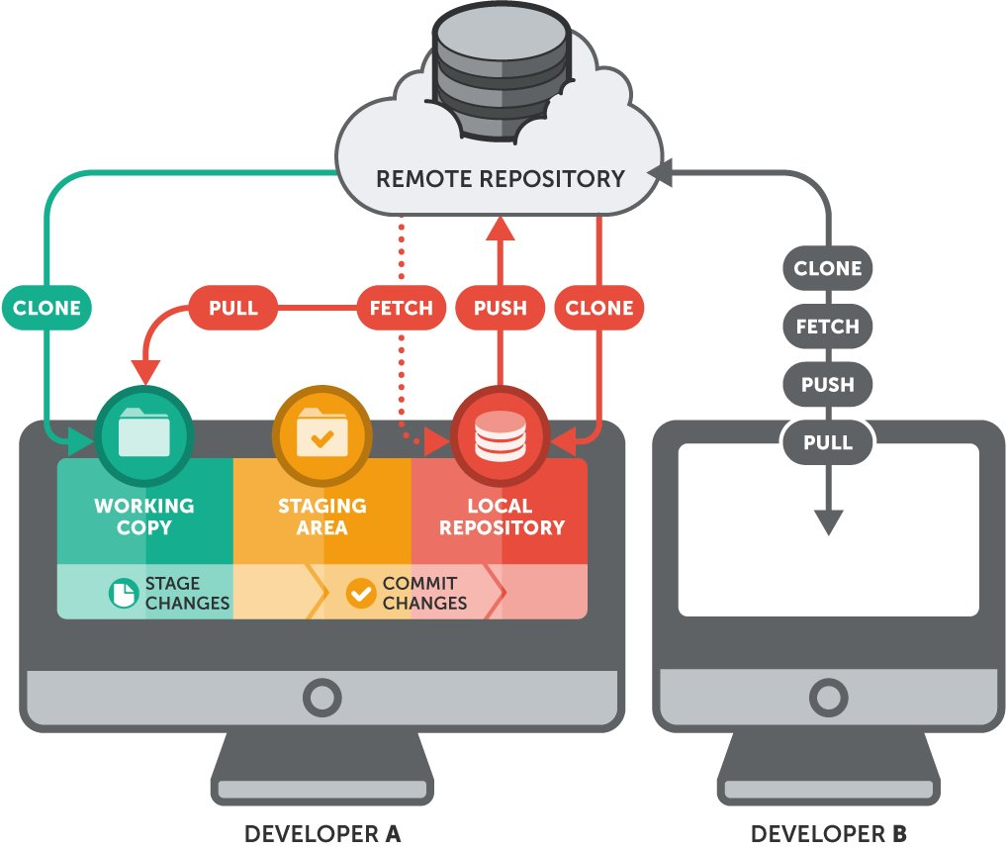
GitHub Part 2: Collaboration in Practice
Working with Others on GitHub
Issues → Pull Requests → Projects
Discussions & Wikis
Teams & Sub-teams
*Live demo focus*
Notes:
Open by recapping Part 1 (“fundamentals”) and showing where we are in the 3-part series.
Stress that this session is about collaboration features—how repos, issues, projects, discussions, wikis, and teams connect.
Point out that slides are a roadmap, but the real learning will come from the live demo.
Mention Part 3 will cover advanced workflows, not today.

Slide 3
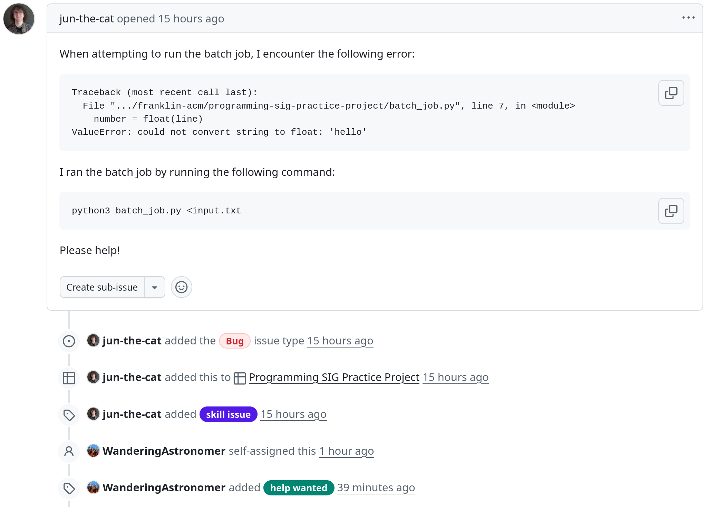
Issues: How to Plan Work!
Describe tasks or bugs in a repo
Use labels and assignees for clarity
Issues connect directly to pull requests
Central place for tracking work
Notes:
Remind them: issues are the project’s to-do list.
Don’t create one live—just show the existing issue.
Point out the “New issue” button so they know where it is.
Show labels and assignees on the sample issue.
Stress the important part: issues link to PRs.
When I open the PR later, go to the sidebar and link this issue.
Closing the loop: once the PR is merged, the issue gets closed automatically.

Slide 4
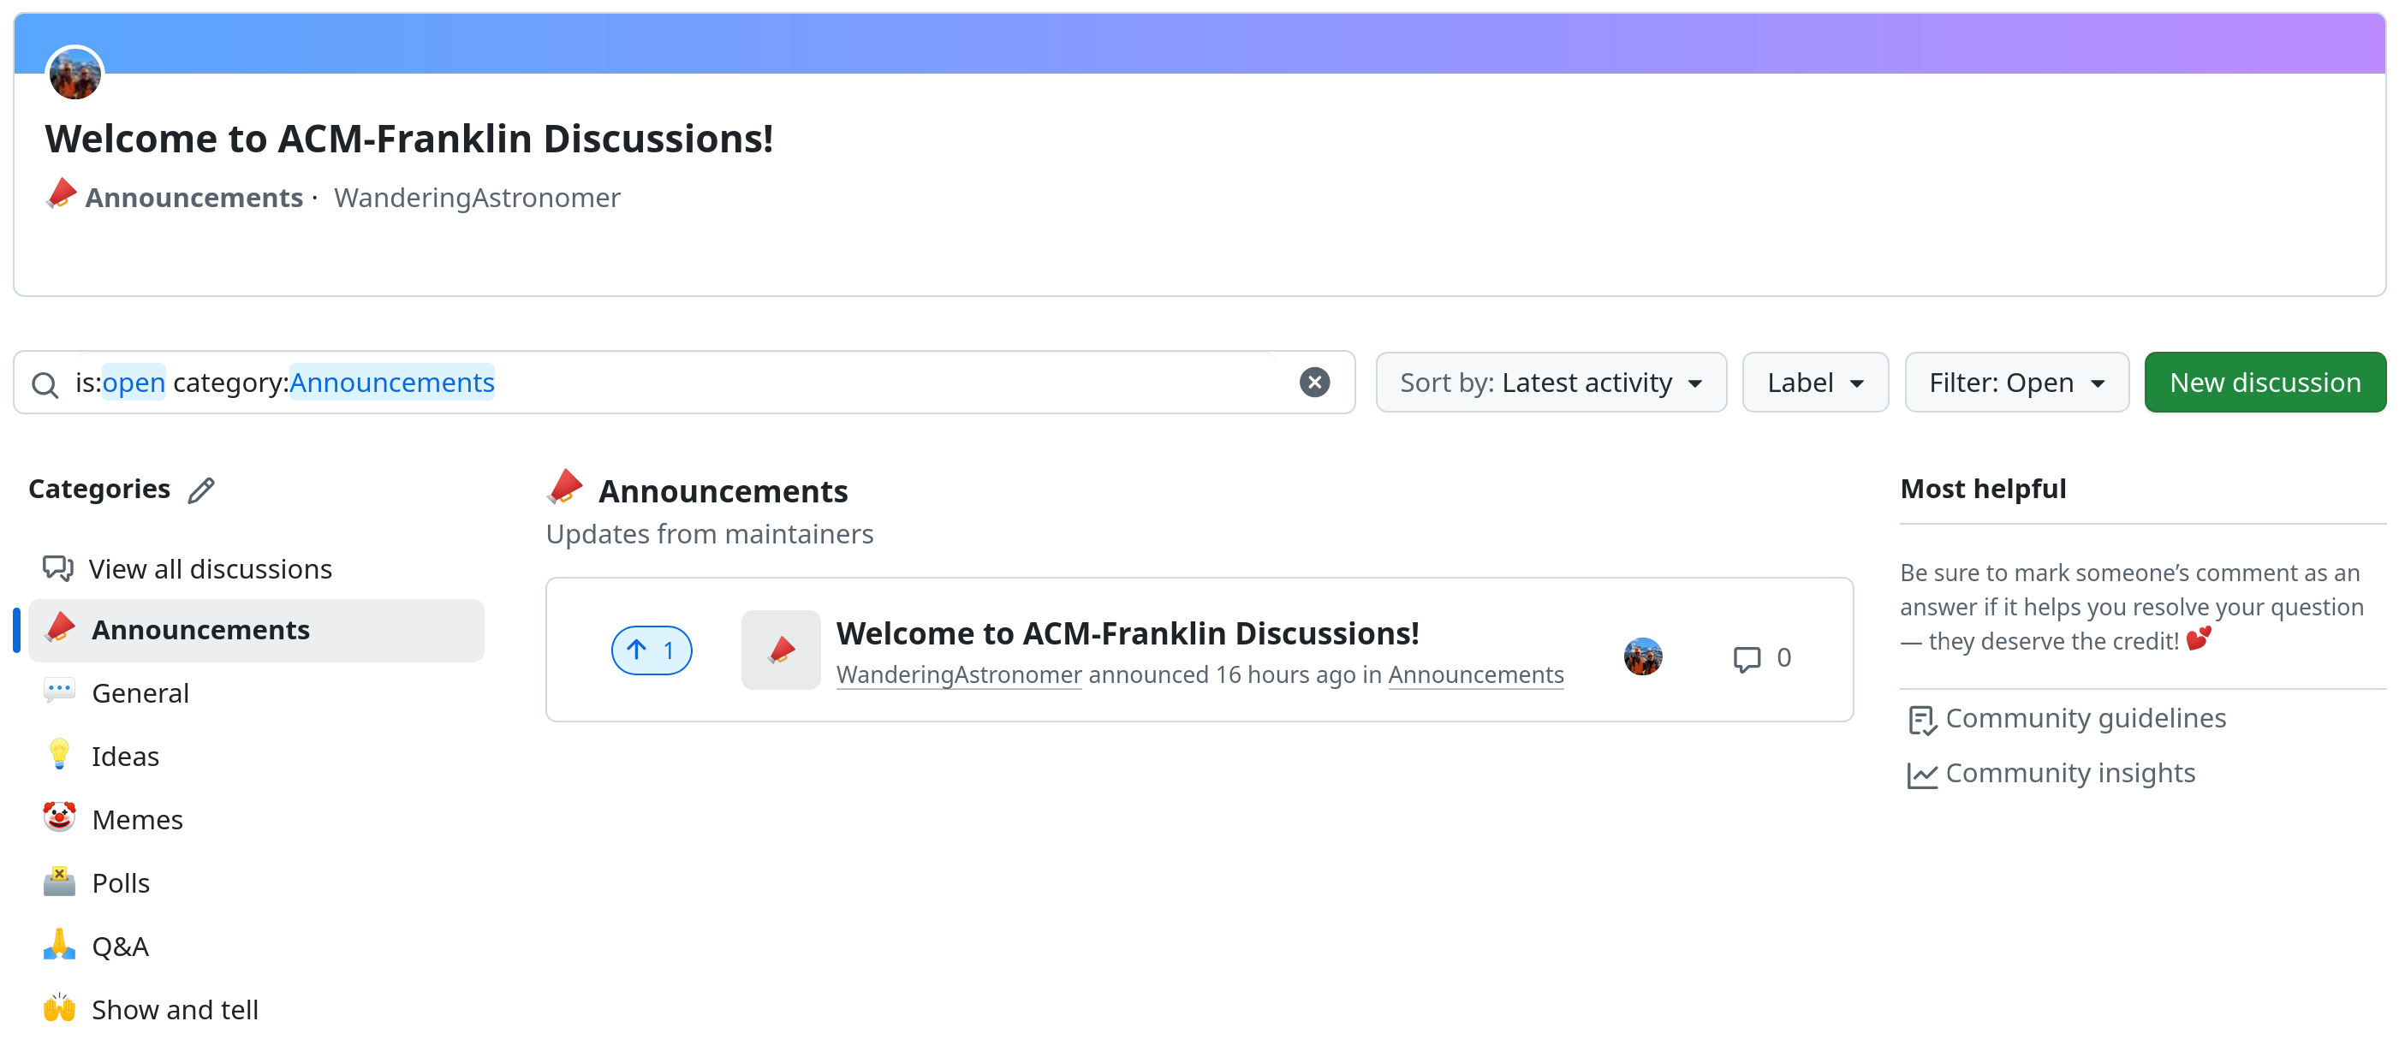
Discussions: Team Conversation
Ask questions, share ideas, make decisions
Categories keep topics organized
Mark answers, pin threads
Convert to/from issues
Lightweight alternative to chat apps
Notes:
Emphasize difference: issues are actionable, discussions are exploratory.
Show how categories organize topics.
Demo a discussion where an answer is marked—call out the green check.
Pin a discussion so it stays visible at the top.
Show converting a discussion into an issue when something becomes actionable.
Remind them: advantage over Discord/Slack is that history is searchable and tied to the repo.

Slide 5
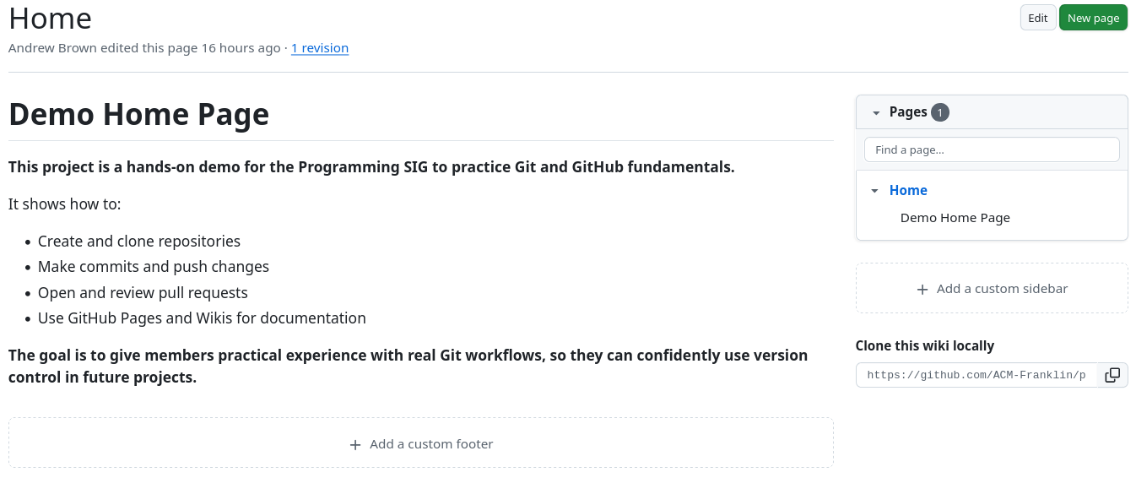
Wiki: Living Documentation
Space for guides, FAQs, reference
Wiki = how we work, deeper docs
Structured with pages and hierarchy
Version-controlled, same as code
Notes:
Make the contrast crystal clear: README is for running the project, Wiki is for working on it.
Show the Wiki tab and open an example page.
Call out sidebar hierarchy and how pages can nest.
Note that changes are tracked with commits, same as source code.
Permissions follow the repo—no need to configure separately.

Slide 6
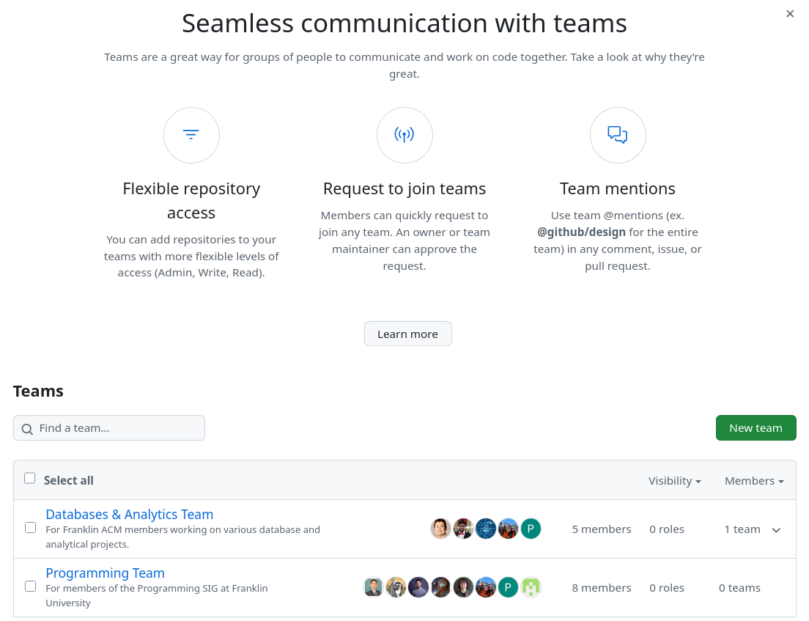
Teams & Sub-teams
Organize people by function or role
Set default repo permissions
Use nested sub-teams for structure
@mention teams in issues/discussions
Notes:
Explain why we’re using teams: Programming vs Data/Analytics.
Show how to create a team and adjust repo access.
Point out the @mention feature for easy notification.
Teams tie people to repos, issues, and projects consistently.

Slide 7

Teamwork & Workflow
Branching, Pull Requests, Reviews
Notes:
Quick recap, since these repos/branches are already set up.
Show where “Code → Clone” lives, but don’t demo the actual clone.
Point out forks as “my copy of your repo.”
Stress: branching is how we avoid breaking main.
Mention that in the demo, we’ll be working off a branch that already exists.
Keep it short, since Part 1 already covered the basics.

Slide 8
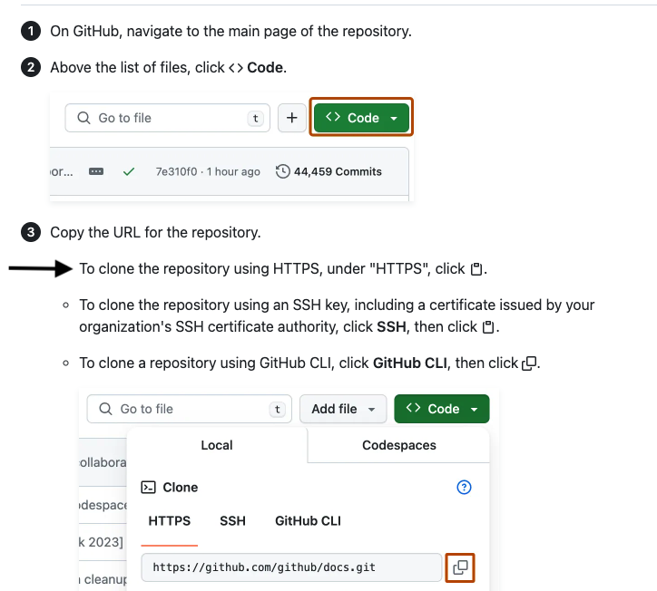
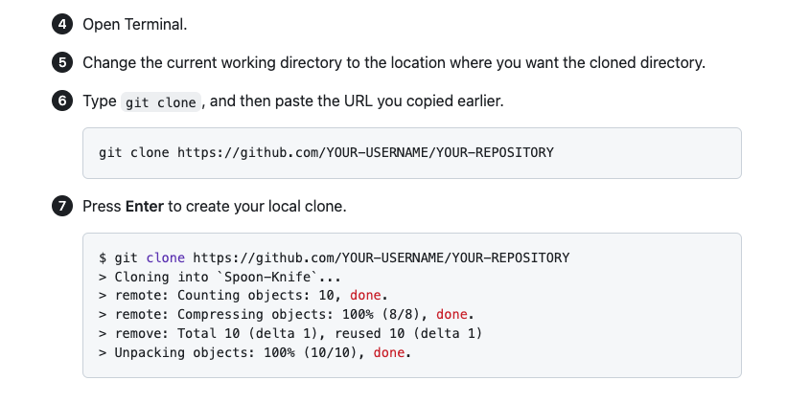
Cloning & Forking Repos
https://docs.github.com/en/repositories/creating-and-managing-repositories/cloning-a-repository

Slide 9
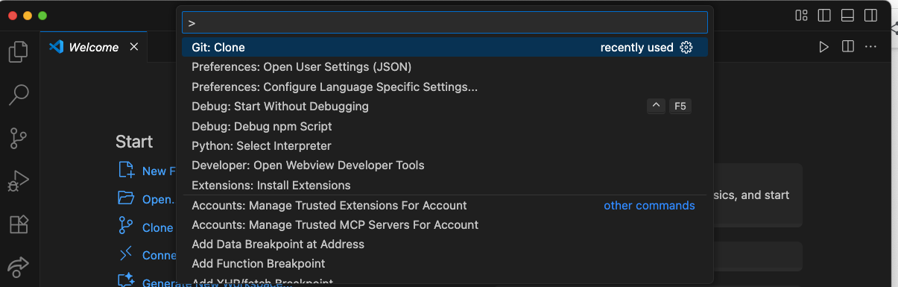
Cloning From VSCode
Press Ctrl+Shift+P (Windows/Linux) or Cmd+Shift+P (macOS) to access the Command Palette
Search for `Git: Clone`

Slide 10
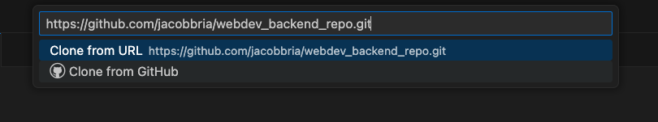
Cloning From VSCode
Enter repo URL
Popup will prompt for a destination folder
VSCode will clone the repo for you after you choose a folder, then ask if you wish to open it

Slide 11
Live Demo!

Slide 12

Q & A
Notes:
Encourage people to ask about workflow, not just the demo error.
Remind them Part 3 will cover more advanced workflows like code reviews and actions (maybe).

