Slide 1
You Were Never "Bad" at Programming
By Franklin University's Programming Special Interest Group
Presented by Andrew Brown
Notes:
Open by naming the quiet belief many people carry: that difficulty with programming is a personal deficiency. State plainly that this session exists to challenge that belief. Do not explain or justify it yet. Plant the flag, then pause and let the room sit with it before moving on.

Slide 2
Where do you feel "stuck" right now?
(A) Starting
(B) Understanding
(C) Debugging
(D) Finishing
Notes:
Run a quick room read to surface patterns without diagnosing anyone. Ask for a show of hands or short responses for A through D. Follow with one clarifying question: “What does ‘stuck’ feel like—confusion, overwhelm, boredom, intimidation, or not knowing what to do next?” Avoid solving anything here. The objective is to normalize the experience and collect language you can reuse later.

Slide 3
The deficiencies of traditional learning when attempting to teach programming:
How it’s often taught:
What learners actually need:
Prioritizes syntax and language features before students understand why they’re using them.
Assumes learners can already decompose problems, even though confusion usually begins before code is ever written.
A reasoning-first approach that builds confidence in problem selection, decomposition, and planning.
Early support for navigating uncertainty: knowing what to do when you don’t know what to do.
Notes:
Invite the group to populate both sides verbally. Keep it fast, aiming for two or three contributions per side. Guide toward the core contrast of syntax-first exposure versus a reasoning-first orientation. If algorithms or data structures are mentioned, acknowledge their importance later, then re-center the point: many learners struggle earlier than that, at problem selection, decomposition, and knowing what to do when they do not know what to do. Close by stating that this workshop intentionally targets the right-hand side first.

Slide 4
Programming is the last step.
Intent
Ideation of Goals – What are you trying to solve?
Reasoning
Acknowledge Blockers – What stands in your way? How might you overcome these Obstacles?
Formalization
Chart a Course – Create a flexible, research-backed plan to conquer the challenge.
Code
Establishing Logic – Translate algorithms into nearly-natural executable language.
Execution
Observe Reality – Run the system, observe behavior, compare outcomes to intent.
Notes:
Use this slide to detach programming from typing. Emphasize that code is a representation of decisions made earlier, not the start of the process. Ask which stage Franklin courses tended to start with, and which stage participants personally get stuck in most often. Reinforce that the goal of the SIG workshop is to strengthen the upstream stages so the downstream stages stop feeling mysterious and fragile.

Slide 5
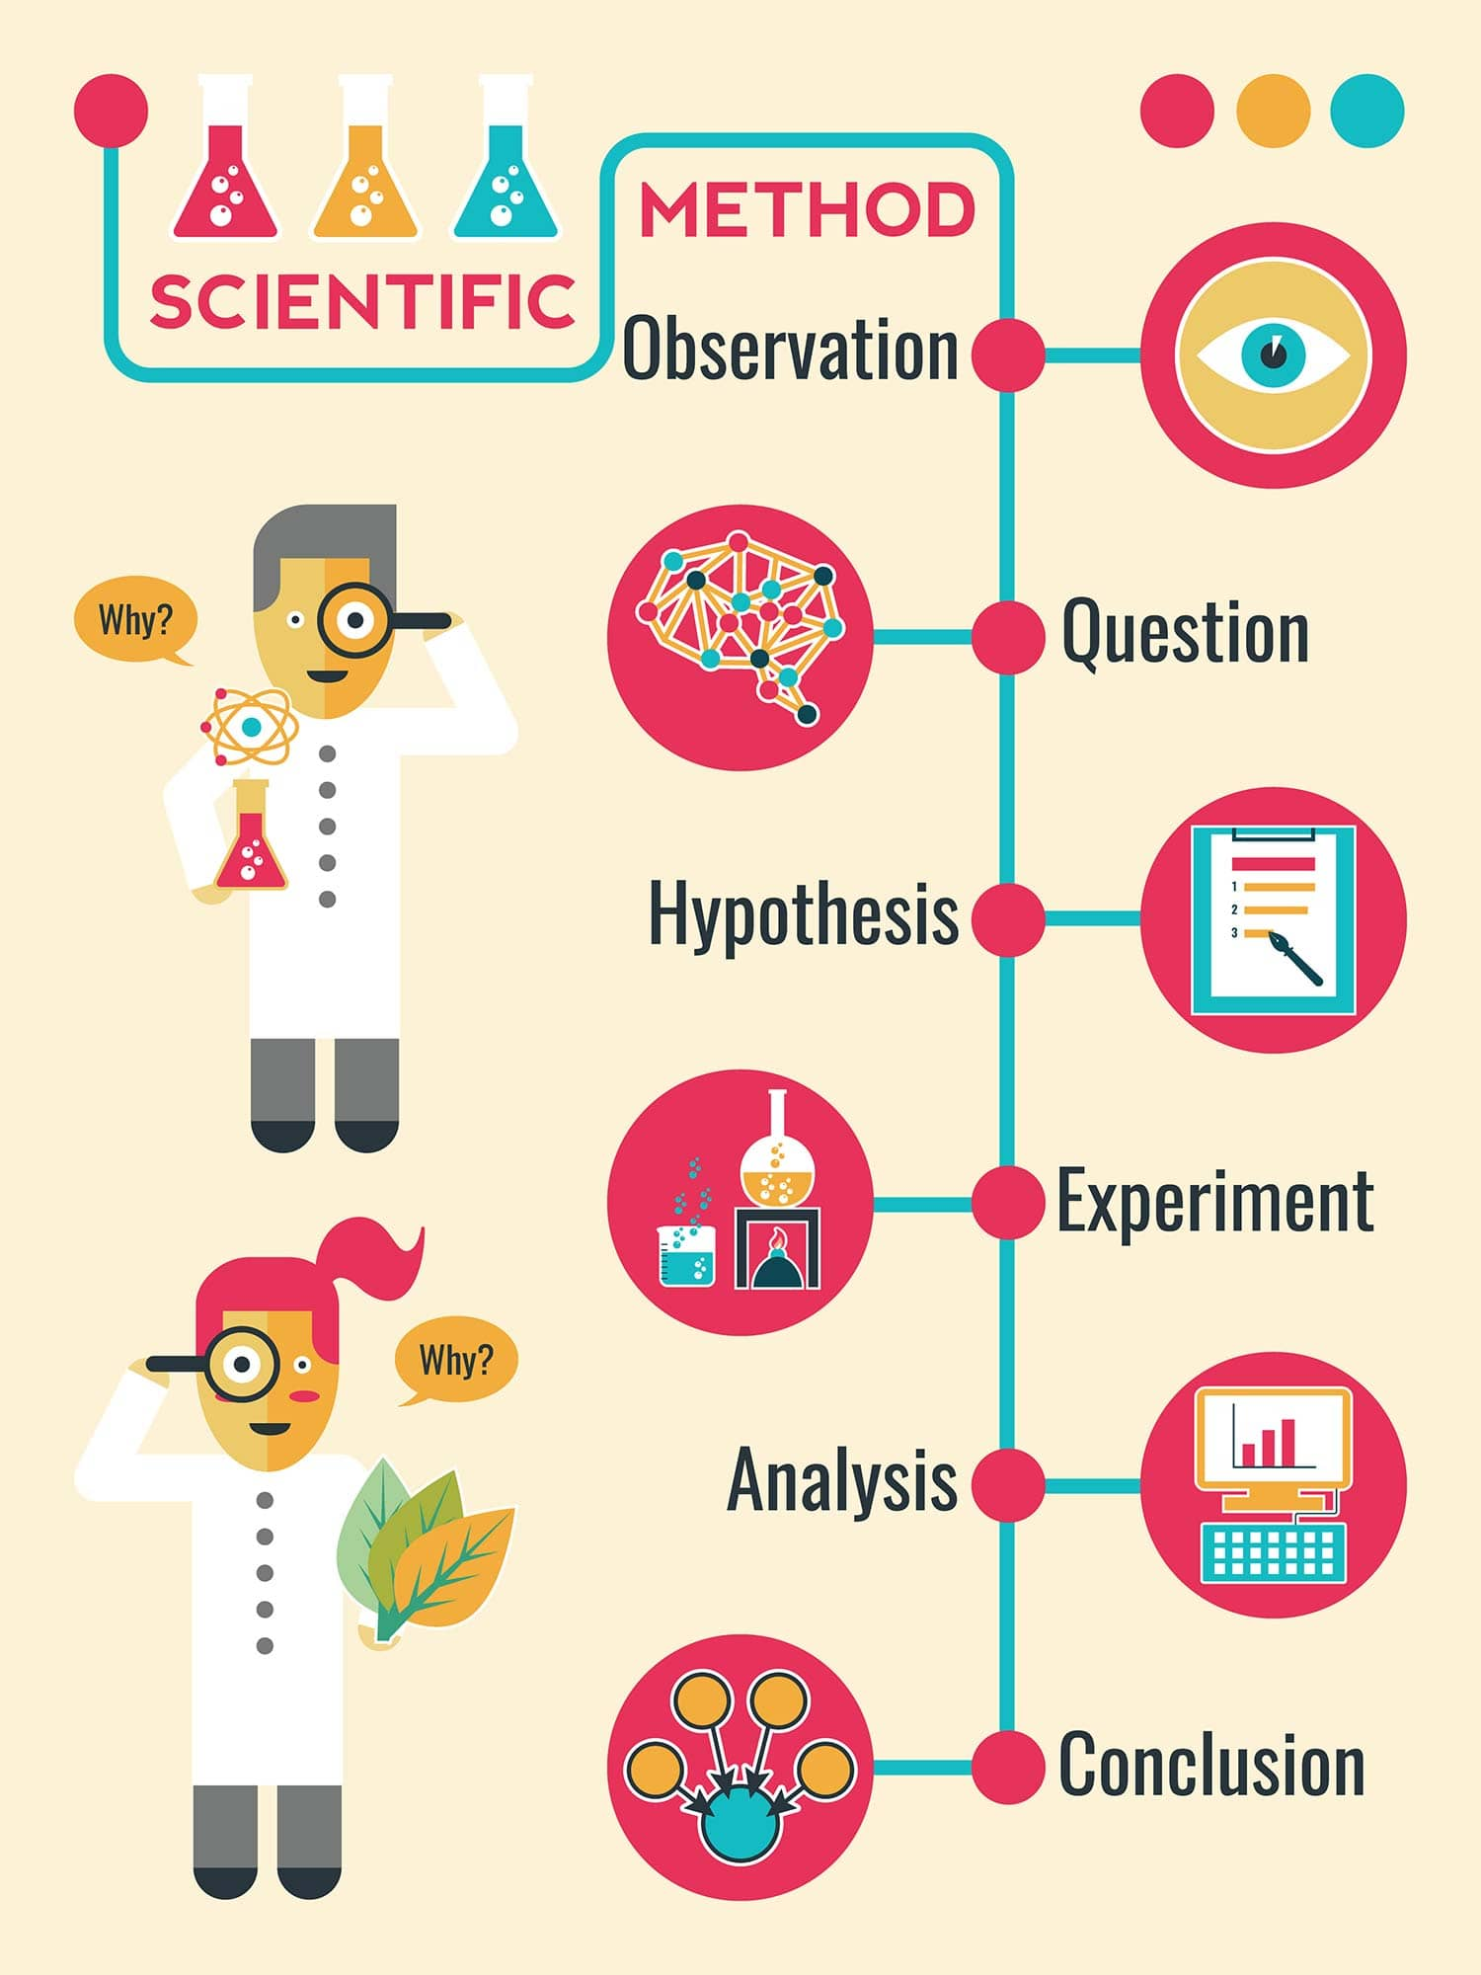
You may have recognized that process from somewhere else…
Observe a real‑world phenomenon and identify something worth understanding or improving.
Ask a clear, testable question that focuses your investigation.
Form a hypothesis — a reasoned guess you can evaluate with evidence.
Run experiments or gather data to test your assumption.
Analyze what actually happened and compare it to what you expected.
Refine your hypothesis or create a new one based on what you learned.
Notes:
Frame this as a recognition moment, not a lesson. Point out that the process just described mirrors how people already reason about the world when they are allowed to slow down and think clearly. Emphasize that programming is not introducing a foreign way of thinking, but formalizing one they already use. Keep this brief and do not linger; the purpose is legitimacy, not instruction.

Slide 6
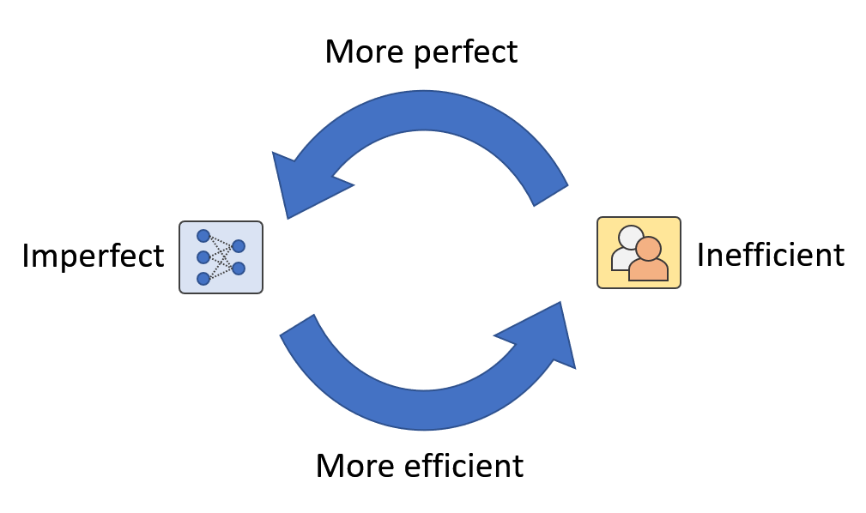
Humans decide. Machines follow.
Ask better questions
But literal!
But adaptive!
Notes:
Make the point that a computer does not solve a problem until a person defines what “solve” means. Highlight that ambiguity is normal for humans, while machines require precision. Ask a quick question: “What happens when you try to code before you can clearly state the problem?” Capture responses like endless rewrites, rabbit holes, or feeling not smart enough. Frame those experiences as predictable outcomes of skipping reasoning, not personal failure.

Slide 7
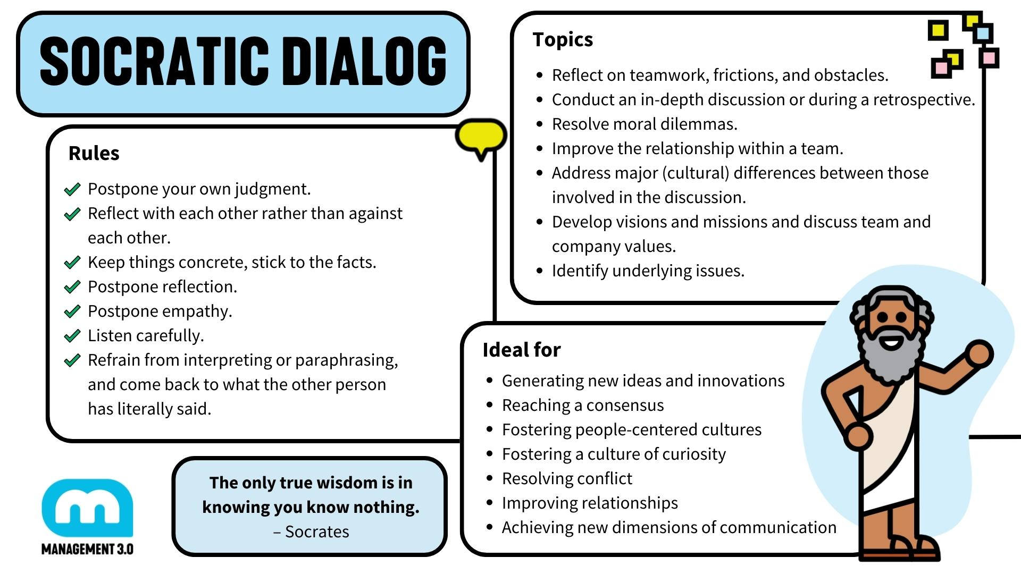
Notes:
Use this slide to make explicit that reasoning does not require another person to be present. Explain that the Socratic method and Socratic dialogue are about disciplined questioning, not debate or philosophy. Emphasize that the same technique used in group discussion can be applied internally when working alone by questioning assumptions, goals, definitions, and constraints before jumping to solutions. Connect this to programming by noting that the MIT rubber duck method is essentially Socratic dialogue externalized, where explaining a problem forces gaps in reasoning to surface.

Slide 8

If it doesn’t matter, it won’t stick.
What problem would you willingly work on for 10 hours?
100 hours??
A thousand?!
Notes:
Transition fully from cognition into motivation by stating plainly that if something does not matter to you, it will not stick, no matter how well it is taught. Explain that retention follows relevance, and relevance follows ownership, and that ownership usually begins when a problem intersects with personal friction rather than a syllabus. Ask what kind of problem someone would willingly work on for ten, one hundred, or a thousand hours, and pause long enough for the question to feel uncomfortable rather than rhetorical.
Use Vociferous as a personal example, not as a technical case study, but as an explanation of why you kept returning to a problem long after novelty wore off. Emphasize the shift from learning tools to becoming someone who builds things that reduce friction in their own life. Reinforce that this identity shift—from learner to creator—is available to anyone once learning is attached to something they genuinely care about.

Slide 9

Noblesse Oblige
Self
Others
Reality
Notes:
Explain that creating anything—software, systems, tools—implicitly places you under a set of contracts: with yourself, with the people affected by what you build, with the community it touches, and with reality itself. These contracts are the basis of trust, collaboration, and safety, and breaking them is how harm enters systems. Emphasize that in the age of AI, stewardship matters more, not less, because tools amplify intent and mistakes scale faster than individuals. This workshop treats programming not just as problem-solving, but as responsible creation.

