Slide 1
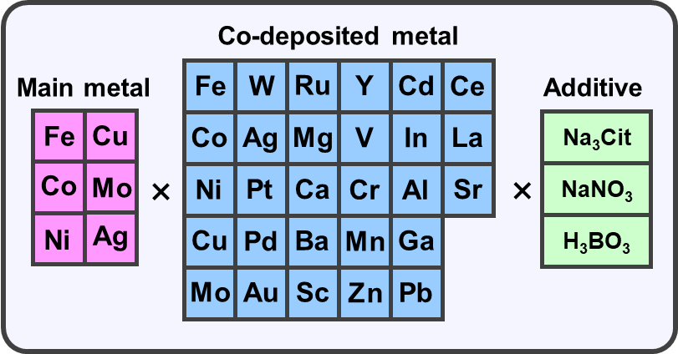


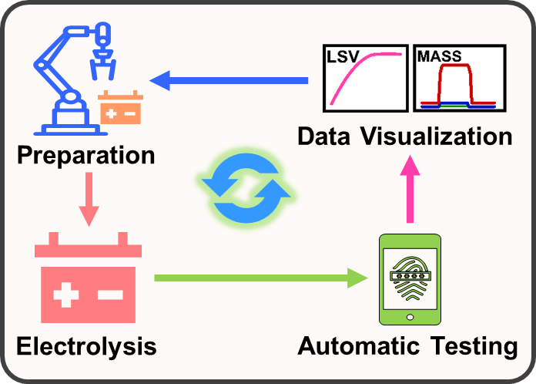
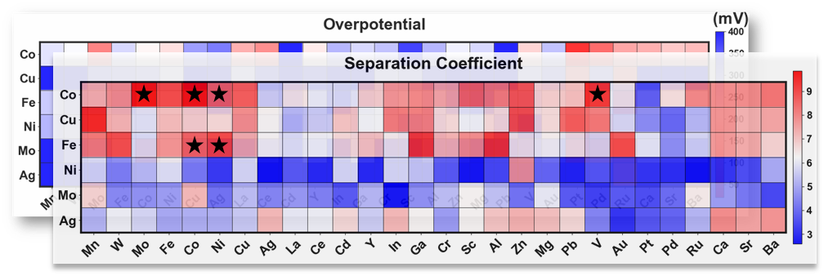
Explore Space
Preferred Combinations
Bayesian Optimization
Composition of electroplating solution
Dual-objective optimization of S_{H/D} and η₁₀
Automated platform
Initial Screening Results

Slide 2
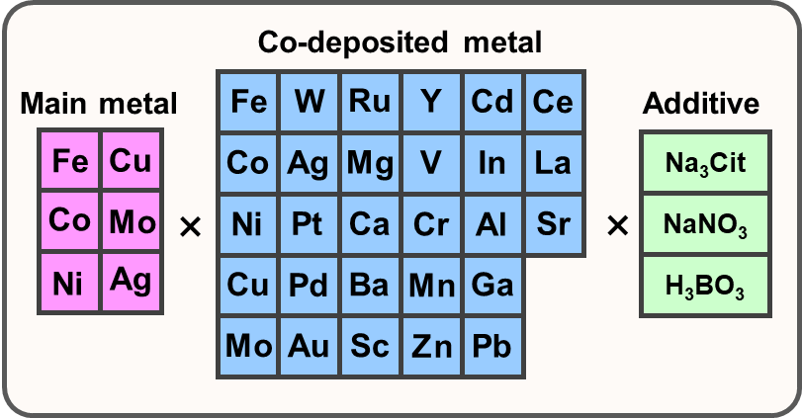
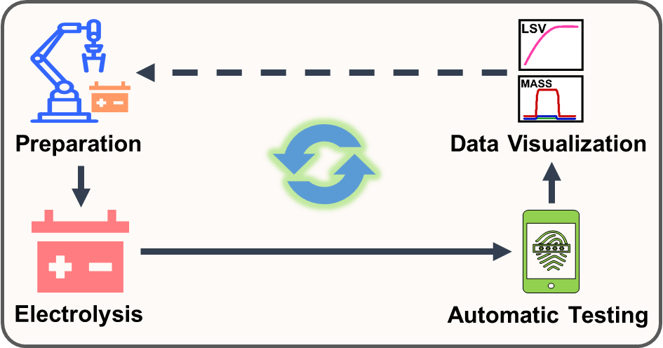

Slide 3
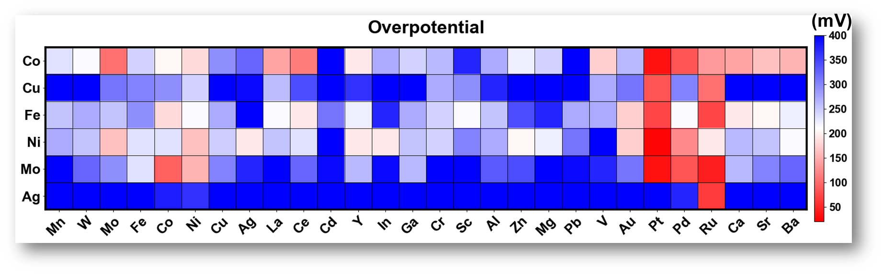
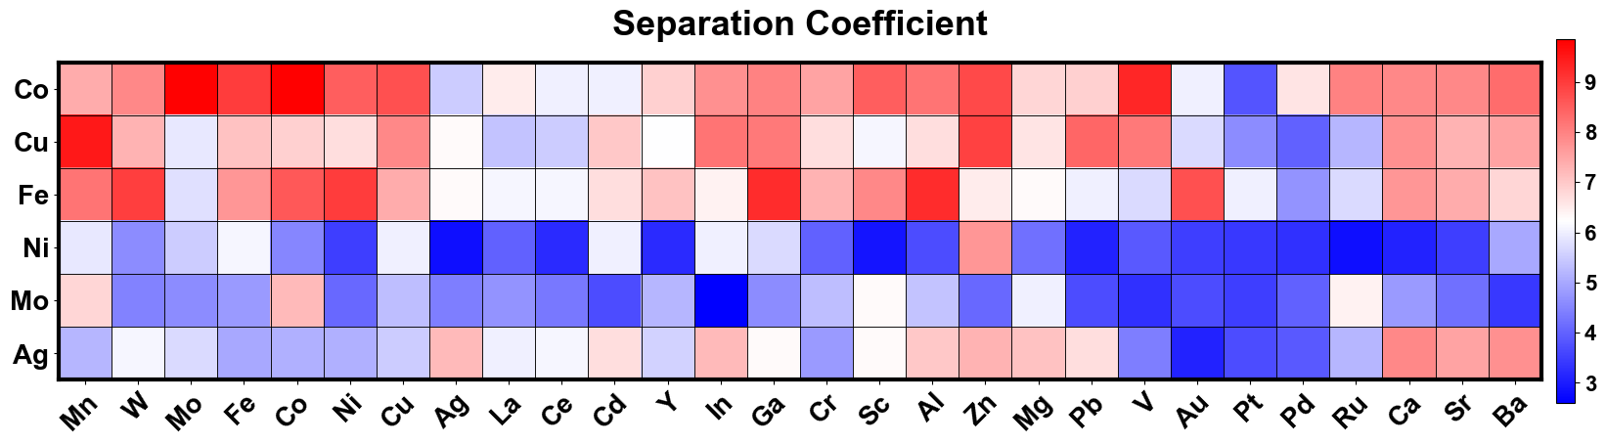
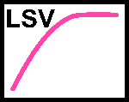

Co-deposited metal
Main metal
Fe
W
Ru
Y
Cd
Ce
Additive
Fe
Cu
Co
Ag
Mg
V
In
La
Na₃Cit
Co
Mo
×
Ni
Pt
Ca
Cr
Al
Sr
×
NaNO₃
Ni
Ag
Cu
Pd
Ba
Mn
Ga
H₃BO₃
Mo
Au
Sc
Zn
Pb
Data Visualization
Preparation
Electrolysis
Automatic Testing

