Slide 1
Architect
Ding Xianli
2018.7.2

Slide 2
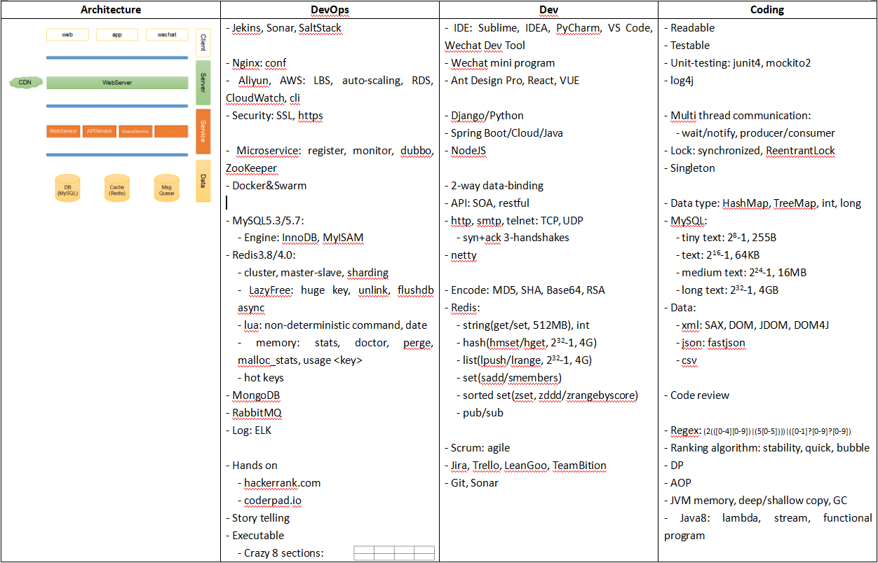
Content
Who's software architect?
Architecture evolution
An architecture
DevOPS
Dev
Coding

Slide 3
Who's software architect?
Design system
Implement system
Hands on
  hackerrank.com
  coderpad.io
Story telling
Executable
  Crazy 8 sections:

Slide 4
Architecture evolution
Mono program
C/S
B/S, 3-layer
Multi layer
Micro service

Slide 5
An architecture
web
app
wechat
Client
Server
CDN
WebServer
Service
WebService
APIService
QueueService
...
Data
DB (MySQL)
Cache (Redis)
Msg
Queue

Slide 6
DevOPS
Jekins, Sonar, SaltStack
Nginx, MySQL, Redis, RabbitMQ
Aliyun, AWS: LBS, auto-scaling, RDS
Microservice: register, monitor
dubbo, zookeeper
Docker&Swarm
Log: ELK

Slide 7
Dev
IDE: sublime, IDEA, PyCharm, VS Code, Wechat Dev Tool
Framework: Wechat Mini Program, Ant Design Pro, React, VUE, Django(Python), Spring Boot/Cloud(Java), NodeJS
Security:
  encode, MD5, SHA, Base64, RSA
Scrum/agile
  Jira, Trello, TeamBition, LeanGoo

Slide 8
Coding
Readable, testable
Unit testing: junit4, mockito2
log4j
multi thread: synchronized, lock
data type: HashMap, TreeMap, int, long
MySQL: text
Code review
API: SOA, restful, TCP, UDP, http
data: xml, json, csv

Slide 9
Which word can describe what architect does?
Contrology

