Slide 1
Final project presentation
Group 18
Chen Yihui, Shen Yixiu, Wang Longfei, Wang Renjie
Github repo link : https://github.com/Wang-Theo/ME5413_Final_Project
https://github.com/Wang-Theo/ME5413_Final_Project

Slide 2
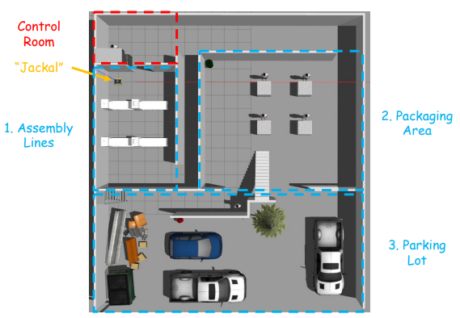
Description
A mini-factory environment in Gazebo.
3 accessible areas
1 inaccessible area.
The aim of the project is to design a robot navigation software stack that can:
From the starting point, move to the given pose within each area in sequence:
Assembly Line 1, 2
Packaging Area 1, 2, 3, 4
Delivery Vehicle 1, 2, 3

Slide 3
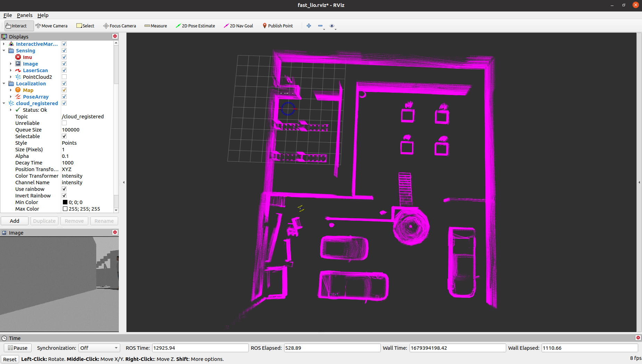
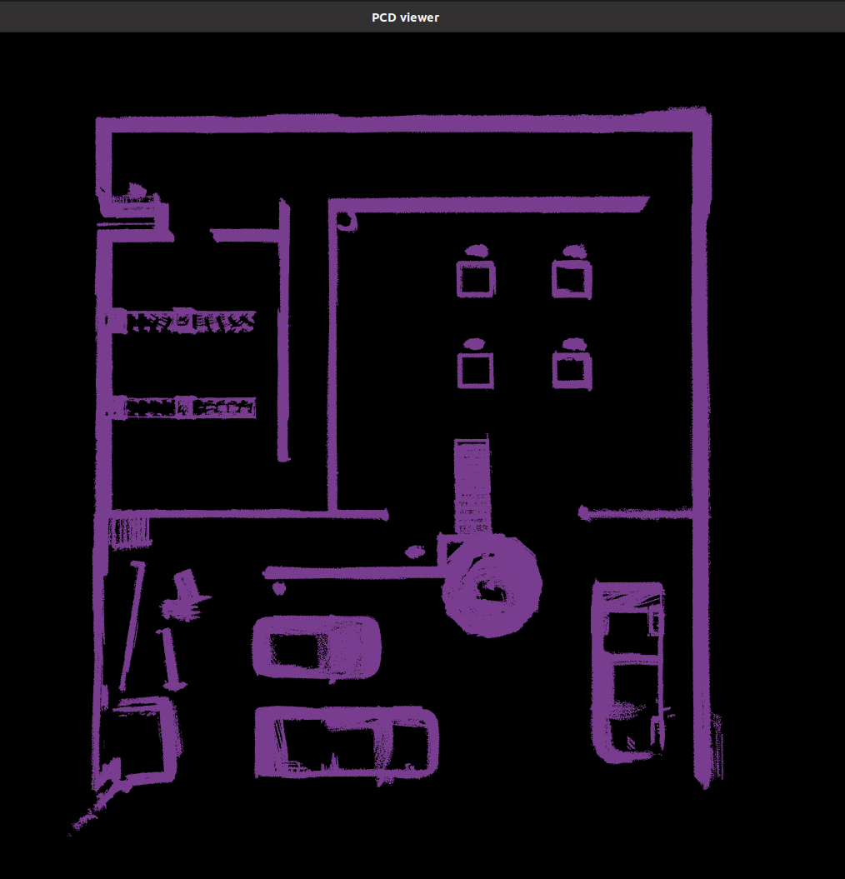
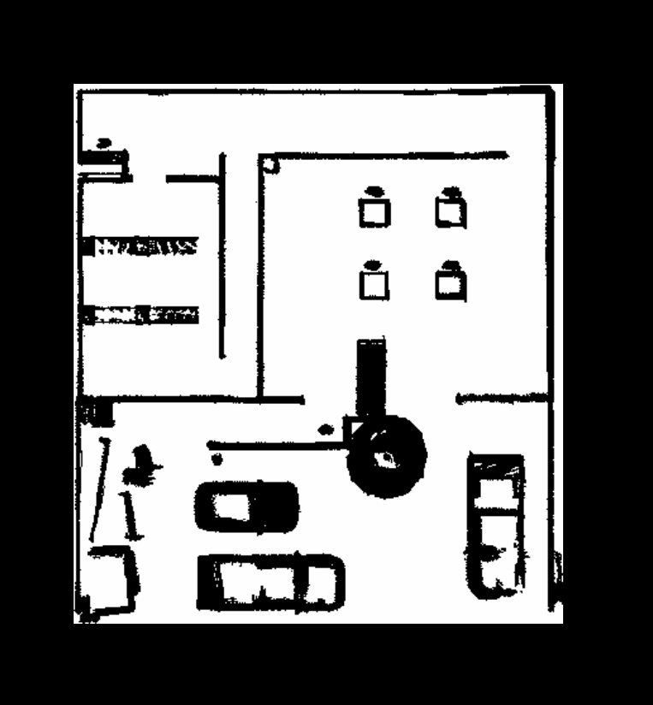
Task 1 Mapping
FAST-LIO (fusion of 3D LiDAR and IMU)
Mapping environment -> Filter pointclouds pcd -> Convert pcd to grid map

Slide 4
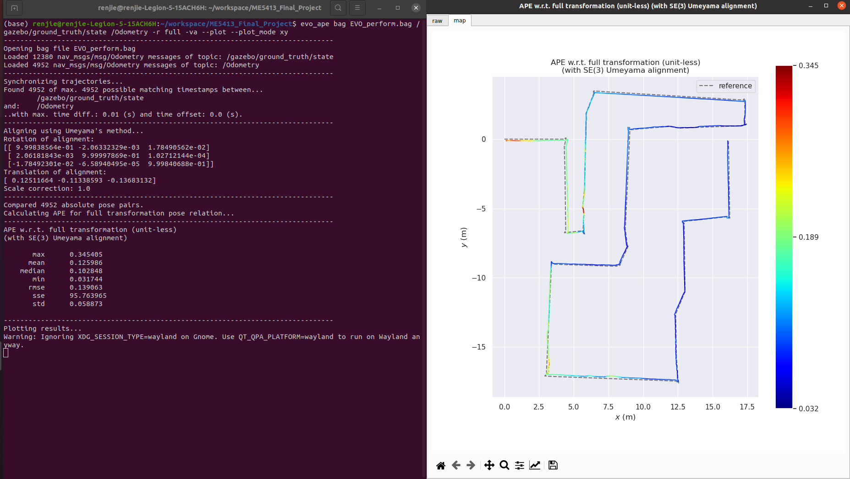
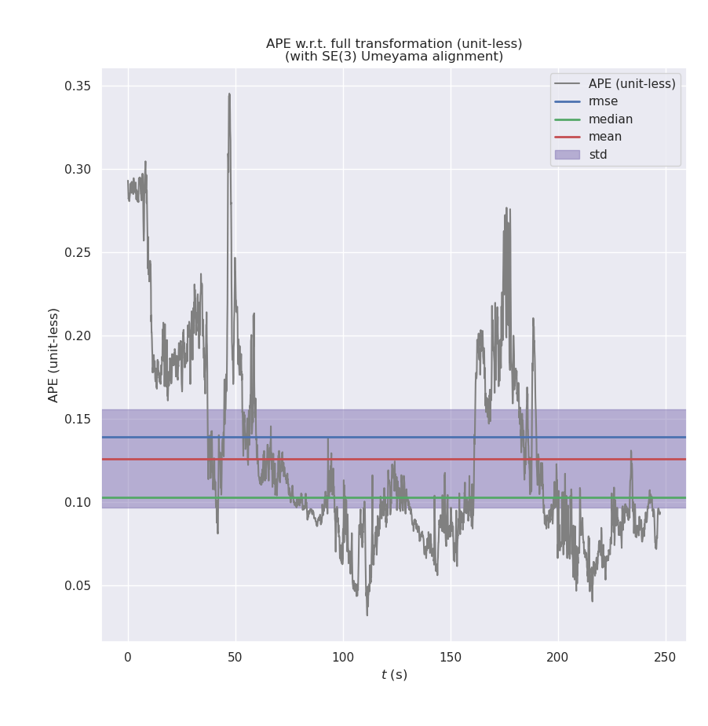
Task 1 Mapping
EVO Performance Evaluation
mean alignment is 0.125986
max alignment is 0.345405.
-> The results show that the accuracy of algorithm performs very good.

Slide 5
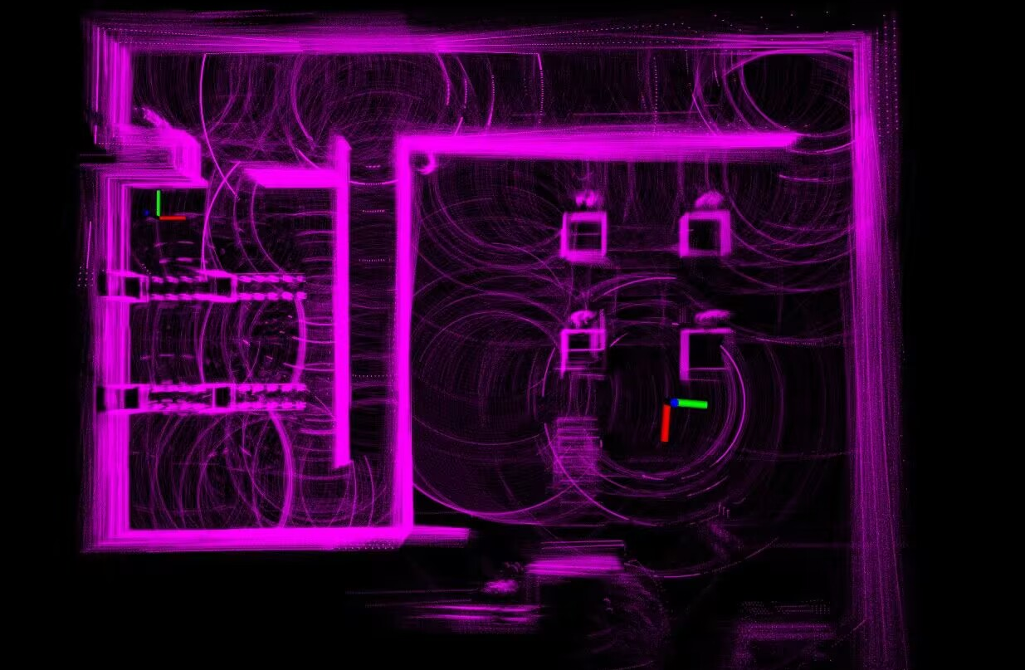
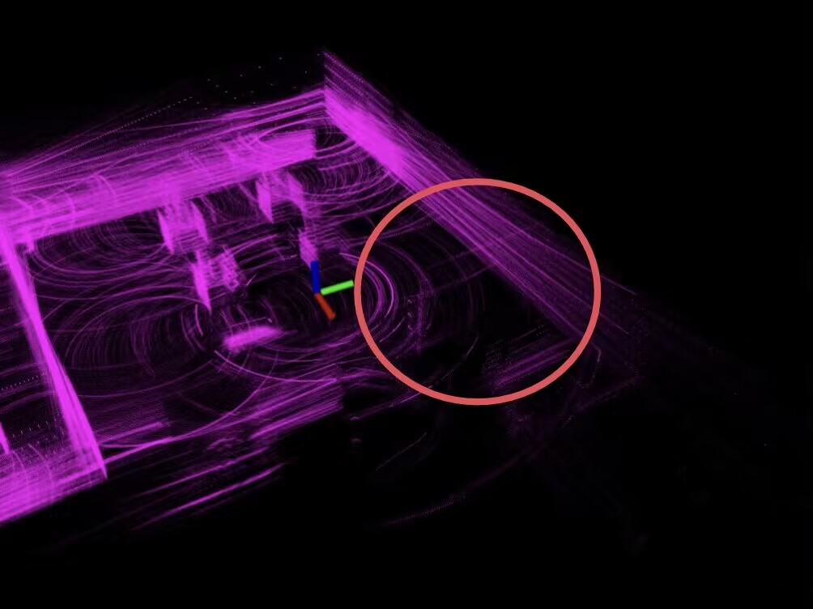
Task 1 Mapping
Challenges faced
Need to cut off ground cloudpoints.
Fail to coincide with original cloudpoints when turning Jackal.
Need to filter noise cloudpoints.
Need to convert pcd file to grid map for navigation.
Solutions
Add height limit for cloudpoints in callback function and add pass-through filter to filter ground points of pcd file.
Increase LiDAR rate from 10 Hz to 50 Hz.
Add radius filter to remove noise points.
Write algorithm package by ourselves to project pointclouds to 2D grid map.

