Slide 1

Cisco Personnel Management System Platform
January 4th, 2021

Slide 2
Our Team
Jiadi Wang
Meiqi Jin
Rui Wang
Shenghe Wang
Weilin Xu
Xinqiang Xiong
Yuxuan Li
Dalian

Slide 3
About the Platform
According to our company's current recruitment situation analysis, our recruitment mainly relies on third-party recruitment websites and manual screening.
We still do not have a personnel management system that is entirely our own. As for the red badge employees, they are managed by different third-party companies, so there are some problems with management inconvenience such as lack of systemic management after entry.
The platform we want to develop intends to solve these problems.

Slide 4
Existing Problems in Recruitment and Personnel Management
- If there are many interviews, it is easy to cause a conflict of interview time
- The results of the interviewer need to be delivered manually, which can not directly measure the ability of each candidate
- Candidates can not intuitively understand the recruitment process
- Can't completely control the whole recruitment process, can't carry out collaborative recruitment
- The whole recruitment process can not be completely recorded, which is prone to errors
- Lack of tracking and systematic management of employee training and certification
Meiqi Jin

Slide 5
Function Introduction
- Interviewees can submit resumes, conduct written examinations, and check the progress of the interview on the website. The system can automatically screen resumes based on big data. The interviewer can score the interviewee according to his performance, and write a comment to record the shortcomings of the interviewee, so as to compare his performance in the second interview
Jiadi Wang
- Another function of this system is talent management. Enter each candidate's information into the system. In addition, even if the candidate fails the interview or voluntarily withdraws, he will be tracked and investigated, such as his next company and position. These data are entered into the database and encrypted. Through this function, it is easier for the human resources department to weigh the salary of each employee.
Yuxuan Li

Slide 6
Technologies to Be Used
- Regarding technical implementation, we have now decided to use Python as a programming language and Flask as a lightweight framework for back-end architecture. This combination makes it easier to crawl data and build systems
Weilin Xu
- We decided to complete front-end development with AngularJS, which has a solid foundation and community support. And it was a relatively complete front-end framework that made it easy to write reusable code, which was very helpful to our development team.
Xinqiang Xiong

Slide 7
Following advantages will be completed
- Our company will have its own talent pool to quickly find suitable talents
- Display the analysis report according to the examiner's comments, and make a clear and accurate comparison of the results
- The interviewer and interviewees can check the interview result in the system
- Simplify the personnel and manual process, and replace running around with online application and approval
- Analyze, plan and improve personnel management level
Rui Wang

Slide 8


Slide 9
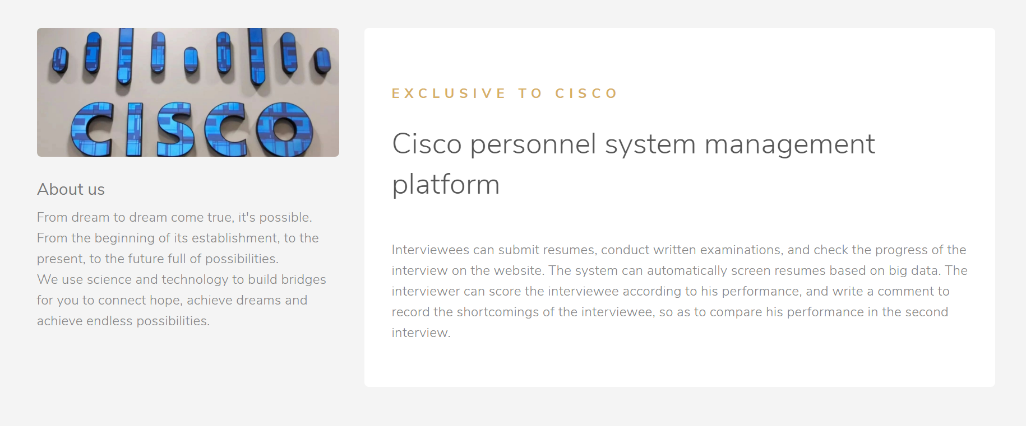

Slide 10
