Slide 1
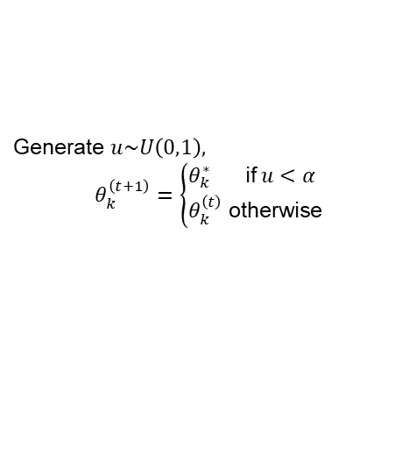







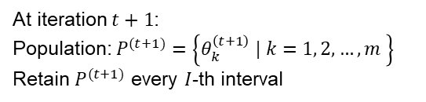
Initialization
Proposal Generation
$$P^{(0)}=\left\{θ_{k}^{\left(0\right)} | k=1, 2,…,m \right\}$$
Randomly select two distinct chains: $θ_{r1}^{\left(t\right)},θ_{r2}^{\left(t\right)}$
Regular DE-MCz
Proposal: $θ_{k}^{∗}=θ_{k}^{\left(t\right)}+G\left(θ_{r1}^{\left(t\right)}−θ_{r2}^{\left(t\right)}\right)+ε$
At iteration $t$:
Population: $P^{(t)}=\left\{θ_{k}^{\left(t\right)} | k=1, 2,…,m \right\}$
Chain $1$: $θ_{1}^{\left(t\right)}$
Snooker update
Select a third chain: $θ_{c3}^{\left(t\right)}$
Proposal: $θ_{k}^{∗}=θ_{k}^{\left(t\right)}+G_{s}\left(θ_{P1}−θ_{P2}\right)$
Chain $2$: $θ_{2}^{\left(t\right)}$
…
Acceptance Probability
Chain $m$: $θ_{m}^{\left(t\right)}$
Generate $u\sim U\left(0,1\right),$
$$θ_{k}^{\left(t+1\right)}=\left\{\begin{aligned}θ_{k}^{∗} \text{if} u<α \\ θ_{k}^{\left(t\right)} \text{otherwise}\end{aligned}\right.$$
Population Update and Thinning
At iteration $t+1$:
Population: $P^{(t+1)}=\left\{θ_{k}^{\left(t+1\right)} | k=1, 2,…,m \right\}$
Retain $P^{(t+1)}$ every $I$-th interval

Slide 2
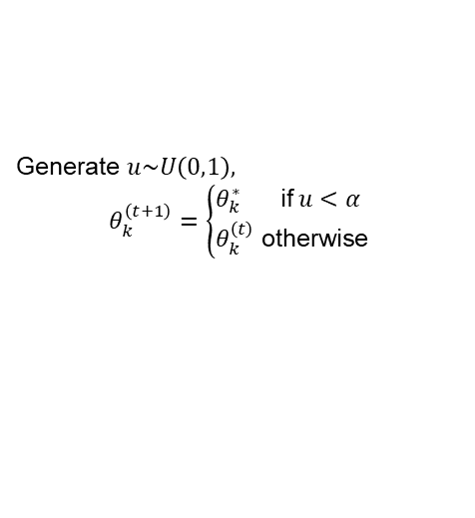


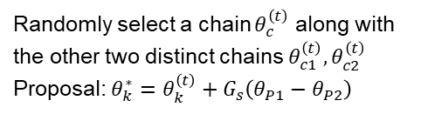



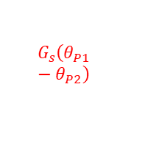



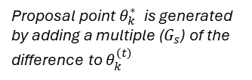


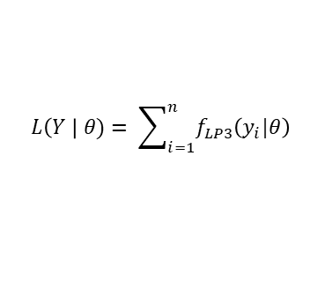



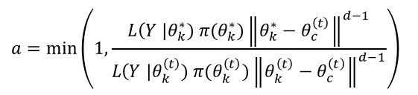





Prior distribution
Distribution Fitting Analysis
$$π(θ)$$
Prior Knowledge
Observations
Model Likelihood
$$Y=\left\{y_{i} | i=1, 2,…,n \right\}$$
$$L\left(Y \right| θ)= \sum_{i=1}^{n}{f_{LP3}\left(y_{i}|θ\right)}$$
$$θ$$
Adaptive Differential Evolution Markov Chain with Snooker updater (DE-MCzS)
$$P^{(0)}=\left\{θ_{k}^{\left(0\right)} | k=1, 2,…,m \right\}$$
Boundary Conditions
Initialization
Proposal Generation
$$P^{(t)}=\left\{θ_{k}^{\left(t\right)} | k=1, 2,…,m \right\}$$
Acceptance Probability
probability $1−ζ$
Regular DE-MCz
Randomly select two distinct chains $θ_{r1}^{\left(t\right)},θ_{r2}^{\left(t\right)}$
Proposal: $θ_{k}^{∗}=θ_{k}^{\left(t\right)}+G\left(θ_{r1}^{\left(t\right)}−θ_{r2}^{\left(t\right)}\right)+ε$
$$a=\min\left(1, \frac{L\left(Y \right|θ_{k}^{∗}) π(θ_{k}^{∗})}{L\left(Y \right|θ_{k}^{\left(t\right)}) π(θ_{k}^{\left(t\right)})}\right)$$
probability $ζ$
Snooker update
Randomly select a chain $θ_{c}^{\left(t\right)}$ along with the other two distinct chains $θ_{c1}^{\left(t\right)},θ_{c2}^{\left(t\right)}$
Proposal: $θ_{k}^{∗}=θ_{k}^{\left(t\right)}+G_{s}\left(θ_{P1}−θ_{P2}\right)$
$$a=\min\left(1, \frac{L\left(Y \right|θ_{k}^{∗}) π(θ_{k}^{∗}){\left\|θ_{k}^{∗}−θ_{c}^{\left(t\right)}\right\|}^{d−1}}{L\left(Y \right|θ_{k}^{\left(t\right)}) π(θ_{k}^{\left(t\right)}){\left\|θ_{k}^{\left(t\right)}−θ_{c}^{\left(t\right)}\right\|}^{d−1}}\right)$$
Proposal point $θ_{k}^{∗}$ is generated by adding a multiple ($G_{s}$) of the difference to $θ_{k}^{\left(t\right)}$
$$θ_{c}^{\left(t\right)}$$
Generate $u\sim U\left(0,1\right),$
$$θ_{k}^{\left(t+1\right)}=\left\{\begin{aligned}θ_{k}^{∗} \text{if} u<α \\ θ_{k}^{\left(t\right)} \text{otherwise}\end{aligned}\right.$$
$$θ_{k}^{∗}$$
$$θ_{c2}^{\left(t\right)}$$
$$θ_{c1}^{\left(t\right)}$$
$$θ_{k}^{\left(t\right)}$$
$$G_{s}\left(θ_{P1}−θ_{P2}\right)$$
$$\left(θ_{P1}−θ_{P2}\right)$$
Project the other two distinct chain orthogonally onto the line and calculate the difference between the projection points.
Proposal $θ_{k}^{∗}$ is generated along the line through $θ_{k}^{\left(t\right)}$ to $θ_{c}^{\left(t\right)}$
Population Update and Thinning
$$P^{(t+1)}=\left\{θ_{k}^{\left(t+1\right)} | k=1, 2,…,m \right\}$$
Retain $P^{(t+1)}$ every $I$-th interval
MCMC
samples
Posterior distribution
$$π(θ|Y)$$
$$θ$$

Slide 3








Proposal point $θ_{k}^{∗}$ is generated by adding a multiple ($G_{s}$) of the difference to $θ_{k}^{\left(t\right)}$
$$θ_{c}^{\left(t\right)}$$
$$θ_{k}^{∗}$$
$$θ_{c2}^{\left(t\right)}$$
$$θ_{c1}^{\left(t\right)}$$
$$θ_{k}^{\left(t\right)}$$
$$G_{s}\left(θ_{P1}−θ_{P2}\right)$$
$$\left(θ_{P1}−θ_{P2}\right)$$
Project the other two distinct chain orthogonally onto the line and calculate the difference between the projection points.
Proposal $θ_{k}^{∗}$ is generated along the line through $θ_{k}^{\left(t\right)}$ to $θ_{c}^{\left(t\right)}$

Slide 4
