Slide 1
VAE: Auto-encoding Variational Bayes

Slide 2
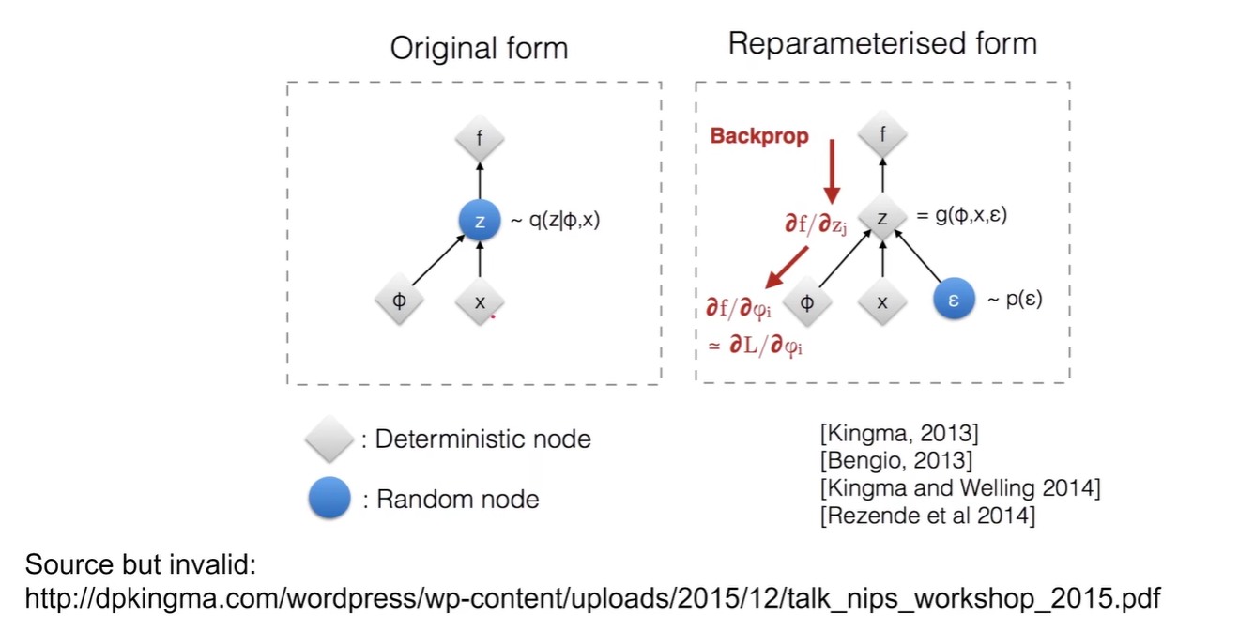
Reparameterization Trick

Slide 3
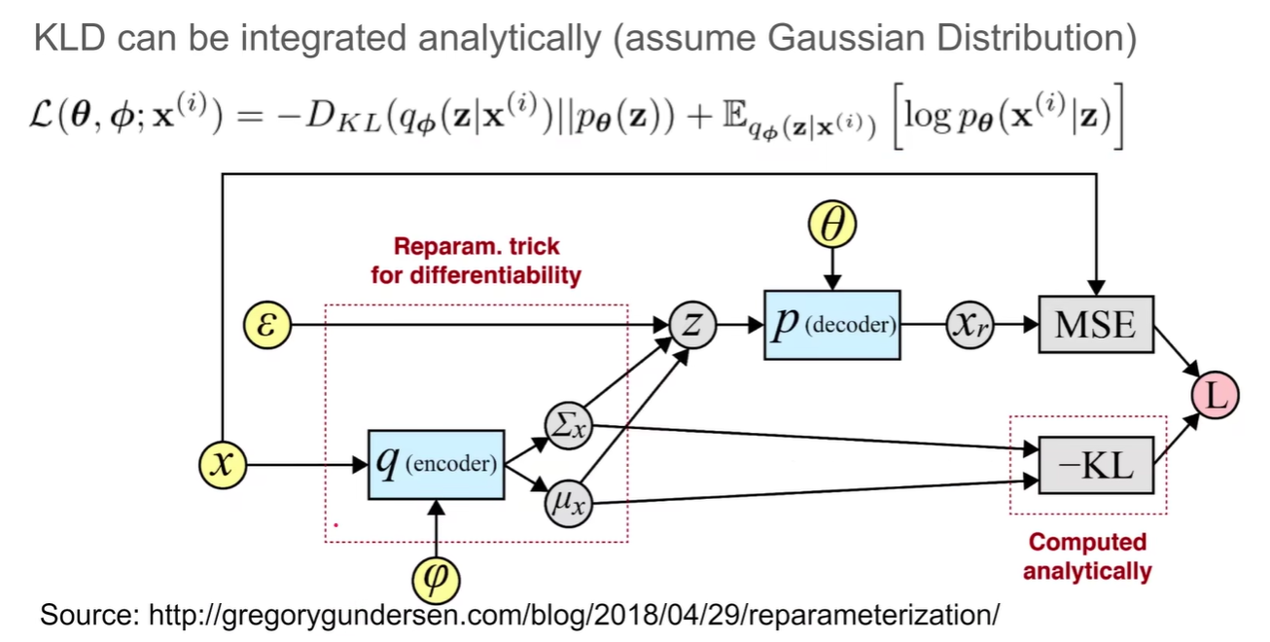
Another SGVB

