Slide 1
Longitudinal pre-RA analysis
Cong
20250319

Slide 2
Longitudinal data overview
Control
(n=35)
Visit 1
(n=35)
Non-converter
(n=20)
Visit 1
(n=20)
Visit 2
(n=20)
Converter
(n=16)
Visit 1, pre-conv.
Visit 2, mid-conv.
Visit 3, post-conv.
n=11
n=11
n=11
n=3
n=3
n=1
n=1
n=1
Early RA
(n=6)
Visit 1
(n=6)
Objective:
Check if the signature is still there in later time points.
Check if the signature is correlated to non-convert/converter states
Notes:
*We have 6 replicates for batch effect correction.
Compare different timepoints for converters and find patterns
Classification on sig/non-sig groups. Converters/ERA have more signature groups; non-converters have fewer signature groups.
Observe the trend.

Slide 3
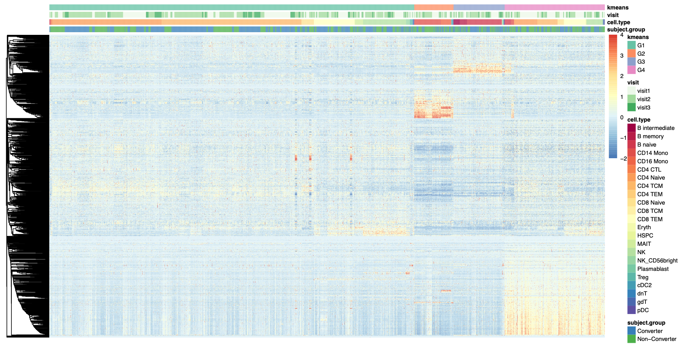
Hierarchical clustering with Kmeans group label
G4
Notes:
Method = Pearson correlation
BR3789

Slide 4
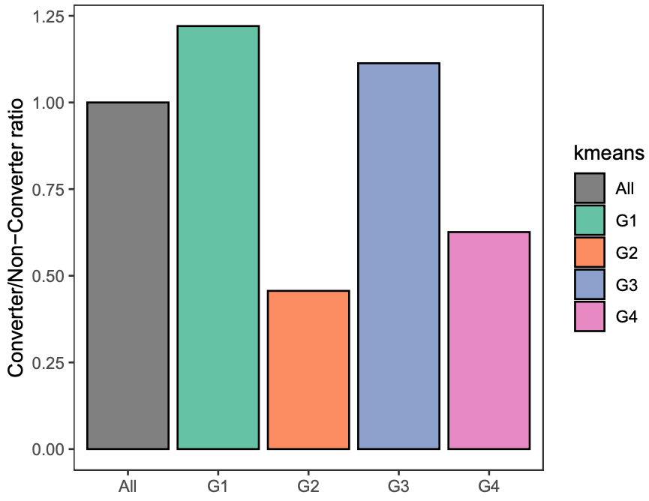
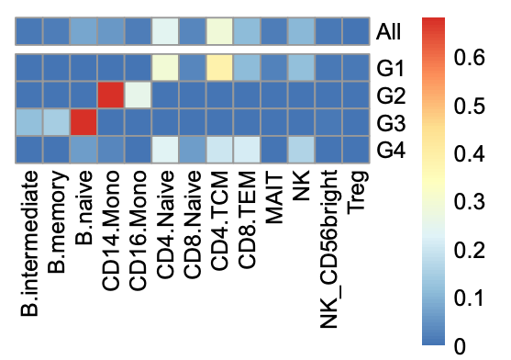
G4 is multi-lineage group enriched in non-converters
***
****
****
Chi-squared test
**** < 1e-5
*** < 1e-4

Slide 5
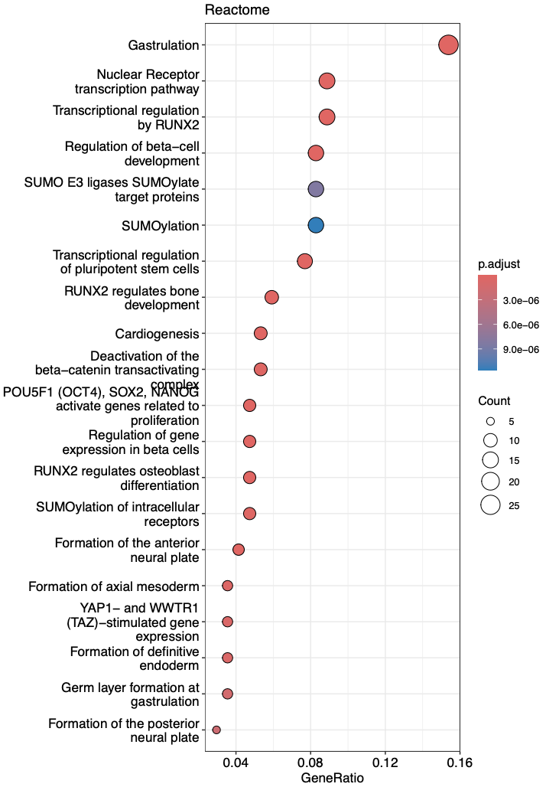
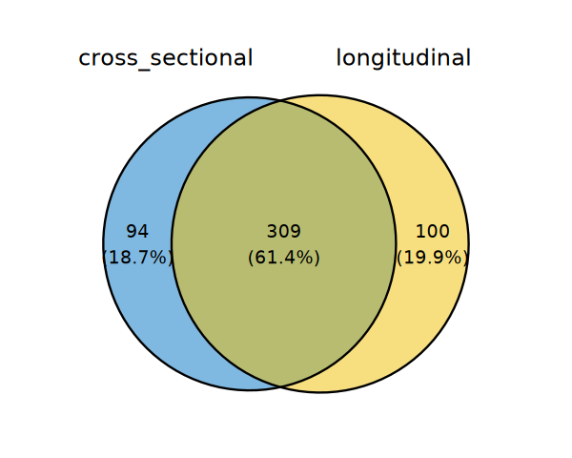
Overlap of new RA signature with previous signature

