Slide 1
IBD analysis
Cong
20250310

Slide 2
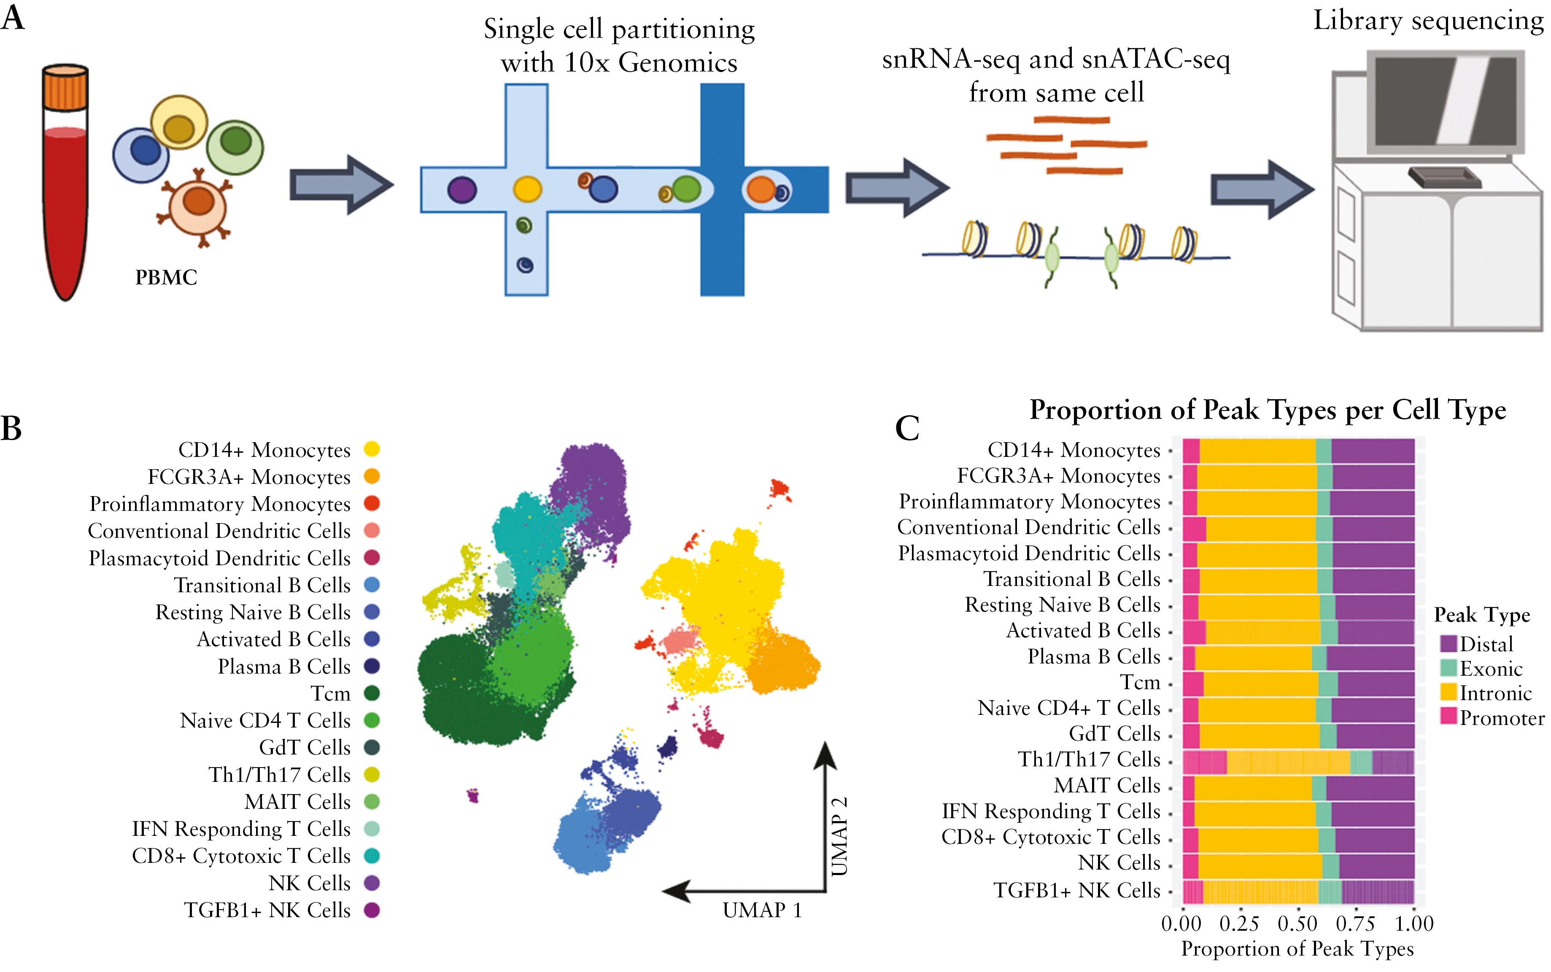
Dataset
29 samples: 19 Crohns, 10 healthy
72,457 cells into 292 pseudo-bulk clusters
https://academic.oup.com/ecco-jcc/article/18/12/1939/7645140

Slide 3
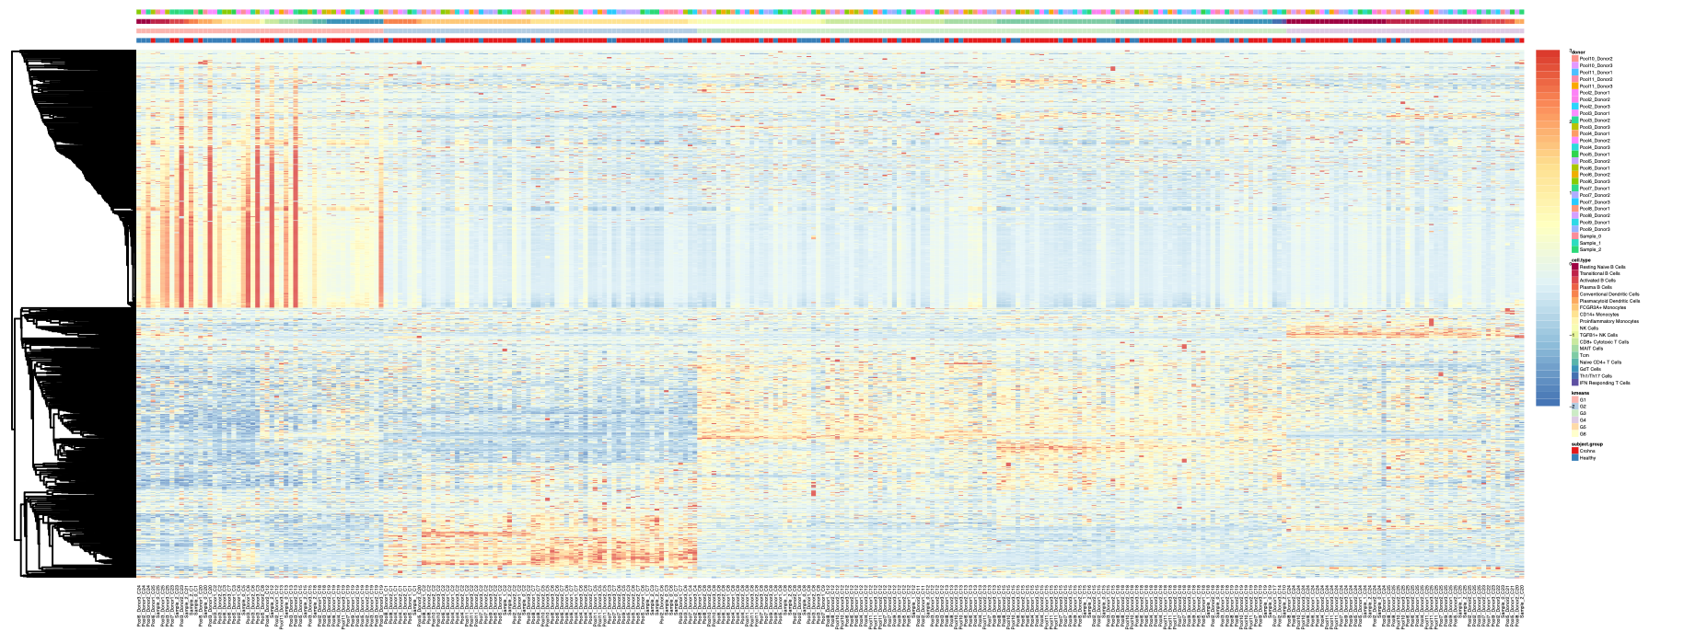
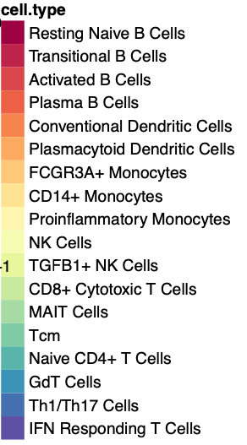

Hierarchical clustering with Kmeans group label
K=4
G1 is enriched in healthy
Notes:
Method = Pearson correlation
BR3789

Slide 4
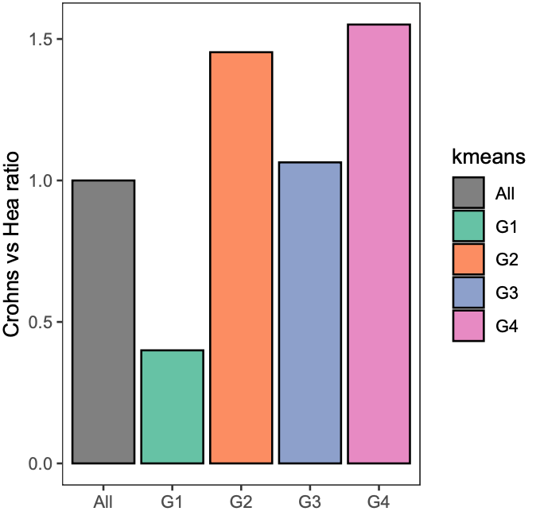
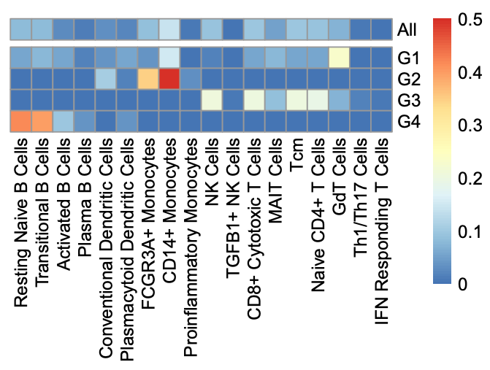
Kmeans groups statistics

Slide 5
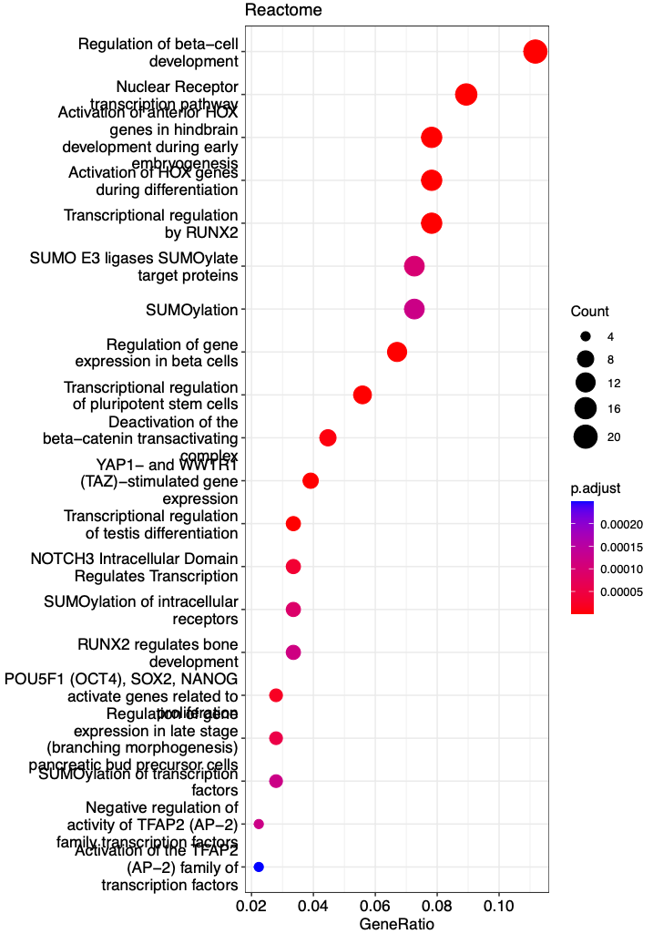
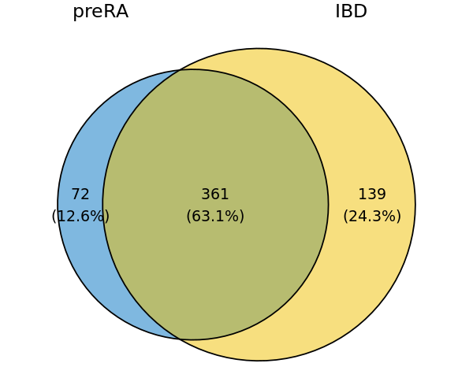
Overlap of IBD signature with pre-RA signature
Reactome pathways related to IBD TFs

