Slide 1
Computer Vision
Spring 2006 15-385,-685
Instructor: S. Narasimhan
Wean 5403
T-R 3:00pm – 4:20pm

Slide 2
Lightness and Retinex:
An Early Vision Problem
Lecture #10
Readings: Horn Chapter 9.
Vision (Marr): pgs 250-258.
“The perception of Surface Blacks and Whites”, A. L. Gilchrist, Scientific American, 240 (pgs 112-114), 1979
Webpages of Prof. Edward Adelson, MIT

Slide 3
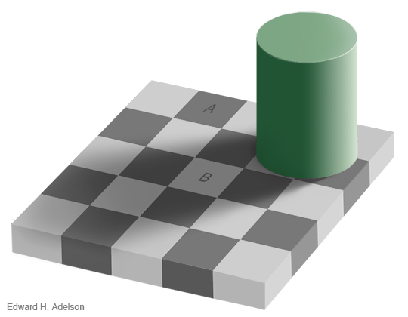
Checker Shadow Illusion
[E. H. Adelson]

Slide 4
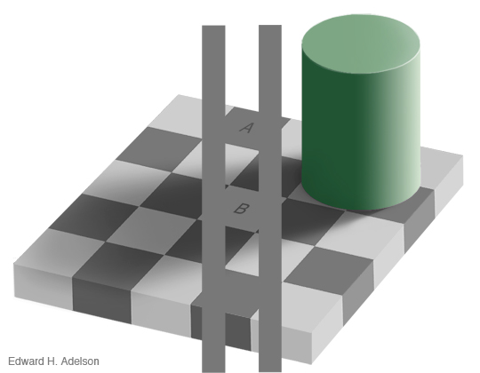
Checker Shadow Illusion
[E. H. Adelson]

Slide 5
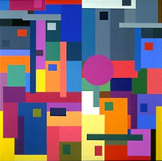
Land’s Experiment (1959)
Cover all patches except a blue rectangle
Make it look gray by changing illumination
Uncover the other patches
Color Constancy
We filter out illumination variations

Slide 6
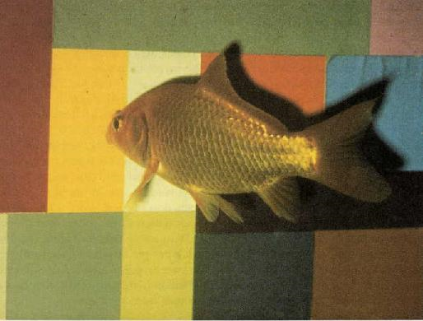
Color Constancy in Gold Fish
In David Ingle's experiment, a goldfish has been trained to swim to a patch of a given
color for a reward—a piece of liver. It swims to the green patch regardless of the
exact setting of the three projectors' intensities. The behavior is strikingly similar to
the perceptual result in humans.
http://neuro.med.harvard.edu/site/dh/b45.htm

Slide 7
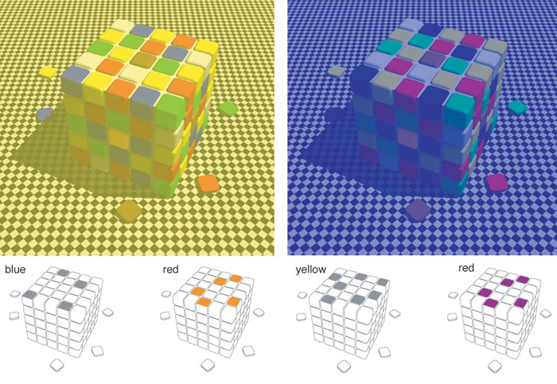
Color Cube Illusion
D. Purves, R. Beau Lotto, S. Nundy “Why We See What We do,” American Scientist

Slide 8
Lightness Recovery and Retinex Theory
Problem: Recover surface reflectance / color in
varying illumination conditions.
We use tools developed before:
- Sensing: Intensity / Color
- Image Processing: Fourier Transform and Convolution
- Edge Operators
- Iterative Techniques

Slide 9





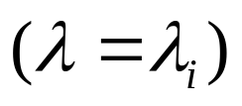

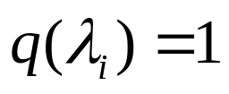
Image Brightness (Intensity)
Scene
Irradiance
Image
Intensity
Scene
Reflectance
Monochromatic Light :
NOTE: The analysis can be applied to COLORED LIGHT using FILTERS

Slide 10







Recovering Lightness
Image Intensity:
Can we recover and from ?
Assumptions:
- Sharp changes in Reflectance
- Smooth changes in Illumination
Frequency spectrum (Fourier transform)
We want to filter out e’

Slide 11

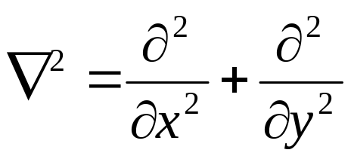
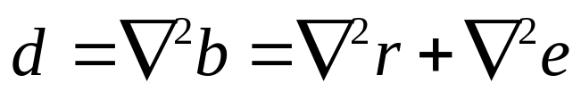
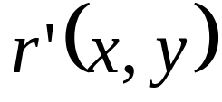


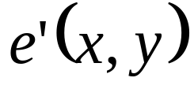

Recovering Lightness
Image Intensity:
Take Logarithm:
OR
Use Laplacian:
Sharp changes in reflectance
Smooth changes in illumination
has 2 infinite spikes near edges and elsewhere
everywhere

Slide 12
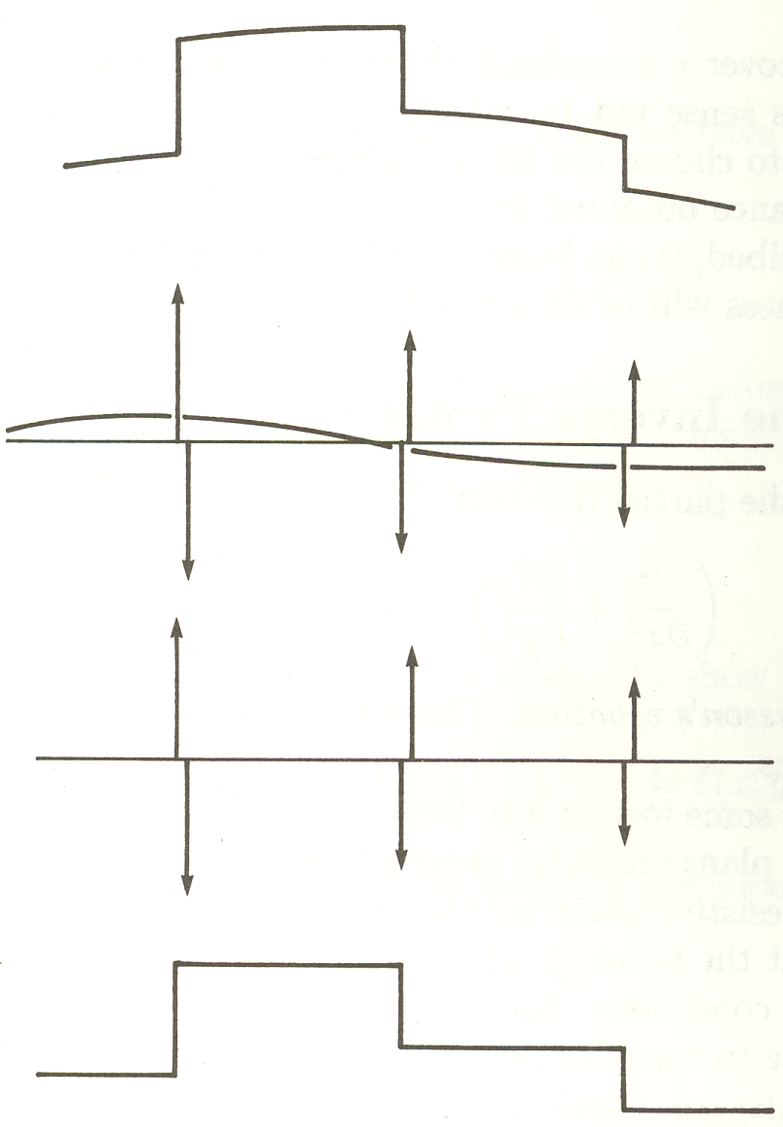


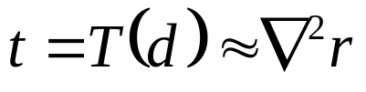


Lightness Recovery (Retinex Scheme)
Image:
Laplacian :
Thresholding :
Reconstruction :
(lightness)
(reflectance)

Slide 13
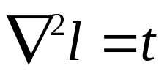
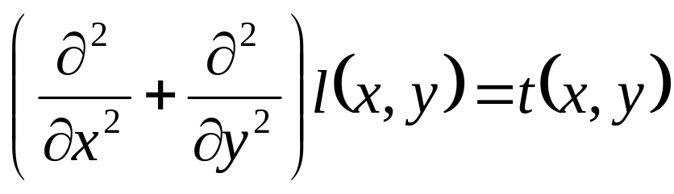
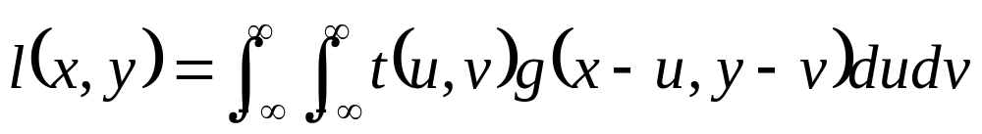
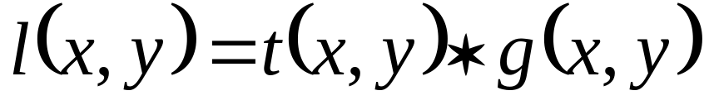
Solving the Inverse Problem
Image
Laplacian
Thresholding
Lightness
Find lightness l(x,y) from t(x,y):
Poisson’s Equation
We have to find g(x,y) which satisfies

Slide 14
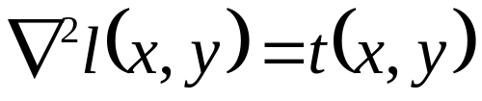



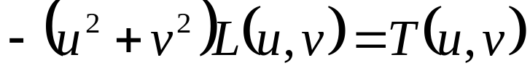
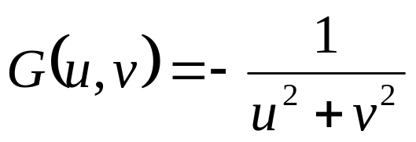
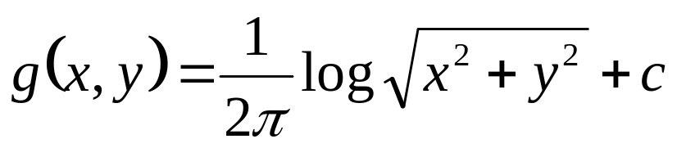
Solving Poisson’s Equation
We have
and
Fourier transform
and
So
and
Thus

Slide 15


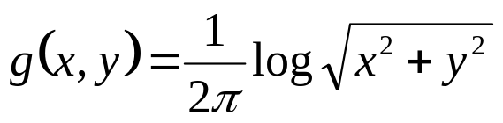








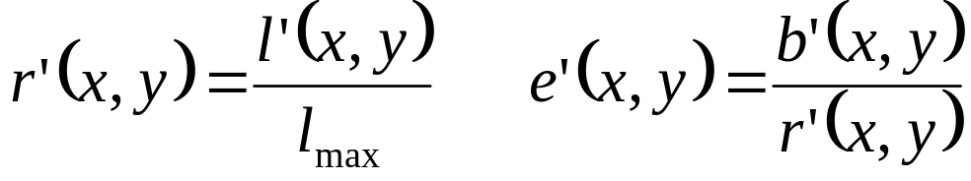
Lightness Recovery
Log of image
(lightness)
(reflectance)
Which means:
Normalize:
Assume maximum value of corresponds to
Then:
(reflectance)
(illumination)

Slide 16


Computing Lightness (Discrete Case)
Log of image
1
4
1
Basically, inverse of Laplacian mask
4
-20
4
But, discrete approximation of the inverse
Laplacian would not be sufficiently accurate!
1
4
1
Solve
directly

Slide 17



Computing Lightness (Discrete Case)
1
4
1
1
4
1
4
-20
4
4
-20
4
1
4
1
1
4
1
Solve iteratively:
Use a discrete approximation to the inverse of Laplacian to
obtain initial estimate of l

Slide 18
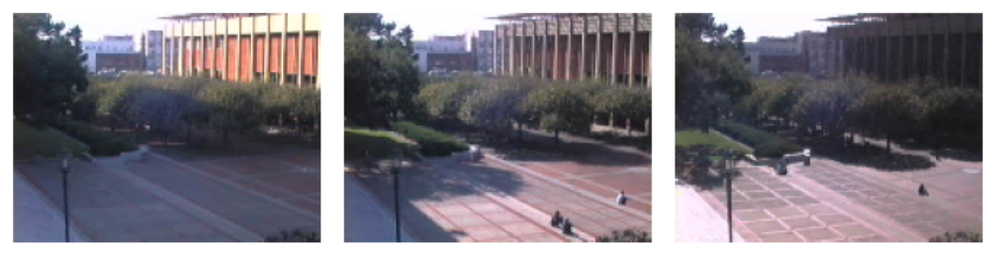
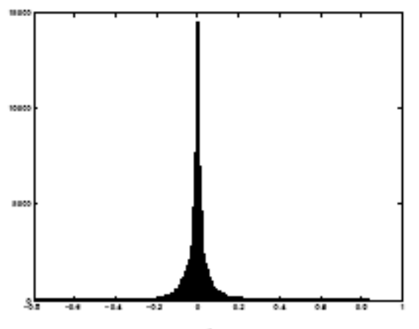
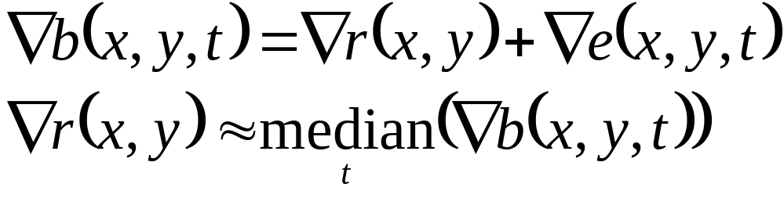
Lightness from Multiple Images taken under Varying Illumination
Illumination is not smooth
Use spatial statistics of edges
Derivative operator responses are sparse
Y. Weiss ICCV 2001

Slide 19
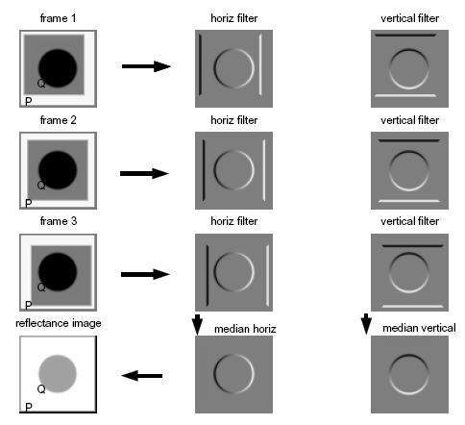
Lightness from Multiple Images taken
under Varying Illumination
Y. Weiss ICCV 2001

Slide 20
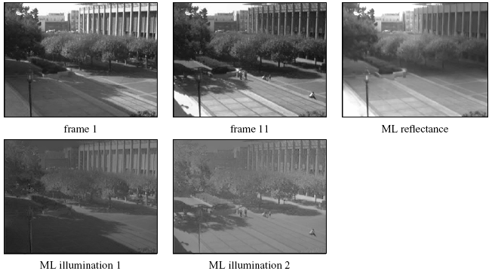
Lightness from Multiple Images taken
under Varying Illumination
Y. Weiss ICCV 2001

Slide 21
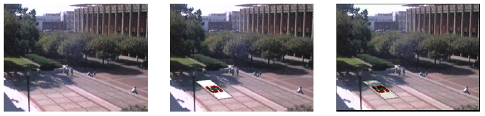
Using Lightness
w/o decomposition
w/ decomposition
Y. Weiss ICCV 2001

Slide 22
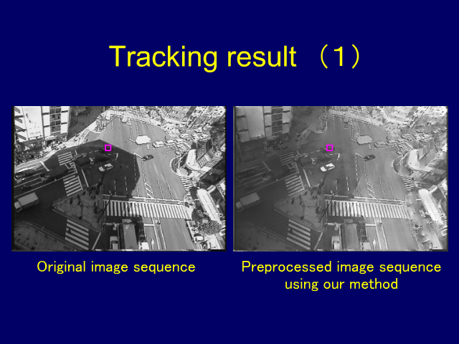
Using Lightness
Y. Matsushita and K. Nishino CVPR 2003

Slide 23
Comments on Retinex Theory
Not applicable to smooth reflectance variations
Not applicable to curved objects
In general:
Intensity=f( Shape, Reflectance, Illumination )
For very good illusions, see:
http://web.mit.edu/persci/gaz/gaz-teaching/index.html
http://www.michaelbach.de/ot/index.html

Slide 24
Tricking the Human Eye
Eye Tremors (~ 35 cycles/second)
Tremors used for edge detection
Edges disappear when edge motion is synchronous with Tremors!

Slide 25
Next Class
Surface Reflectance and BRDF
Reading: Horn, Chapter 10.
F. E. Nicodemus, J.C. Richmond and J.J. Hsia, “Geometrical Considerations and Nomenclature for Reflectance”, Institute of Basic Standards, National Bureau of Standards, October 1977

