Slide 1
Computer Vision
Spring 2006 15-385,-685
Instructor: S. Narasimhan
Wean 5403
T-R 3:00pm – 4:20pm
Lecture #13

Slide 2
Announcements
Homework 4 will be out today. Due 4/4/06.
Please start early.
Midterm stats: A range → 40+, B range → 30+
40+ → 13 students
30+ → 9 students
Below 30 → 6 students

Slide 3
Shape from Shading
Lecture #13

Slide 4
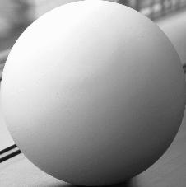
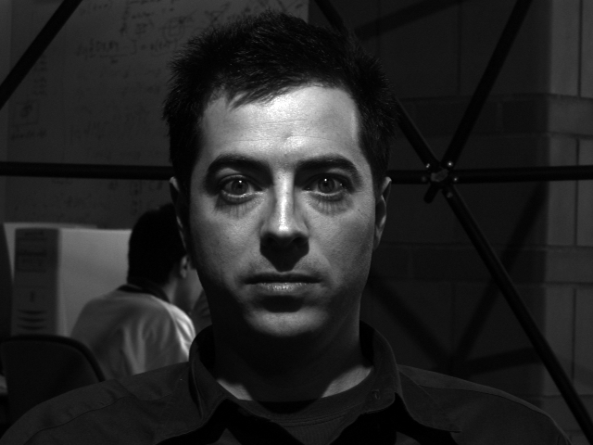
Image Intensity and 3D Geometry
Shading as a cue for shape reconstruction
What is the relation between intensity and shape?
  Reflectance Map

Slide 5








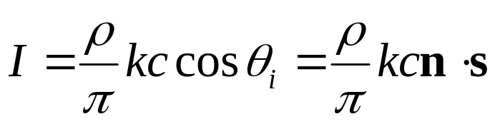
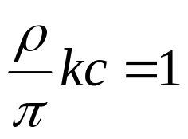
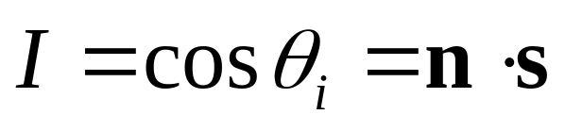
Reflectance Map - RECAP
Relates image irradiance I(x,y) to surface orientation (p,q) for given source direction and surface reflectance
Lambertian case:
: source brightness
: surface albedo (reflectance)
: constant (optical system)
Image irradiance:
Let
then

Slide 6
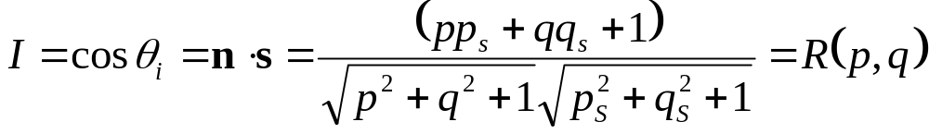
Reflectance Map - RECAP
Lambertian case
Reflectance Map
(Lambertian)
Iso-brightness contour
cone of constant

Slide 7













Reflectance Map - RECAP
Lambertian case
iso-brightness
contour
Note: is maximum when

Slide 8
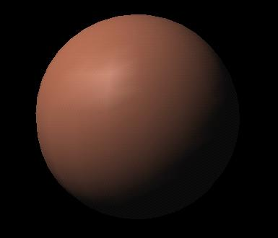
Shape from a Single Image?
Given a single image of an object with known surface reflectance taken under a known light source, can we recover the shape of the object?
Given R(p,q) ( (p_{S},q_{S}) and surface reflectance) can we determine (p,q) uniquely for each image point?
NO

Slide 9
Solution
Take more images
  Photometric stereo (previous class)
Add more constraints
  Shape-from-shading (this class)

Slide 10



Photometric Stereo

Slide 11
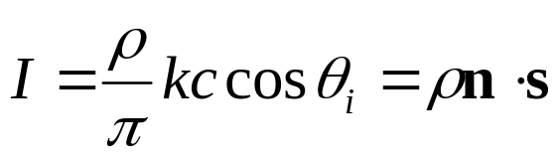
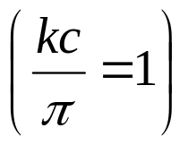





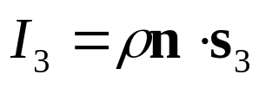
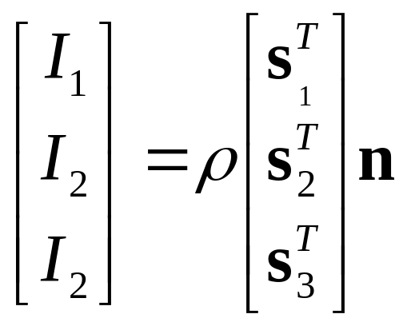
Photometric Stereo
Lambertian case:
Image irradiance:
We can write this in matrix form:

Slide 12
Solution
Take more images
  Photometric stereo (previous class)
Add more constraints
  Shape-from-shading (this class)

Slide 13
Human Perception
Our brain often perceives shape from shading.
Mostly, it makes many assumptions to do so.
For example:
Light is coming from above (sun).
Biased by occluding contours.
by V. Ramachandran

Slide 14
See Ramachandran’s work on Shape from Shading by Humans
http://psy.ucsd.edu/chip/ramabio.html

Slide 15














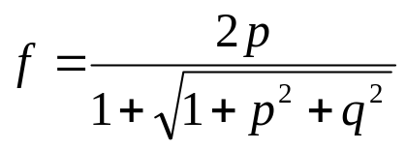
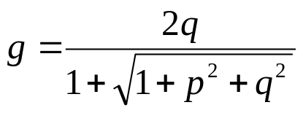

Stereographic Projection
(p,q)-space (gradient space)
(f,g)-space
Problem
(p,q) can be infinite when
Redefine reflectance map as

Slide 16


Occluding Boundaries
and are known
The values on the occluding boundary can be used as
the boundary condition for shape-from-shading

Slide 17
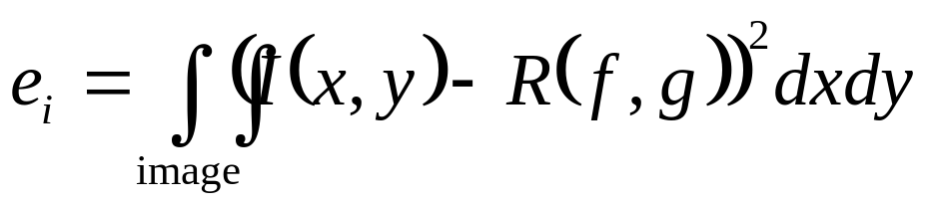
Image Irradiance Constraint
Image irradiance should match the reflectance map
Minimize
(minimize errors in image irradiance in the image)

Slide 18
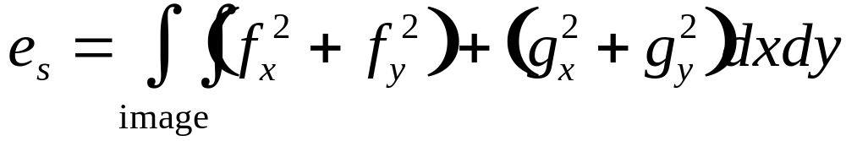

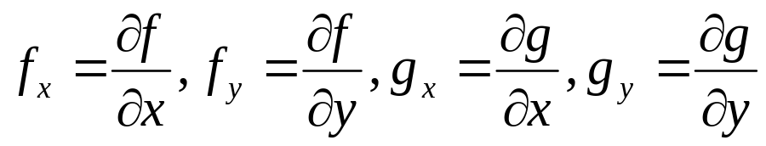
Smoothness Constraint
Used to constrain shape-from-shading
Relates orientations (f,g) of neighboring surface points
Minimize
: surface orientation under stereographic projection
(penalize rapid changes in surface orientation f and g over the image)

Slide 19
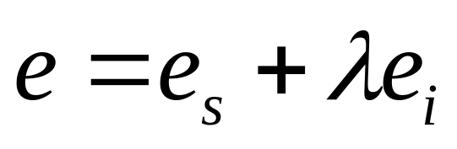
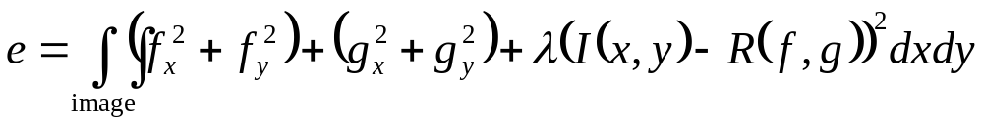
Shape-from-Shading
Find surface orientations (f,g) at all image points that minimize
weight
smoothness
constraint
image irradiance
error
Minimize

Slide 20
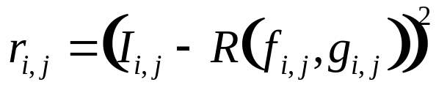
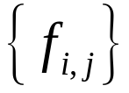
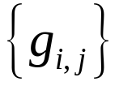
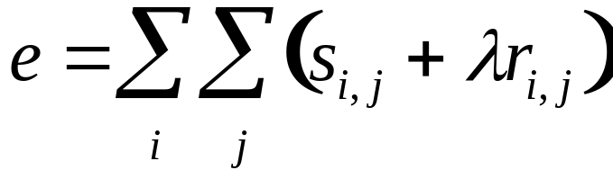
Numerical Shape-from-Shading
Smoothness error at image point (i,j)
Of course you can consider more neighbors (smoother results)
Image irradiance error at image point (i,j)
Find and that minimize
(Ikeuchi & Horn 89)

Slide 21

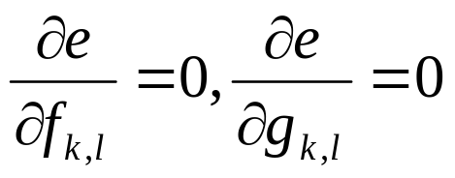
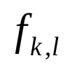
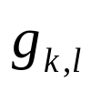

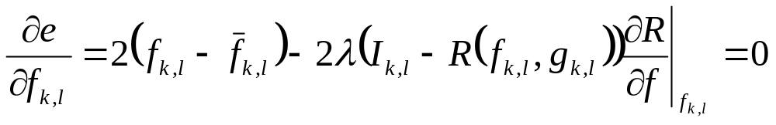
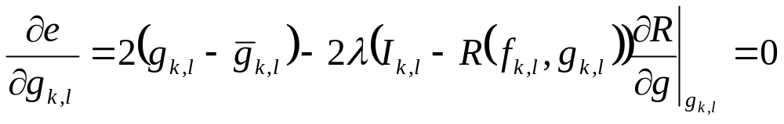


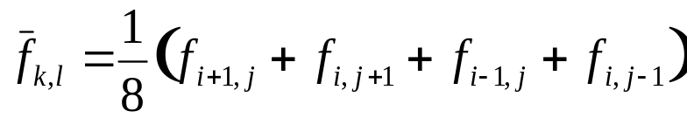
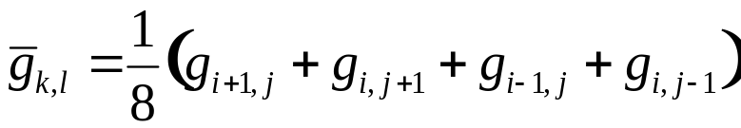
Numerical Shape-from-Shading
Find and that minimize
If and minimize , then
where and are 4-neighbors average around image point (k,l)
(Ikeuchi & Horn 89)

Slide 22
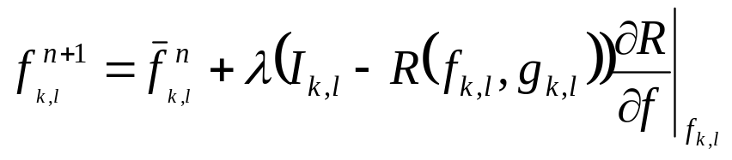
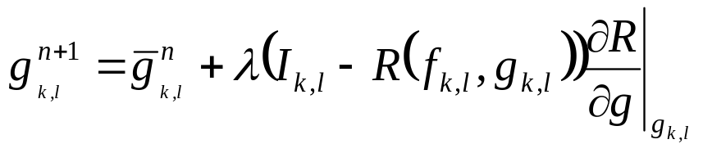



Numerical Shape-from-Shading
Update rule
Use known values on the occluding boundary to constrain the solution (boundary conditions)
Compare with for convergence test
As the solution converges, increase to remove the smoothness constraint
(Ikeuchi & Horn 89)

Slide 23
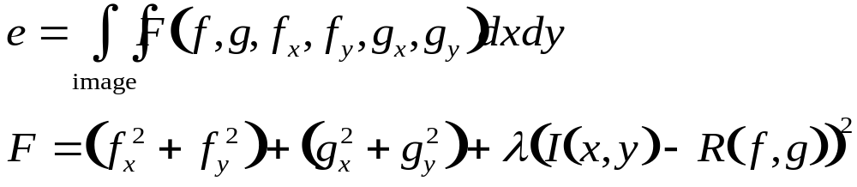
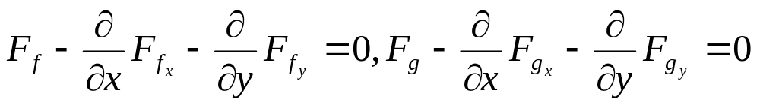
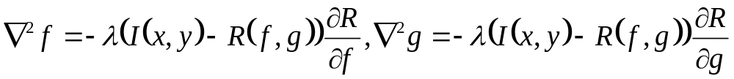
Calculus of Variations
Minimize
Euler equations for F
(read Horn A.6)
Euler equations for shape-from-shading
Solve this coupled pair of second-order partial differential equations
with the occluding boundary conditions!

Slide 24
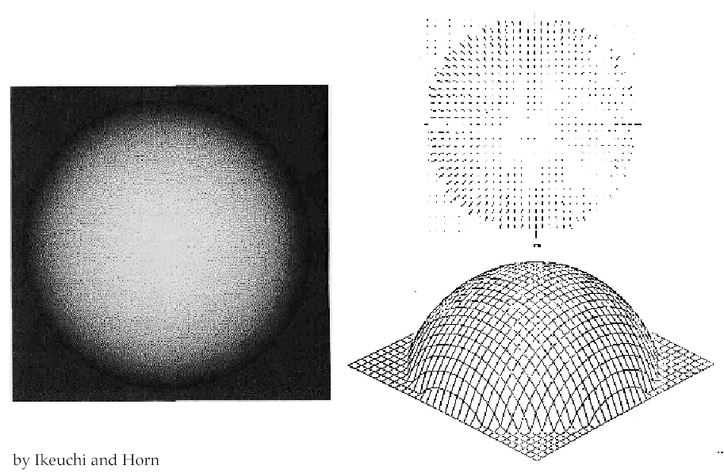
Results

Slide 25
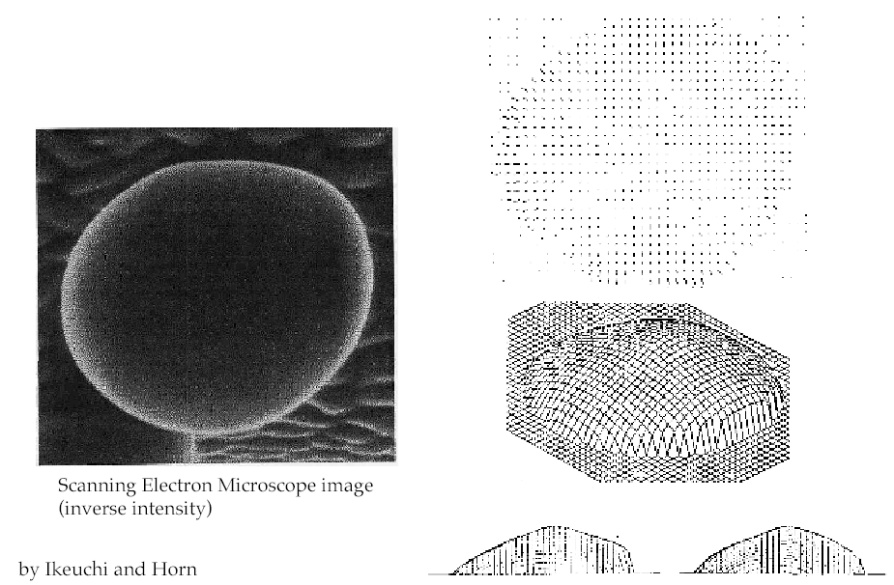
Results

Slide 26
Next Two Classes
Binocular Stereo
Reading: Horn, Chapter 13.

