Slide 1
Computer Vision
Spring 2006 15-385,-685
Instructor: S. Narasimhan
Wean 5403
T-R 3:00pm – 4:20pm
Lecture #15

Slide 2
Binocular Stereo - Calibration
Lecture #15

Slide 3
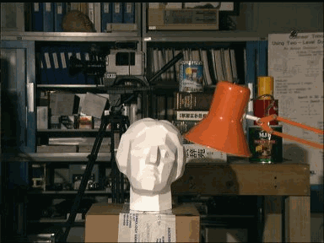
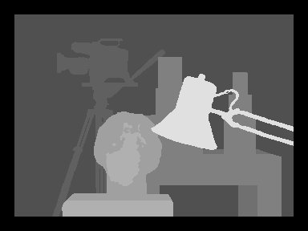
Binocular Stereo

Slide 4

Stereo Reconstruction - RECAP
The Stereo Problem
  Shape from two (or more) images
  Biological motivation
known
camera
viewpoints

Slide 5









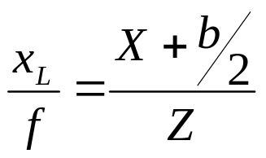
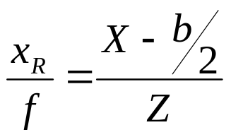
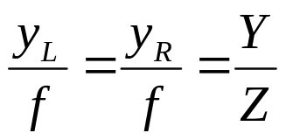
Disparity and Depth - RECAP
scene
left image
right image
baseline
Assume that we know corresponds to
From perspective projection (define the coordinate system as shown above)

Slide 6
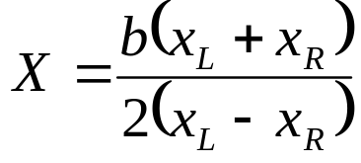
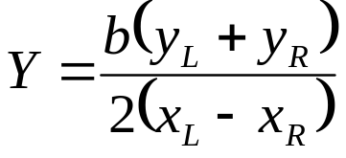
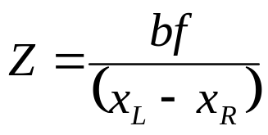


Disparity and Depth - RECAP
scene
left image
right image
baseline
is the disparity between corresponding left and right image points
inverse proportional to depth
disparity increases with baseline b

Slide 7
Vergence
field of view
of stereo
uncertainty of
scenepoint
one pixel
Optical axes of the two cameras need not be parallel
Field of view decreases with increase in baseline and vergence
Accuracy increases with baseline and vergence

Slide 8
Binocular Stereo Calibration
RELATIVE ORIENTATION:
We need to know position and orientation of one camera with
respect to the other, before computing depth of scene points.
ABSOLUTE ORIENTATION:
We may need to know position and orientation of a stereo system
with respect to some external system (for example, a 3D scanner).

Slide 9


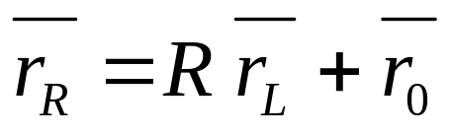


Binocular Stereo Calibration - Notation
Left Camera
Frame
Right Camera
Frame
We need to transform one coordinate frame to another.
The transformation includes a rotation and a translation:
: Translation of Left frame w.r.t Right
: Rotation of Left frame w.r.t Right

Slide 10
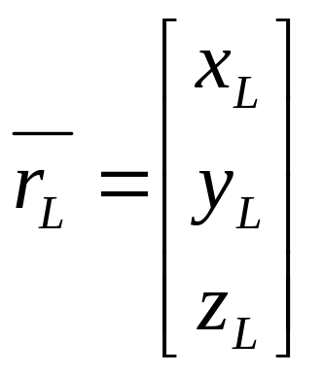
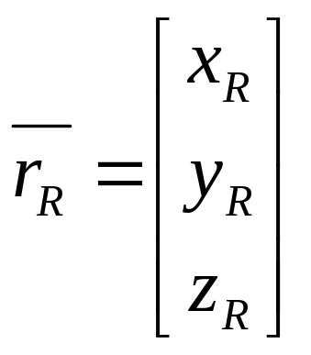
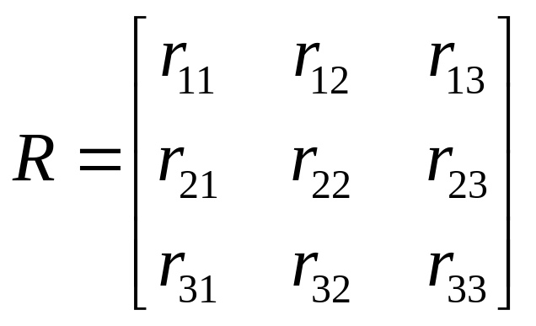
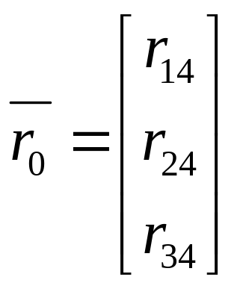
Binocular Stereo Calibration - Notation
In matrix notation, we can write as:

Slide 11
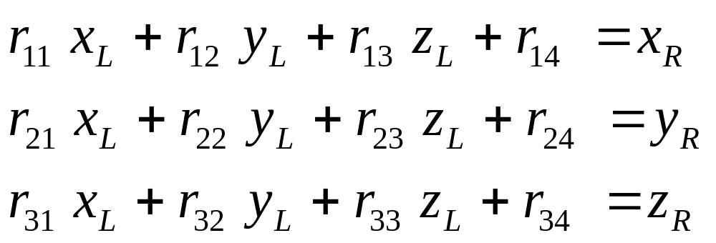
Binocular Stereo Calibration - Notation
We can expand as:

Slide 12
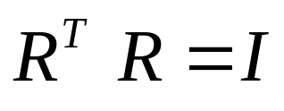
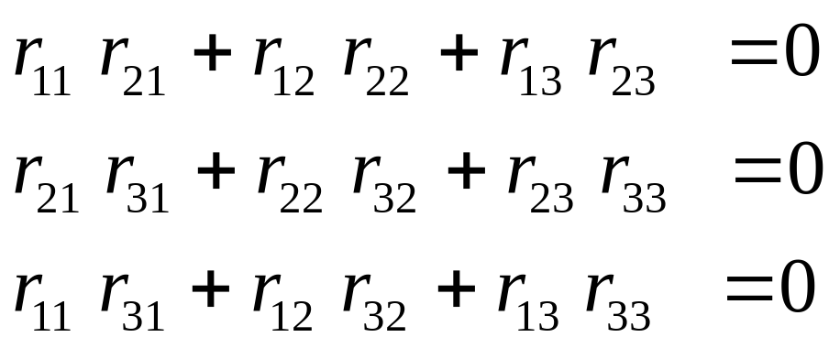
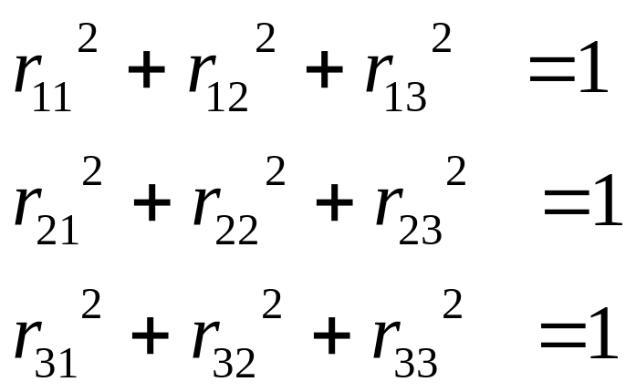
Orthonormality Constraints
(a) Rows of R are perpendicular vectors
(b) Each row of R is a unit vector
NOTE: Constraints
are NON-LINEAR!
They can only be used
once (do not change
with scene points).

Slide 13
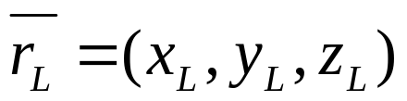
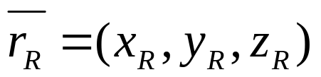
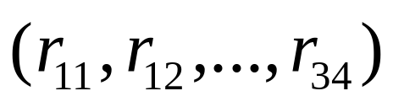
Absolute Orientation
We have measured some scene points using Stereo System L
and Stereo System R
Find Orientation (Translation and Rotation) of system L w.r.t system R.
Useful for merging partial depth information from different views.
Left
System L
Right
System R
Problem:
Given
Find

Slide 14
How many scene points are needed?
Each scene point gives 3 equations:
Six additional equations from orthonormality of Rotation matrix
For n scene points, we have (3n + 6) equations and 12 unknowns
It appears that 2 scene points suffice. But orthonormal constraints are
non-linear.
THREE NON-COLLINEAR SCENE POINTS ARE SUFFICIENT (see Horn)

Slide 15
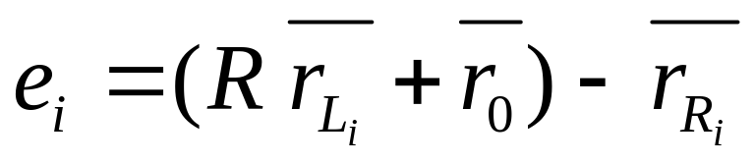
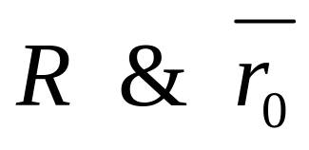
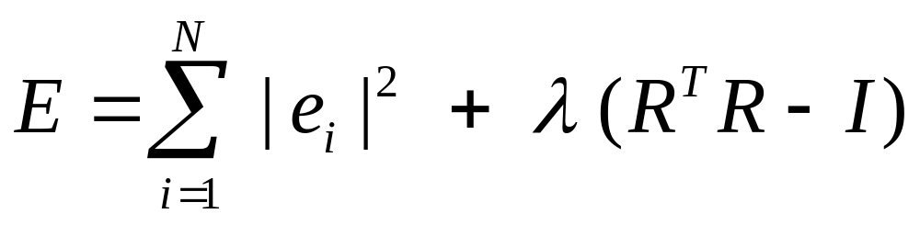
Solving an Over-determined System
Generally, more than 3 points are used to find the 12 unknowns
Formulate Error for scene point i as:
Find that minimize:
Orthonormality Constraint

Slide 16
Relative Orientation

Slide 17


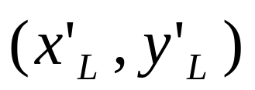
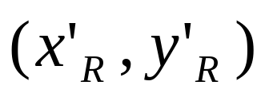
Relative Orientation
Find Orientation (Translation and Rotation) between two cameras
(within the same stereo system).
We must do this before using the stereo system.
Left
Camera L
Right
Camera R
Problem:
Here, we DO NOT know both
We only know the image coordinates
in the two cameras CORRESPOND to the same scene point!

Slide 18
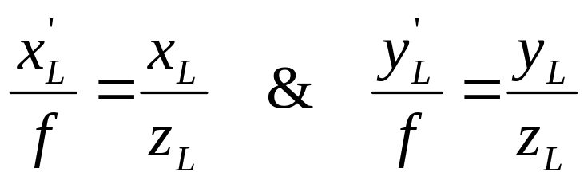
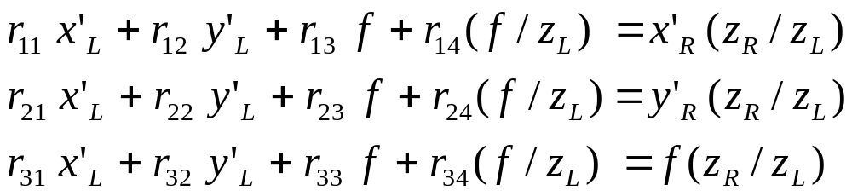
Relative Orientation
Again, we start with:
OR:
Assume: we know focal length of both cameras
Then:
Hence,
(same for right camera)

Slide 19
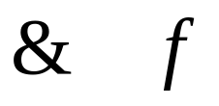
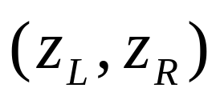
Problem Formulation
We know:
Find:
That satisfies :
And satisfies the 6 orthonormality constraints

Slide 20

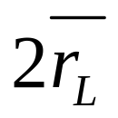
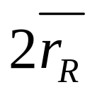
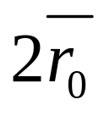
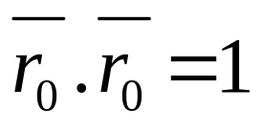
Scale Ambiguity
Same image coordinates can be generated by doubling
Hence, we can find only upto a scale factor!
So, fix scale by using constraint: (1 additional equation)

Slide 21
How many scene points are needed?
If we have n pairs of image coordinates:
Number of equations: 3n + 6 + 1 = 3n + 7
Number of unknowns: 2n + 12
n = 5 points will give us equal number of equations & unknowns.
In theory, 5 points indeed are good enough if chosen carefully.
However, in practice, more points are used and
an over-determined system of equations is solved as before.

Slide 22
Eye and the Brain

Slide 23
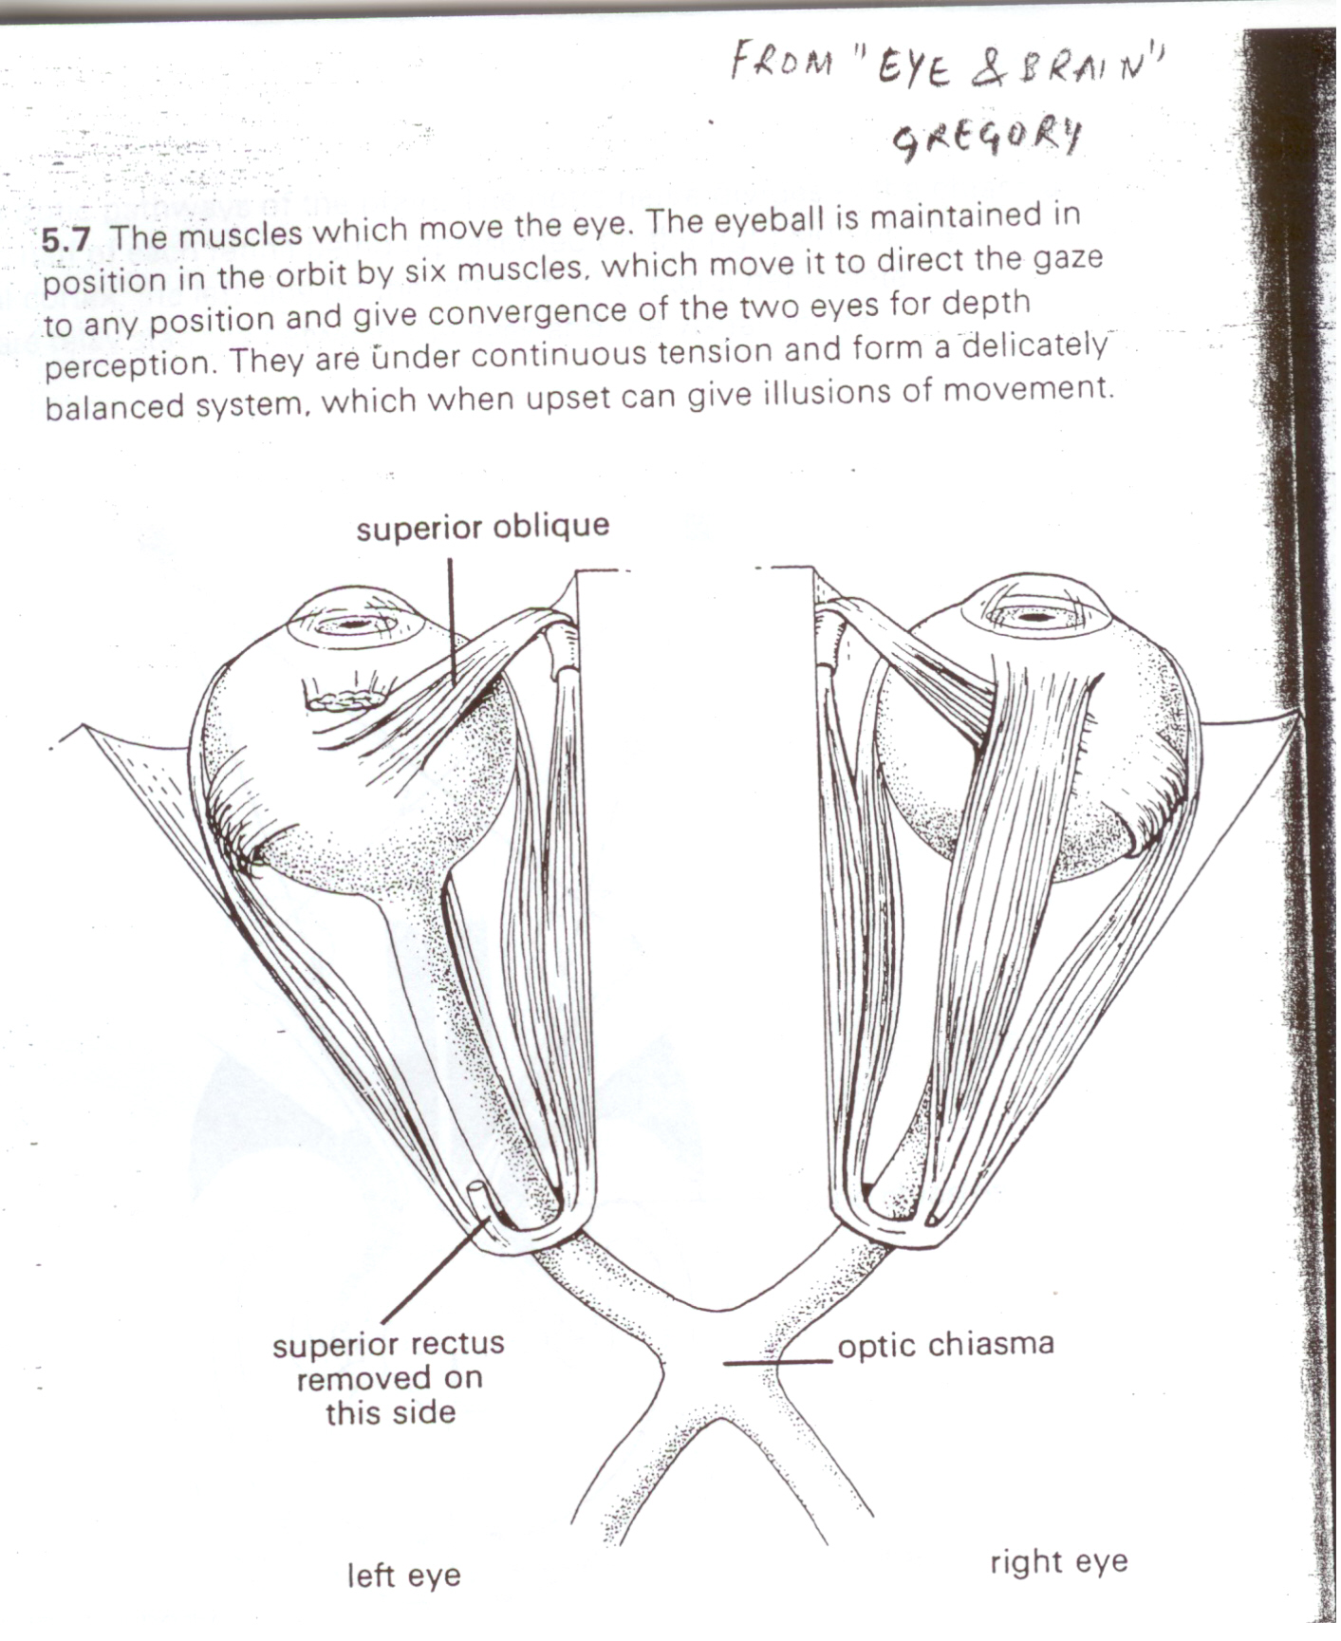

Slide 24
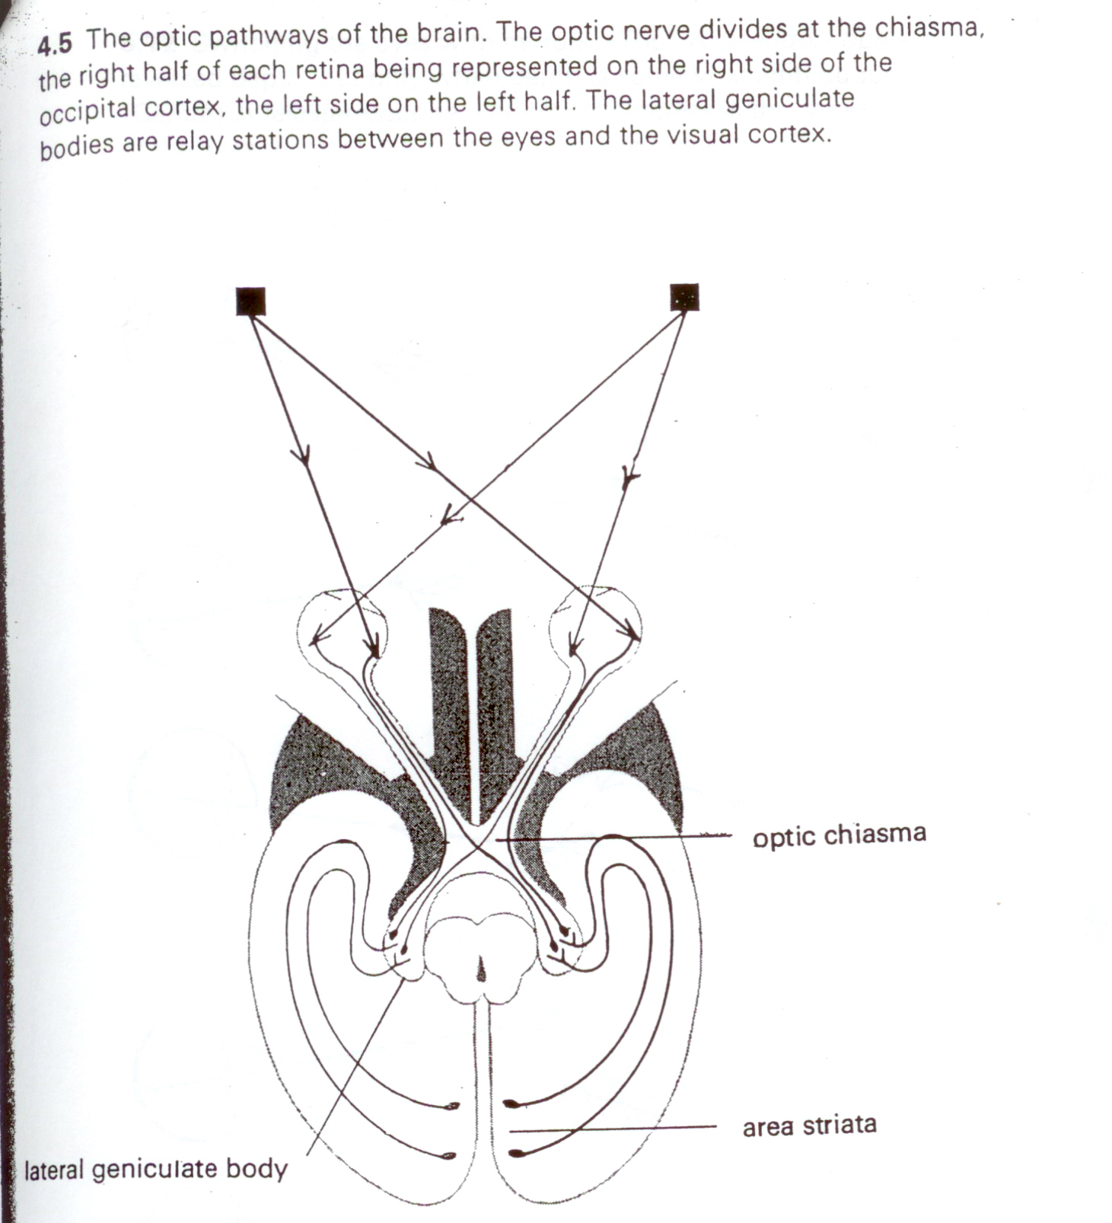

Slide 25
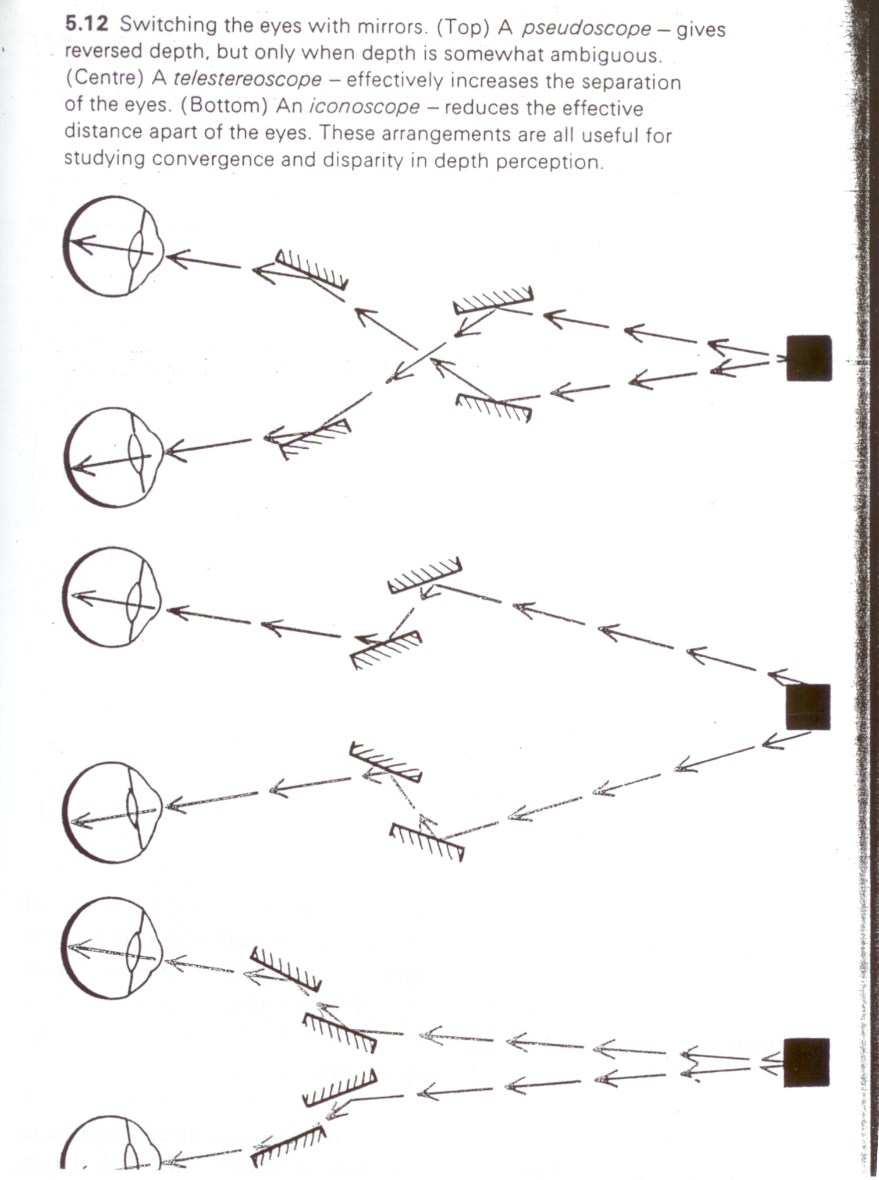

Slide 26
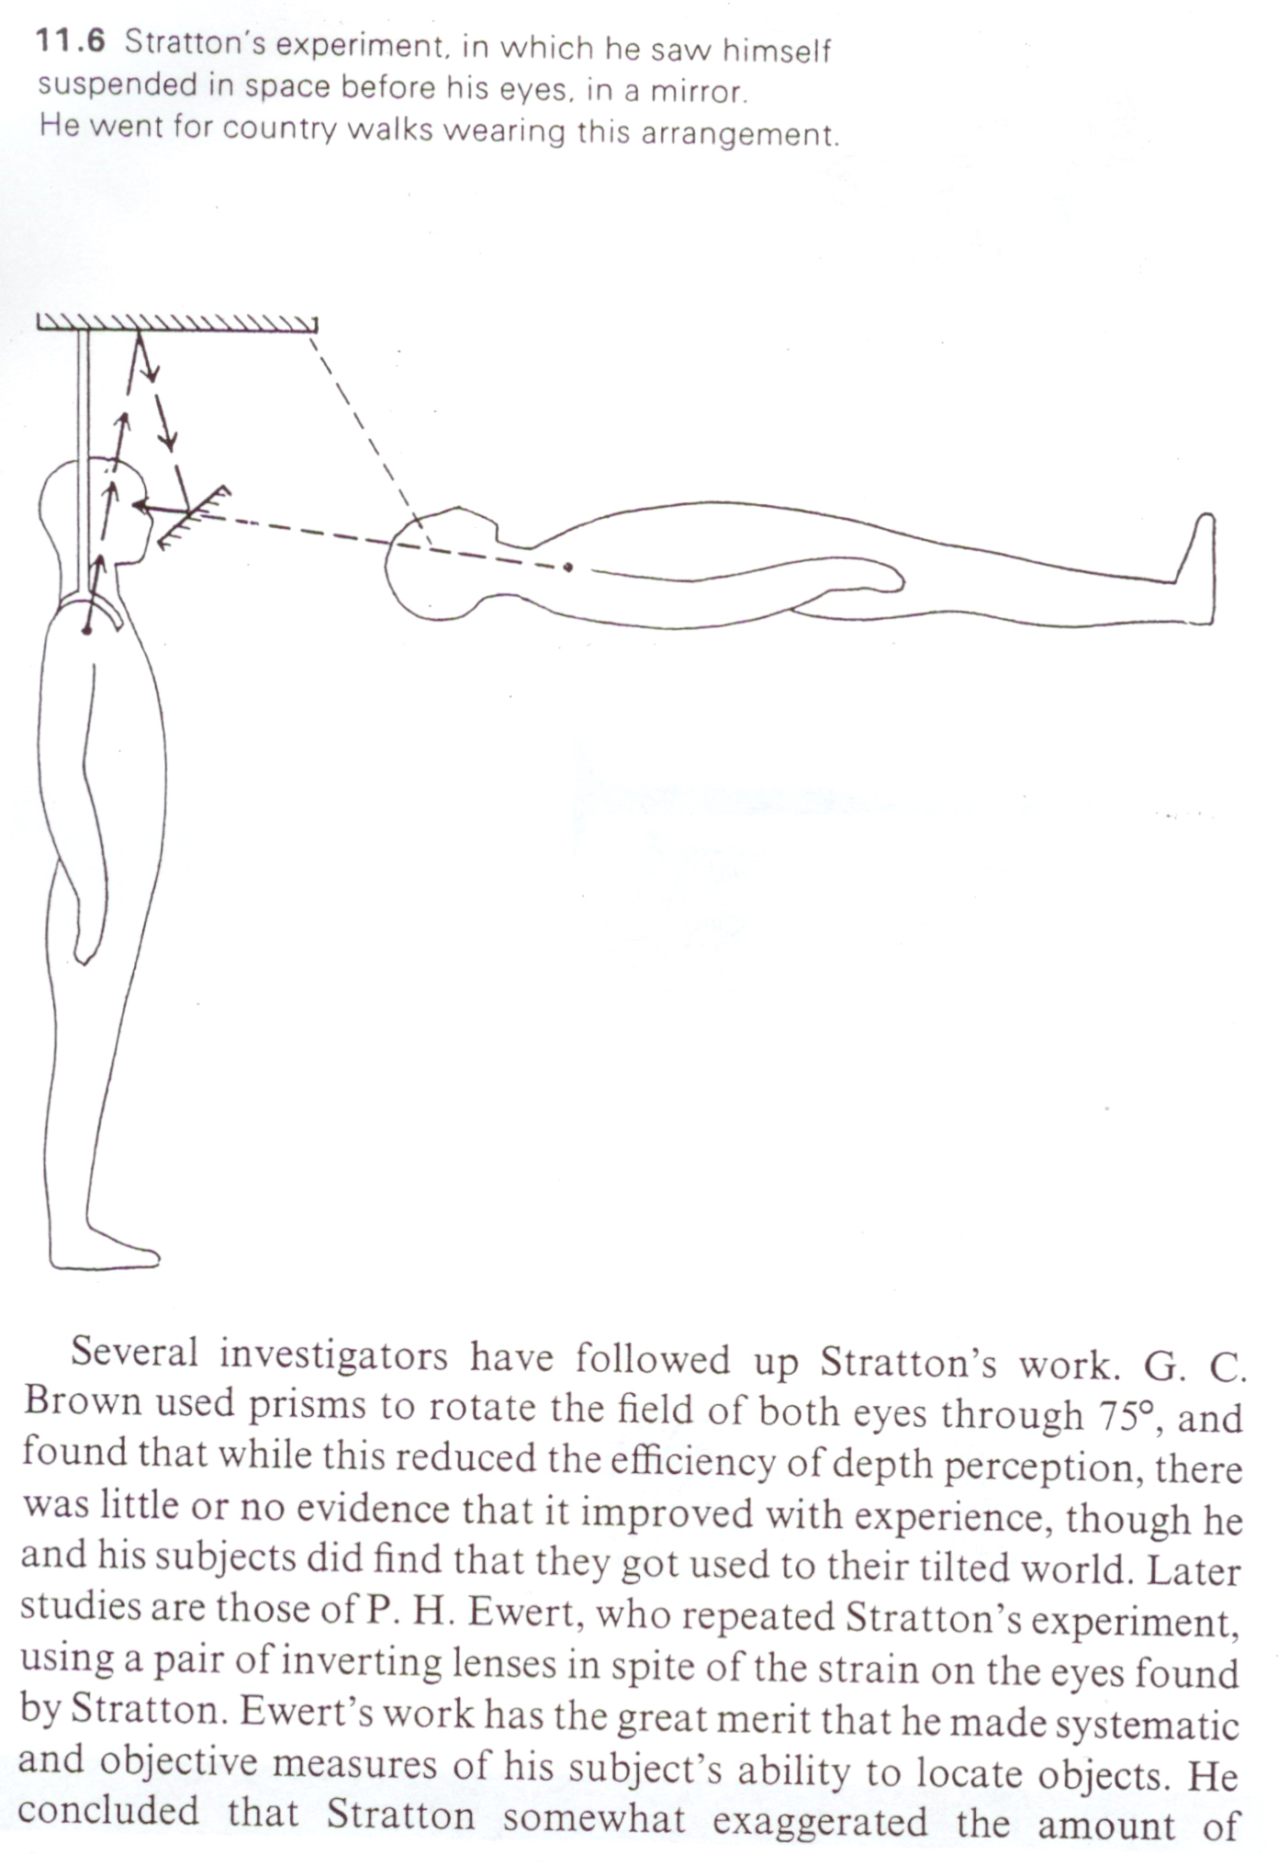

Slide 27
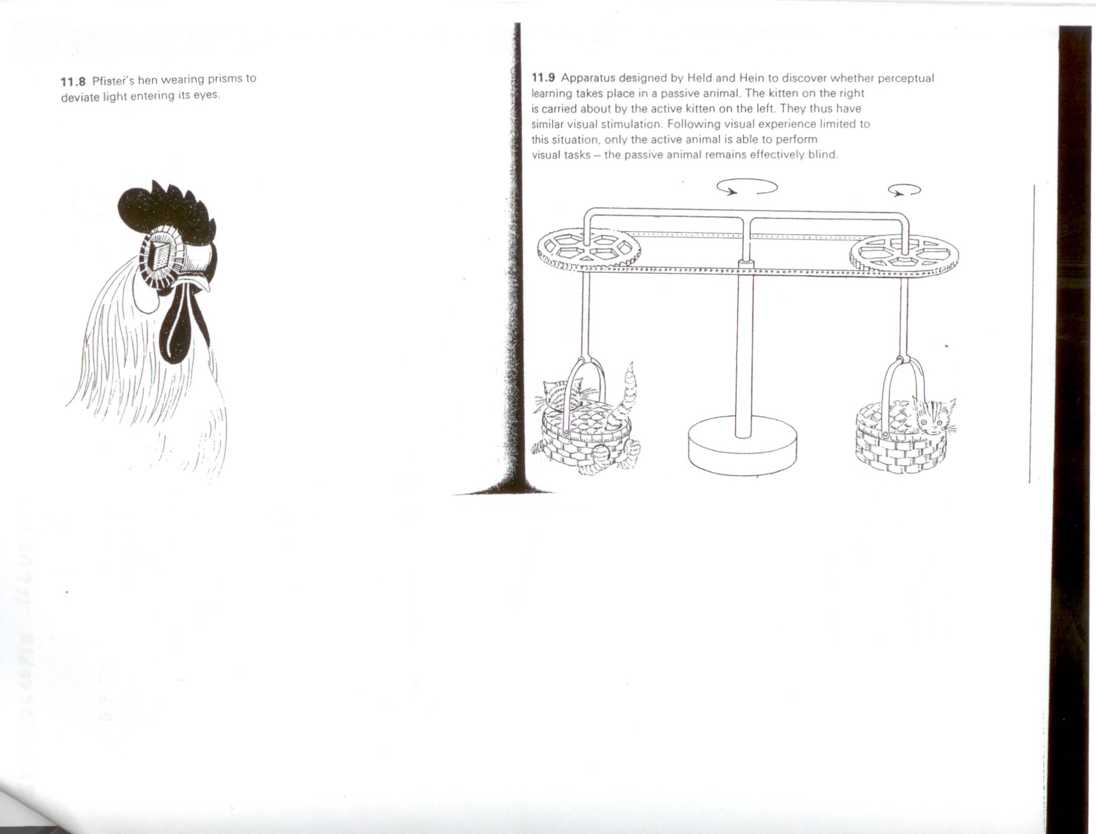

Slide 29
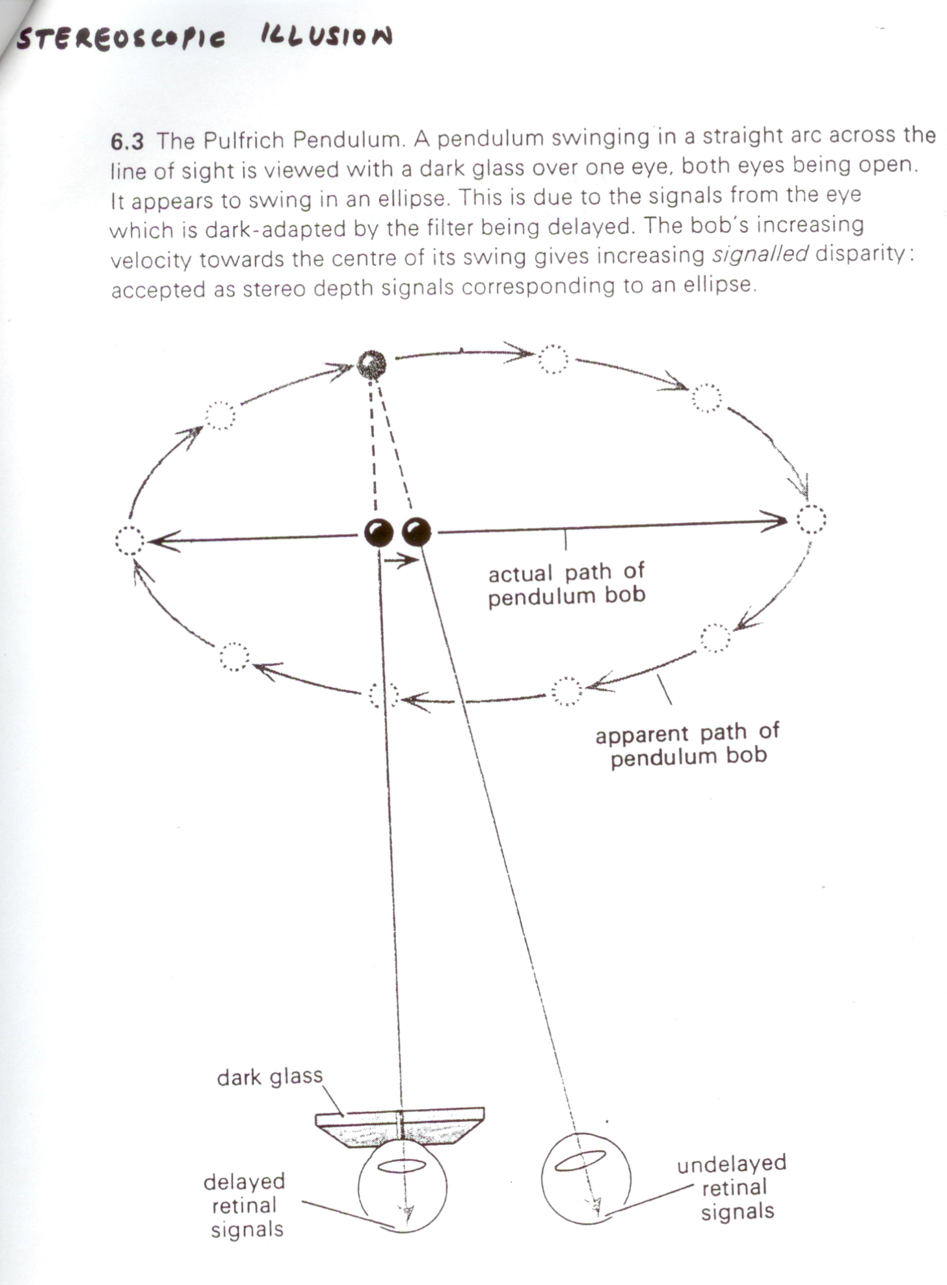

Slide 30
Next Class
Optical Flow and Motion
Reading: Horn, Chapter 12.

