Slide 1
Computer Vision
Spring 2006 15-385,-685
Instructor: S. Narasimhan
Wean 5403
T-R 3:00pm – 4:20pm
Lecture #18

Slide 2
Polyhedral Objects and Line Drawing
Lecture #18

Slide 3
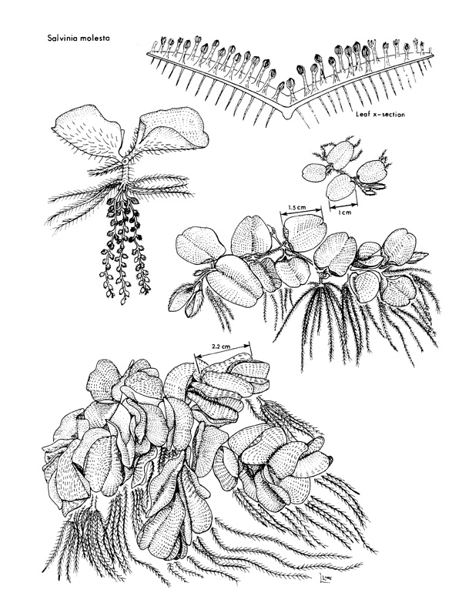
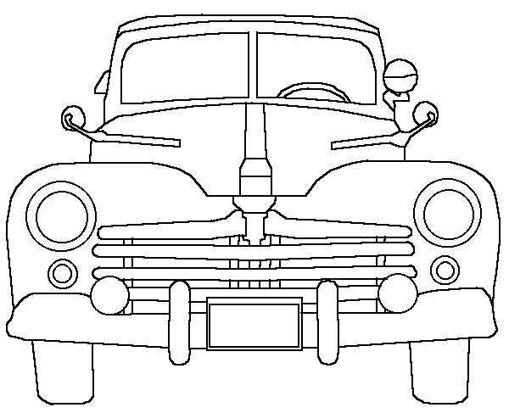
Line Drawings
We often communicate using
Line Drawings

Slide 4
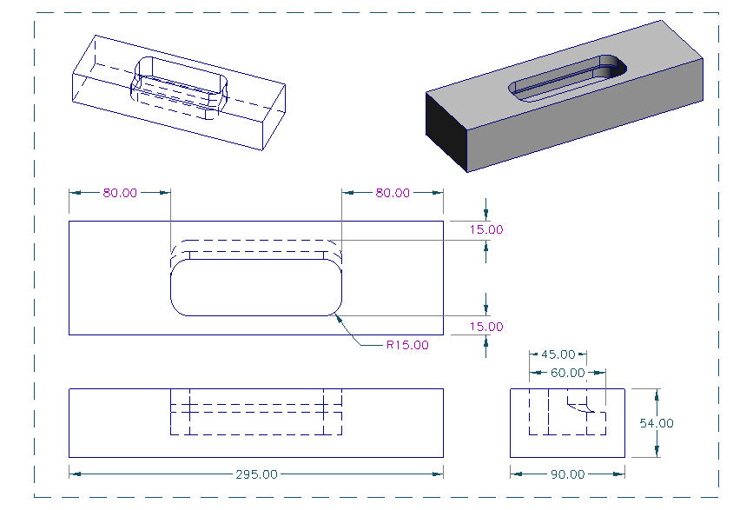
Engineering Drawings

Slide 5
Topics
We can recover 3-D shape information from lines in the image.
Line Drawings
Line Labeling
Possible Labels and Coherence
Constraint Propagation
Gradient Space Constraint

Slide 6
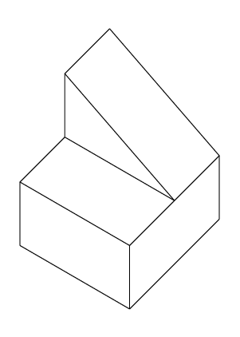
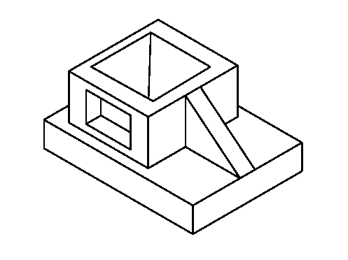
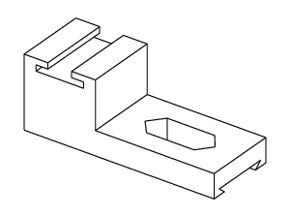
Line Drawings of Polyhedral Objects
We can recover 3-D shape information from lines in the image.
We will assume that lines are “clean” and “well-connected”.

Slide 7
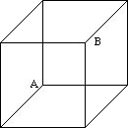
Limitations of Line Drawings
Necker’s Cube Reversal
Sometimes multiple interpretations are possible!

Slide 8
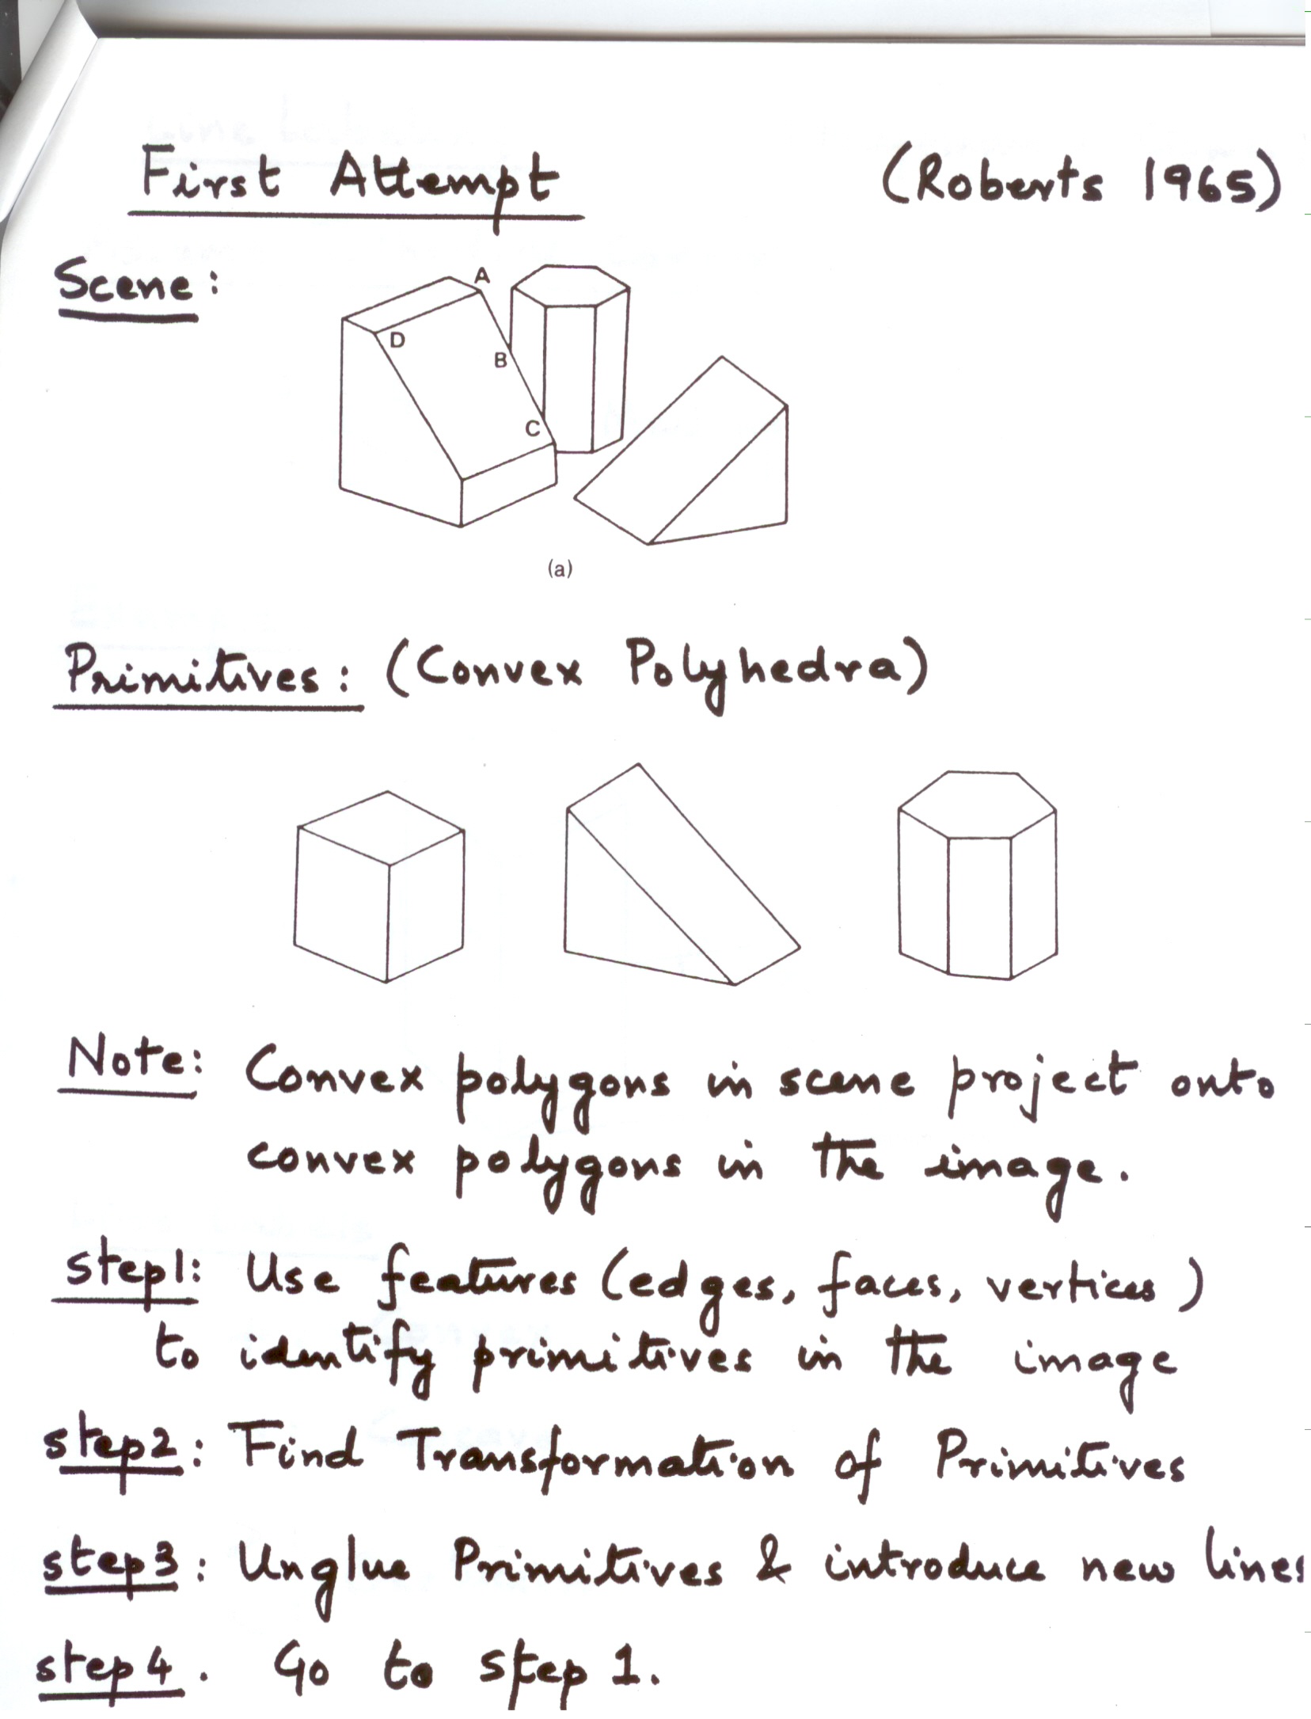
First Attempt – Primitives
[Roberts, 1965]
Scene:
Primitives
Note: Convex polygons in scene project onto convex polygons in the image.
Step1: Use features (edges, faces, vertices) to identify Primitives in the image.
Step2: Find transformation of Primitives.
Step3: UNGLUE Primitives and introduce new lines. Return to Step1.

Slide 9
Line Labeling
Assume Trihedral Corners:
Example:
Line Labels:
+ : Convex
— : Concave
> < : Occlusion
B
A
Meeting of 3 Faces
C
+
+
+
-
-
[Huffman and Clowes, 1971]

Slide 10
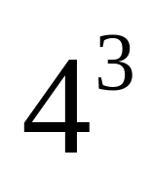

Vertex Types
Fork
Arrow
T
L
Possible Labelings: (Exhaustive)
    Each edge can have one of 4 Labels

Slide 11
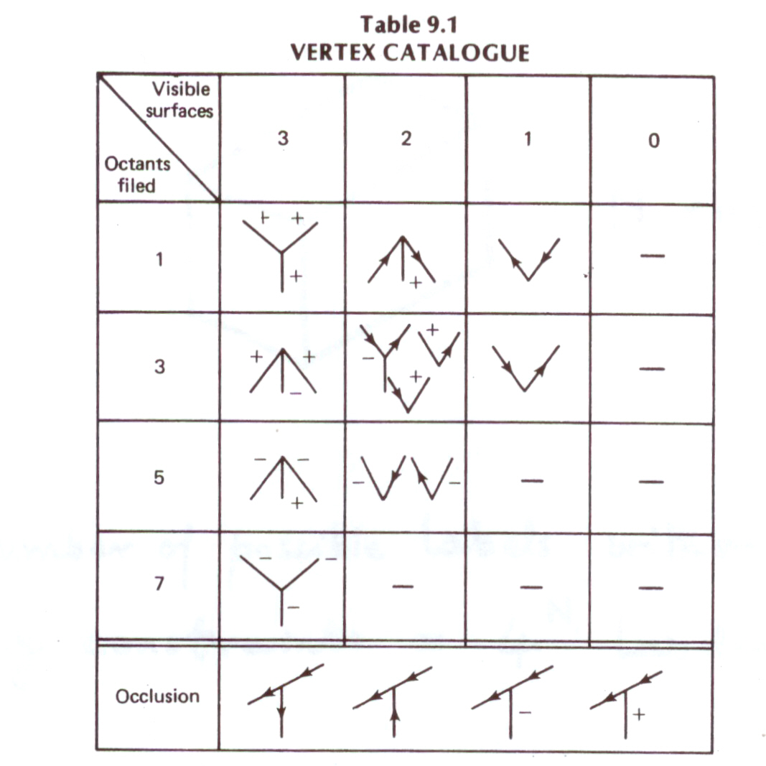
Vertex Dictionary
In a Trihedral World, all image vertices must belong to the Dictionary

Slide 12
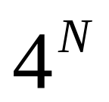
Constraints on Labeling
N edges
Number of possible labels without any constraints : labelings
Two Important Constraints:
    Vertex Type must belong to Dictionary
    A line must have the SAME label at both ends (COHERENCE RULE)

Slide 13
Labeling by Constraint Propagation
Waltz Filtering [Waltz 75]
Extended Dictionary (includes shadows, 4 line vertices)
Constraint Propagation:
    Pick a vertex and assign a label.
    Propagate coherence rule to pick labels of connected
    vertices.
    If Coherence rule is violated, backtrack.
+
-
+
+
+
+
NOTE: Boundaries are good starting points

Slide 14
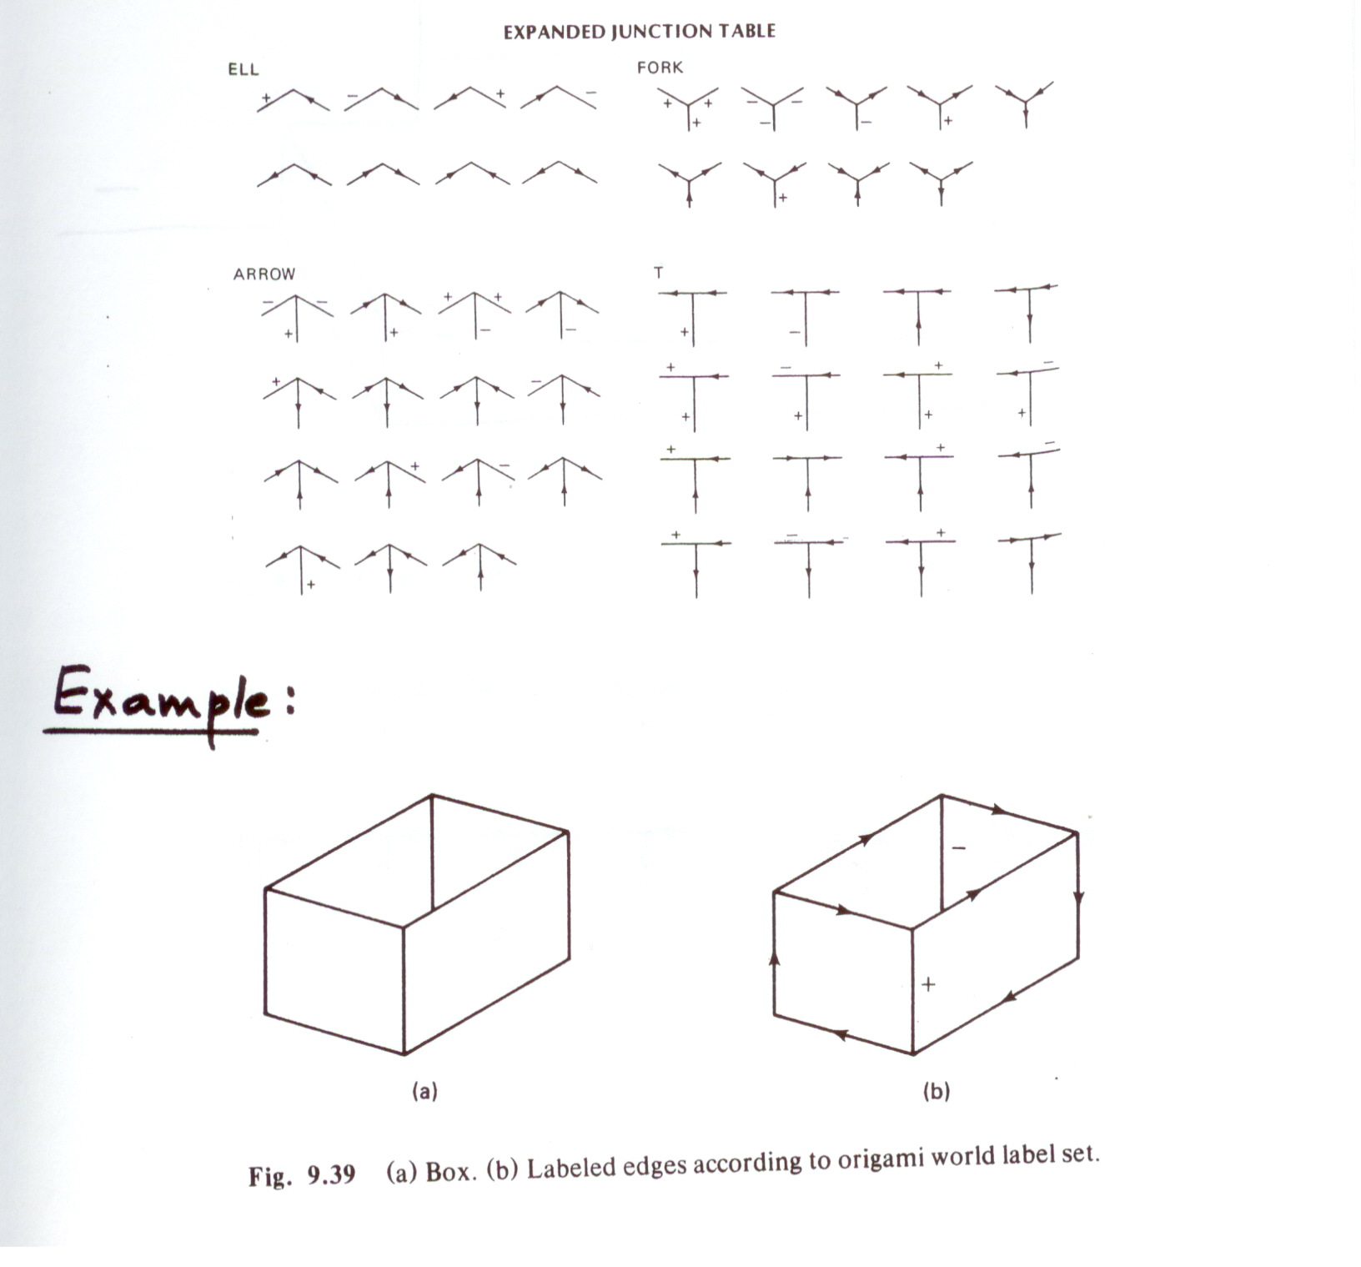
Origami World
Generalizes line labeling from solid polyhedra to non-closed
shells [Kanade 1978].

Slide 15
Origami World
Generalizes line labeling from solid polyhedra to non-closed
shells [Kanade 1978].

Slide 16
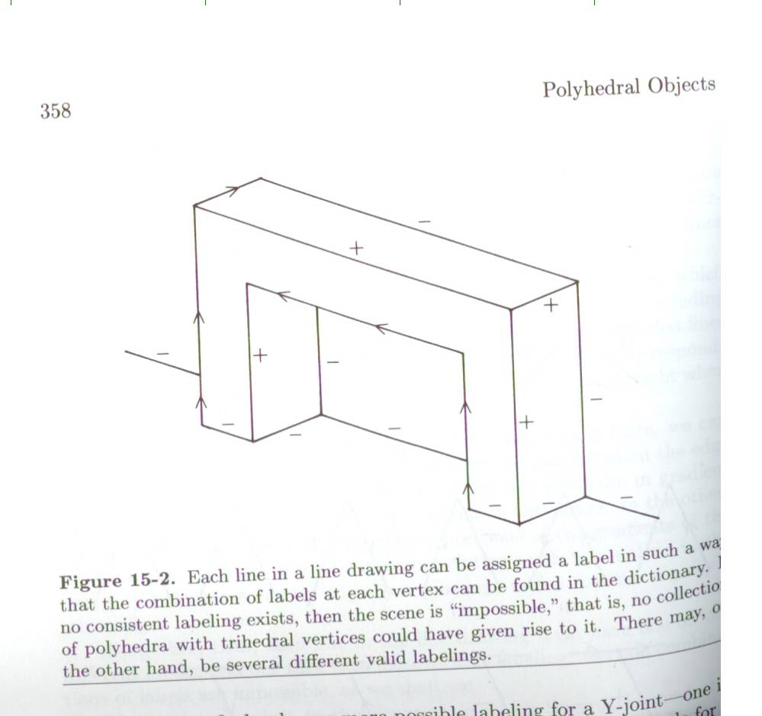

Slide 17
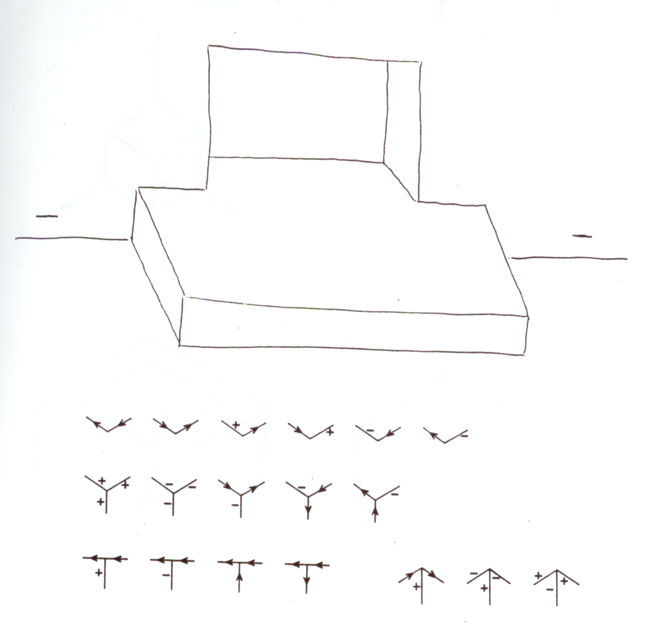

Slide 18
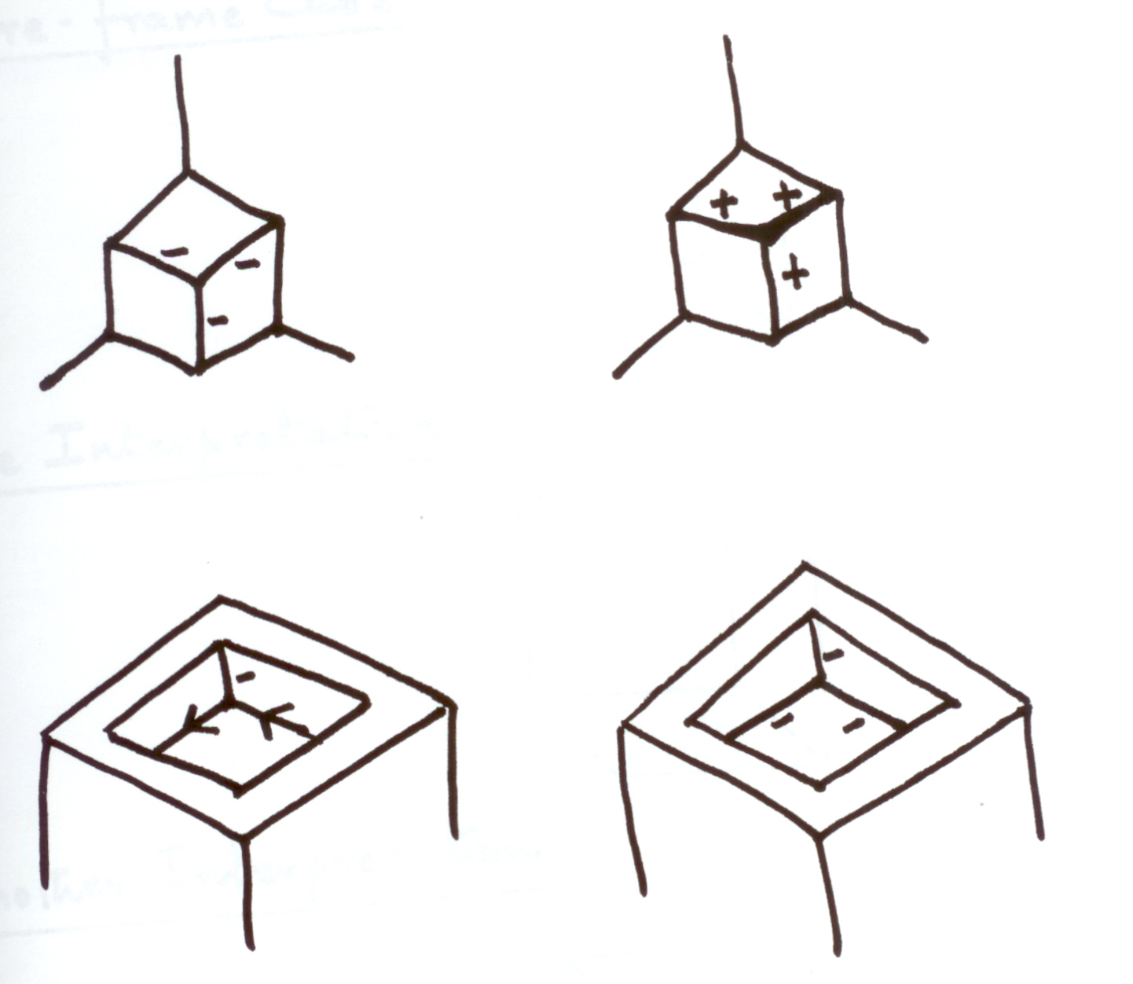
Ambiguity in Labeling
Sometimes Multiple Labelings are possible!

Slide 19
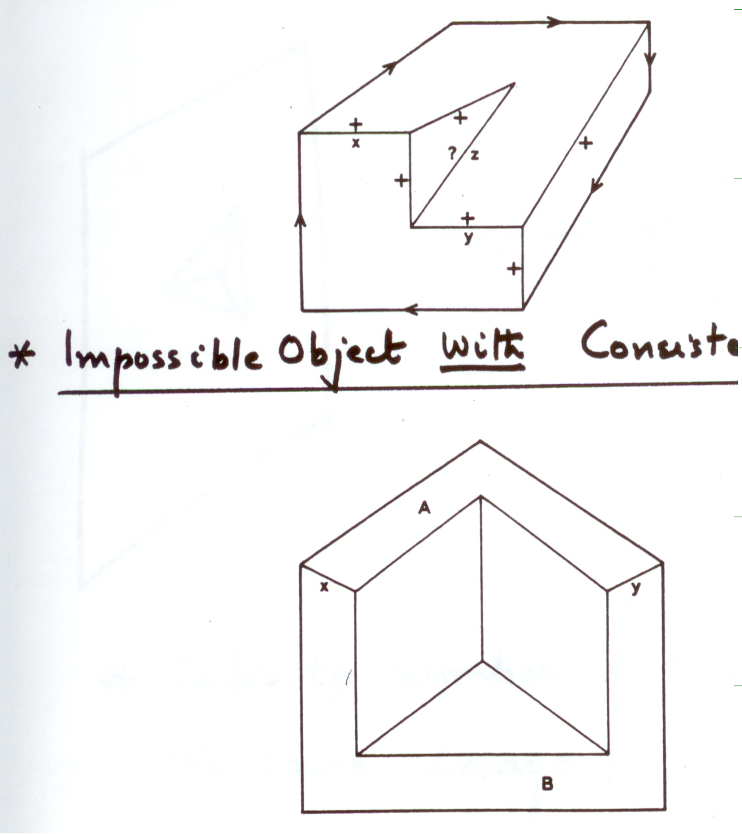
Impossible Objects
Impossible under the Polyhedral Assumption
Impossible Object WITH
NO consistent labeling
Impossible Object WITH
consistent labeling
Locally Fine, Globally Wrong!

Slide 20
Ambiguity in 3-D Shape
Even after consistent labeling, 3-D shape is ambiguous.
Infinite number of shapes produce the same image!
Solution: Use brightness information to find exact shape.

Slide 21

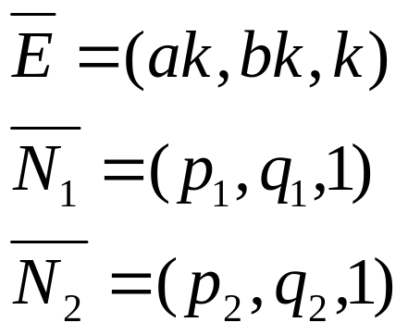
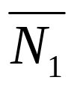
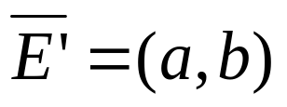
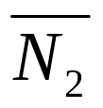
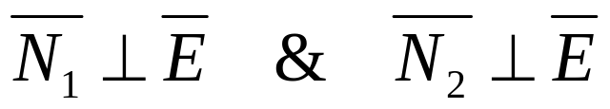
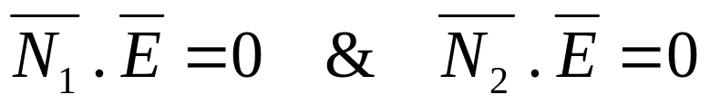
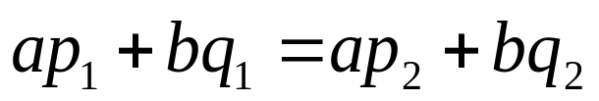
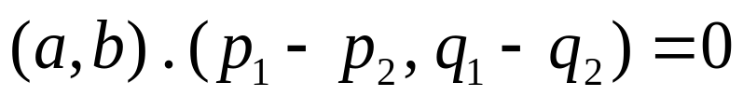
Gradient Space Constraint
[Mackworth 1975]
We Know:
Or:
Hence,

Slide 22
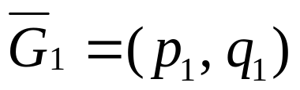
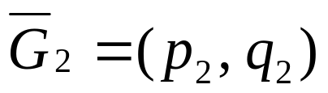


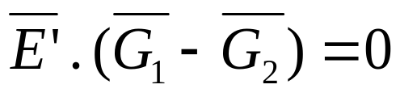

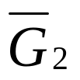

Gradient Space Constraint
Let:
lie on a line that is perpendicular
to the image edge.
We do not know the distance between
, we only know their relative positions.

Slide 23
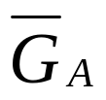

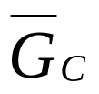
Possible Interpretations of Constraint
Example:
B
A
C
(concave)
(convex)
Scale and positions of the triangles in gradient space are UNKNOWN.
Brightness values of faces A, B, and C may be used
if reflectance map is KNOWN.

Slide 24
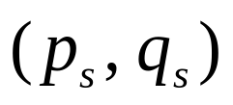


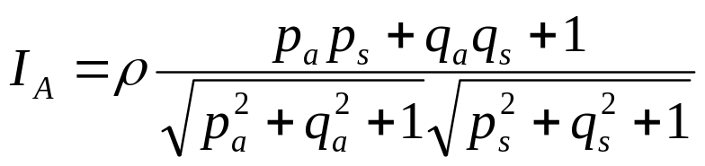
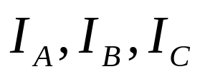

Using the Reflectance Map
Assume: Lambertian reflectance and source direction
Image intensities on faces A, B, and C:
Use equations for
and gradient space constraints
to solve for

Slide 25
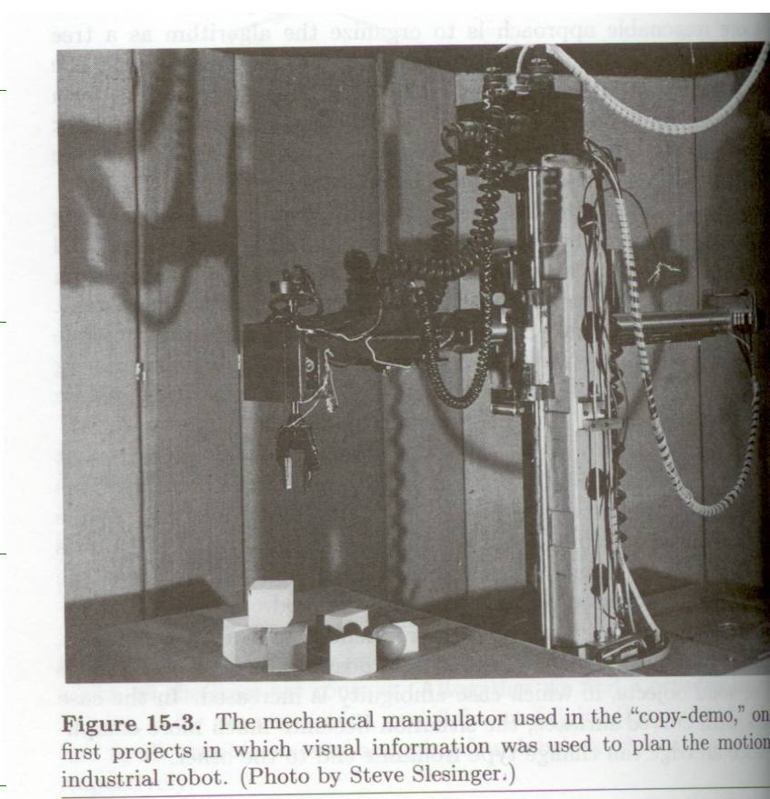
Early Robot Demo

Slide 26
Next Class
Principal Components Analysis
Reading → Notes, Online reading material

Slide 27
Finding Physically Possible Labelings
Divide 3-D space into 8 octants.
Enumerate:
    All ways to fill up 8 octants.
    All ways to view from unfilled octant.

