Slide 1
Computer Vision
Spring 2006 15-385,-685
Instructor: S. Narasimhan
Wean 5403
T-R 3:00pm – 4:20pm
Lecture #19

Slide 2
Principal Components Analysis
Lecture #19

Slide 3
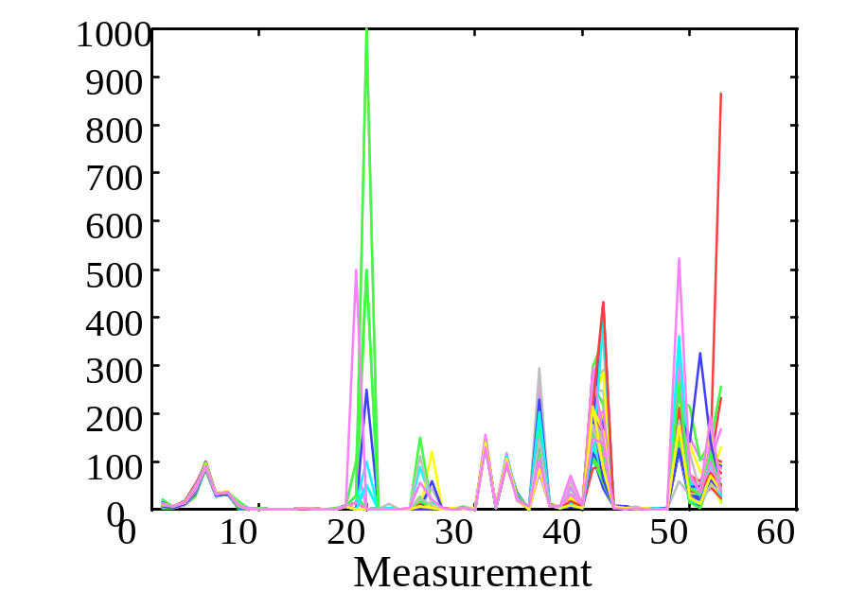
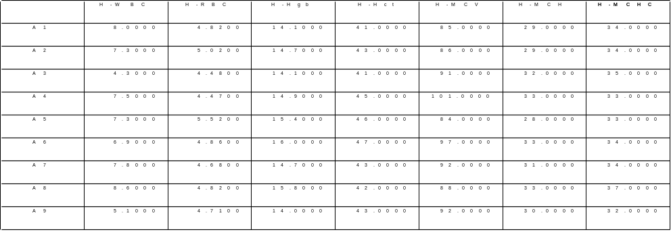
Data Presentation
Example: 53 Blood and urine measurements (wet chemistry) from 65 people (33 alcoholics, 32 non-alcoholics).
Matrix Format
Spectral Format

Slide 4
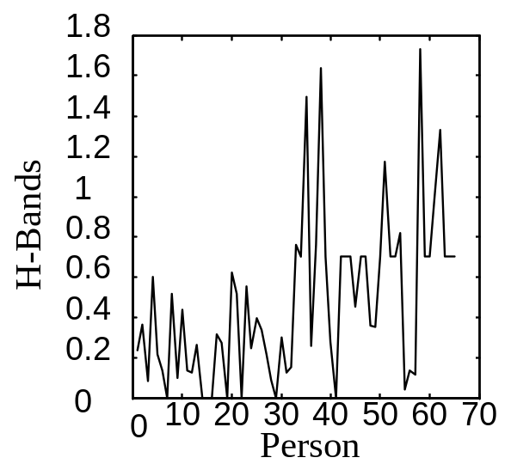
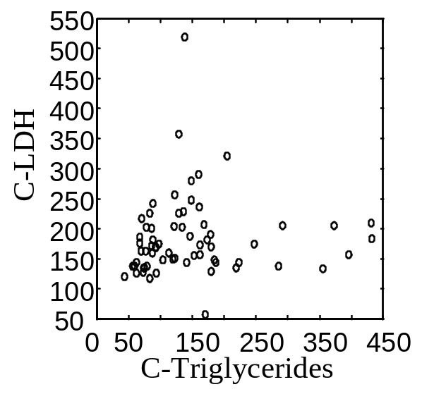
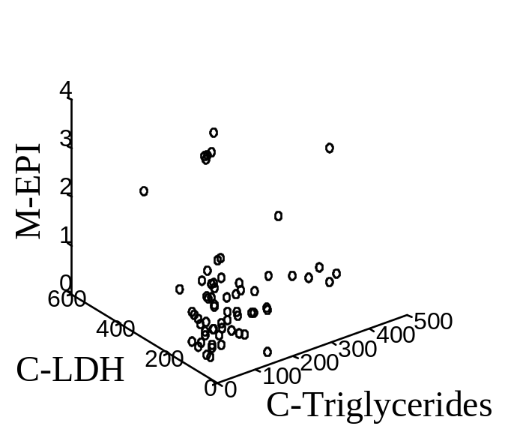
Data Presentation
Univariate
Bivariate
Trivariate

Slide 5
Data Presentation
Better presentation than ordinate axes?
Do we need a 53 dimension space to view data?
How to find the ‘best’ low dimension space that conveys maximum useful information?
One answer: Find “Principal Components”

Slide 6
Principal Components
All principal components (PCs) start at the origin of the ordinate axes.
First PC is direction of maximum variance from origin
Subsequent PCs are orthogonal to 1st PC and describe maximum residual variance
30
25
20
Wavelength 2
PC 1
15
10
5
0
0
5
10
15
20
25
30
Wavelength 1
30
25
20
PC 2
Wavelength 2
15
10
5
0
0
5
10
15
20
25
30
Wavelength 1

Slide 7
The Goal
We wish to explain/summarize the underlying variance-covariance structure of a large set of variables through a few linear combinations of these variables.

Slide 8
Applications
Uses:
  Data Visualization
  Data Reduction
  Data Classification
  Trend Analysis
  Factor Analysis
  Noise Reduction
Examples:
  How many unique “sub-sets” are in the sample?
  How are they similar / different?
  What are the underlying factors that influence the samples?
  Which time / temporal trends are (anti)correlated?
  Which measurements are needed to differentiate?
  How to best present what is “interesting”?
  Which “sub-set” does this new sample rightfully belong?

Slide 9
Trick: Rotate Coordinate Axes
Suppose we have a population measured on p random variables X₁,…,X_{p}. Note that these random variables represent the p-axes of the Cartesian coordinate system in which the population resides. Our goal is to develop a new set of p axes (linear combinations of the original p axes) in the directions of greatest variability:
X₂
X₁
This is accomplished by rotating the axes.

Slide 10
FLASHBACK:
“BINARY IMAGES” LECTURE!

Slide 11



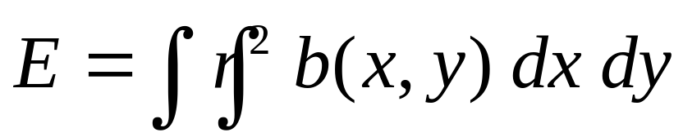
Geometric Properties of Binary Images
Orientation: Difficult to define!
  Axis of least second moment
  For mass: Axis of minimum inertia
b(x, y)
y
y
(x, y)
x
x
Minimize:

Slide 12
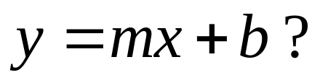
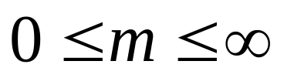
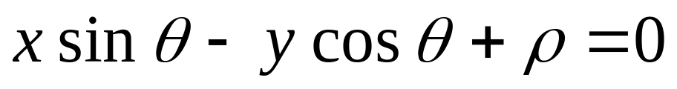
Which equation of line to use?
y
(x, y)
x
We use:
are finite

Slide 13
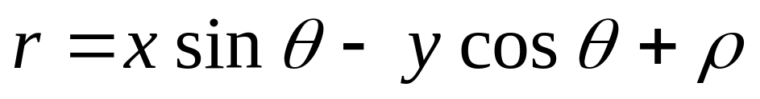
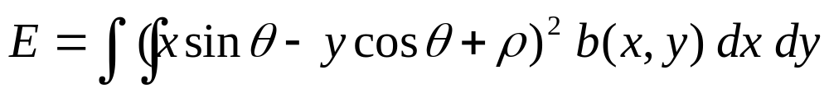
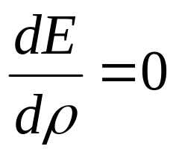
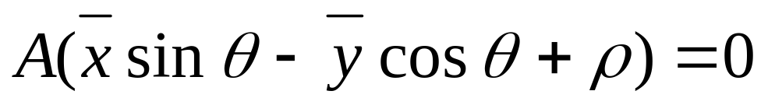
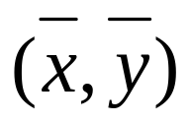
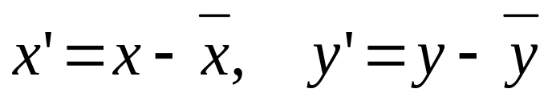
Minimizing Second Moment
Find and that minimize E for a given b(x,y)
We can show that:
So,
Using we get:
Note: Axis passes through the center
So, change co-ordinates:

Slide 14
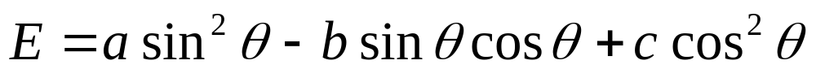
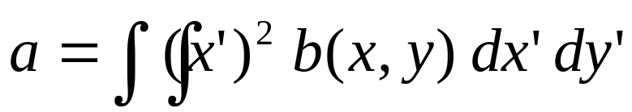
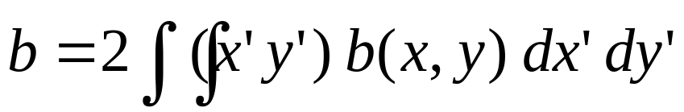
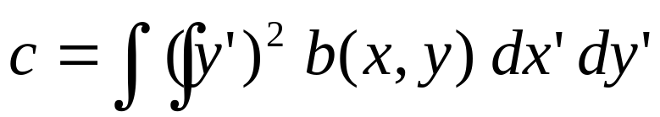
Minimizing Second Moment
We get:
where,
- second moments w.r.t
We are not done yet!!

Slide 15
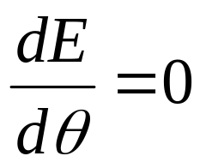
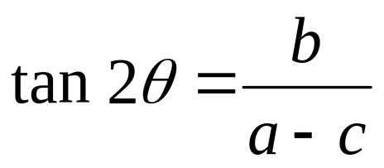
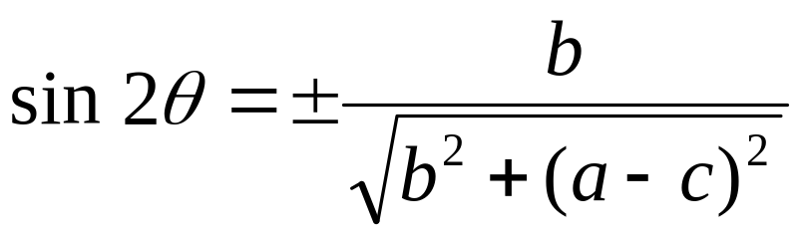
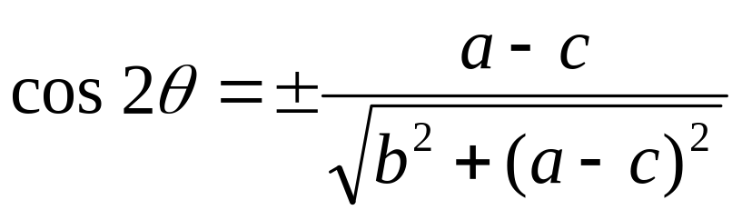
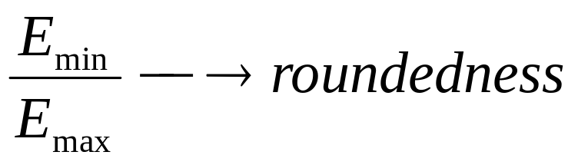
Minimizing Second Moment
Using we get:
Solutions with +ve sign must be used to minimize E. (Why?)

Slide 16
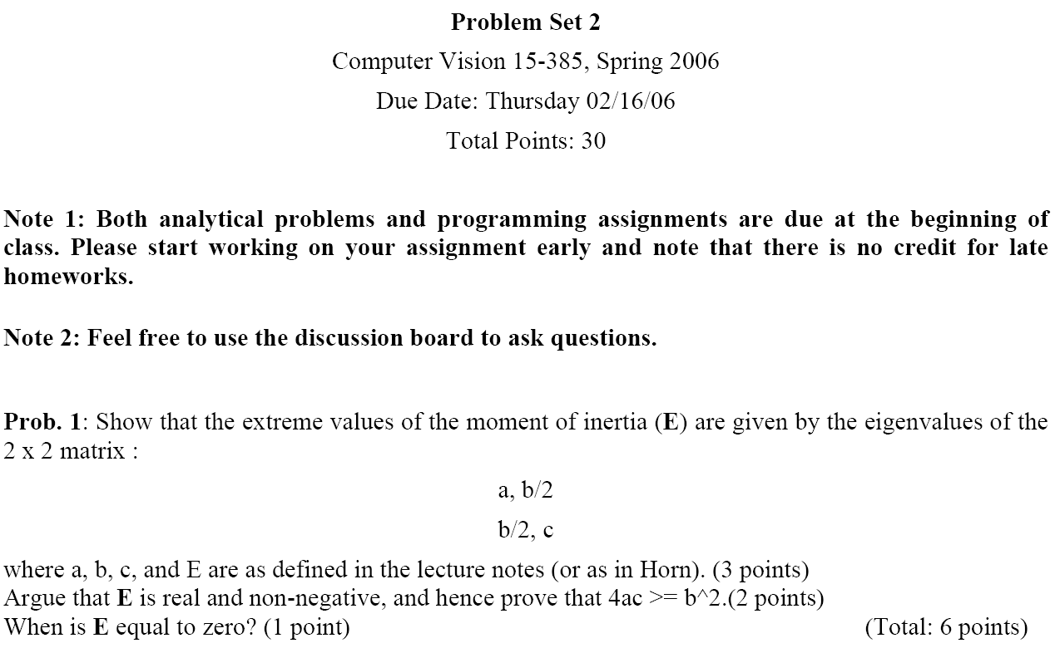

Slide 17
END of FLASHBACK!

Slide 18
Algebraic Interpretation
Given m points in a n dimensional space, for large n, how does one project on to a low dimensional space while preserving broad trends in the data and allowing it to be visualized?

Slide 19
Algebraic Interpretation – 1D
Given m points in a n dimensional space, for large n, how does one project on to a 1 dimensional space?
Choose a line that fits the data so the points are spread out well along the line

Slide 20
Algebraic Interpretation – 1D
Formally, minimize sum of squares of distances to the line.
Why sum of squares? Because it allows fast minimization, assuming the line passes through 0

Slide 21
Algebraic Interpretation – 1D
Minimizing sum of squares of distances to the line is the same as maximizing the sum of squares of the projections on that line, thanks to Pythagoras.

Slide 22
Algebraic Interpretation – 1D
How is the sum of squares of projection lengths expressed in algebraic terms?
L i n e
P P P … P
t t t … t
1 2 3 … m
Point 1
Point 2
Point 3
:
Point m
L
i
n
e
x^{T}
B^{T}
B
x

Slide 23
Algebraic Interpretation – 1D
How is the sum of squares of projection lengths expressed in algebraic terms?
max( x^{T}B^{T} Bx), subject to x^{T}x = 1

Slide 24
Algebraic Interpretation – 1D
Rewriting this:
x^{T}B^{T}Bx = e = e x^{T}x = x^{T} (ex)
<=> x^{T} (B^{T}Bx – ex) = 0
Show that the maximum value of x^{T}B^{T}Bx is obtained for x satisfying B^{T}Bx=ex
So, find the largest e and associated x such that the matrix B^{T}B when applied to x yields a new vector which is in the same direction as x, only scaled by a factor e.

Slide 25
Algebraic Interpretation – 1D
(B^{T}B)x points in some other direction in general
x is an eigenvector and e an eigenvalue if
(B^{T}B)x
x
ex=(B^{T}B)x
x

Slide 26
Algebraic Interpretation – 1D
How many eigenvectors are there?
For Real Symmetric Matrices
  except in degenerate cases when eigenvalues repeat, there are n eigenvectors
  x₁…x_{n} are the eigenvectors
  e₁…e_{n} are the eigenvalues
  all eigenvectors are mutually orthogonal and therefore form a new basis
    Eigenvectors for distinct eigenvalues are mutually orthogonal
    Eigenvectors corresponding to the same eigenvalue have the property that any linear combination is also an eigenvector with the same eigenvalue; one can then find as many orthogonal eigenvectors as the number of repeats of the eigenvalue.

Slide 27
Algebraic Interpretation – 1D
For matrices of the form B^{T}B
  All eigenvalues are non-negative (show this)

Slide 28
PCA: General
From k original variables: x₁,x₂,...,x_{k}:
Produce k new variables: y₁,y₂,...,y_{k}:
y₁ = a₁₁x₁ + a₁₂x₂ + ... + a_{1k}x_{k}
y₂ = a₂₁x₁ + a₂₂x₂ + ... + a_{2k}x_{k}
...
y_{k} = a_{k1}x₁ + a_{k2}x₂ + ... + a_{kk}x_{k}

Slide 29
PCA: General
From k original variables: x₁,x₂,...,x_{k}:
Produce k new variables: y₁,y₂,...,y_{k}:
y₁ = a₁₁x₁ + a₁₂x₂ + ... + a_{1k}x_{k}
y₂ = a₂₁x₁ + a₂₂x₂ + ... + a_{2k}x_{k}
...
y_{k} = a_{k1}x₁ + a_{k2}x₂ + ... + a_{kk}x_{k}
such that:
y_{k}'s are uncorrelated (orthogonal)
y₁ explains as much as possible of original variance in data set
y₂ explains as much as possible of remaining variance
etc.

Slide 30
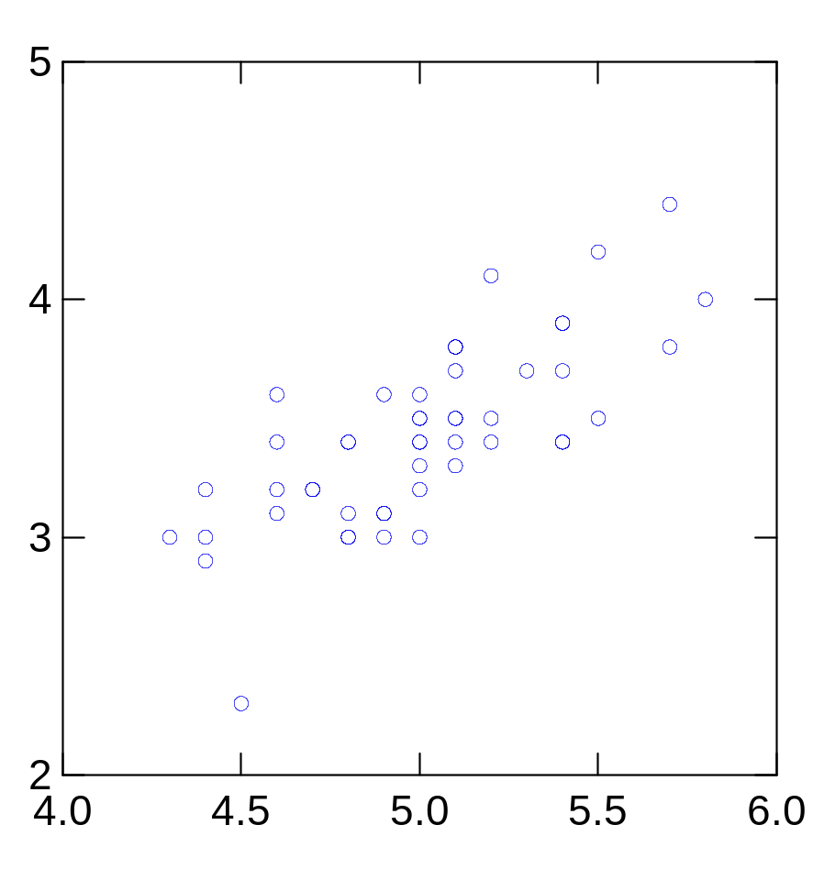
2nd Principal
Component, y₂
1st Principal
Component, y₁

Slide 31
PCA Scores
x_{i2}
y_{i,1}
y_{i,2}
x_{i1}

Slide 32
PCA Eigenvalues
λ₂
λ₁

Slide 33
PCA: Another Explanation
From k original variables: x₁,x₂,...,x_{k}:
Produce k new variables: y₁,y₂,...,y_{k}:
y₁ = a₁₁x₁ + a₁₂x₂ + ... + a_{1k}x_{k}
y₂ = a₂₁x₁ + a₂₂x₂ + ... + a_{2k}x_{k}
...
y_{k} = a_{k1}x₁ + a_{k2}x₂ + ... + a_{kk}x_{k}
y_{k}'s are
Principal Components
such that:
y_{k}'s are uncorrelated (orthogonal)
y₁ explains as much as possible of original variance in data set
y₂ explains as much as possible of remaining variance
etc.

Slide 34
Principal Components Analysis on:
Covariance Matrix:
  Variables must be in same units
  Emphasizes variables with most variance
  Mean eigenvalue ≠1.0
Correlation Matrix:
  Variables are standardized (mean 0.0, SD 1.0)
  Variables can be in different units
  All variables have same impact on analysis
  Mean eigenvalue = 1.0

Slide 35
PCA: General
{a₁₁,a₁₂,...,a_{1k}} is 1st Eigenvector of correlation/covariance matrix, and coefficients of first principal component
{a₂₁,a₂₂,...,a_{2k}} is 2nd Eigenvector of correlation/covariance matrix, and coefficients of 2nd principal component
…
{a_{k1},a_{k2},...,a_{kk}} is kth Eigenvector of correlation/covariance matrix, and coefficients of kth principal component

Slide 36
PCA Summary until now
Rotates multivariate dataset into a new configuration which is easier to interpret
Purposes
  simplify data
  look at relationships between variables
  look at patterns of units

Slide 37
PCA: Yet Another Explanation

Slide 38







Classification in Subspace
convert x into v₁, v₂ coordinates
What does the v₂ coordinate measure?
  distance to line
  use it for classification—near 0 for orange pts
What does the v₁ coordinate measure?
  position along line
  use it to specify which orange point it is
Classification can be expensive
  Must either search (e.g., nearest neighbors) or store large probability density functions.
Suppose the data points are arranged as above
  Idea—fit a line, classifier measures distance to line

Slide 39
Dimensionality Reduction
Dimensionality reduction
  We can represent the orange points with only their v₁ coordinates
    since v₂ coordinates are all essentially 0
  This makes it much cheaper to store and compare points
  A bigger deal for higher dimensional problems

Slide 40
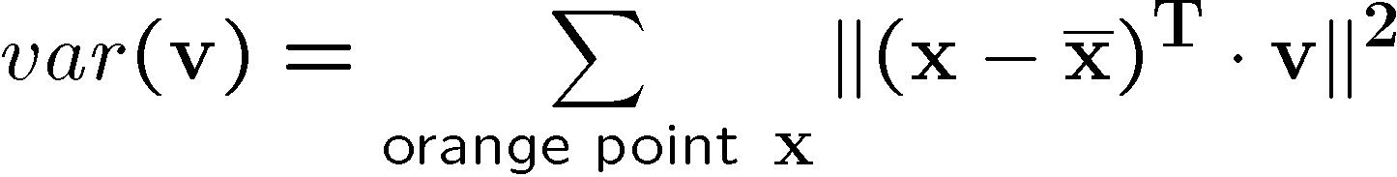


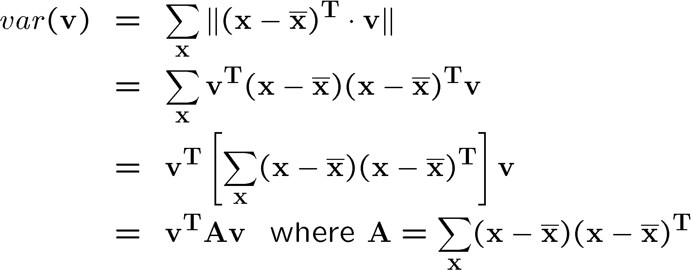
Linear Subspaces
Consider the variation along direction v among all of the orange points:
What unit vector v minimizes var?
What unit vector v maximizes var?
Solution: v₁ is eigenvector of A with largest eigenvalue
v₂ is eigenvector of A with smallest eigenvalue

Slide 41
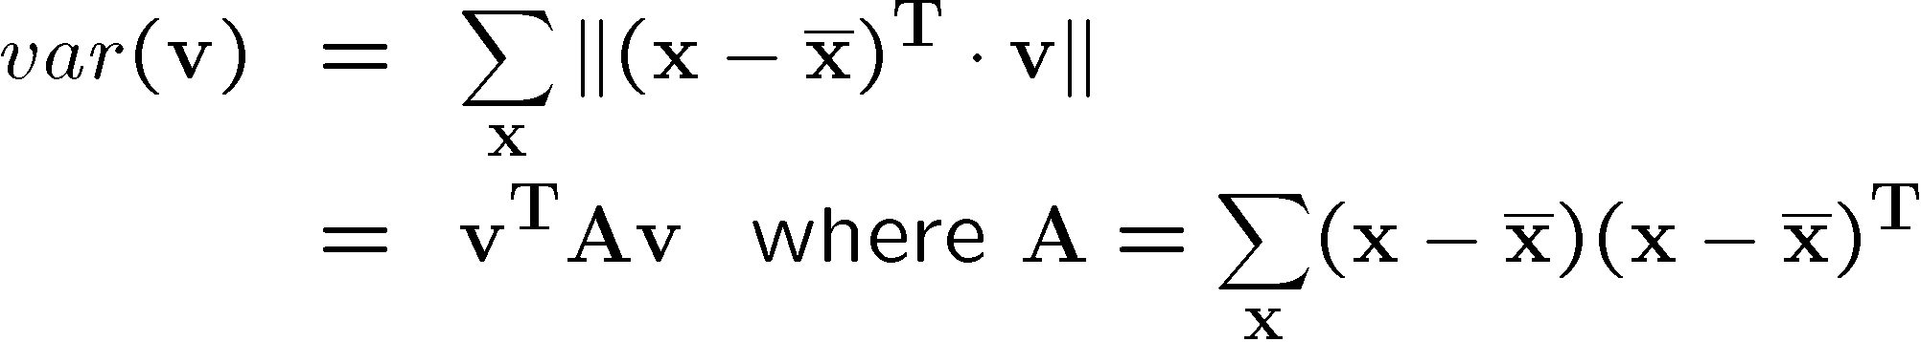
Higher Dimensions
Suppose each data point is N-dimensional
  Same procedure applies:
  The eigenvectors of A define a new coordinate system
    eigenvector with largest eigenvalue captures the most variation among training vectors x
    eigenvector with smallest eigenvalue has least variation
  We can compress the data by only using the top few eigenvectors
    corresponds to choosing a “linear subspace”
      represent points on a line, plane, or “hyper-plane”
    these eigenvectors are known as the principal components

Slide 42
End of Yet Another Explanation

Slide 43
A 2D Numerical Example

Slide 44
PCA Example –STEP 1
Subtract the mean
from each of the data dimensions. All the x values have x subtracted and y values have y subtracted from them. This produces a data set whose mean is zero.
Subtracting the mean makes variance and covariance calculation easier by simplifying their equations. The variance and co-variance values are not affected by the mean value.

Slide 45
PCA Example –STEP 1
http://kybele.psych.cornell.edu/~edelman/Psych-465-Spring-2003/PCA-tutorial.pdf
ZERO MEAN DATA:
x y
.69 .49
-1.31 -1.21
.39 .99
.09 .29
1.29 1.09
.49 .79
.19 -.31
-.81 -.81
-.31 -.31
-.71 -1.01
DATA:
x y
2.5 2.4
0.5 0.7
2.2 2.9
1.9 2.2
3.1 3.0
2.3 2.7
2 1.6
1 1.1
1.5 1.6
1.1 0.9

Slide 46
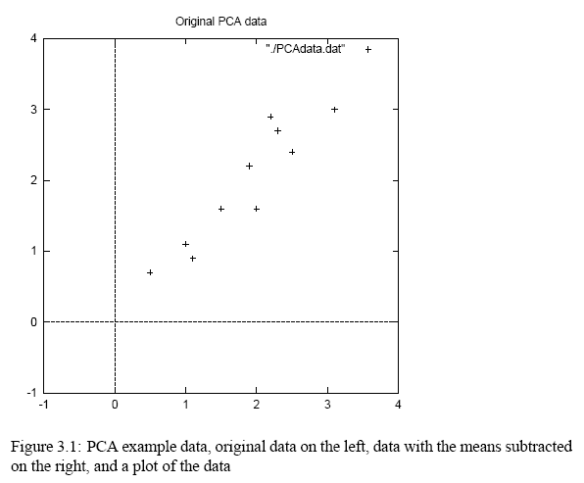
PCA Example –STEP 1
http://kybele.psych.cornell.edu/~edelman/Psych-465-Spring-2003/PCA-tutorial.pdf

Slide 47
PCA Example –STEP 2
Calculate the covariance matrix
cov = .616555556 .615444444
.615444444 .716555556
since the non-diagonal elements in this covariance matrix are positive, we should expect that both the x and y variable increase together.

Slide 48
PCA Example –STEP 3
Calculate the eigenvectors and eigenvalues of the covariance matrix
eigenvalues = .0490833989
1.28402771
eigenvectors = -.735178656 -.677873399
.677873399 -.735178656

Slide 49
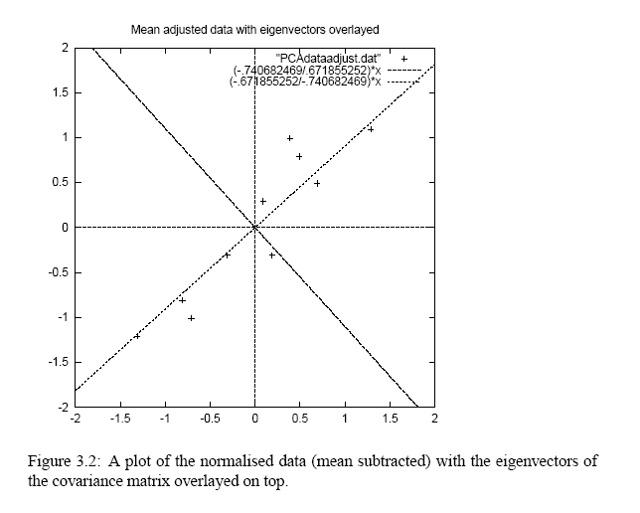
PCA Example –STEP 3
http://kybele.psych.cornell.edu/~edelman/Psych-465-Spring-2003/PCA-tutorial.pdf
eigenvectors are plotted as diagonal dotted lines on the plot.
Note they are perpendicular to each other.
Note one of the eigenvectors goes through the middle of the points, like drawing a line of best fit.
The second eigenvector gives us the other, less important, pattern in the data, that all the points follow the main line, but are off to the side of the main line by some amount.

Slide 50
PCA Example –STEP 4
Reduce dimensionality and form feature vector
the eigenvector with the highest eigenvalue is the principle component of the data set.
In our example, the eigenvector with the larges eigenvalue was the one that pointed down the middle of the data.
Once eigenvectors are found from the covariance matrix, the next step is to order them by eigenvalue, highest to lowest. This gives you the components in order of significance.

Slide 51
PCA Example –STEP 4
Now, if you like, you can decide to ignore the components of lesser significance.
You do lose some information, but if the eigenvalues are small, you don’t lose much
n dimensions in your data
calculate n eigenvectors and eigenvalues
choose only the first p eigenvectors
final data set has only p dimensions.

Slide 52
PCA Example –STEP 4
Feature Vector
FeatureVector = (eig₁ eig₂ eig₃ … eig_{n})
We can either form a feature vector with both of the eigenvectors:
-.677873399 -.735178656
-.735178656 .677873399
or, we can choose to leave out the smaller, less significant component and only have a single column:
- .677873399
- .735178656

Slide 53
PCA Example –STEP 5
Deriving the new data
FinalData = RowFeatureVector x RowZeroMeanData
RowFeatureVector is the matrix with the eigenvectors in the columns transposed so that the eigenvectors are now in the rows, with the most significant eigenvector at the top
RowZeroMeanData is the mean-adjusted data transposed, ie. the data items are in each column, with each row holding a separate dimension.

Slide 54
PCA Example –STEP 5
FinalData transpose: dimensions along columns
x y
-.827970186 -.175115307
1.77758033 .142857227
-.992197494 .384374989
-.274210416 .130417207
-1.67580142 -.209498461
-.912949103 .175282444
.0991094375 -.349824698
1.14457216 .0464172582
.438046137 .0177646297
1.22382056 -.162675287

Slide 55
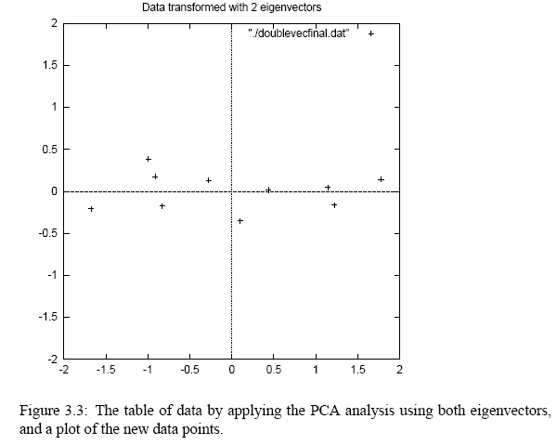
PCA Example –STEP 5
http://kybele.psych.cornell.edu/~edelman/Psych-465-Spring-2003/PCA-tutorial.pdf

Slide 56
Reconstruction of original Data
If we reduced the dimensionality, obviously, when reconstructing the data we would lose those dimensions we chose to discard. In our example let us assume that we considered only the x dimension…

Slide 57
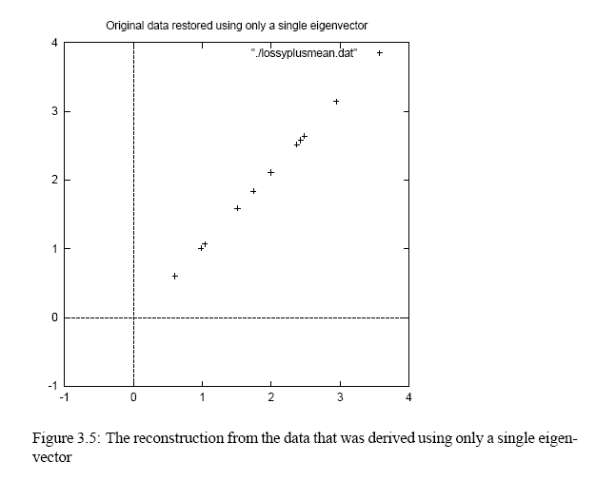
Reconstruction of original Data
http://kybele.psych.cornell.edu/~edelman/Psych-465-Spring-2003/PCA-tutorial.pdf
x
-.827970186
1.77758033
-.992197494
-.274210416
-1.67580142
-.912949103
.0991094375
1.14457216
.438046137
1.22382056

Slide 58
Next Class
Principal Components Analysis (continued)
Reading → Notes, Online reading material

