Slide 1
Computer Vision
Spring 2006 15-385,-685
Instructor: S. Narasimhan
Wean 5403
T-R 3:00pm – 4:20pm
Lecture #20

Slide 2
Announcements
Homework 5 due today.
Homework 6 will be released this evening.
Required for Graduate students.
Extra-credit for undergrads.
No class this Thursday (April 20).

Slide 3
Principal Components Analysis
on Images
Lecture #20

Slide 4
Appearance-based Recognition
Directly represent appearance (image brightness), not geometry.
Why?
Avoids modeling geometry, complex interactions
between geometry, lighting and reflectance.
Why not?
Too many possible appearances!
m “visual degrees of freedom” (eg., pose, lighting, etc)
R discrete samples for each DOF
How to discretely sample the DOFs?
How to PREDICT/SYNTHESIS/MATCH with novel views?

Slide 5
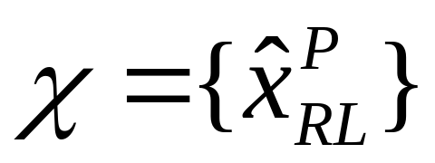
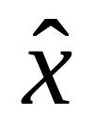
Appearance-based Recognition
Example:
  Visual DOFs: Object type P, Lighting Direction L, Pose R
Set of R * P * L possible images:
Image as a point in high dimensional space:
is an image of N pixels and
A point in N-dimensional space
Pixel 2 gray value
Pixel 1 gray value

Slide 6
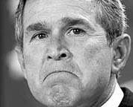
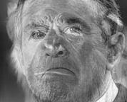
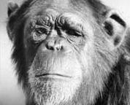
The Space of Faces
=
+
An image is a point in a high dimensional space
  An N x M image is a point in R^{NM}
  We can define vectors in this space as we did in the 2D case
[Thanks to Chuck Dyer, Steve Seitz, Nishino]

Slide 7
Key Idea
Images in the possible set are highly correlated.
So, compress them to a low-dimensional subspace that
captures key appearance characteristics of the visual DOFs.
EIGENFACES: [Turk and Pentland]
USE PCA!

Slide 8
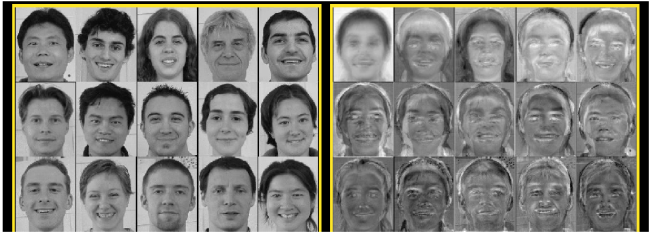
Eigenfaces
Eigenfaces look somewhat like generic faces.

Slide 9

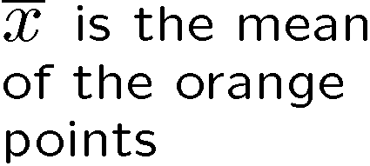





Linear Subspaces
convert x into v₁, v₂ coordinates
What does the v₂ coordinate measure?
  distance to line
  use it for classification—near 0 for orange pts
What does the v₁ coordinate measure?
  position along line
  use it to specify which orange point it is
Classification can be expensive
  Must either search (e.g., nearest neighbors) or store large probability density functions.
Suppose the data points are arranged as above
  Idea—fit a line, classifier measures distance to line

Slide 10
Dimensionality Reduction
Dimensionality reduction
  We can represent the orange points with only their v₁ coordinates
    since v₂ coordinates are all essentially 0
  This makes it much cheaper to store and compare points
  A bigger deal for higher dimensional problems

Slide 11
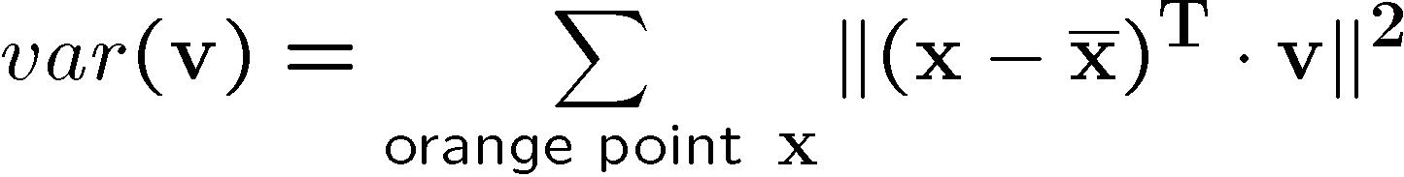


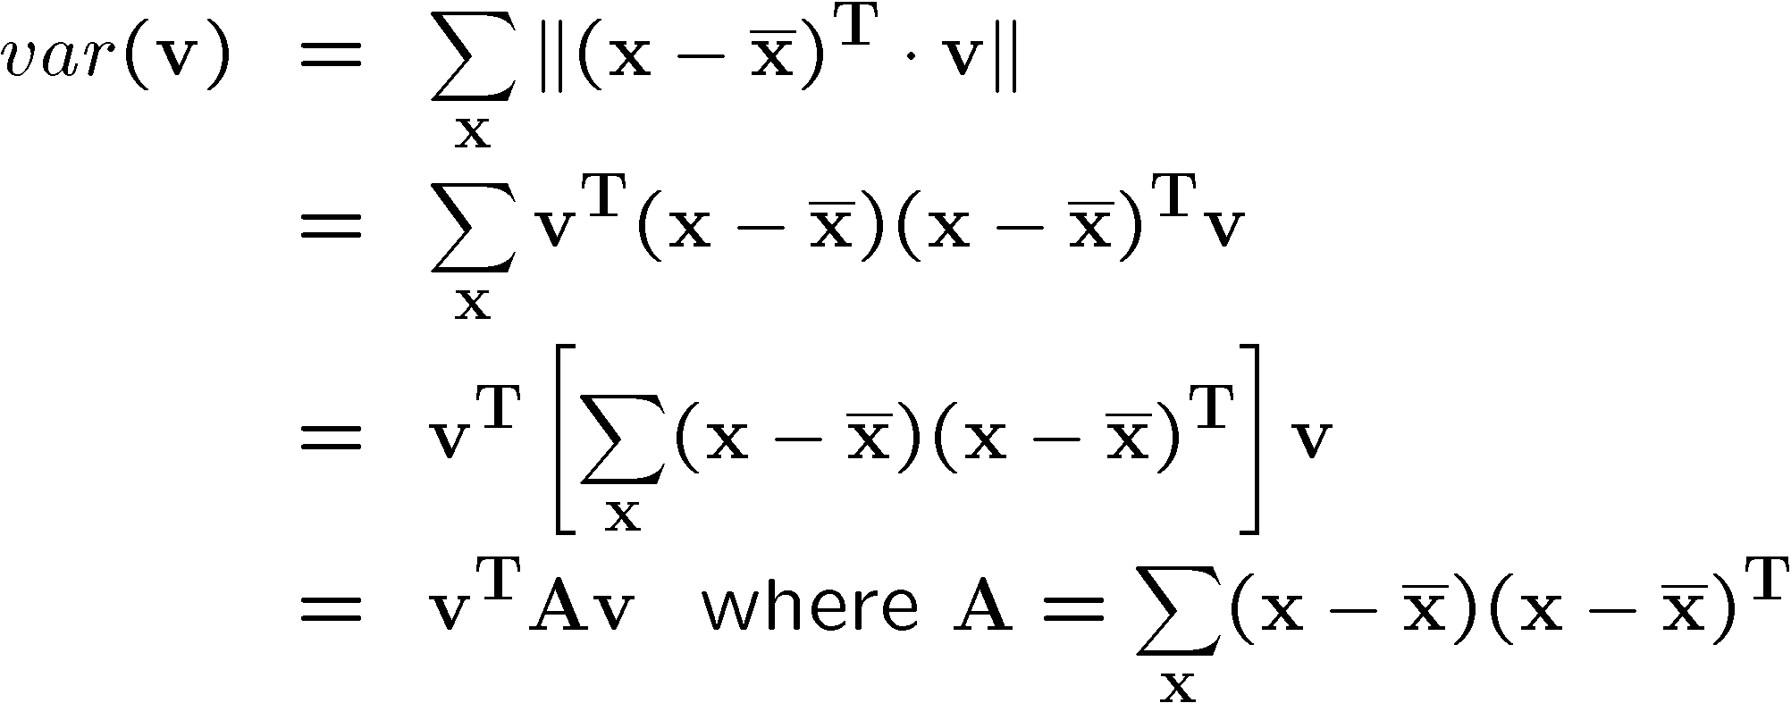
Linear Subspaces
Consider the variation along direction v among all of the orange points:
What unit vector v minimizes var?
What unit vector v maximizes var?
Solution: v₁ is eigenvector of A with largest eigenvalue
v₂ is eigenvector of A with smallest eigenvalue

Slide 12
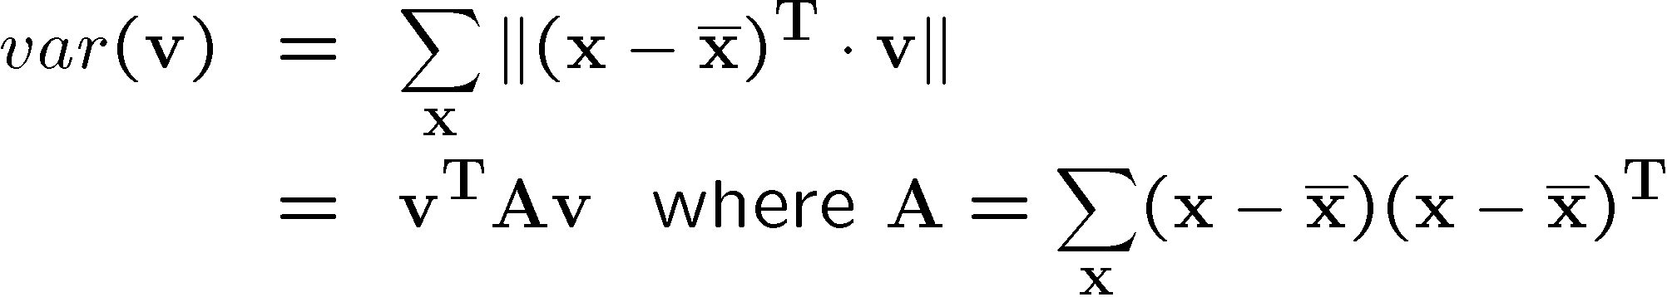
Higher Dimensions
Suppose each data point is N-dimensional
  Same procedure applies:
  The eigenvectors of A define a new coordinate system
    eigenvector with largest eigenvalue captures the most variation among training vectors x
    eigenvector with smallest eigenvalue has least variation
  We can compress the data by only using the top few eigenvectors
    corresponds to choosing a “linear subspace”
      represent points on a line, plane, or “hyper-plane”
    these eigenvectors are known as the principal components

Slide 13
Problem: Size of Covariance Matrix A
Suppose each data point is N-dimensional (N pixels)
  The size of covariance matrix A is N x N
  The number of eigenfaces is N
  Example: For N = 256 x 256 pixels,
  Size of A will be 65536 x 65536 !
  Number of eigenvectors will be 65536 !
  Typically, only 20-30 eigenvectors suffice. So, this
  method is very inefficient!
2
2

Slide 14
Efficient Computation of Eigenvectors
If B is MxN and M<<N then A=B^{T}B is NxN >> MxM
  M → number of images, N → number of pixels
  use BB^{T} instead, eigenvector of BB^{T} is easily
  converted to that of B^{T}B
      (BB^{T}) y = e y
        => B^{T}(BB^{T}) y = e (B^{T}y)
        => (B^{T}B)(B^{T}y) = e (B^{T}y)
        => B^{T}y is the eigenvector of B^{T}B

Slide 15
Eigenfaces – summary in words
Eigenfaces are
the eigenvectors of
the covariance matrix of
the probability distribution of
the vector space of
human faces
Eigenfaces are the ‘standardized face ingredients’ derived from the statistical analysis of many pictures of human faces
A human face may be considered to be a combination of these standardized faces

Slide 16
Generating Eigenfaces – in words
Large set of images of human faces is taken.
The images are normalized to line up the eyes, mouths and other features.
The eigenvectors of the covariance matrix of the face image vectors are then extracted.
These eigenvectors are called eigenfaces.

Slide 17
Eigenfaces for Face Recognition
When properly weighted, eigenfaces can be summed together to create an approximate gray-scale rendering of a human face.
Remarkably few eigenvector terms are needed to give a fair likeness of most people's faces.
Hence eigenfaces provide a means of applying data compression to faces for identification purposes.

Slide 18
Dimensionality Reduction
The set of faces is a “subspace” of the set
of images
  Suppose it is K dimensional
  We can find the best subspace using PCA
  This is like fitting a “hyper-plane” to the set of faces
    spanned by vectors v₁, v₂, ..., v_{K}
Any face:

Slide 19
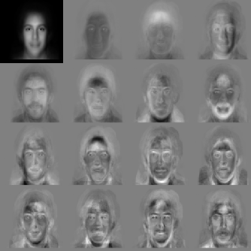


Eigenfaces
PCA extracts the eigenvectors of A
  Gives a set of vectors v₁, v₂, v₃, ...
  Each one of these vectors is a direction in face space
    what do these look like?

Slide 20



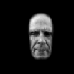
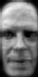










Projecting onto the Eigenfaces
The eigenfaces v₁, ..., v_{K} span the space of faces
  A face is converted to eigenface coordinates by

Slide 21
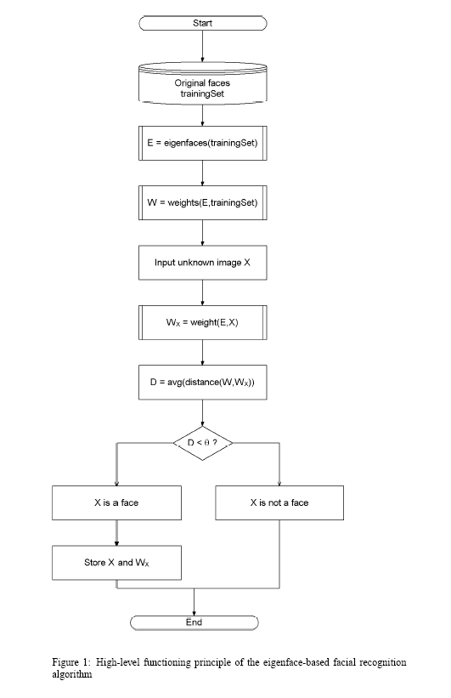
Is this a face or not?

Slide 22

Recognition with Eigenfaces
Algorithm
  Process the image database (set of images with labels)
    Run PCA—compute eigenfaces
    Calculate the K coefficients for each image
  Given a new image (to be recognized) x, calculate K coefficients
  Detect if x is a face
  If it is a face, who is it?
    Find closest labeled face in database
      nearest-neighbor in K-dimensional space

Slide 23
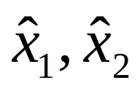


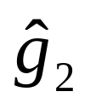

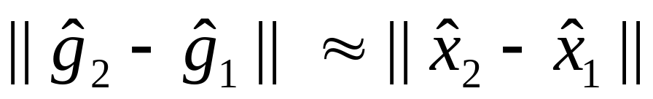
Key Property of Eigenspace Representation
Given
    2 images that are used to construct the Eigenspace
    is the eigenspace projection of image
    is the eigenspace projection of image
Then,
That is, distance in Eigenspace is approximately equal to the
correlation between two images.

Slide 24
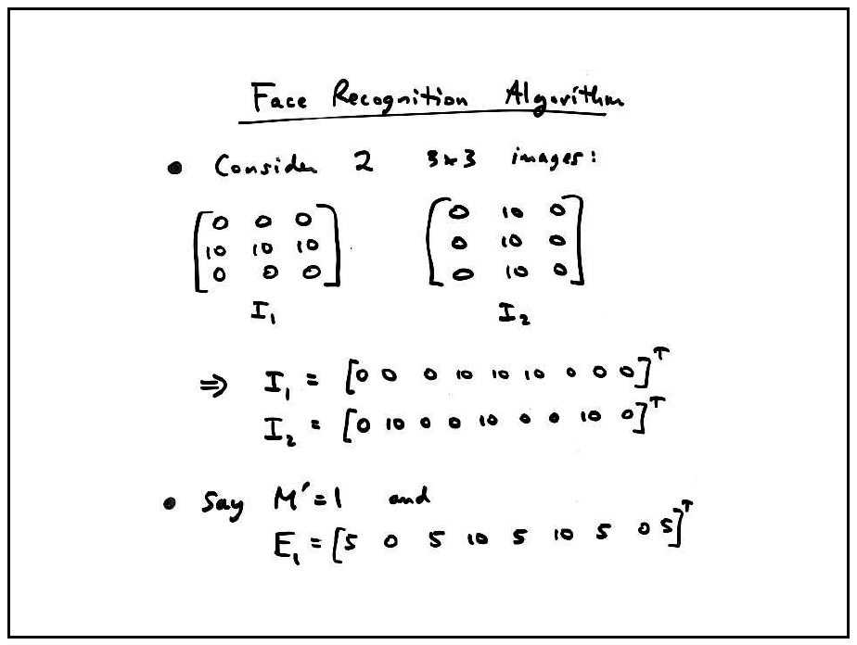
(M’ is the number of eigenfaces used)

Slide 25
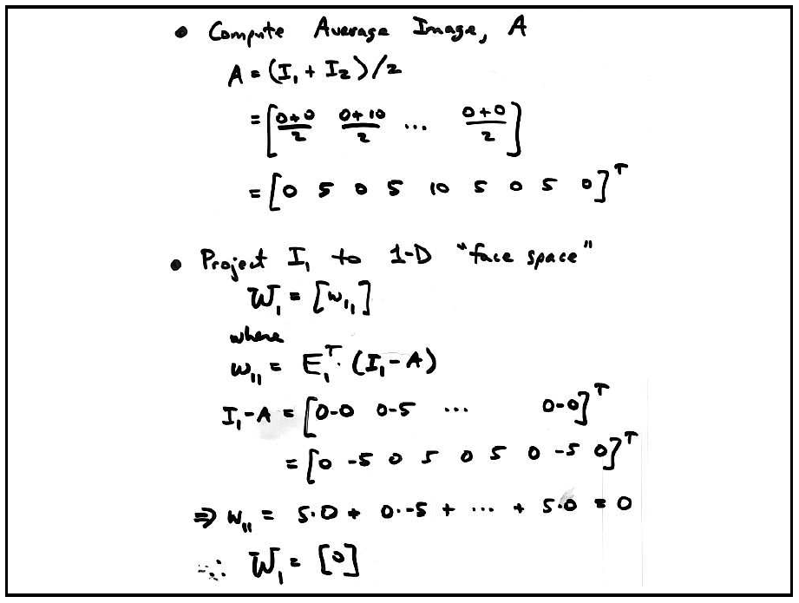

Slide 26
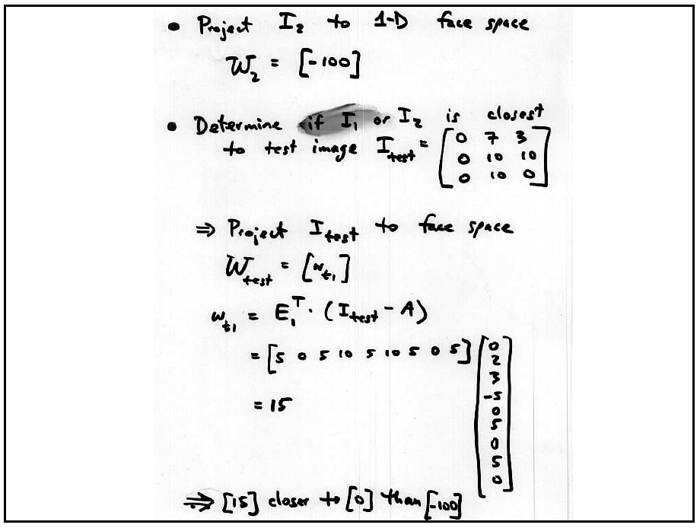

Slide 27
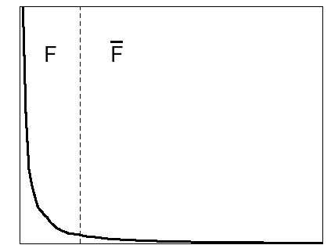
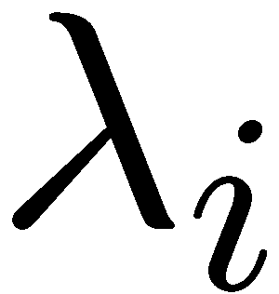
Choosing the Dimension K
eigenvalues
i =
K
NM
How many eigenfaces to use?
Look at the decay of the eigenvalues
  the eigenvalue tells you the amount of variance “in the direction” of that eigenface
  ignore eigenfaces with low variance

Slide 28
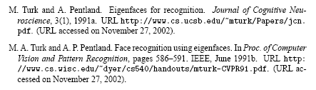
Papers

Slide 29
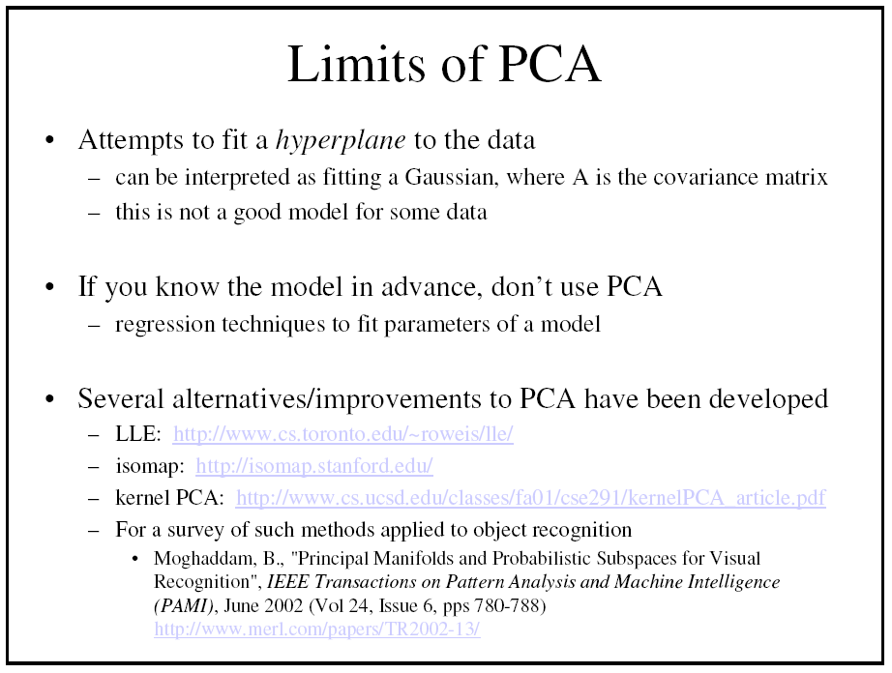

Slide 30
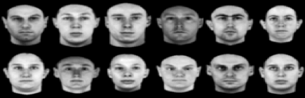
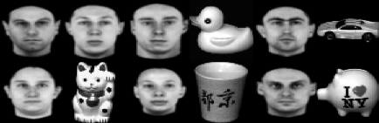
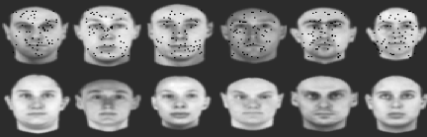
More Problems: Outliers
Sample Outliers
Intra-sample outliers
Need to explicitly reject outliers before or during computing PCA.
[De la Torre and Black]

Slide 31


Robustness to Intra-sample outliers
PCA
RPCA
RPCA: Robust PCA, [De la Torre and Black]

Slide 32
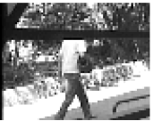
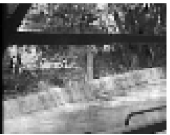
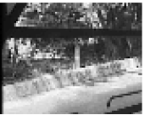
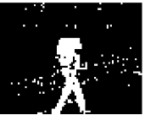
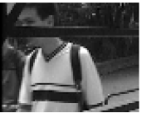
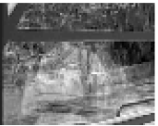
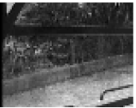
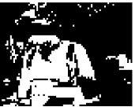
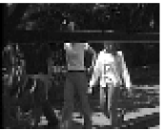
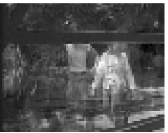
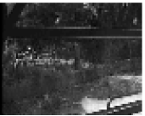
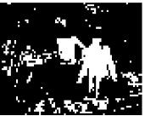
Robustness to Sample Outliers
Original
PCA
RPCA
Outliers
Finding outliers = Tracking moving objects

Slide 33
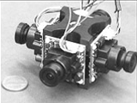
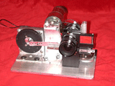
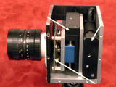
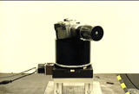
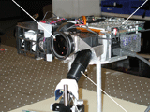
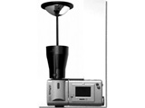
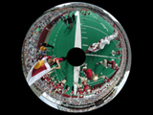
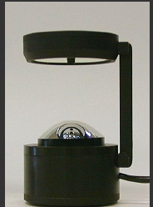
Next Week
Novel Cameras and Displays***
*** Topics change every year

Slide 34
Next Week
Recent Trends in Computer Vision
  This semester: Novel Sensors
  Reading: notes, papers, online resources.

