Slide 1
Computer Vision
Spring 2006 15-385,-685
Instructor: S. Narasimhan
Wean 5403
T-R 3:00pm – 4:20pm

Slide 2
Announcements
Homework 1 is due on Thursday in class.
Homework 2 will be out on Thursday.
Start homeworks early.
Post questions on bboard.

Slide 3
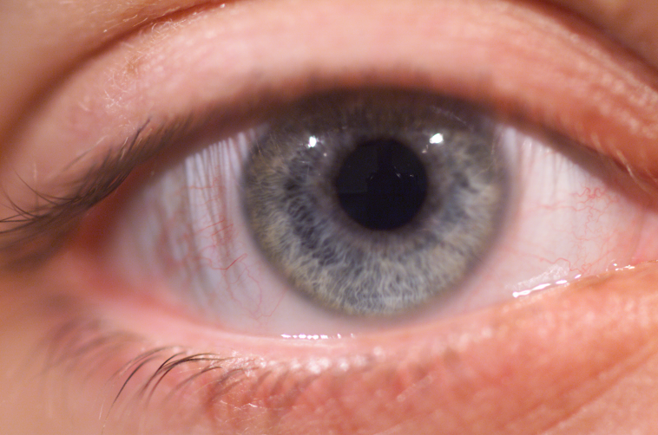
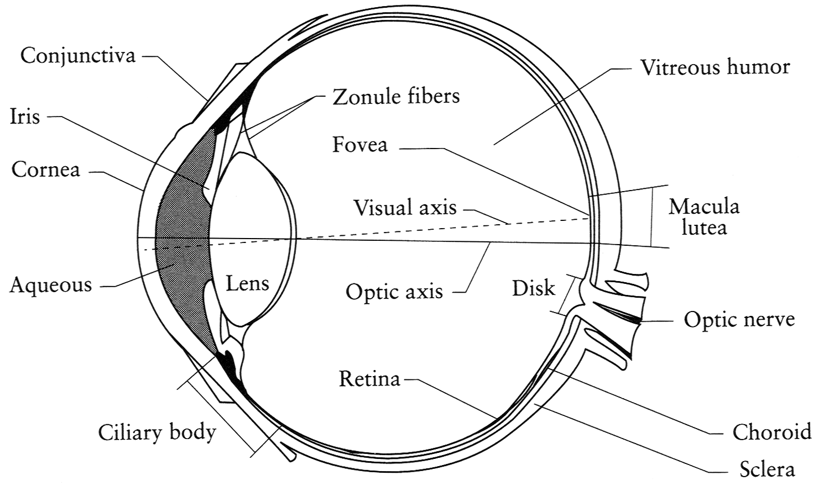
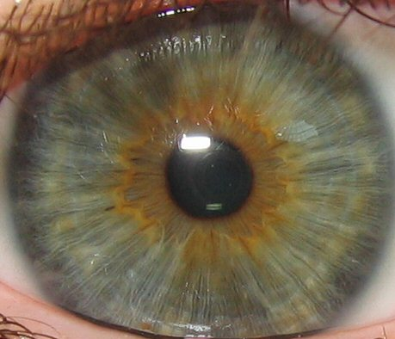
Our Eyes
Iris
Pupil
Sclera
Cornea
Index of refraction: cornea 1.376, aqueous 1.336, lens 1.406-1.386
Iris is the diaphragm that changes the aperture (pupil)
Retina is the sensor where the fovea has the highest resolution

Slide 4
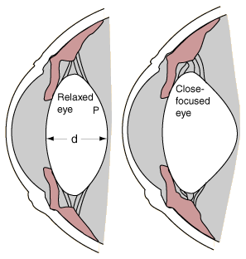
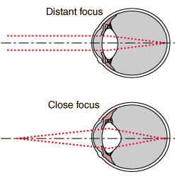
Accommodation
shorter focal length
Changes the focal length of the lens

Slide 5
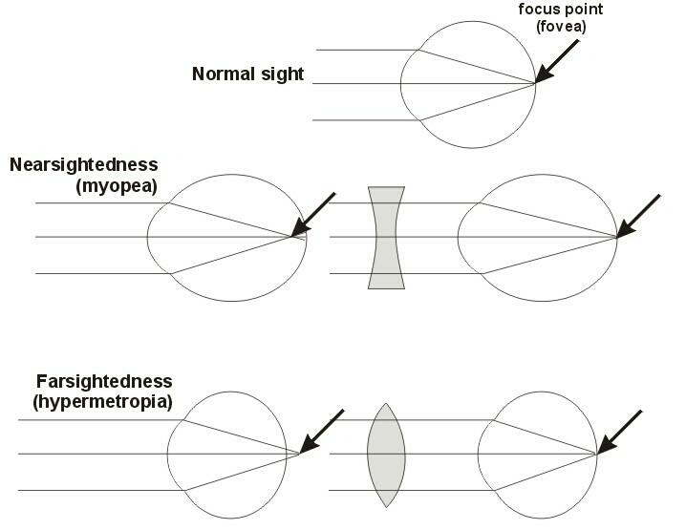
Myopia and Hyperopia
(myopia)

Slide 6
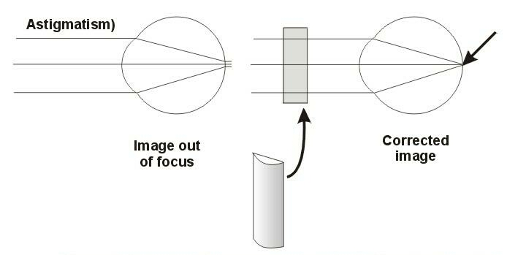
Astigmatism
The cornea is distorted causing images to be un-focused on the retina.

Slide 7
Blind Spot in Eye
Close your right eye and look directly at the “+”

Slide 8
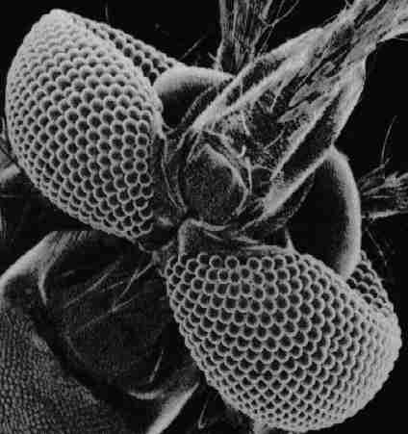
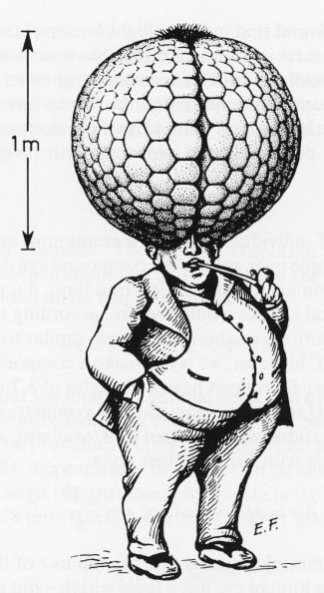
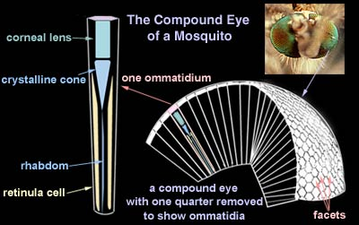
Eyes in Nature
Mosquito
http://ebiomedia.com/gall/eyes/octopus-insect.html
Mosquitos have microscopic vision, but to focus at large distances their would need to be 1 m!

Slide 9
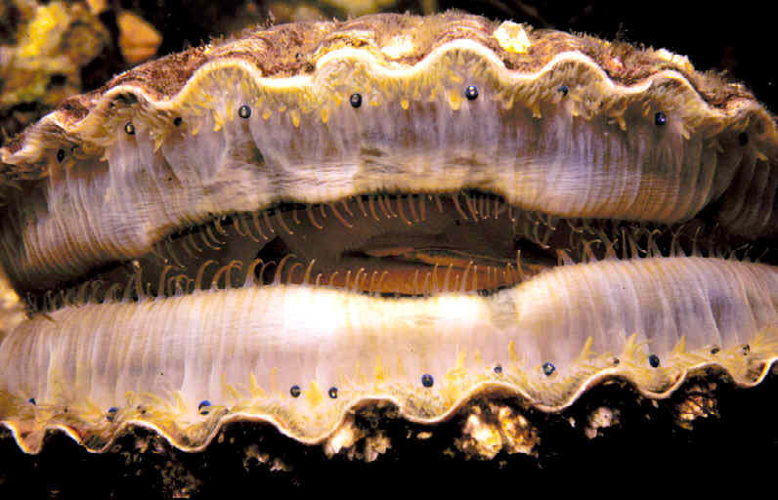
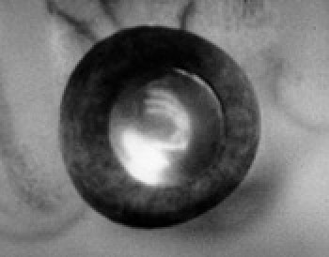
Curved Mirrors in Scallop Eyes
Telescopic Eye
(by Mike Land, Sussex)
… More in the last part of the course

Slide 10
Binary Images: Properties and Methods
Lecture #4

Slide 11


Binary Images
Images with only two values (0 or 1)
Simple to process and analyze
Very useful for industrial applications

Slide 12
Binary Images
Obtained from gray-level (or color) image g(x, y)
by Thresholding
Characteristic Function
    b(x, y) = 1 if g(x, y) < T
    0 if g(x, y) >= T
Topics Discussed:
    Geometric Properties
    Continuous and Discrete Binary Images
    Multiple Objects (Connectivity)
    Sequential (iterative) processing

Slide 13
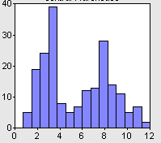
Selecting a Threshold
Bimodal Histogram
Threshold

Slide 14
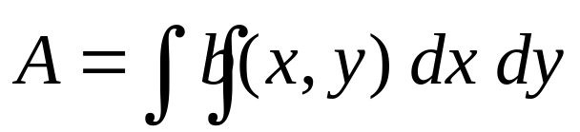
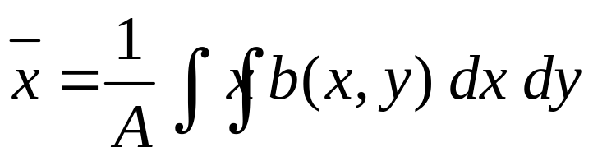
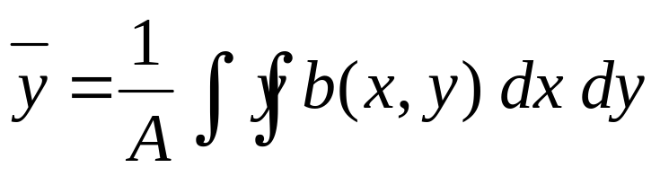
Geometric Properties of Binary Images
Assume:
b(x, y) is continuous
only one object
Area: Zeroth Moment
Position: Center of Mass (First Moment)
b(x, y)
y
x

Slide 15



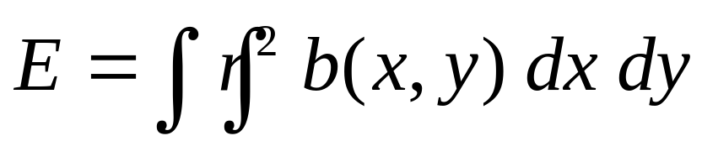
Geometric Properties of Binary Images
Orientation: Difficult to define!
  Axis of least second moment
  For mass: Axis of minimum inertia
b(x, y)
y
y
(x, y)
x
x
Minimize:

Slide 16
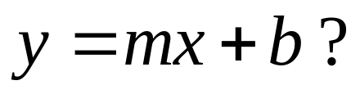
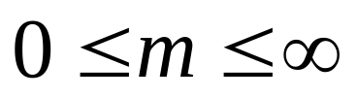
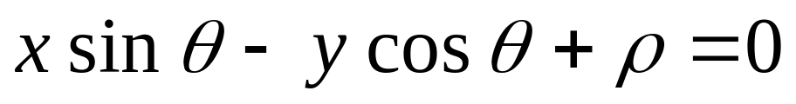
Which equation of line to use?
y
(x, y)
x
We use:
are finite

Slide 17
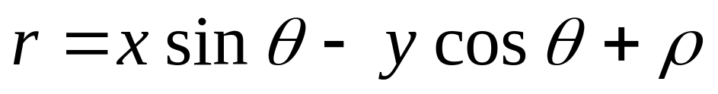
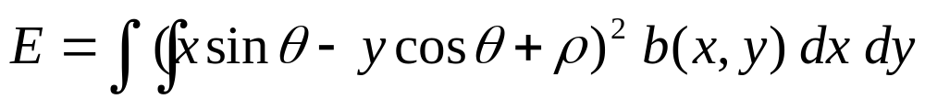
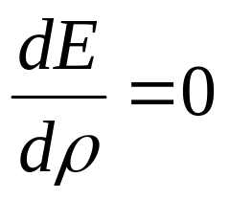
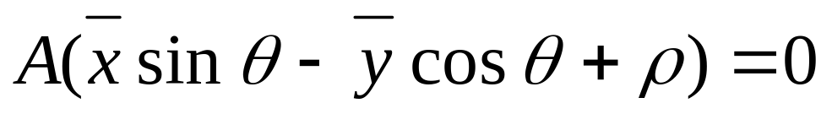
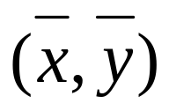
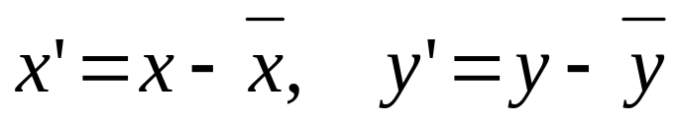
Minimizing Second Moment
Find and that minimize E for a given b(x,y)
We can show that:
So,
Using we get:
Note: Axis passes through the center
So, change co-ordinates:

Slide 18
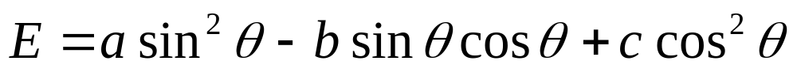
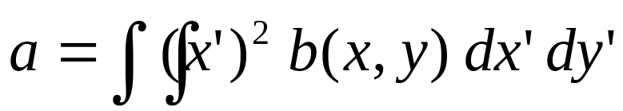
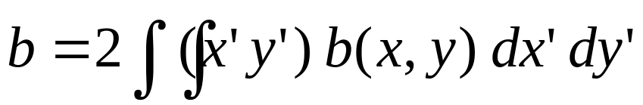
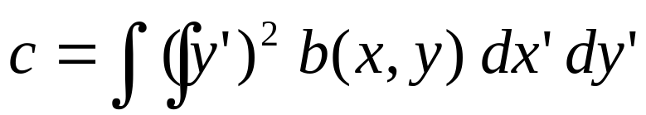
Minimizing Second Moment
We get:
where,
- second moments w.r.t
We are not done yet!!

Slide 19
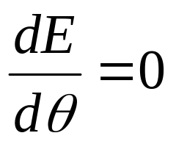
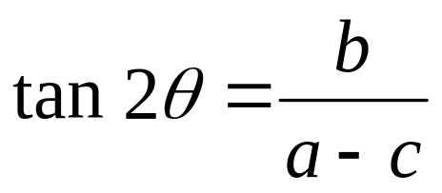
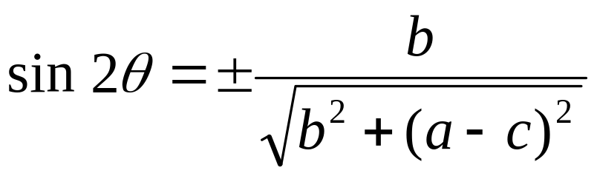
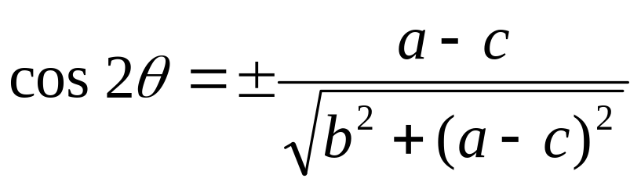
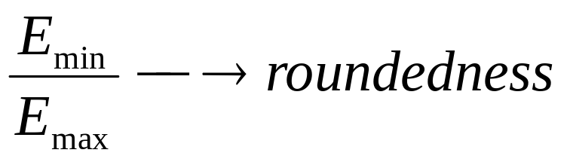
Minimizing Second Moment
Using we get:
Solutions with +ve sign must be used to minimize E. (Why?)

Slide 20
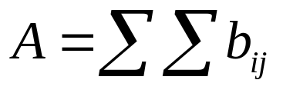
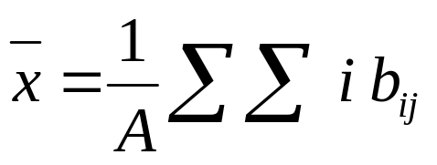
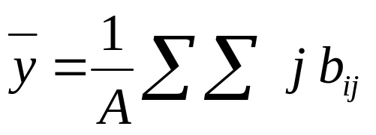
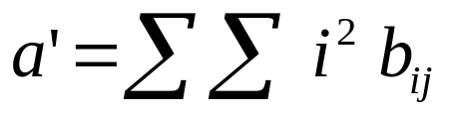
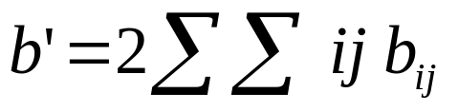
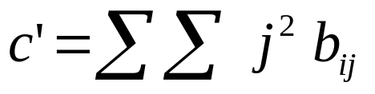
Discrete Binary Images
Assume:
b(x, y) is discrete
only one object
Area: Zeroth Moment
Position: Center of Mass (First Moment)
Second Moments:
j
b(i, j)
i
Note: a’,b’,c’ are defined w.r.t origin

Slide 21
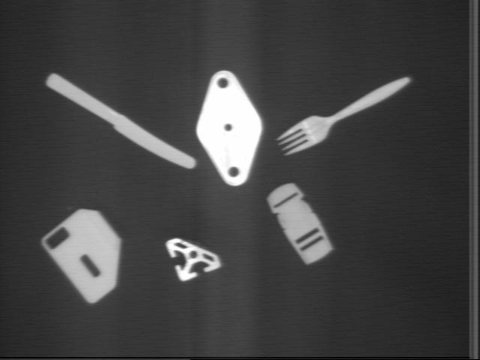
Multiple Objects
Need to SEGMENT image into separate COMPONENTS (regions)
- ( Non-trivial !)

Slide 22
Connected Components
Maximal Set of Connected points
Remember Graph Theory?
A & B are connected: Path exists
between A & B along which b(x,y) is
constant.
b(x, y)
A
y
B
x

Slide 23
Connected Component Labeling
Region Growing Algorithm:
Start with “SEED” point where b(x,y) = 1
Assign LABEL to seed point
Assign SAME LABEL to its Neighbors with b(x,y) = 1
(d) Assign SAME LABEL to Neighbors of Neighbors
Terminates when a component is completely labeled.
Then, pick another UNLABELED seed point.

Slide 24
What do we mean by Neighbors?
Connectedness:
4-connectedness
8-connectedness
Neither is perfect!

Slide 25
What do we mean by Neighbors?
Jordan’s Curve Theorem:
Closed Curve → 2 connected regions
Consider:
A
B
(4-C)
(8-C)
0
1
0
B1
O1
B1
B
O
B
1
0
1
O2
B2
O3
O
B
O
0
1
0
B1
O4
B1
B
O
B
Hole without
Closed curve!
Connected
Backgrounds
with closed
Ring!

Slide 26
Solution to Neighborhood Problem
Introduce Asymmetry
Using (b)
(a)
OR
(b)
0
1
0
B
O1
B
Two separate
Line Segments
1
0
1
O1
B
O2
0
1
0
B
O2
B

Slide 27
Hexagonal Tessellation
Asymmetry makes a SQUARE grid like HEXAGONAL grid

Slide 28
Sequential Labeling Algorithm
D
B
C
A
Raster Scan
Note: We want to label A.
B, C, D are already labeled.

Slide 29
Sequential Labeling Algorithm
0
0
X
X
→
label(A) = new label
→
label(A) = “background”
0
1
X
0
D
X
0
0
→
label(A) = label(D)
→
label(A) = label(C)
X
1
C
1
0
B
0
B
→
label(A) = label(B)
→
If
label(B) = label(C)
then,
label(A) = label(B)
0
1
C
1

Slide 30
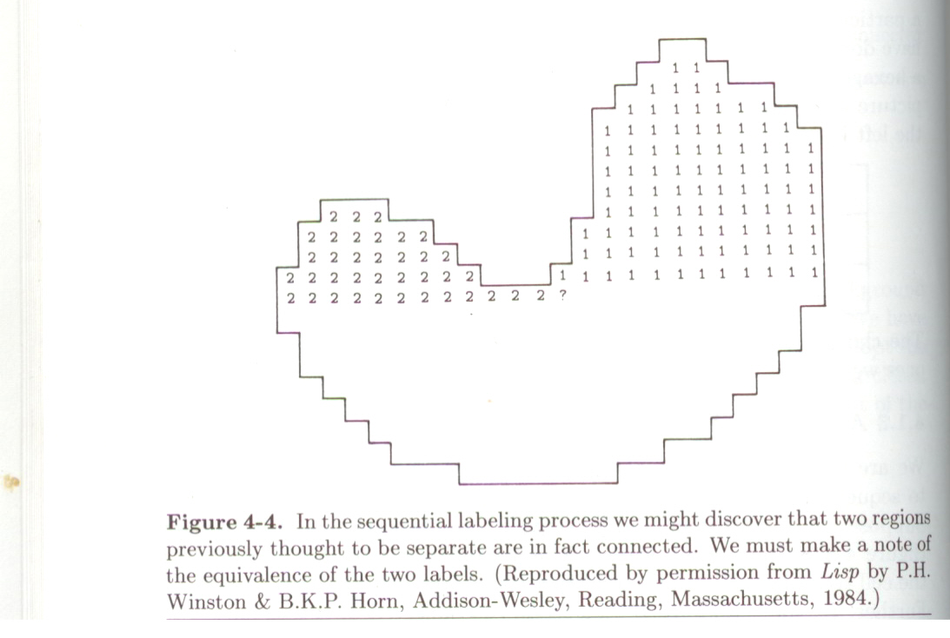
Sequential Labeling Algorithm
0
B
→
What if label(B) not equal to label(C)?
C
1
?

Slide 31
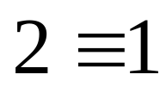
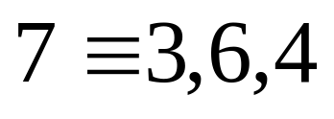

Sequential Labeling Algorithm
0
B
→
What if label(B) not equal to label(C)?
C
1
Solution:
Let: label(A) = label(B) = 2
Create EQUIVALENCE TABLE
Resolve Equivalence in Second Pass

Slide 32
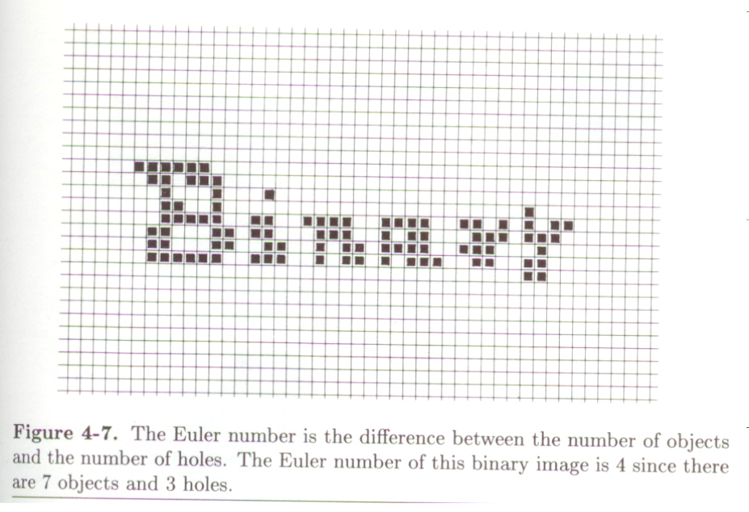
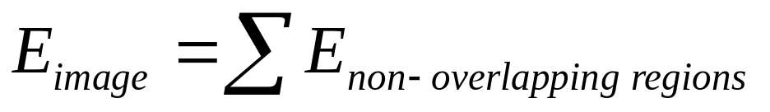
Morphological Operations
Euler Number
Number of Bodies (B) – Number of Holes (H)
B : E = -1
i : E = 2
A : E = 0

Slide 33
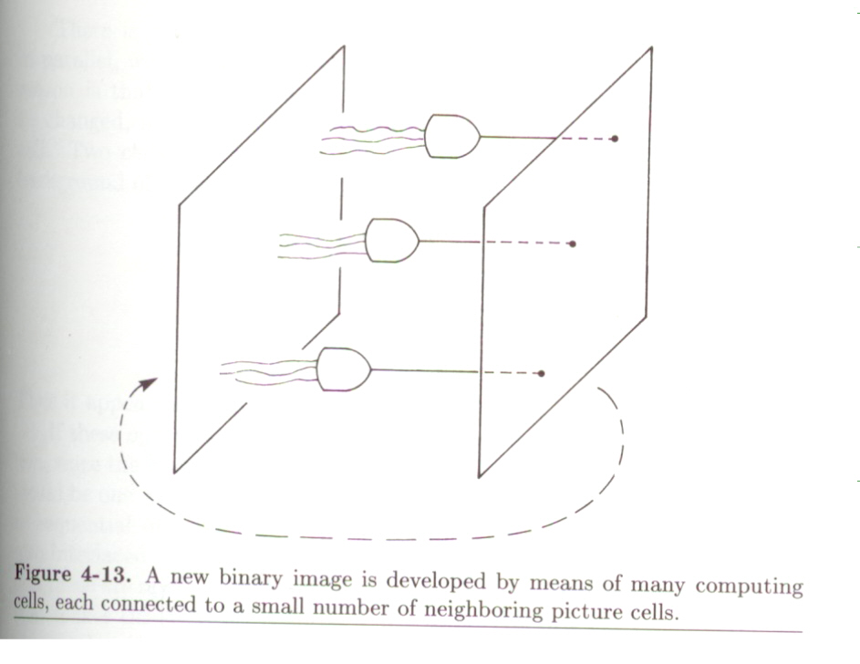
Iterative Modification
Allows us to incrementally change image
Example:
Etch (thin) object to produce SKELETON
Conservative Operations:
    Do not change the Euler number of image.
0
0
0
0
→
New Body!
Euler Differential = +1
0
0
0
0
1
0
0
0
0
0
E=1
E=0

Slide 34
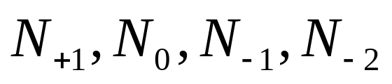
Euler Differential E*
Note: If E* = +1, for center pixel, 0 → 1
If E* = -1, for center pixel, 1 → 0
Each pixel has 64 neighborhoods.
We want to find Neighborhoods with E* = 0
Only 5 different sets of neighborhoods possible
1
1
1
1
1
1
E* = +1
0
0
1
1
1
0
1
0
0
0
0
1
1
1
0
1
0
0
0
1
0
0
1
0
E* = +1
E* = 0
E* = -1
E* = -2

Slide 35

Problem with Parallel Implementation
0
0
0
0
0
0
0
0
0
1
1
0
→
0
0
0
0
0
0
0
0
0
0
0
0
Solution: Use Interlaced Subfields
No two neighbors have the same label
Apply parallel operations to ONE subfield
at a time
1 | 2 | 3 | 1 | 2 | 3
2 | 3 | 1 | 2 | 3 | 1
3 | 1 | 2 | 3 | 1 | 2
1 | 2 | 3 | 1 | 2 | 3
2 | 3 | 1 | 2 | 3 | 1
3 | 1 | 2 | 3 | 1 | 2

Slide 36
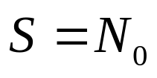




Notation for Iterative Modification
Specify Neighborhood Set, S, for which the same action must be taken
For example:
Consider pixel (i, j):
16 Boolean
Functions

Slide 37

Finding Skeletons
Use (Zero Euler Differential Set)
Use 5th Column in the Boolean Functions Table
Thinning without changing Euler Number!
Other Tricks:
* Expanding: Thinning the Background
* Noise Removal: Thin and Expand

Slide 38

Finding Skeletons
Use (Zero Euler Differential Set)
Use 5th Column in the Boolean Functions Table
Thinning without changing Euler Number!

Slide 39
Announcements
Homework 1 is due on Thursday in class.
Homework 2 will be out on Thursday.
Start homeworks early.
Post questions on bboard.

Slide 40
Next Two Classes
1D Signal and 2D Image Processing
Horn, Chapter 6

