Slide 1
Computer Vision
Spring 2006 15-385,-685
Instructor: S. Narasimhan
Wean 5403
T-R 3:00pm – 4:20pm

Slide 2
Boundary Detection:
Hough Transform
Lecture #9
Reading: Computer Vision (Ballard and Brown): Chapter 4
“Use of the Hough Transform to detect lines and curves in pictures”, Comm. ACM 15, 1, January 1972 (pgs 112-115)

Slide 3
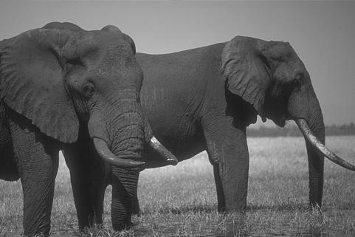
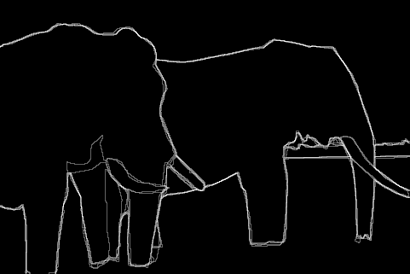
Boundaries of Objects
Marked by many users
http://www.eecs.berkeley.edu/Research/Projects/CS/vision/grouping/segbench/bench/html/images.html

Slide 4
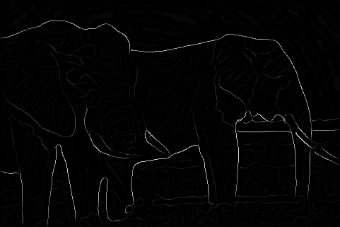
Boundaries of Objects from Edges
Brightness Gradient (Edge detection)
Missing edge continuity, many spurious edges

Slide 5
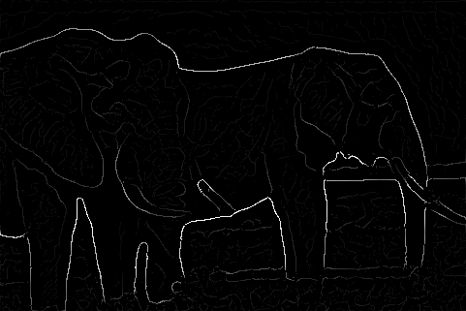
Boundaries of Objects from Edges
Multi-scale Brightness Gradient
But, low strength edges may be very important

Slide 6
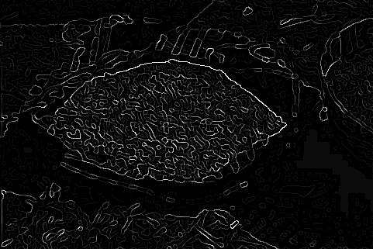
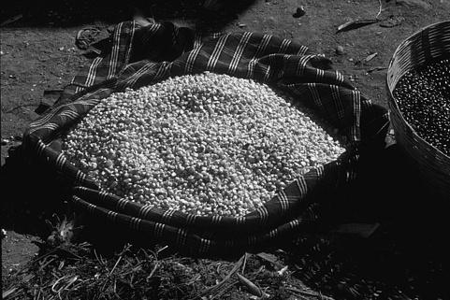
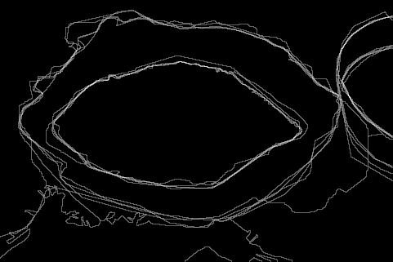
Boundaries of Objects from Edges
Machine Edge Detection
Image
Human Boundary Marking

Slide 7
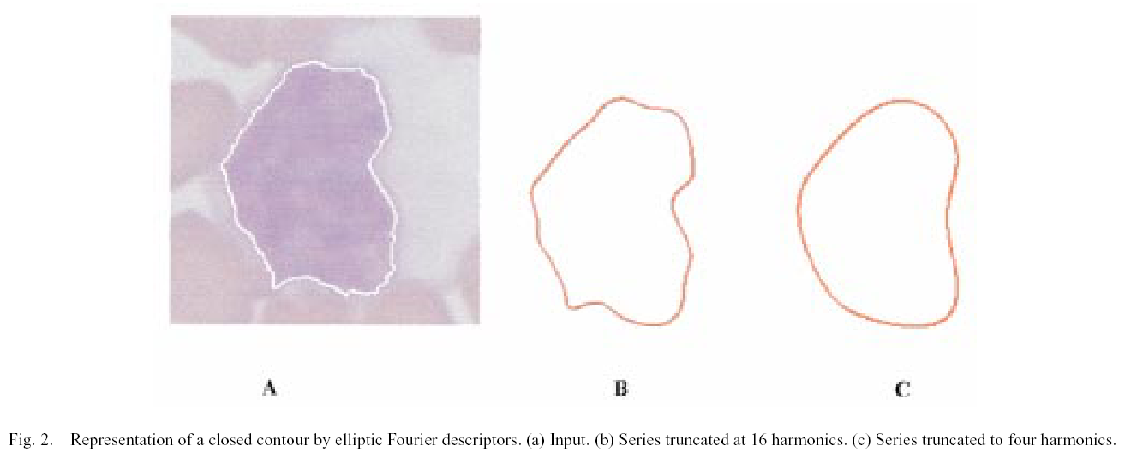
Boundaries in Medical Imaging
Detection of cancerous regions.
[Foran, Comaniciu, Meer, Goodell, 00]

Slide 8
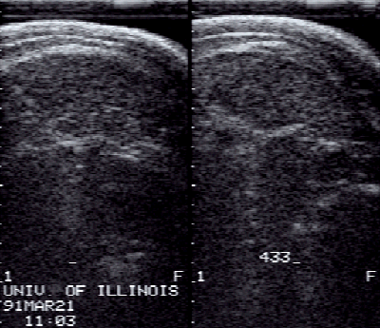
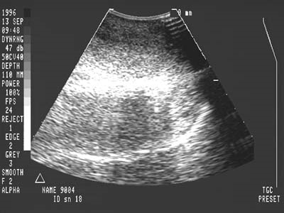
Boundaries in Ultrasound Images
Hard to detect in the presence of large amount of speckle noise

Slide 9
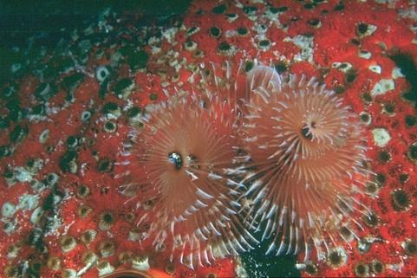
Boundaries of Objects
Sometimes hard even for humans!

Slide 10
Topics
Preprocessing Edge Images
Edge Tracking Methods
Fitting Lines and Curves to Edges
The Hough Transform

Slide 11
Preprocessing Edge Images
Edge detection
and Thresholding
Image
Noisy edge image
Incomplete boundaries
Shrink and Expand
Thinning

Slide 12
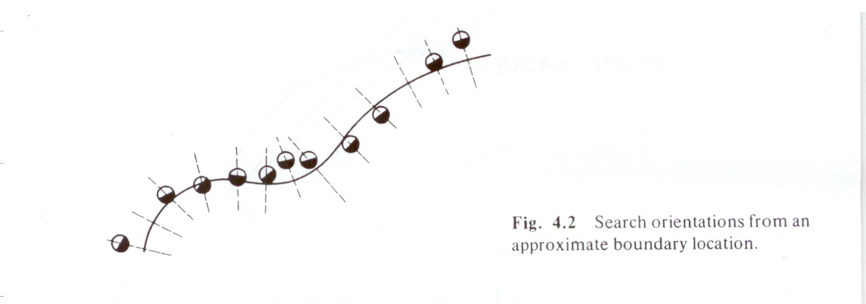
Edge Tracking Methods
Adjusting a priori Boundaries:
Given: Approximate Location of Boundary
Task: Find Accurate Location of Boundary
Search for STRONG EDGES along normals to approximate boundary.
Fit curve (eg., polynomials) to strong edges.

Slide 13
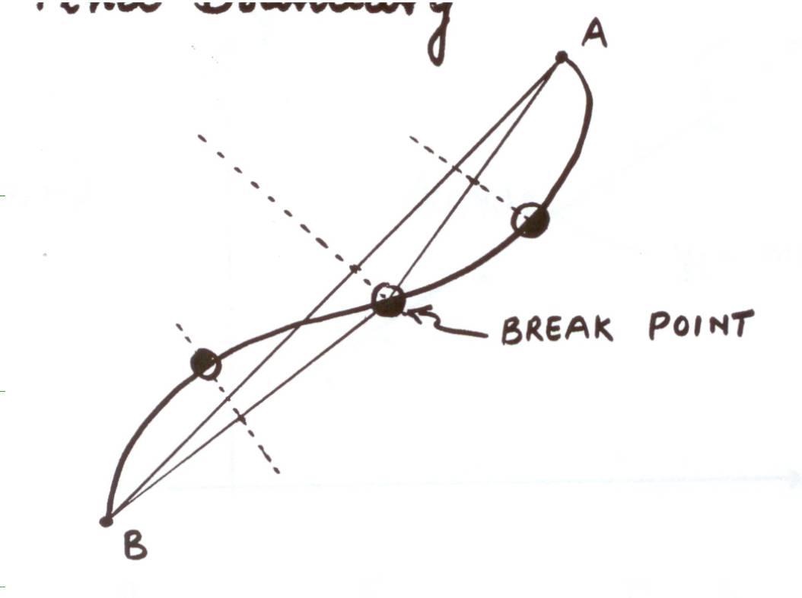
Edge Tracking Methods
Divide and Conquer:
Given: Boundary lies between points A and B
Task: Find Boundary
Connect A and B with Line
Find strongest edge along line bisector
Use edge point as break point
Repeat

Slide 14
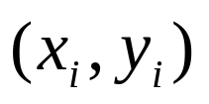



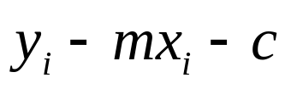
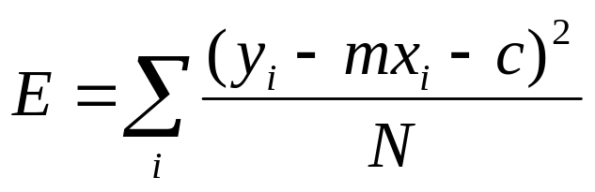

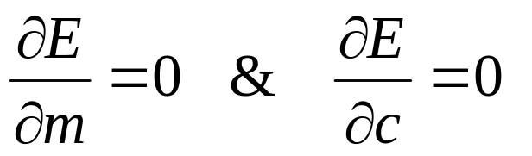
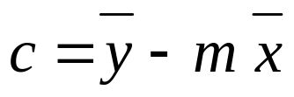
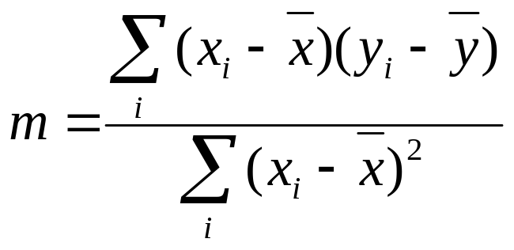
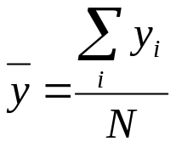
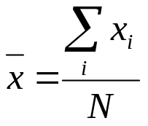
Fitting Lines to Edges (Least Squares)
Given: Many pairs
Find: Parameters
Minimize: Average square distance:
Using:
Note:

Slide 15
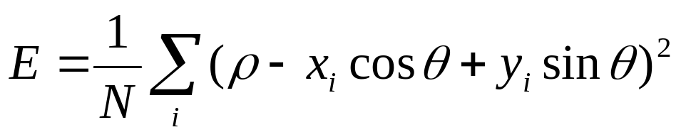
Problem with Parameterization
Line that minimizes E!!
Solution: Use a different parameterization
(same as the one we used in computing Minimum Moment of Inertia)
Note: Error E must be formulated carefully!

Slide 16
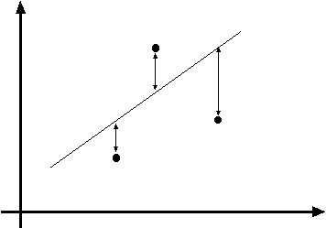
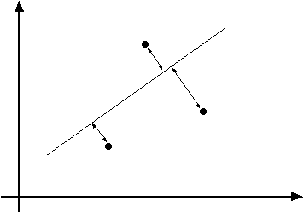
Line fitting can be max.
likelihood - but choice of
model is important
Notes:
This is figure 15.5; I didn’t have the energy to write the algebra around that figure out on a slide,
but the point is well worth making.

Slide 17
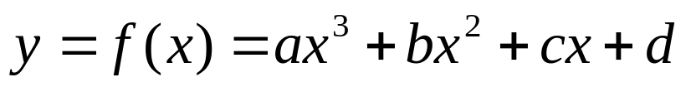
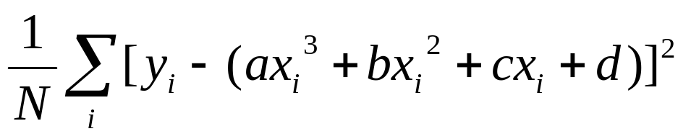
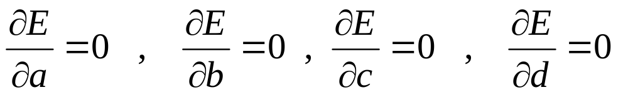

Curve Fitting
Find Polynomial:
that best fits the given points
Minimize:
Using:
Note: is LINEAR in the parameters (a, b, c, d)

Slide 18
Line Grouping Problem
Slide credit: David Jacobs

Slide 19
This is difficult because of:
Extraneous data: clutter or multiple models
  We do not know what is part of the model?
  Can we pull out models with a few parts from much larger amounts of background clutter?
Missing data: only some parts of model are present
Noise
Cost:
  It is not feasible to check all combinations of features by fitting a model to each possible subset

Slide 20
Hough Transform
Elegant method for direct object recognition
    Edges need not be connected
    Complete object need not be visible
    Key Idea: Edges VOTE for the possible model

Slide 21
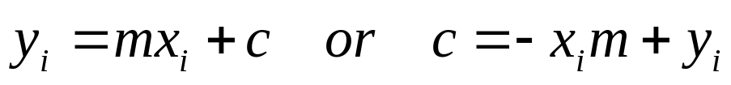


Image and Parameter Spaces
Equation of Line:
Find:
Consider point:
Image Space
Parameter space also called Hough Space
Parameter Space

Slide 22



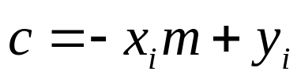
Line Detection by Hough Transform
Algorithm:
Quantize Parameter Space
Create Accumulator Array
Set
For each image edge increment:
If lies on the line:
Find local maxima in
Parameter Space
 | 1 |  |  |  |  |  | 1
 |  | 1 |  |  |  | 1
 |  |  | 1 |  | 1
 |  |  |  | 2
 |  |  | 1 |  | 1
 |  | 1 |  |  |  | 1
 | 1 |  |  |  |  |  | 1

Slide 23


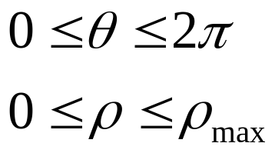



Better Parameterization
NOTE:
Large Accumulator
More memory and computations
Improvement:
Line equation:
Here
Given points find
(Finite Accumulator Array Size)
Image Space
?
Hough Space Sinusoid
Hough Space

Slide 24
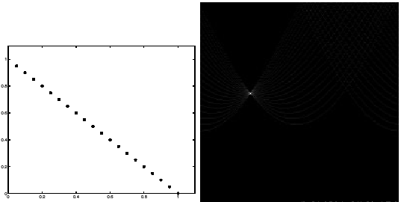
Image space
Votes
Horizontal axis is θ, vertical is rho.
Notes:
Figure 15.1, top half. Note that most points in the vote array are very dark, because they
get only one vote.

Slide 25
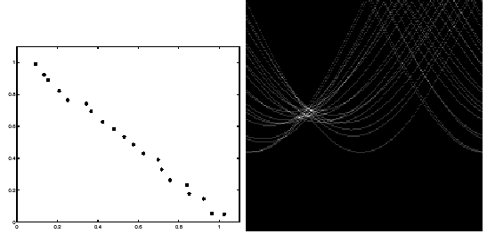
Image space
votes
Notes:
This is 15.1 lower half

Slide 26
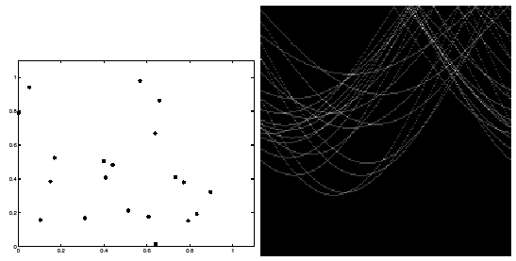
Notes:
15.2; main point is that lots of noise can lead to large peaks in the array

Slide 27
Mechanics of the Hough transform
Difficulties
  how big should the cells be? (too big, and we merge quite different lines; too small, and noise causes lines to be missed)
How many lines?
  Count the peaks in the Hough array
  Treat adjacent peaks as a single peak
Which points belong to each line?
  Search for points close to the line
  Solve again for line and iterate

Slide 28
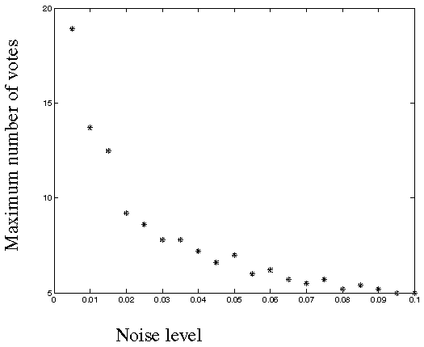
Fewer votes land in a single bin when noise increases.
Notes:
This is the number of votes that the real line of 20 points gets with increasing noise (figure15.3)

Slide 29
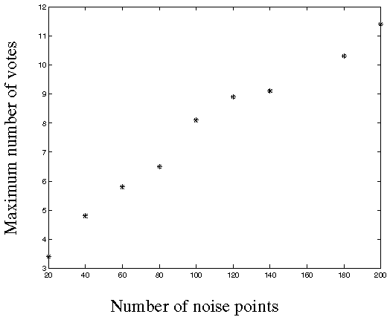
Adding more clutter increases number of bins with false peaks.
Notes:
Figure 15.4; as the noise increases in a picture without a line, the number of points in the max cell goes
up, too

Slide 30
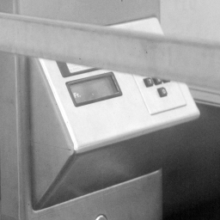
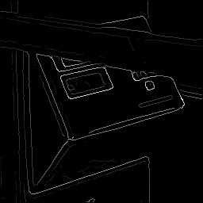
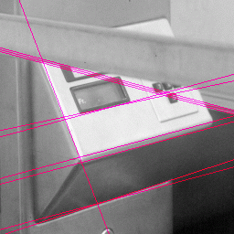

Real World Example
Original
Edge Detection
Found Lines
Parameter Space

Slide 31
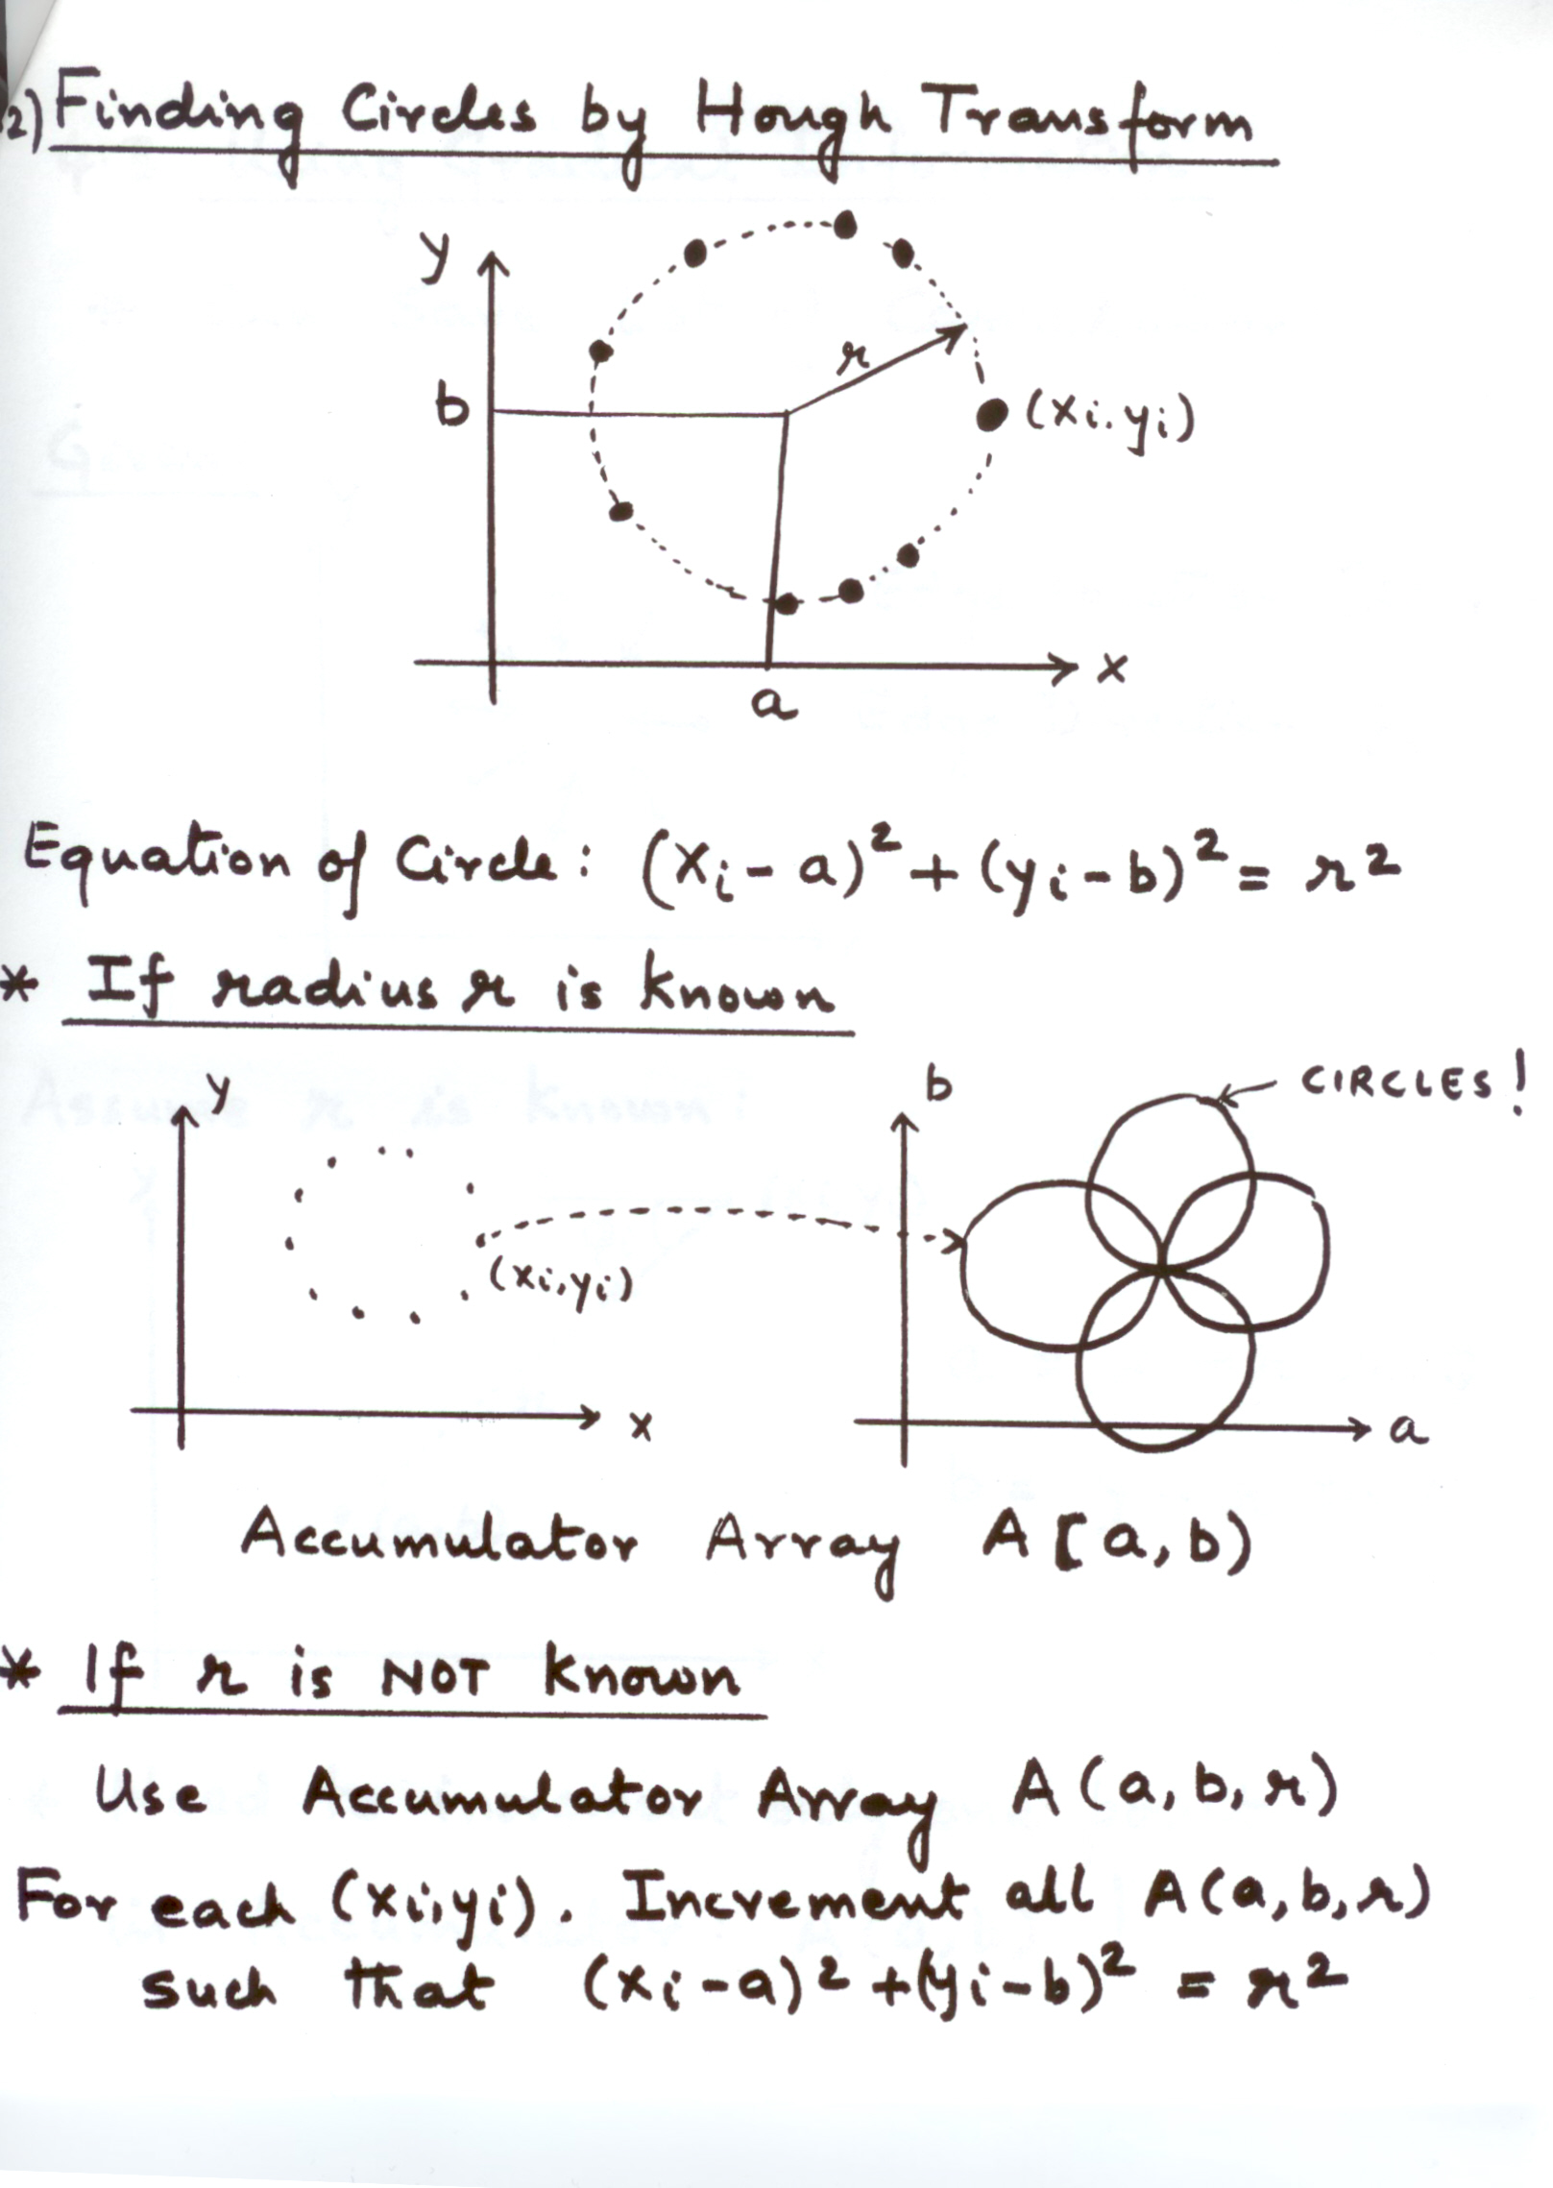
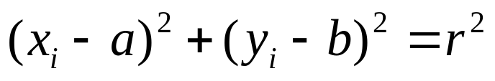

Finding Circles by Hough Transform
Equation of Circle:
If radius is known:
(2D Hough Space)
Accumulator Array

Slide 32

Finding Circles by Hough Transform
Equation of Circle:
If radius is not known: 3D Hough Space!
Use Accumulator array
What is the surface in the hough space?

Slide 33
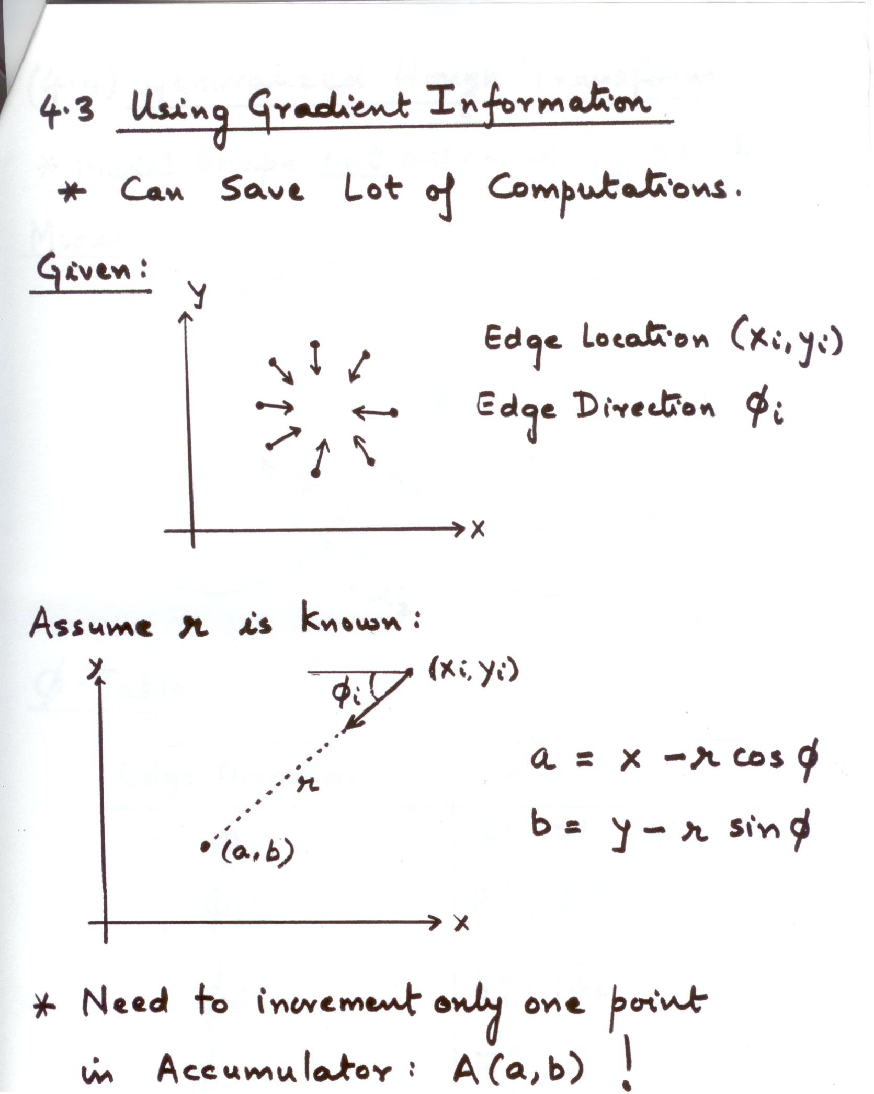

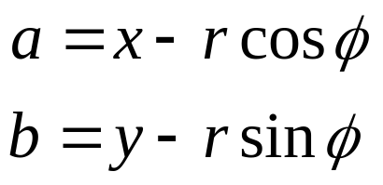
Using Gradient Information
Gradient information can save lot of computation:
Edge Location
Edge Direction
Assume radius is known:
Need to increment only one point in Accumulator!!

Slide 34
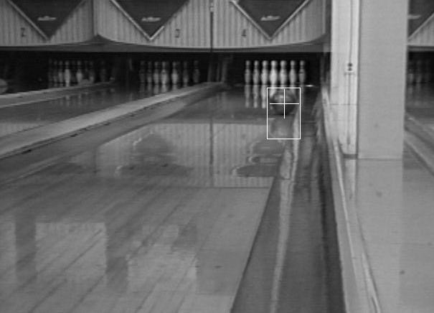
Real World Circle Examples
Crosshair indicates results of Hough transform,
bounding box found via motion differencing.

Slide 35
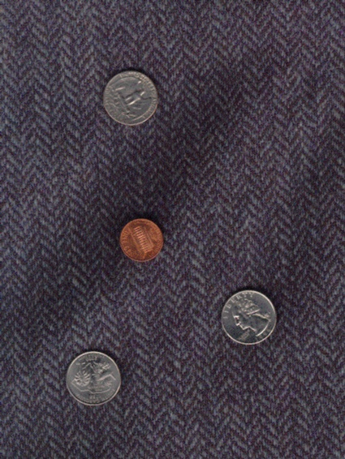
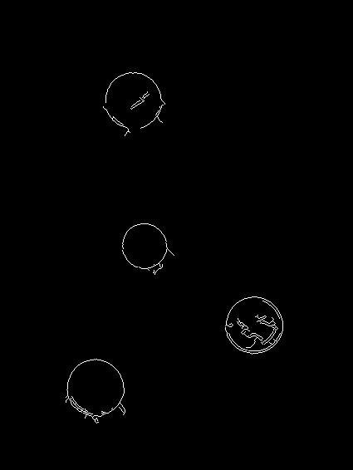
Finding Coins
Original
Edges (note noise)

Slide 36
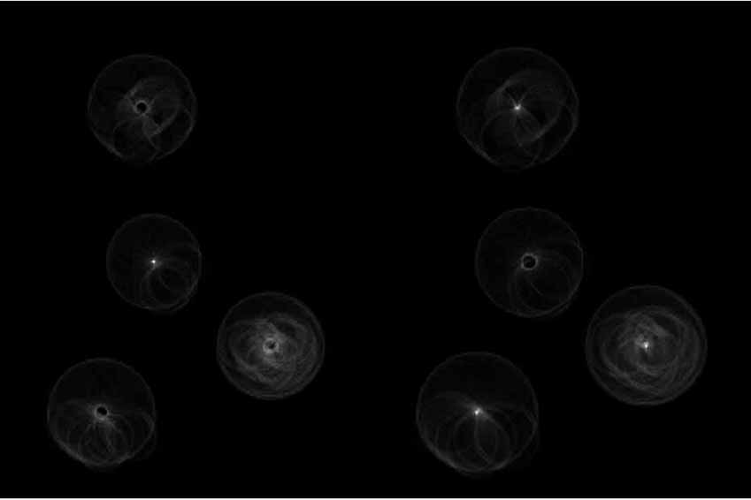
Finding Coins (Continued)
Penny
Quarters

Slide 37
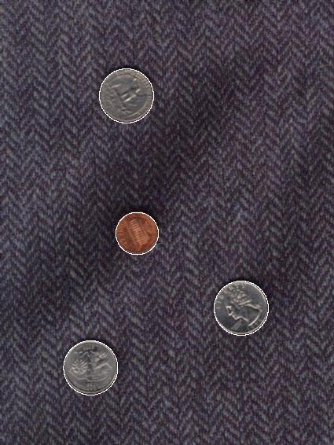
Finding Coins (Continued)
Note that because the quarters and penny are different sizes, a different Hough transform (with separate accumulators) was used for each circle size.
Coin finding sample images from: Vivek Kwatra

Slide 38
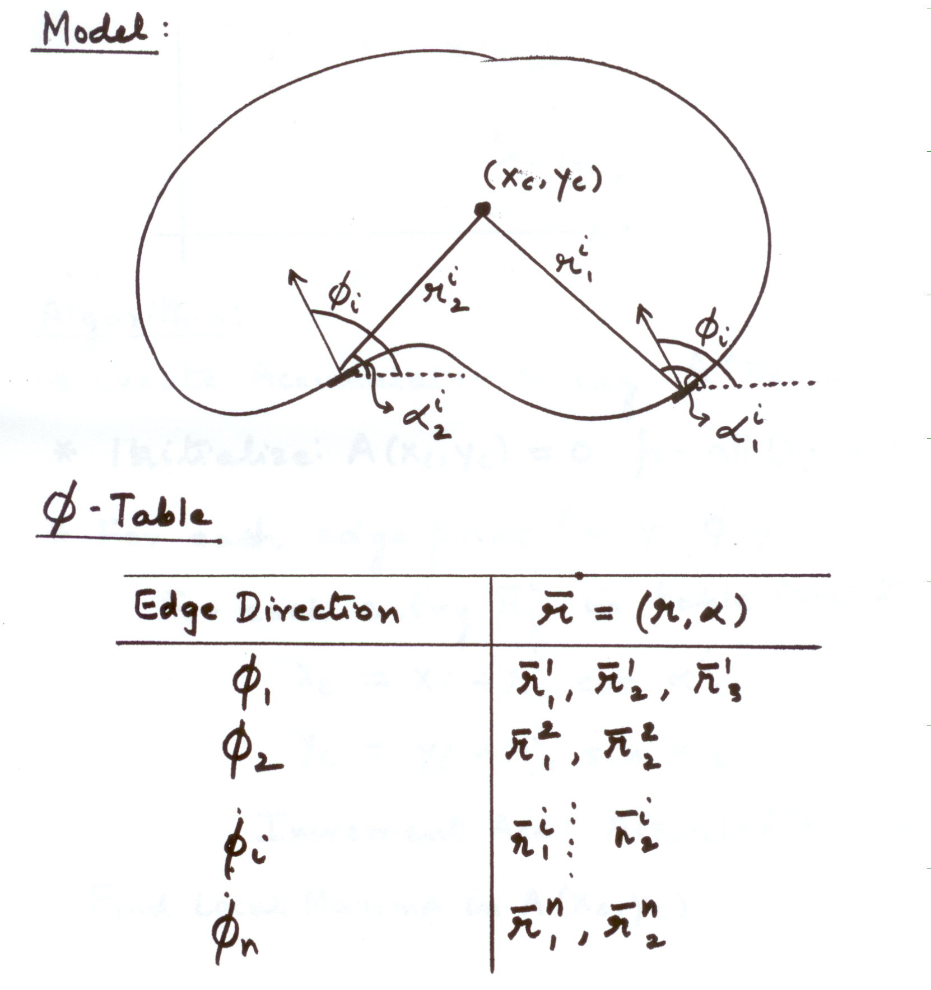
Generalized Hough Transform
Model Shape NOT described by equation

Slide 39
Generalized Hough Transform
Model Shape NOT described by equation

Slide 40
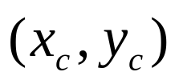
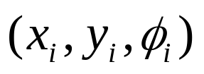





Generalized Hough Transform
Find Object Center given edges
Create Accumulator Array
Initialize:
For each edge point
For each entry in table, compute:
Increment Accumulator:
Find Local Maxima in

Slide 41


Slide 42
Hough Transform: Comments
Works on Disconnected Edges
Relatively insensitive to occlusion
Effective for simple shapes (lines, circles, etc)
Trade-off between work in Image Space and Parameter Space
Handling inaccurate edge locations:
    Increment Patch in Accumulator rather than a single point

Slide 43
Next Class
Lightness and Retinex.
Reading: Horn, Chapter 9.
Research webpages of Edward Adelson (MIT).
Google for illusions.

