Slide 1



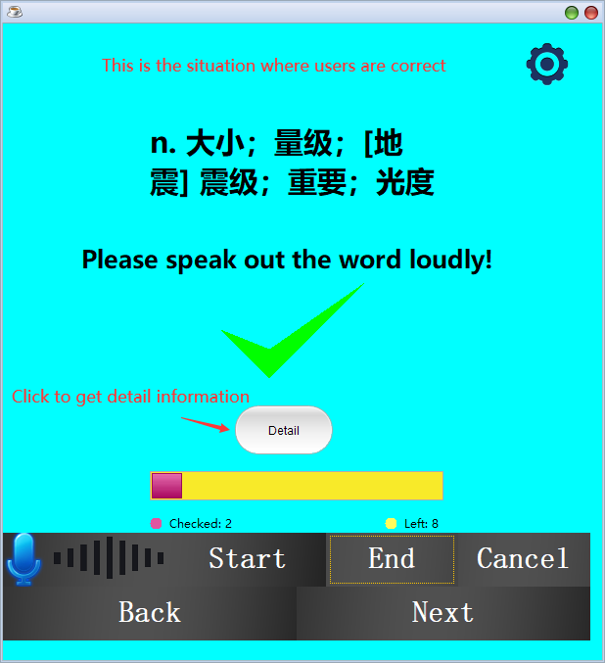
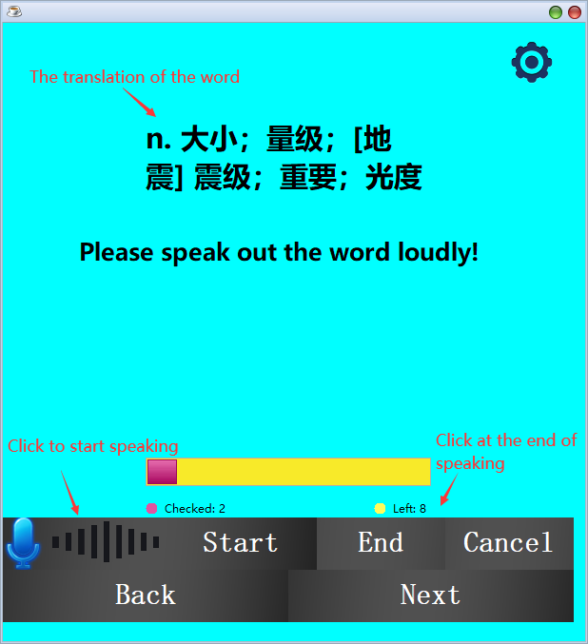
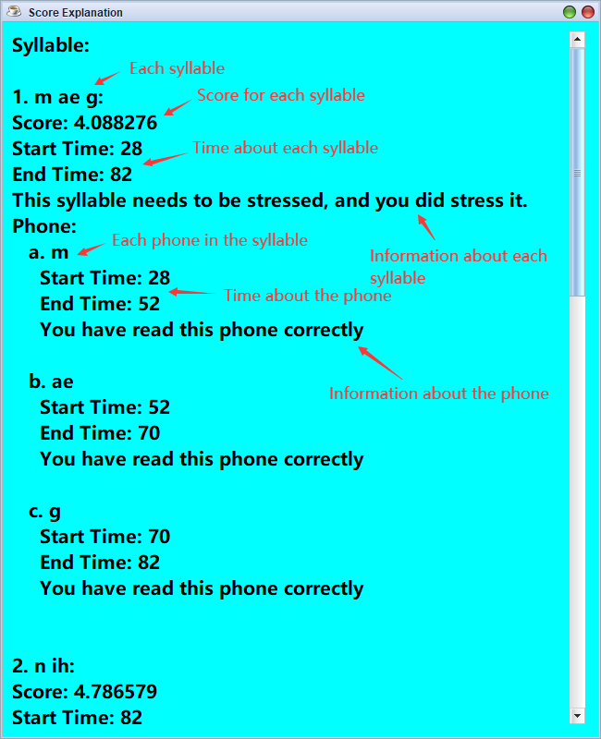
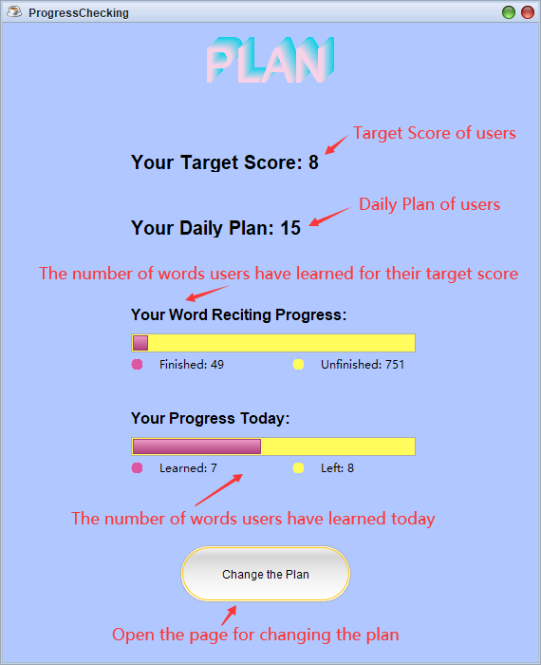
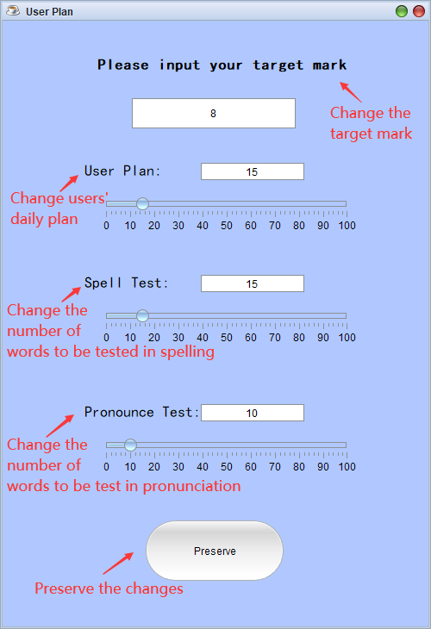
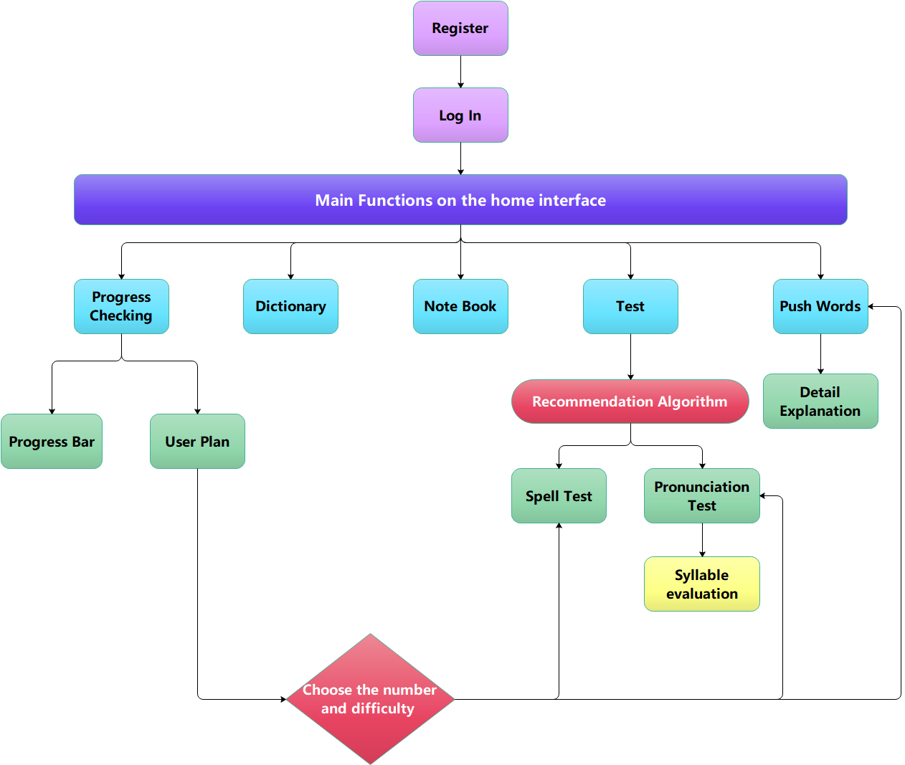
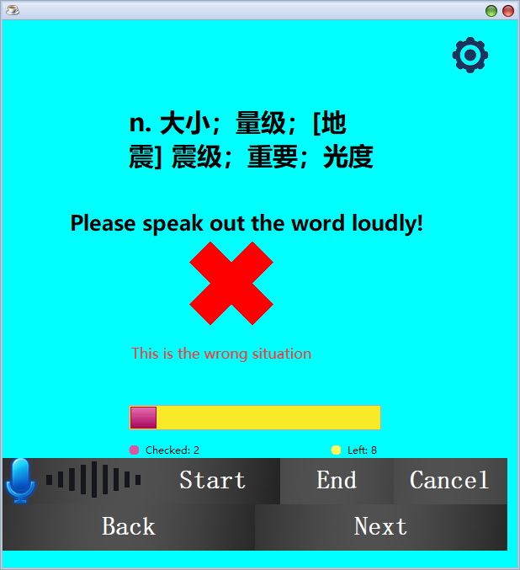
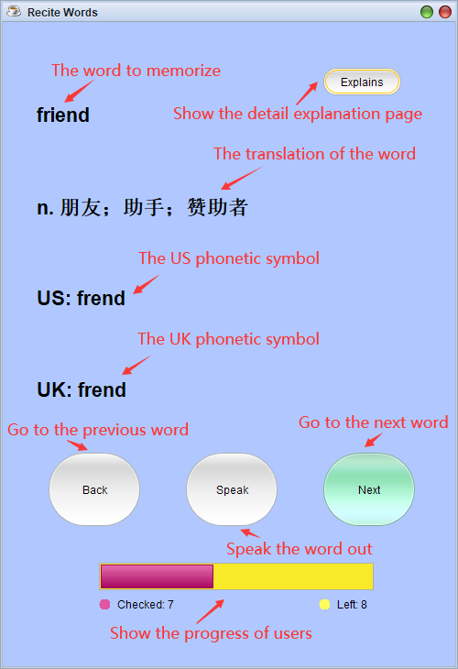
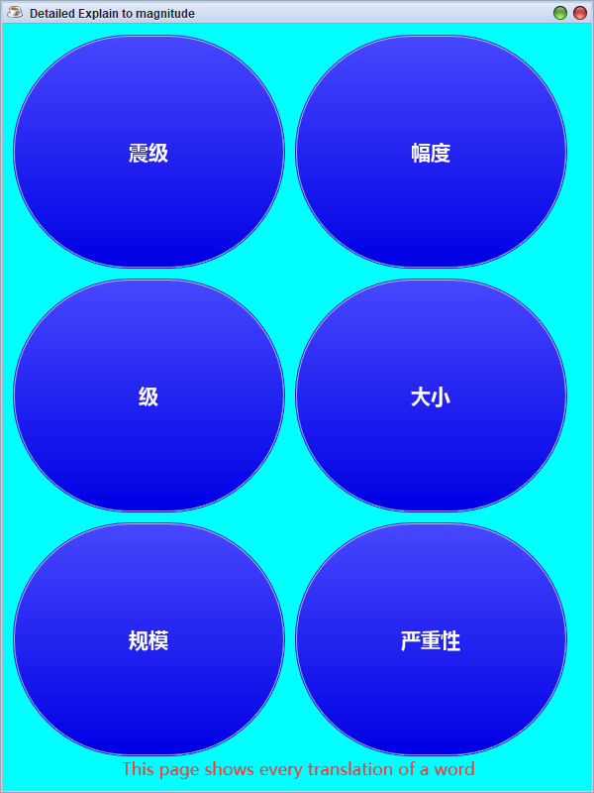
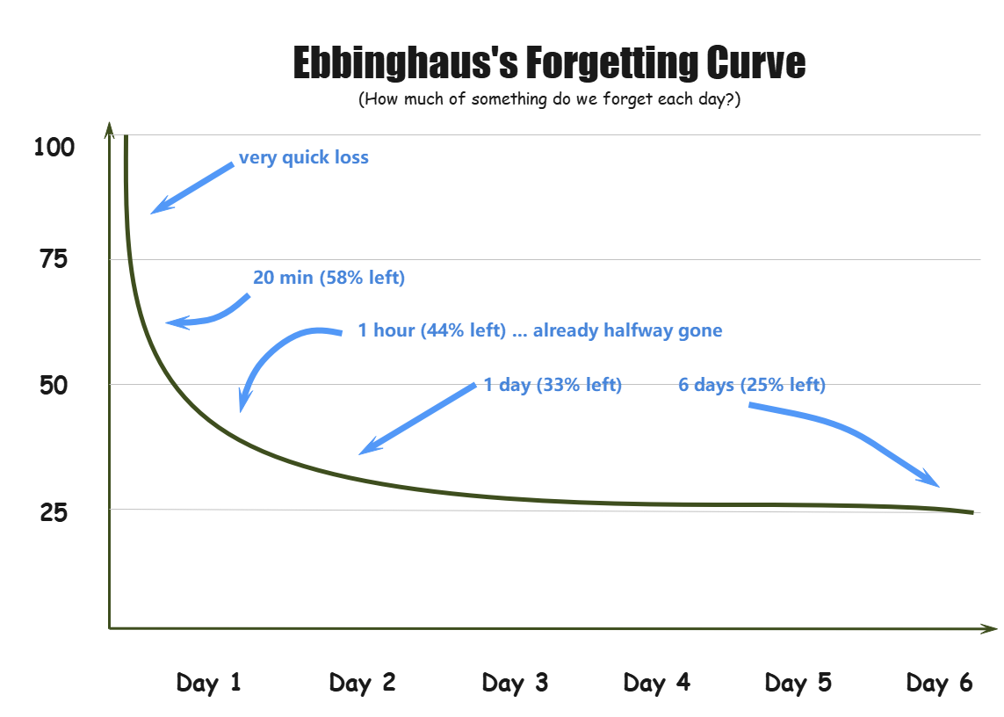
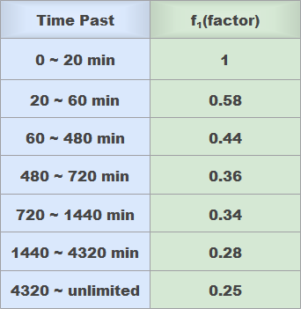
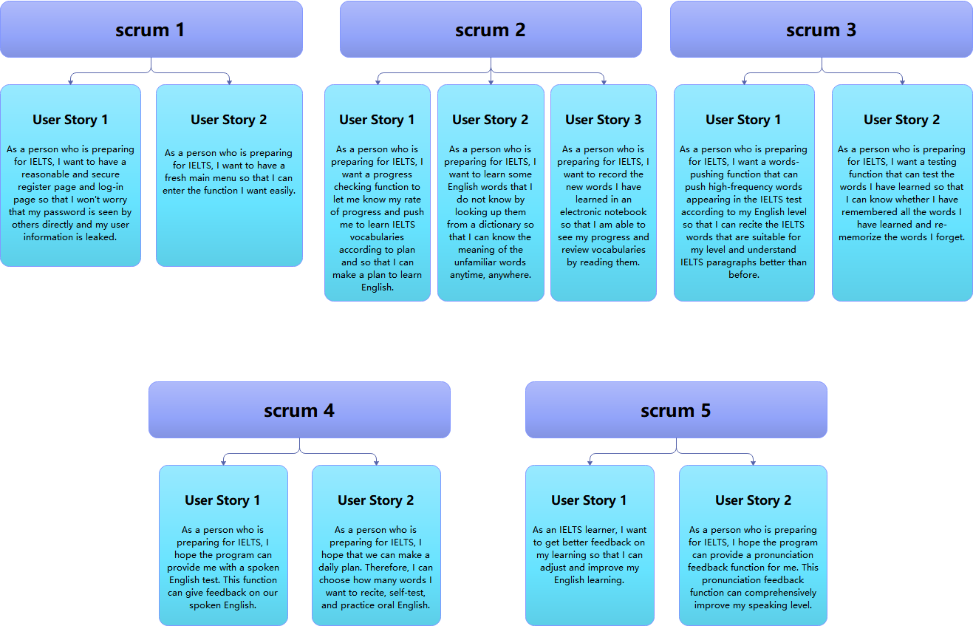
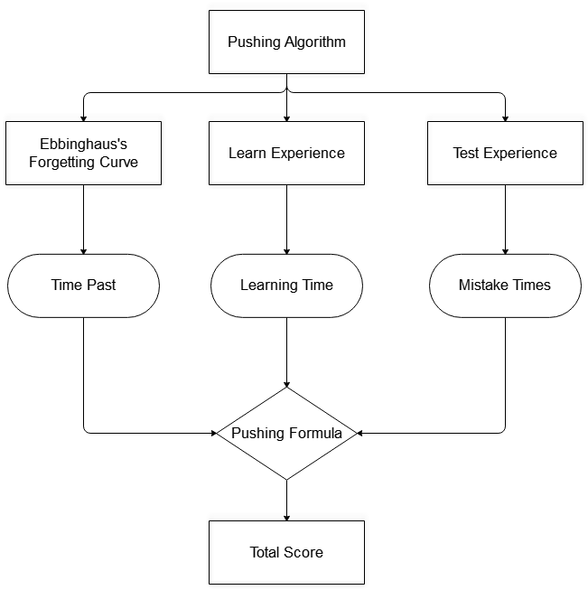
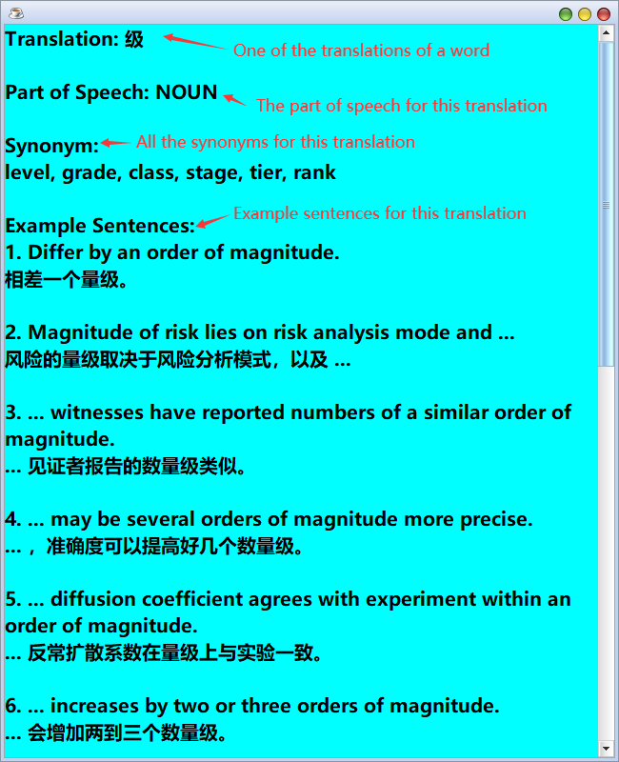
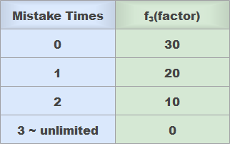
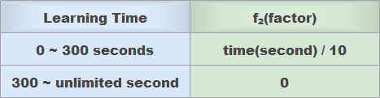
Woodpecker Vocabulary IELTS
Author: Wang Hewei, Ma Zixiao, Yang Dezheng, etc.
2021.2 -- 2021.7
Pronunciation Test
📋 Project overview
In this feature, users can see their target score, their daily plan, the number of words they have learned for their target score and the number of words they have learned today directly. Users can also open the page to change their plan including target score, daily plan and the number of words to be test in this feature.
Progress Check-In
The project we developed is an IELTS vocabulary memory software, which is a desktop software. The main users are students who want to learn English to improve their IELTS scores. This software provides a variety of functions to help users recite IELTS words to strengthen their memory of vocabulary, and test learning results of users; allow users to make learning plans and give learning feedback. Most importantlly, our software is presented in a beautiful, user-friendly form, in order for users to enjoy a good experience.
In this feature, users can see their target score, their daily plan, the number of words they have learned for their target score and the number of words they have learned today directly. Users can also open the page to change their plan including target score, daily plan and the number of words to be test in this feature.
Introduction of Functions
plan page
plan changing page
Word Push
Testing Words Recommendation Algorithm
This feature is push words for users to memorize and shows the translation, American and British phonetic transcription for each word. Users can click the “Speak” button to hear the pronunciation of each word and click the “Explanation” button to learn many parts of speech, synonyms and example sentences for every translation of each word.
This feature is push words for users to memorize and shows the translation, American and British phonetic transcription for each word. Users can click the “Speak” button to hear the pronunciation of each word and click the “Explanation” button to learn many parts of speech, synonyms and example sentences for every translation of each word.
For the date aspect, this algorithm references to Ebbinghaus Forgetting Curve and so each word’s factor of its score is calculated according to the curve.
For the learning time aspect, the algorithm references to the learning experience from students who are preparing for IELTS to calculate the score for each word. For the mistake times aspect, the algorithm references to the self testing experience and calculate the factor of each word’s score independently.
all translations of
a word
Our Development Plan
word frame
detail explanation for a
tranlation of a word
Links
Group Presentation:
https://share.weiyun.com/Uf6Hy6O4
Gitlab Address: (Require Login)
https://csgitlab.ucd.ie/comp2008j-group-17/

