Slide 1

Toward Universal
Representation
For Unseen
Action
Recognition

Slide 2
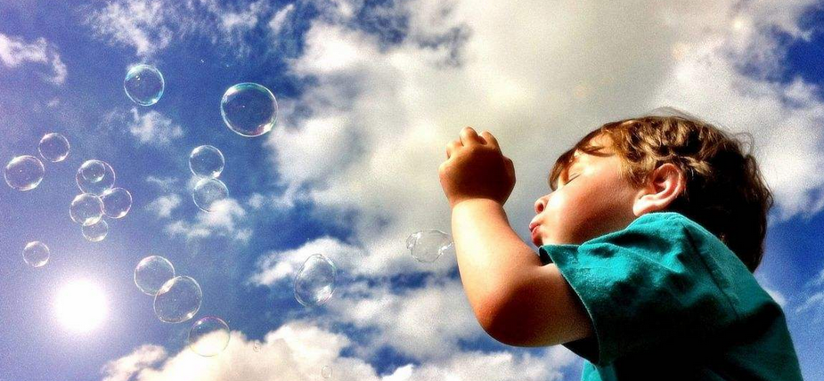
What it is ?
Unseen action recognition (UAR)
New Algorithm
A more efficiency to zero-shot recognition instead of innovation.

Slide 3
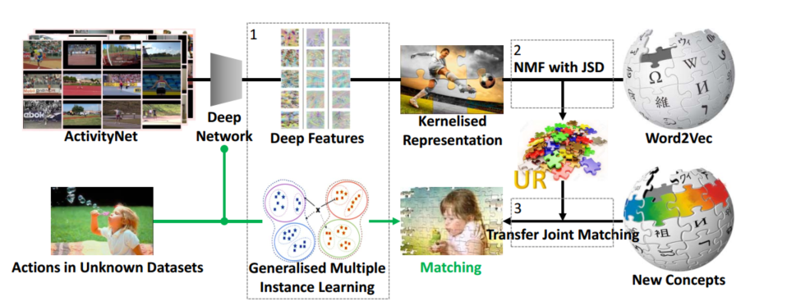
How ? – URL Algorithm
Intuitive impression
Notes:
Functions that can be compactly represented by a depth K architecture might require an exponential number pf computational elements to be represented by a depth K-1 architecture
Recurrent network convolution deep

Slide 4
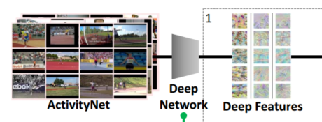
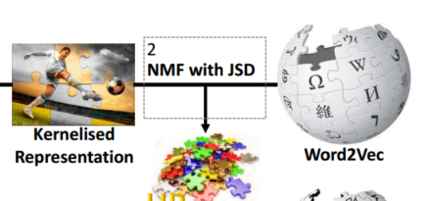
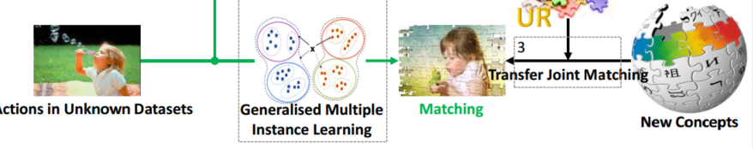
Exact representation
1.Extract deep features for each frame and summaries the video (GMIL) CROSS-DATASET
2.Preserve shared component with the label embedding to achieve UR(NMF with JSD)
3.New concept(action ) can be represented by UR and domain adaptation

Slide 5
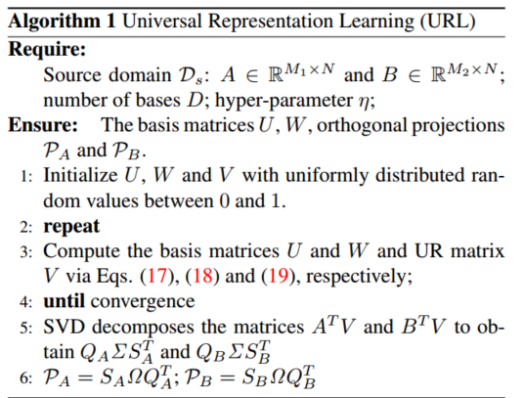
Mathematic

Slide 6
Conclusion
Make a big step toward the challenging Cross-Dataset Unseen Action Recognition with pipeline consisting of deep feature extraction ,Generative Multiple-Instance Learning ,Universal Representation , and Domain Adaptation .

