Slide 1
暑假以及近期工作
添加副标题

Slide 2
概要
1
CPU上的k-means
2
GPU上的k-means
3
对lsh的调研

Slide 3
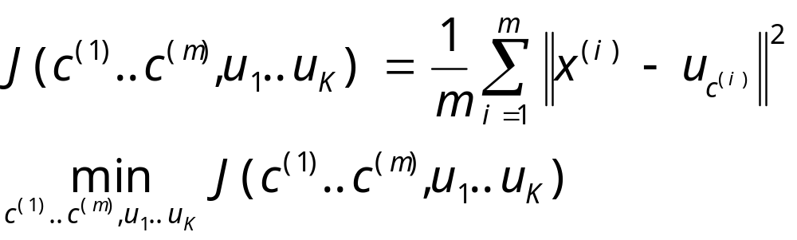
K-Means Objective
n: #features m: #vectors K: #clusters
x^{(i)}: the i^{th} vector
c^{(i)}: the index of cluster which x^{(i)} is assigned to
u_{j} : the j^{th} cluster centroid
Objective:

Slide 4
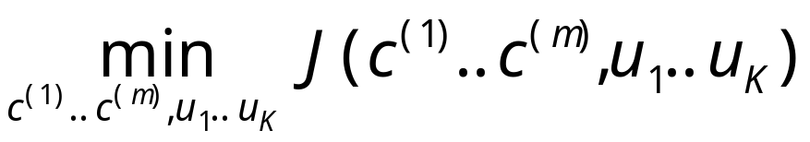
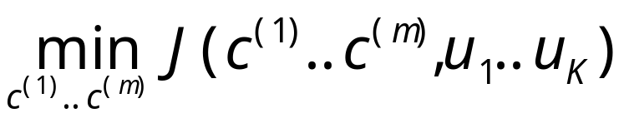
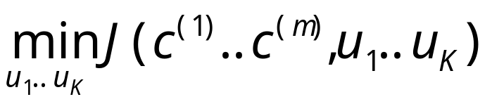
K-Means Method
Objective:
Step1: holding u₁..u_{k}
Step2: holding c⁽¹⁾..c^{(m)}

Slide 5
K-Means Framework
Some essential initialization
WHILE (true) {
update c⁽¹⁾..c^{(m)} (find closest centroid for every vector)
IF nothing modified THEN break while loop
update u₁..u_{K} (recompute every centroids)
}

Slide 6
Document Clustering
Preprocess IDF factor of every word
Pick highest n word as features (say n = 100000 in practice)
Process TF factor of every word in every article
Store TF*IDF vector as input data

Slide 7
Find Closest Centroid
Pseudo code:
for every x^{(i)}:
set old_idx = c^{(i)};
set mind = ||x^{(i)}, u_{old_idx}||²
for j = 1 to K:
if j == old_idx:
continue
set dis = ||x^{(i)}, u_{j}||²
if dis < mind:
mind = dis
idx[i] = j
can be process
parallel

Slide 8
Recompute Centroids
Pseudo code:
set sum[1]..sum[K] to Zeros
set u₁..u_{k} to Zero Vectors
for every x^{(i)}:
++sum[c^{(i)}] (atomic add)
u_{c(i)} += x^{(i)} (implies a for loop)
for every centroids:
u_{j} /= sum[j]
can be process
parallel
can be process
parallel

Slide 9
GPU加速模块
针对kmeans计算复杂度比较高的模块使用GPU进行加速
将每层迭代计算每个点到K个点的距离的部分移到GPU中

Slide 10
Experiment
Synthetic Data
1 we have mentioned that you must buy our product
2 we have mentioned that you must buy our cat
….
12 last week we have sent you our product
13 last week we have sent you our cat
….
22 synthetic documents in all

Slide 11

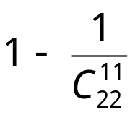
Experiment Results
K=2
Result 1:
cluster 1: doc 1~11 (probability: 10/21)
cluster 2: doc 12~22
Result 2:
cluster1: doc_{x} doc_{x+11} (probability: 11/21)
cluster2: the others
K=11
Result 1:
cluster x: doc_{x} doc_{x+11} (probability: )
every cluster has 2 documents
Result 2:
partly as Result (probability: )
the other randomly

Slide 12
Speedup Experiment
#doc/#cluster | Single Core | Multi Core | GPU
500 / 50 | 2500 / 1 | 156 / 16 | 219 / 11
1000 / 100 | 10125 / 1 | 620 / 16 | 547 / 18
3000 / 100 | 30110 / 1 | 1630 / 18 | 1750 / 17
3000 / 300 | 90768 / 1 | 5010 / 18 | 3300 / 27
3000 / 500 | 154941 / 1 | 8500 / 18 | 5078 / 31

Slide 13
对LSH的调研
主要调研内容：
  深入阅读LSH相关的论文以及资料
  实现CPU版本的LSH
接下来的方向

Slide 14
调研内容
--深入调研
  主要阅读了几篇论文，包括Bi-level Locality Sensitive Hashing for k-Nearest Neibor Computation，Fast GPU-based Locality Sensitive Hashing for K-Nearest Neighbor Computation，Locality-Sensitive Hashing Scheme Based on p-Stable Distributions，以及寿老师推荐的那篇Streaming Similarity Search over one Billion Tweets Using Parallel Locality-Sensitive Hashing.

Slide 15
调研内容
--深入调研
  这一阶段主要是阅读论文以及结合网上的资料对LSH进行比较全面的了解，LSH最开始是在汉明空间（也就是01空间）中，距离度量也只能使用汉明距离，主要思想是随机取原始数据的若干维进行哈希，将哈希值相同的点插入到相同的桶中，后来又发展到欧式空间，称之为p-Stable LSH
  p-Stable LSH将lSH拓展到欧式空间，距离度量方法也拓展到欧氏距离、曼哈顿距离以及余弦距离等

Slide 16
调研内容
--实现CPU版本的LSH
在调研完之后开始实现CPU版本的LSH，后来跟王俊俏对代码做了一些改正，发现原始的LSH在数据是低维的情况下效果非常好，以下是n = 100000, dim = 5, L = 2, m = 20, k=15得到的结果：
  construct time:260ms
  average checked points:3114.600000
  average intersection number:15.000000
  average intersection ratio:1.000000
  average ckecked ratio:0.031146
  average precision:1.000000
  可以看出，在低维的时候即使只检查3%左右的点也可以完全将前15个最近邻找到

Slide 17
调研内容
--实现CPU版本的LSH
但是在维数很高的时候（500维以及以上），结果就变得非常糟糕，以下是n = 100000, dim = 1000, L = 10, m = 7, k=15得到的结果：
  construct time:12428ms
  average checked points:9513.500000
  average intersection number:1.900000
  average intersection ratio:0.126667
  average checked ratio:0.095135
  average precision:0.126667
  可以看出，在维数急剧升高以后，即使检查了超过9%的点起准确率也只有12%左右，基本上只比随机情况要好一点

Slide 18
调研内容
--实现CPU版本的LSH
造成上述现象的原因应该是由于维度灾难引起的，但是还没有找到比较有效的解决方法，寿老师推荐的那篇论文中使用的维度是50,000维，论文最后说可以达到92%的准确率（论文中使用的R-NN+余弦距离），另外一篇Locality-Sensitive Hashing Scheme Based on p-Stable Distributions中数据的维数从20~500维，论文最后也说只有7.5%的错误率

Slide 19
调研内容
--接下来的工作
针对上述情况，接下来准备继续研究LSH，想看一下论文相应的代码，检查一下是否是某些细节出错；先将CPU上的LSH的准确率提上来再考虑GPU上面的实现

Slide 20


