Slide 1




International Joint Conference on Neural Networks (IJCNN)
ISCST: Improved Supporting Clustering Based on Sentence-Transformers with Contrastive Learning
Kongqiang Wang, Xuejie Zhang, Jin Wang, Xiaobing Zhou*
School of Information Science and Engineering, Yunnan University, Kunming, Yunnan, China

Slide 2
PART 01 Task Overview
PART 02 Dataset Introduction
PART 03 Experimental Method
CONTENTS
PART 04 Experimental Result
PART 05 Conclusion and Future Work

Slide 3

PART 01
Task Overview

Slide 4
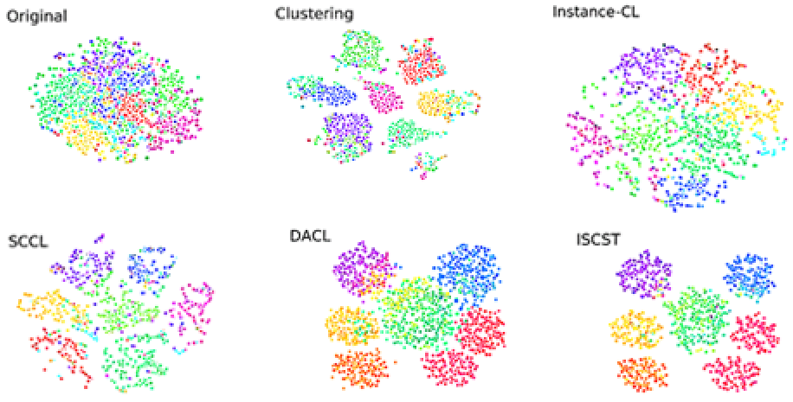
Clustering represents one of the most fundamental challenges in unsupervised machine learning, attracting extensive research attention over decades. Traditional algorithms like K-means and Gaussian Mixture Models measures distances in the original data space, but prove inadequate for high-dimensional data, where the curse of dimensionality significantly degrades performance.
As illustrated in Figure 1, one possible reason is that, even with a deep neural network, data still has significant overlap across categories before clustering starts. Consequently, the clusters learned by optimizing various distance or similarity-based clustering objectives suffer from poor purity. Although the most advanced research methods, such as SCCL and DACL, could perform clustering separation to a certain extent, they still could not clearly and distinctly separate clusters with distinct boundaries.
Fig. 1. TSNE visualization of the embedding space learned on SearchSnippets using Sentence Transformer Sentence-bert as backbone. Each color corresponds to a ground-truth semantic category.

Slide 5
We propose a joint model that combines instance-wise contrastive learning (Instance-CL) and clustering for unsupervised representation learning. As shown in Figure 2, a backbone ψ(·) maps the input data to embeddings, followed by two different heads: g(·) for contrastive loss and f (·) for clustering loss. Our data consists of both the original and the augmented data. Specifically, for a randomly sampled minibatch B = {xi}^{M}_{i=1}, we randomly generate augmented data Bª = {˜xi}^{2M}_{i=1}.

Slide 6
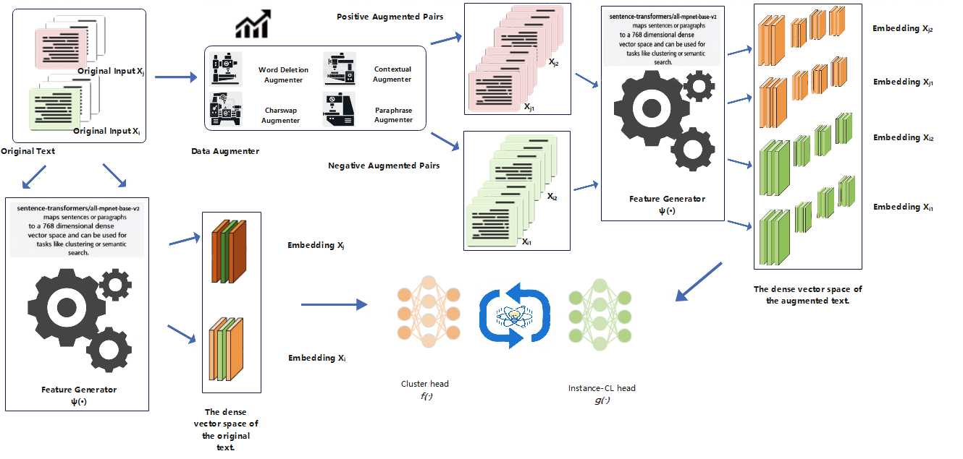
Fig. 2. We propose an Improved Supporting Clustering based on Sentence-Transformers with Contrastive Learning (ISCST), a novel framework combining bottom-up instance discrimination with top-down clustering objectives. ISCST leverages contrastive learning to simultaneously enhance categorical separation and optimize intra-cluster compactness and inter-cluster discrimination.

Slide 7
PART 02
Dataset Introduction

Slide 8
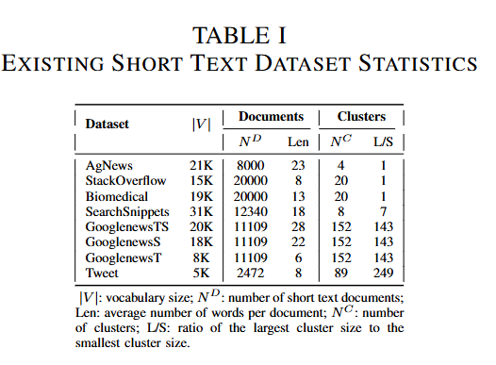
We evaluate ISCST on eight benchmark datasets spanning diverse domains (see Table 1).
SearchSnippets contains 12,340 web search snippets across 8 groups. StackOverflow includes 20,000 technical question titles in 20 categories, extracted from Kaggle. Biomedical comprises 20,000 scientific paper titles from 20 research domains, randomly selected from the PubMed corpus distributed by BioASQ. AgNews covers news titles in 4 topics. Tweet contains 2,472 social media posts across 89 categories. GoogleNews includes 11,109 articles across 152 events, partitioned into GoogleNews-TS (full), GoogleNews-T (titles), and GoogleNews-S (snippets) variants.

Slide 9
PART 03
Experimental Method

Slide 10
We implement our model in PyTorch with the Sentence Transformer library.
ISCST employs all-mpnet-base-v2 for embedding performance. Both utilize linear clustering heads (f ) of dimensions 768 × K, where K represents the number of target clusters. The contrastive learning component employs an MLP (g) with 768 hidden units and 128-dimensional outputs.

Slide 11
Exploration of Data Augmentations
We explore four unsupervised text augmentation strategies:
(1) Word Deletion Augmenter. It randomly removes words using WordNet;
(2) Charswap Augmenter. It enhances text by swapping random characters of words in a sentence;
(3) Contextual Augmenter. It leverages pre-trained transformers to identify top-n suitable words for insertion or substitution. For contextual augmentation, we use google-bert/bert-base-uncased and FacebookAI/roberta-base models to generate augmented pairs, providing transformer-based semantic understanding for robust positive pair creation in contrastive learning.
(4) Paraphrase Augmenter. Machine translation models can be used to paraphrase text by translating it to an intermediate language and back (round-trip translation). This augmenter shows how to paraphrase text by first passing it through an English-French translation model, then through a French-English mixture-of-experts translation model.

Slide 12
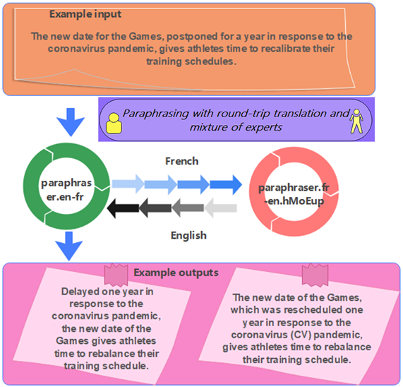
Using example input as “The new date for the Games, postponed for a year in response to the coronavirus pandemic, gives athletes time to recalibrate their training schedules.” as basic text to generate two sentences obtained through paraphrasing. Data flow is shown in the figure 3.
Fig. 3. Paraphrasing with round-trip translation and mixture of experts.

Slide 13
PART 04
Experimental Result

Slide 14
Evaluation Metrics
We employ four standard clustering metrics: Accuracy (ACC) measures agreement between predicted assignments and ground truth categories. Normalized Mutual Information(NMI) quantifies information correlation between clustering results and true labels (0-1 range). Adjusted Rand Index (ARI) evaluates consistency while correcting for chance (-1 to 1 range). Adjusted Mutual Information (AMI) functions like NMI with random clustering adjustment (0-1 range). Based on the short text clustering complexity, we prioritize ACC and NMI for model comparison, providing complementary perspectives through direct category matching and information-theoretic relationships, respectively.

Slide 15
Comparison with State-of-the-art Methods
We compare against several established approaches for short text clustering evaluation.
STCC employs three-stage optimization: Word2Vec pretraining on in-domain corpus, CNN-based representation enrichment, and K-means clustering. Self-Train enhances pretrained embeddings using layer-wise pretrained autoencoders with clustering objectives and interval-based target distribution updates. SimCTC proposes simple contrastive learning for text clustering improvement. HAC-SD applies hierarchical agglomerative clustering on sparse pairwise similarity matrices with threshold-based pruning. BoW&TF-IDF applies K-means on 1500-dimensional traditional features. SCCL introduces the Supporting Clustering with Contrastive Learning framework for better separation. DACL improves SCCL through pseudo-label enhancement.
Our method achieves superior performance by updating target distributions at each iteration, demonstrating significant improvements over multi-stage and hierarchical approaches.

Slide 16
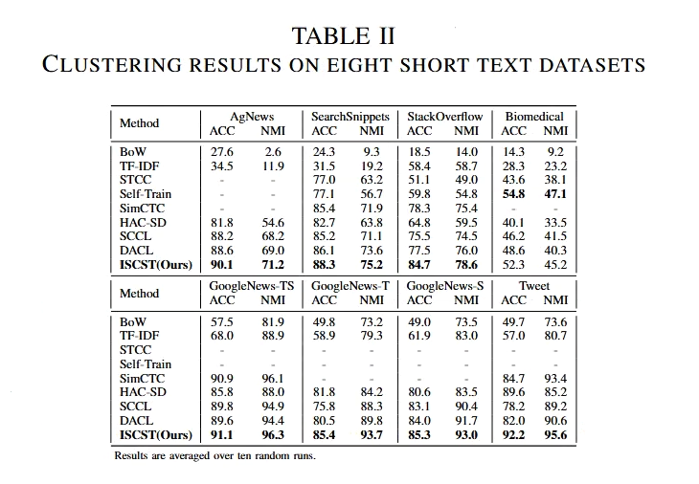
Approach Comparison
We demonstrate robustness by avoiding preprocessing on all datasets, while most baselines employ extensive text normalization procedures.
Table 2 shows that ISCST achieves superior performance across most datasets. Notable exceptions provide valuable insights: Hadifar et al. outperforms on Biomedical due to domain-specific word embeddings trained on biomedical corpora and layer-wise pretrained autoencoders, contrasting with our general-purpose sentence transformers.
Importantly, our approach offers superior scalability for large-scale applications.

Slide 17
PART 05
Conclusion and Future Work

Slide 18
We propose ISCST, a novel framework that leverages instance-wise contrastive learning to enhance unsupervised clustering with sentence-transformers. Evaluated across eight benchmark short-text datasets, our model substantially outperforms state-of-the-art methods. Ablation studies validate the effectiveness of integrating bottom-up instance discrimination with top-down clustering, generating high-quality clusters with improved intra- and inter-cluster distances. While evaluated on the short texts domain, our generic framework applies to various text clustering problems. Future work will explore data mixing strategies to address natural language’s discrete nature and augmentation challenges.

Slide 19
We sincerely invite experts to raise questions
Conference Presenters： Kongqiang Wang Corresponding Author: Xiaobing Zhou

Slide 20
Q: What are the core innovations and valuable highlights in your paper?
A: The research topic is precisely targeted at the core pain points of unsupervised clustering. To address the problem of performance degradation of distance-based clustering methods due to semantic category overlap, the ISCST joint optimization framework is proposed, which realizes the collaborative optimization of bottom-up instance contrastive learning and top-down clustering objectives, with a complete logical loop.
Q&A
Q: Could you give a general overview of the overall content of your paper?
A: Based on Sentence-Transformer, an end-to-end short text clustering scheme was constructed. By jointly optimizing intra-class compactness and inter-class discrimination through a combined loss function, significant improvements of 5%-8% ACC and 3%-5% NMI were achieved on 8 public benchmark datasets. The performance surpassed the existing state-of-the-art, and it has clear engineering practical value. The system analyzed the impact of text enhancement strategies on short text clustering, revealed the performance limitations of combined enhancement in the short text scenario, and provided empirical references for the practical application of contrastive learning in text clustering.

